Slide 1

Designing the national HPC and public cloud-based solutions for the data-driven animal behavior detection
Progress Update
Jan 2, 2024
Oct 17, 2023

Slide 2
Progress Update
Updated BPMN Business process based on sup. feedbacks
Prepared Sitemap and wireframe (draft)
Implemented the task processing logic using factory pattern (for Yolo)
Extracted possible input fields from UI for FairMOT model

Slide 3
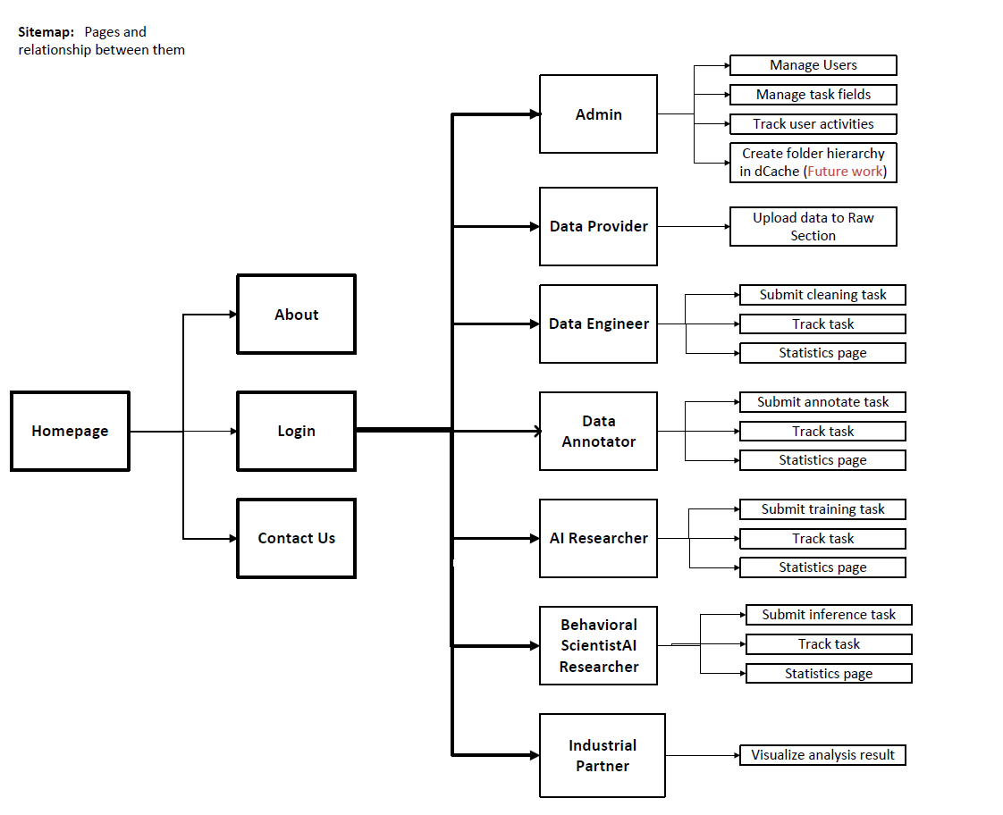

Slide 4
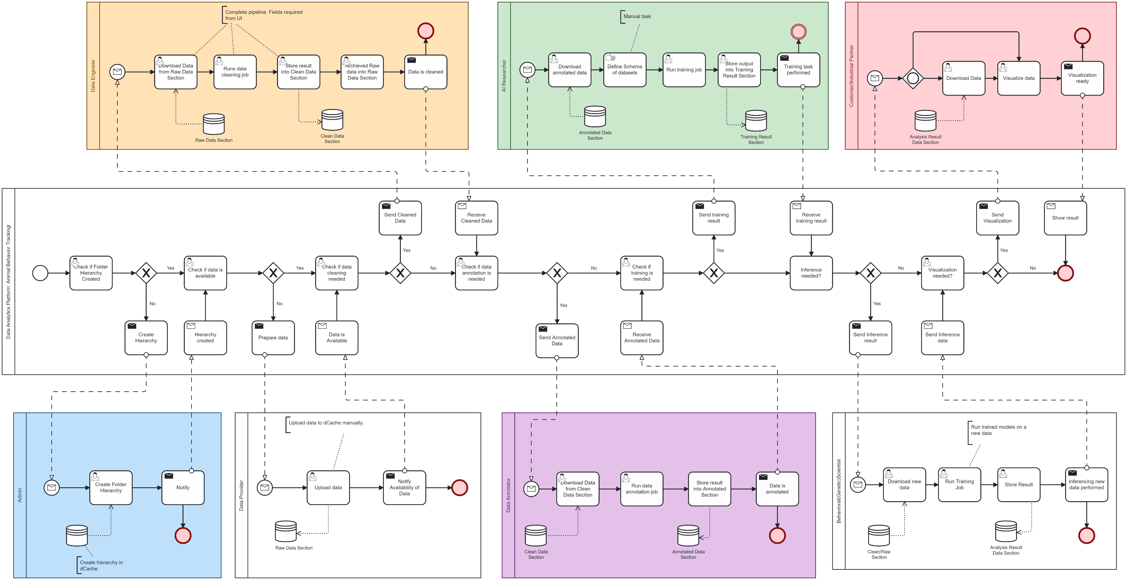
Progress Update: BPMN Business Process

Slide 5

Progress Update: Containerize and Running FairMOT Model
Preparation
Libraries and dependencies
Extract input fields
Data Preparation
Definition file
Image
Verification
Error
Store in Repo
Run via
PiCas
Create an Image
Run via PiCas
Run via UI
Until Jan 12
Jan 19
Jan 26
Run via
UI

Slide 6
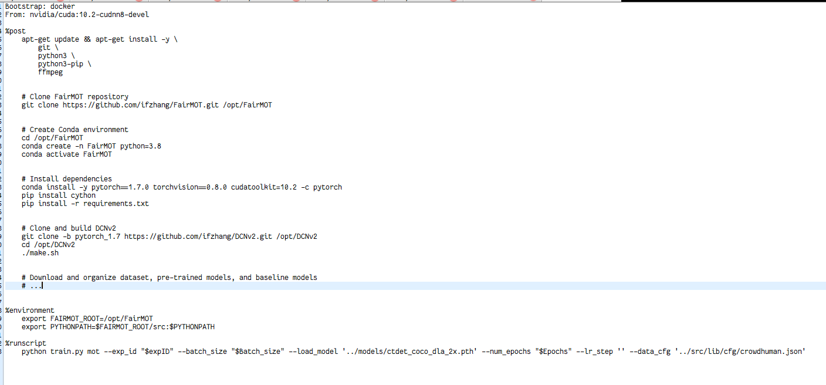
Progress Update: FairMOT Containerization (draft)

Slide 7
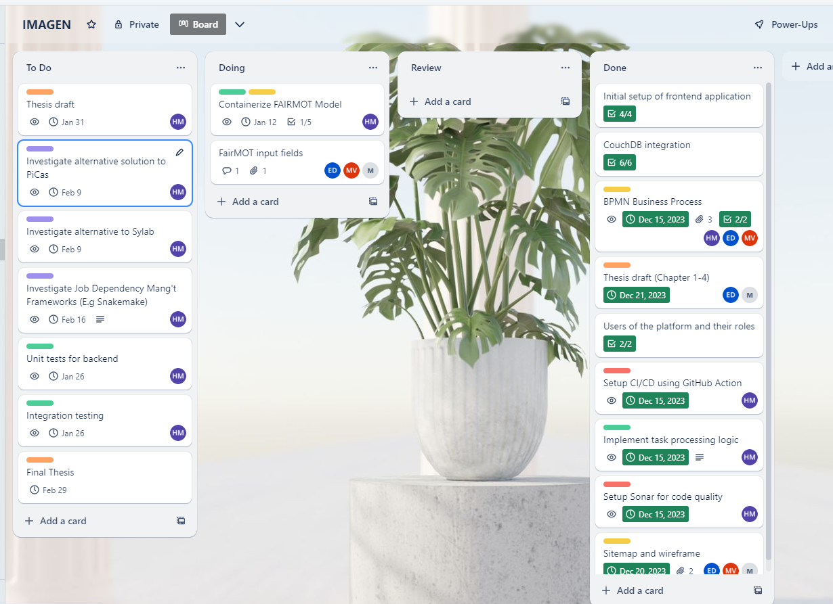
Plan for next month

