Slide 1
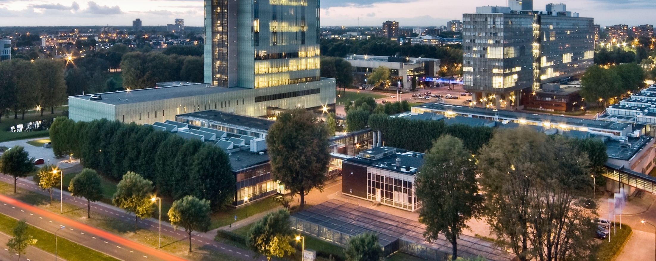
Designing the national HPC and public cloud-based solutions for the data-driven animal behavior detection
Haftom Hailu
Running Yolov5 on Surf via User interface
Nov 30, 2023
Oct 17, 2023

Slide 2
Agenda
Problem statement
Our approach
Demo
Discussion

Slide 3
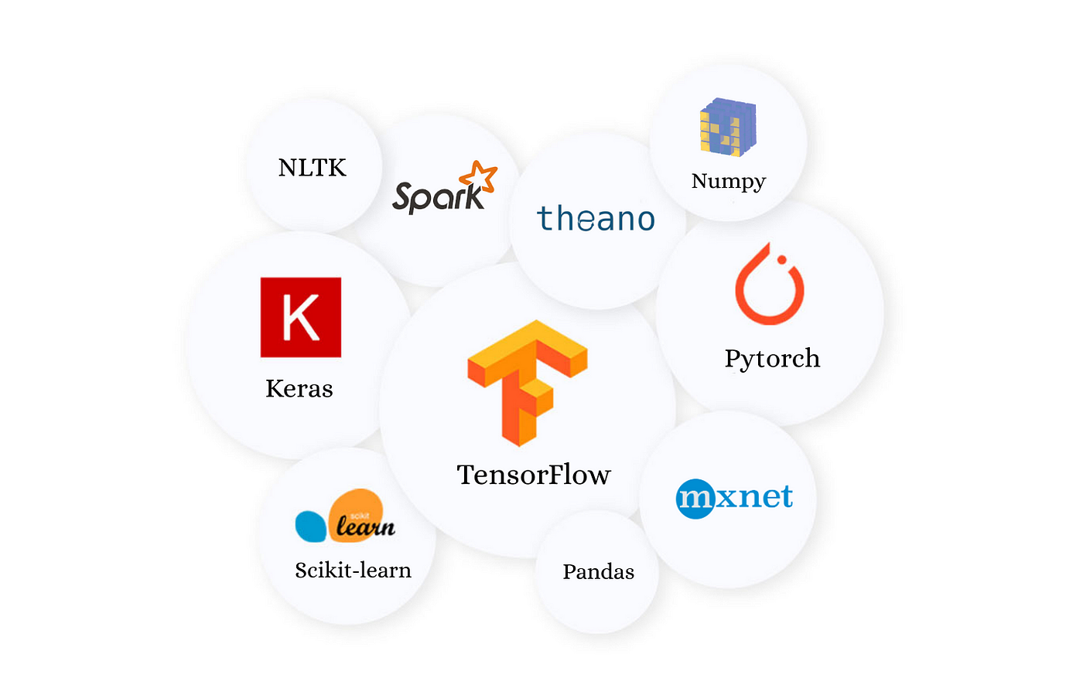

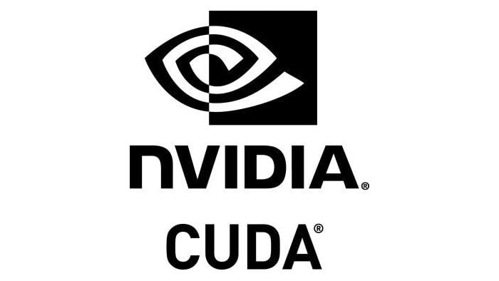


Problem-1
Goal: Portable machine/deep learning environment
Let’s say we have a model that we want to run
Config files
User 1

Slide 4



Problem-1
Running your model on a new machine involves a series of manual steps
Each developer needs to install and configure all the libraries, config files, and run time environments
Installation process is different for each OS environment
Environment inconsistencies
Dependency nightmare
User 2
User 3

Slide 5

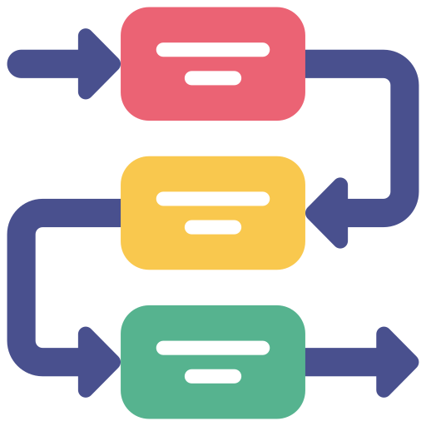
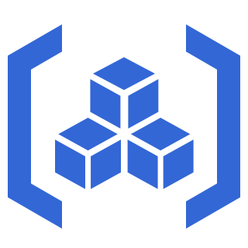

Solution: Containerization
Containerization bundles all dependencies (frameworks, libraries), configuration files, and runtime environments required to run a model.
Configuration
Dependency
Container
Source code
Container artifacts includes everything the source code needs.

Slide 6
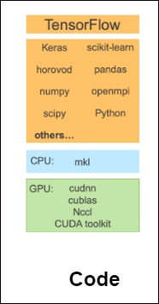

Solution: Containerization
Containerization bundles all dependencies (frameworks, libraries), configuration files, and runtime environments required to run a model.
Push
Pull
Pull
User 1
User 2
User 3

Slide 7
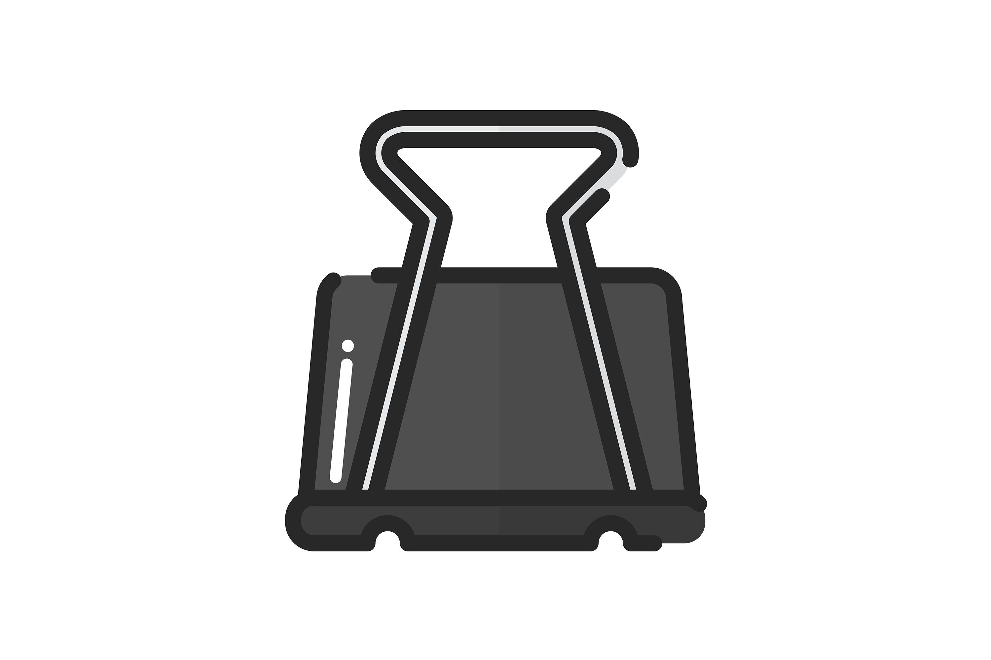
Solution: Containerization
Benefits
Fast
deployment
Isolation
Portability
Collaboration

Slide 8

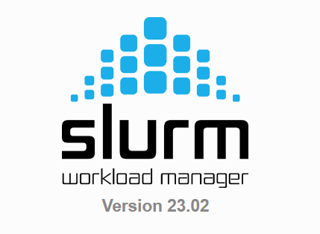


Problem - 2
Let’s say we want to run a model on a cluster/supercomputer
Users
Login Nodes
Compute Nodes
Cluster
Cluster
A group of interconnected computers (nodes) that work together to perform parallel processing.
Designed to handle complex computation tasks
Slurm (Simple Linux Utility for Resource Management)
Cluster management and job scheduling system.
Allocate resources within the cluster to its users.

Slide 9
Problem - 2
Users
Login Nodes
Compute Nodes
Cluster
Drawbacks
User need to know technical details
sbatch
squeue
scancel
sinfo
srun
What if we have 10s, 100s, or 1000s tasks that we want to run
Hard to track and monitor tasks - no centralized DB
Job submission overhead

Slide 10
Our approach: Job management framework + User Interface
Goal: Facilitate a seamless experience for a user when working with a cluster
Hide internal implementation details
Why job management framework?
To manage large amount of jobs
The Pitch-Catch System (PiCaS) framework is used as job management framework
Has a database
Why user interface?
To efficiently interact with the cluster and pipelines
Hide unnecessary technical details

Slide 11
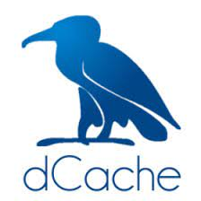
Our approach: Job management framework + User Interface
Cluster
Web Application
Submit task
Fetch and process task
.
.
Task status and output
Task status and output

Slide 12
Our approach: Job management framework + User Interface
Benefits
Efficient
interaction
with pipeline
via UI
Hides technical details
Reduces job
submission
overhead
Ease of use

Slide 13
Demo: Running yolo on surf

Slide 14
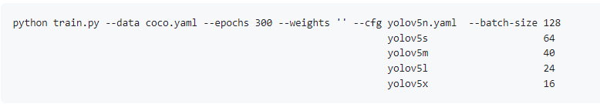
Demo: Running Yolo
A state-of-the-art object detection algorithm
Yolov5
(.py)
Input data
Training/Inference result
Parameters/Hyper-parameters
Epoch
Learning rate
Batch-size
….

Slide 15
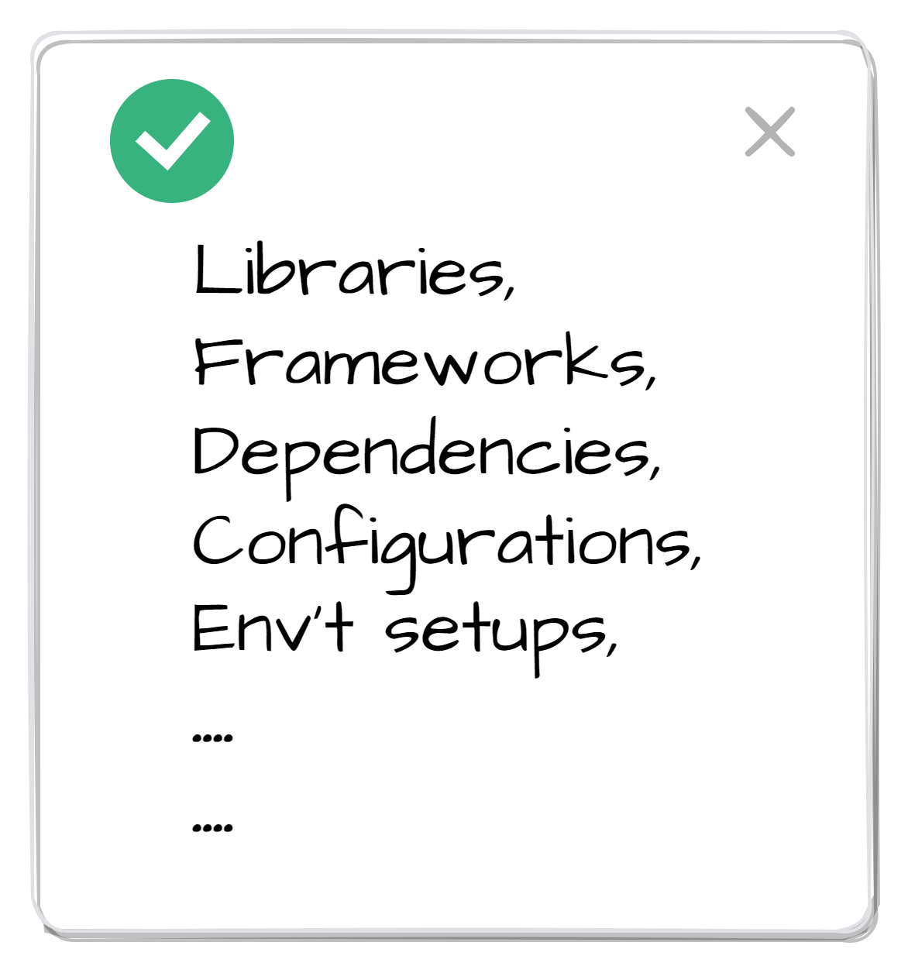
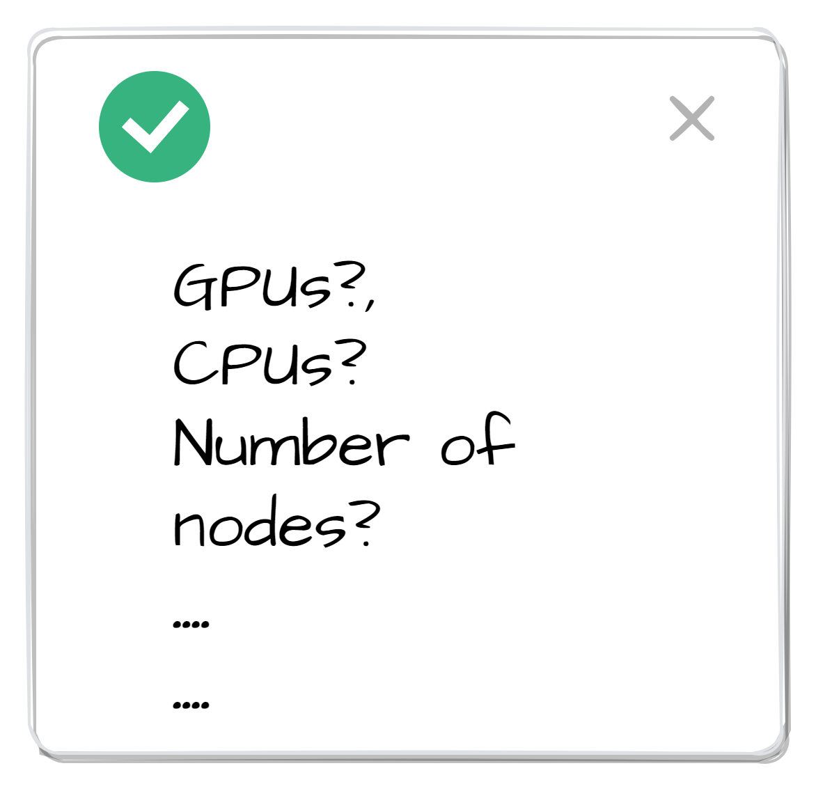
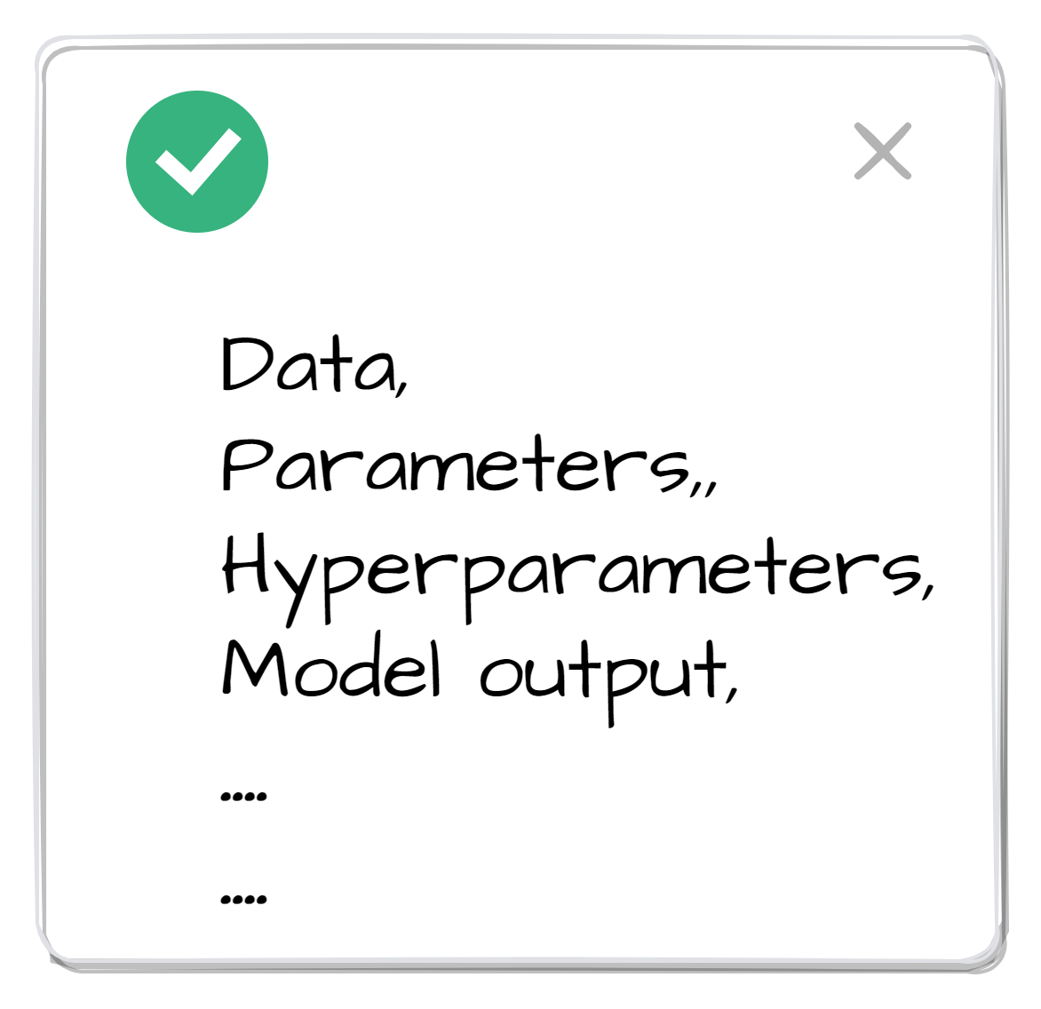
Demo: Running Yolo
First, create an image by following these steps:
Preparation
Container Image
Publish Image
build
push

Slide 16
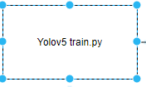
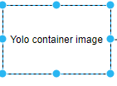

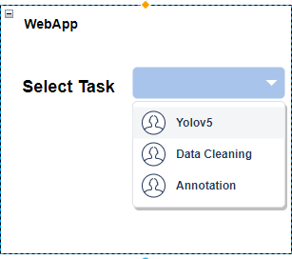
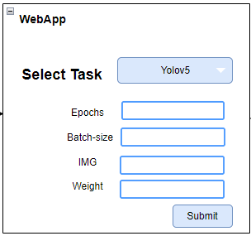
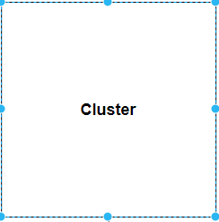
Demo: Running Yolo via UI

Slide 17

What do we need from you?
Collaboration
Models and data
What specific data inputs, parameters, and hyperparameter are crucial for the model’s execution?
What are the expected results or outputs produced by the model?
Where is the data located?
And where do you want the output to be stored?
Computation requirement
Under what resource should the models run?
User interface
What do you want to see from the UI?

Slide 18
Discussion

