Slide 1
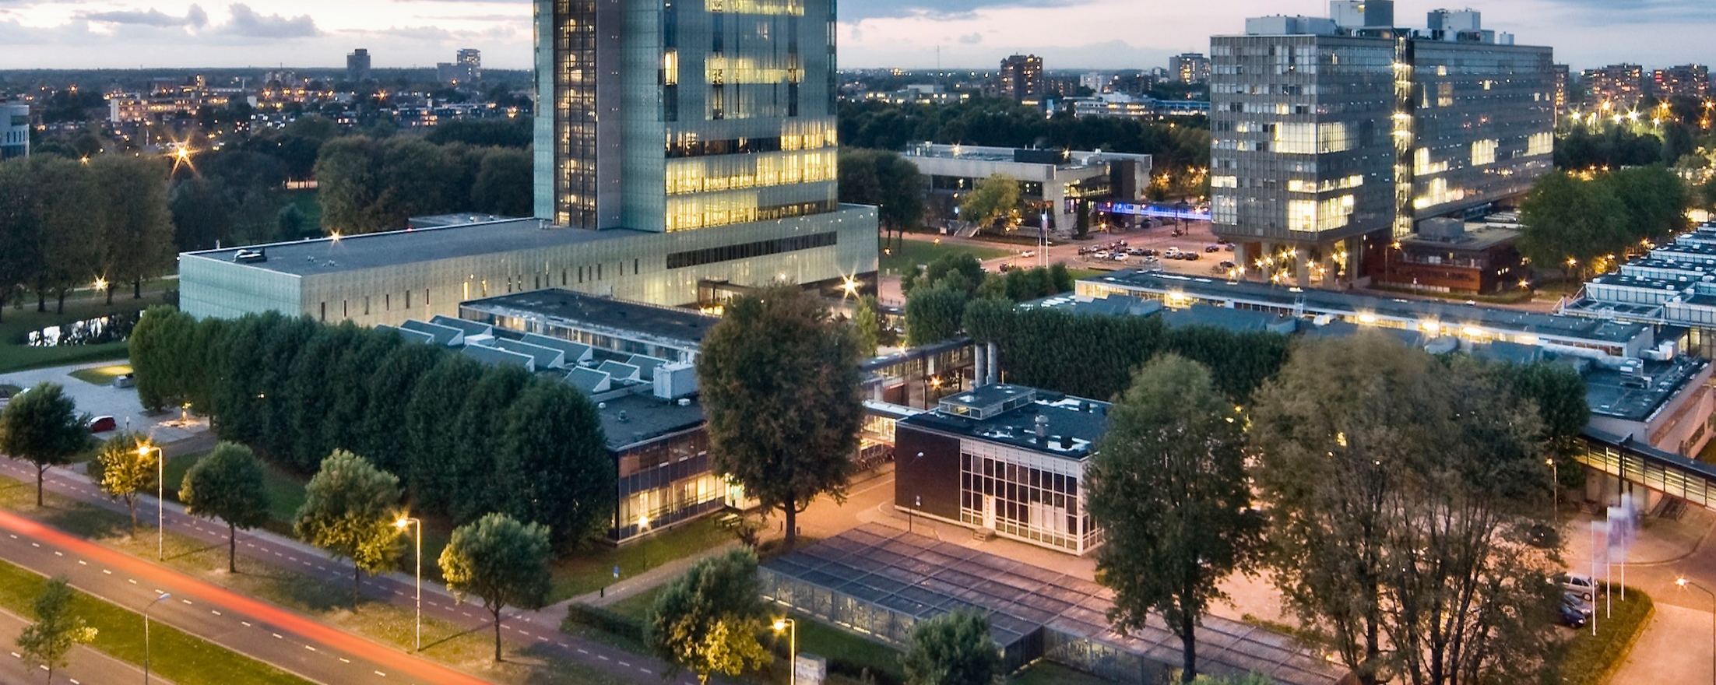
Designing the national HPC and public cloud-based solutions for the data-driven animal behavior detection
Progress Update
Jan 9, 2024
Oct 17, 2023

Slide 2
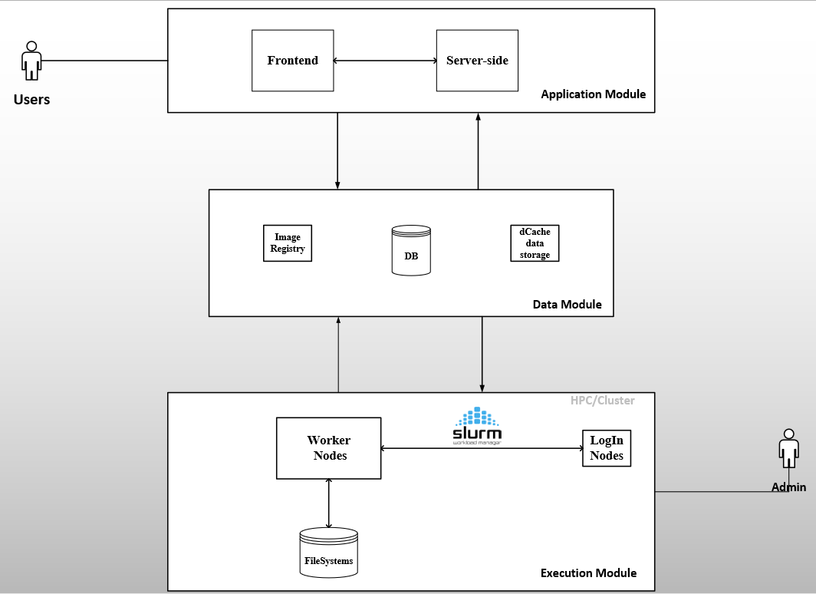
Progress Update
Image Registry: To store container images
DB: To store task information
(token) and users
Data storage (dCache): To store
Input data (datasets) and model results
HPC* filesystem (scratch):
To temporarily store data for fast I/O
operations
HPC: High performance computing

Slide 3








Progress Update
Users
Frontend
(HTML, JS, CSS, React)
Server-side
Firestore
WebApp
CouchDB
PiCaClient
Login Node
admin
Container Registry
Worker nodes
Cluster
Backend

Slide 4
Progress Update
WebApp (by Martijn)
Backend (by Haftom)
User management
Task (Job) management
Submit
Track task
Notify user
Visualize statistics
Prepare container images for tasks (Singularity)
Prepare Pilot-Jobs (Python)
Prepare task scripts (bash)
Data pipeline

Slide 5

WebApp Integration Process
Familiarize with the domain
WebApp Design
WebApp Implementation
Create CouchDB account for Martj.
Integration: Push token to CouchDB
Users of the system
Components of the system
CouchDB :- Token structure and
token lifecycle
Sitemap
Wireframe
Extract input and output fields
BPMN Business process
PilotJob: Process token from CouchDB
Discussion on what users want to see from UI?

Slide 6
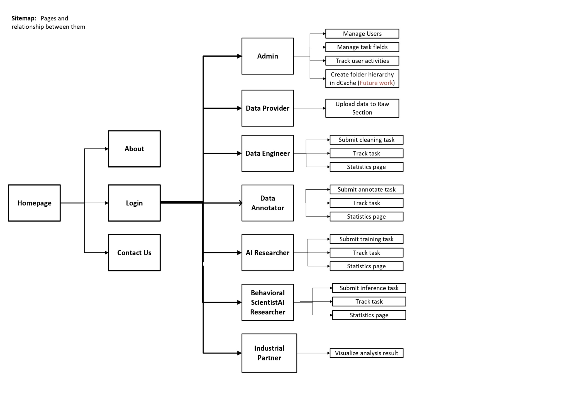
WebApp: Sitemap

Slide 7
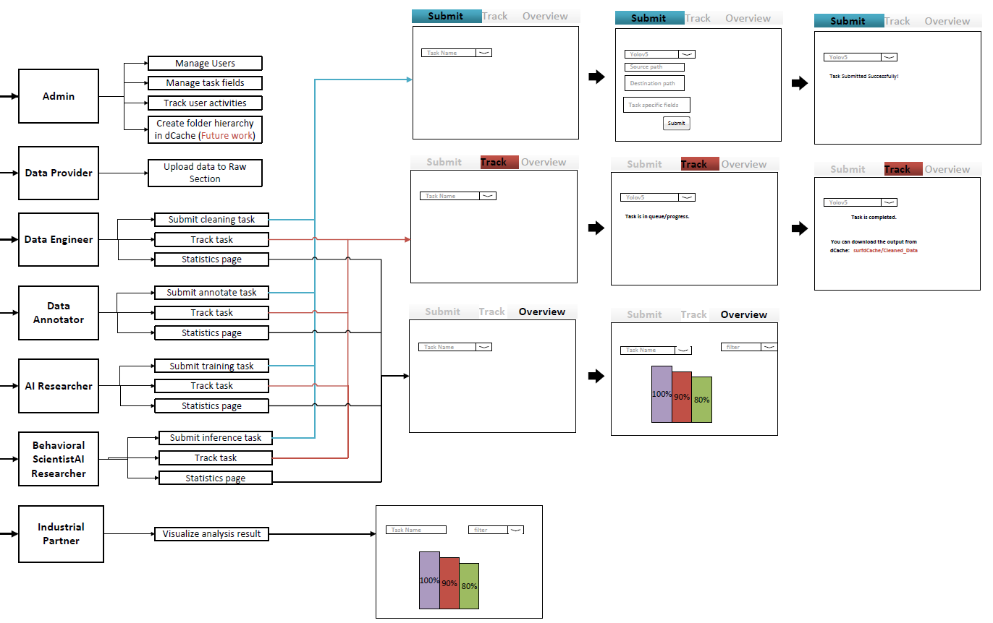
WebApp: Wireframe

Slide 8
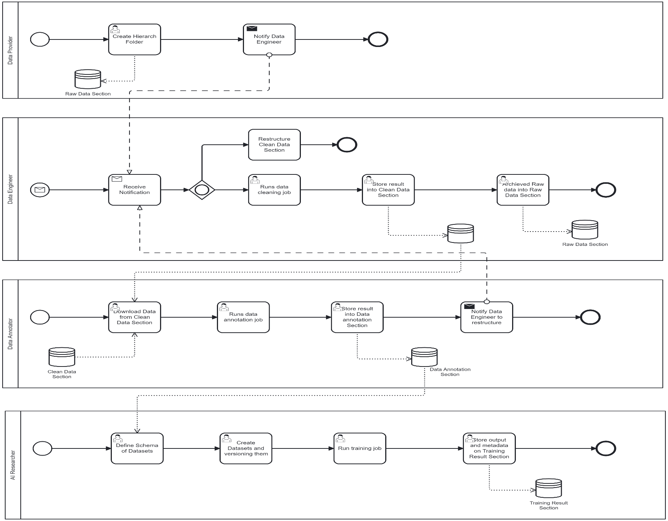
BPMN Business Process
Using
Camunda modeler

Slide 9

Backend: Containerize FairMOT Model
Preparation
Libraries and dependencies
Extract input fields
Data Preparation
Definition file
Image
Verification
Error
Store in Repo
Run via
PiCas
Run via
UI

Slide 10
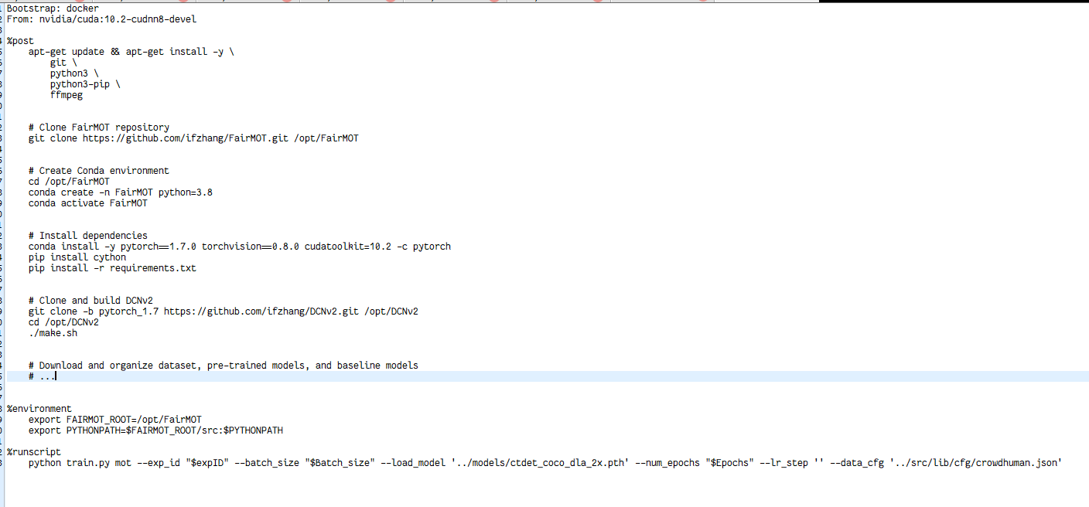

Progress Update: FairMOT Containerization (draft)
Minimal base image
Libraries, dependencies, and env’t

Slide 11
Documentation
Tasks | Status
Chapter 1-4 (Introduction, Problem analysis, stakeholder analysis, Requirements)
Chapter 5-8 (Investigating pilot-job frameworks, design and architecture, Verification and validation, Conclusion and result) | In progress

Slide 12
Defense and
Closure
Prepare for defense
Submit report to TEC
Presentation and defense
Project Booklet
Clearance (TU/e card, return laptop,
monitor, back up email)
FairMOT Containerization
WebApp Integration
Jan 8 -12 | 15-19 | 22-26 | 29-02 | Feb 05-09 | 12-16 | 19-23 | 26-01 | Mar 04-08 | 11-15 | 18-22 | 25-29
Send report
to TEC
Demo: Running a model via Martijn’s webAPP
Verification and validation
Presentation
and defense

Slide 13
Defense and
Closure
Prepare for defense
Submit report to TEC
Presentation and defense
Project Booklet
Clearance (TU/e card, return laptop,
monitor, back up email)
Report writing
Review (by sup.)
and revise
Send for
review
Jan 8 -12 | 15-19 | 22-26 | 29-02 | Feb 05-09 | 12-16 | 19-23 | 26-01 | Mar 04-08 | 11-15 | 18-22 | 25-29
Thesis outline
(updated and detailed)
Review
by Judith
Send report
to TEC
Review Thesis
Presentation
and defense

Slide 14
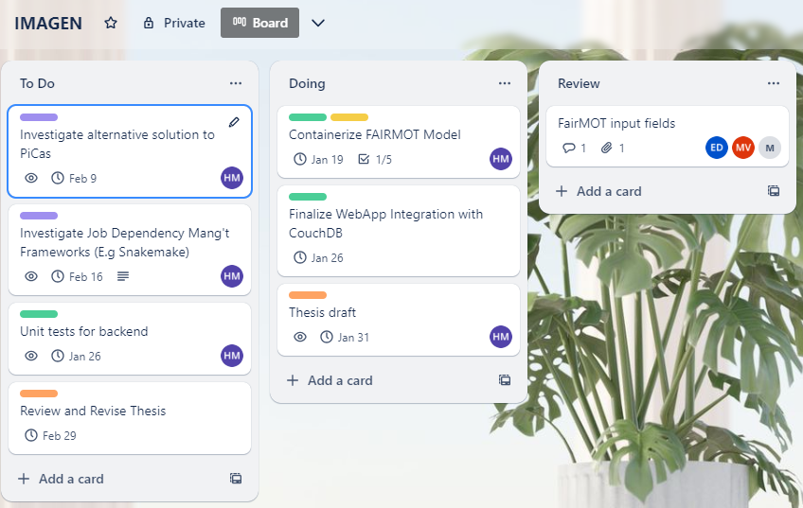
Project Plan: Next month

