Slide 1

1. OVERVIEW JAVA
JAVA is a programming language and computing platform first released by Sun Microsystems in 1995. Today it is owned by Oracle.
Java is free to download and can be used on almost every platform.
Java consists of a JRE (Java Runtime Environment) which consists of:
a Java Virtual Machine (JVM) to run Java on various operating systems
Java platform core classes (eg. java.lang package)
Supporting Java platform libraries

Slide 2
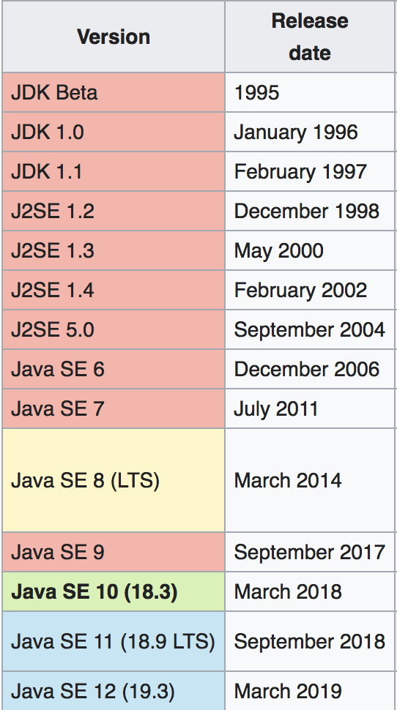
1. OVERVIEW JAVA - CONTINUED
Versions of Java:
Major improvements in version 5.0 (originally 1.5)
Generics (see example)
Autoboxing
Enum
Varargs
Static imports
Java 6.0 performance improvements
Java 7 new io-library
Java 8 lambda’s and streams
Java 9 modularization

Slide 3
1. OVERVIEW JAVA - CONTINUED
The language
Data types - Operators
Keywords - Constructor
Classes - Statics
Packages / imports - Wrapper classes
Fields - Autoboxing
Methods - Statements / flow control
Access control - Equals(), hashCode(), toString()

Slide 4
1. OVERVIEW JAVA – DATA TYPES
Data types (primitive)
Java supports 8 basic data types known as primitive types. We can see it is a primitive type
because their first letter is lowercase. Later we’ll see Wrapper classes.
Primitive data types always have a value and cannot be null. If not initialized they have a default value.
The basic difference between them is the size of the value they can contain or whether they can contain decimals or not.

Slide 5
1. OVERVIEW JAVA – DATA TYPES
Function and default value of data types

Slide 6
1. OVERVIEW JAVA – DATA TYPES
Scope
Variables within a Java class can have different scopes.
Scope of a variable is the part of the program where the variable is accessible.
Often declared within a block, usually between { }, the variable can only be addressed there.
Several scopes:
Class scope
Method level scope
Block scope
See example.

Slide 7
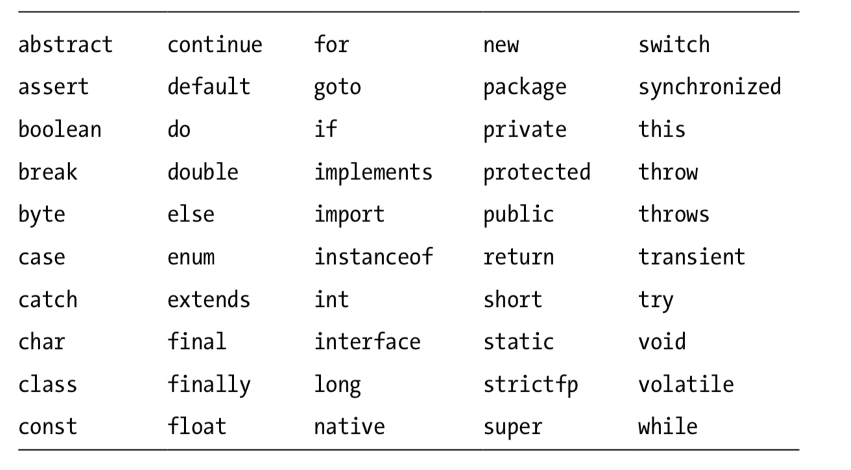
1. OVERVIEW JAVA - KEYWORDS
In the Java programming language, a keyword is one of 50 reserved words that have a
predefined meaning in the language;
Because of this, programmers cannot use keywords as names for variables, methods, classes,
or as any other identifier.

Slide 8
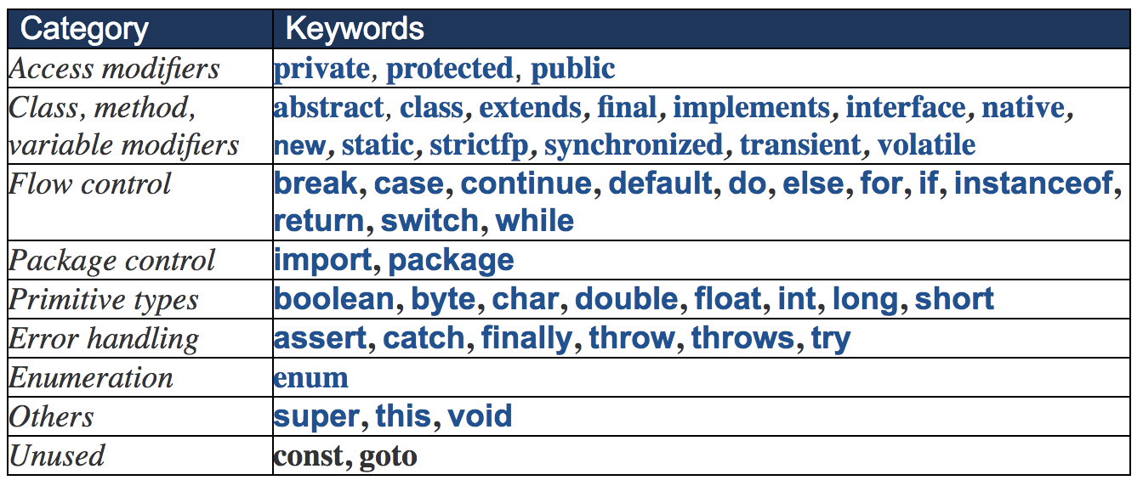
1. OVERVIEW JAVA - KEYWORDS
The compiler will complain when using one of the reserved keywords. The reserved keywords can
be grouped to have a better understanding:

Slide 9
1. OVERVIEW JAVA – CLASSES
In Java programs, classes are the basic building blocks. When defining a class, you describe all the parts and characteristics of one of those building blocks.
A class is a definition contained in a file with the .java extension.
Often each class resides in it’s own file, however it is also possible to create a new class in an existing class-file. These classes are called inner-classes and are often used when we need to group some data which only is needed in the outer-class.
See example for inner class.
There’s a big difference between a class and a object (instance).
A class is a definition of the data, contained in a file. There is always 1 class.
An object is a concrete example of a class. There can be multiple objects.

Slide 10
1. OVERVIEW JAVA – PACKAGES / IMPORTS
A package, as the name suggests, is a pack(group) of classes, interfaces and other packages.
In java we use packages to organize our classes and interfaces. We have two types of packages in Java:
built-in packages
packages we can create ourselves (also known as user defined package).

Slide 11
1. OVERVIEW JAVA – PACKAGES / IMPORTS
Three reasons for using packages:
Reusability: While developing a project in java, we often feel that there are few things that we are writing again and again in our code. Using packages, you can create such things in form of classes inside a package and whenever you need to perform that same task, just import that package and use the class.
Better Organization: Again, in large java projects where we have several hundreds of classes,
it is always required to group the similar types of classes in a meaningful package name so
that you can organize your project better and when you need something you can quickly
locate it and use it, which improves the efficiency.
Name Conflicts: We can define two classes with the same name in different packages so to
avoid name collision, we can use packages.

Slide 12
1. OVERVIEW JAVA – PACKAGES / IMPORTS
To group classes within a package, we can use subpackages. A subpackage is a package
Inside another package.
Using classes from other packages can be done by importing them.
As long as the class is on the classpath it can be imported in the current Java class.
Example:
import nl.craftsmen.domain.Product;
Avoid ‘star-imports’:
Import nl.craftsmen.domain.*;
This way it is uncertain and unclear for the reader which class is imported.

Slide 13
1. OVERVIEW JAVA – PACKAGES / IMPORTS
Static imports can make the code more readable provided that it is clear where
the imported class comes from.
import java.time.DayOfWeek;
public String isWeekend(DayOfWeek dayOfWeek) { if (dayOfWeek == DayOfWeek.SATURDAY || dayOfWeek == DayOfWeek.SUNDAY) { return "Let's party!"; } return "Let's work!"; }

Slide 14
1. OVERVIEW JAVA – PACKAGES / IMPORTS
import java.time.DayOfWeek; import static java.time.DayOfWeek.SATURDAY; import static java.time.DayOfWeek.SUNDAY;
public String isWeekend(DayOfWeek dayOfWeek) { if (dayOfWeek == SATURDAY || dayOfWeek == SUNDAY) { return "Let's party!"; } return "Let's work!"; }

Slide 15
1. OVERVIEW JAVA – PACKAGES / IMPORTS
Finally:
One package is always available and does not need to be imported:
java.lang
It is always present on the classpath.

Slide 16
1. OVERVIEW JAVA – FIELDS
Fields and methods are also known as members of the class.
Fields of a class represent properties (also called attributes) of objects of that class.
Declaring fields syntax:
<<modifiers>> <<data type>> <<field name>> = <<initial value>>;
Naming convention:
The name of fields and methods should start with a lowercase letter and the
subsequent words should be capitalized, for example:
name
firstName
maxDebitAmount

Slide 17
1. OVERVIEW JAVA – FIELDS
Modifiers
Two kinds of modifiers:
1. Access control modifiers (default, private, public and protected)
2. Non-access modifiers (static, final, abstract and synchronized

Slide 18
1. OVERVIEW JAVA – FIELDS
Access control modifiers
private visible for the class only
default only access from same package
protected visible to the package and all sub-classes
public visible to the ‘world’
Try to keep the access ‘as private as possible’ !!

Slide 19
1. OVERVIEW JAVA – FIELDS
Non-access modifiers
static available on class level, shared with all instances of class
final value for variable can not be changed after initialization
abstract for abstract classes and methods (later)
synchronized/ used in threads (later)
volatile

Slide 20
1. OVERVIEW JAVA – METHODS
Methods in a class define the behavior of its objects.
A method is like a procedure (or subroutine) in the procedural paradigm. Methods can access/modify the state of the object. A message is sent to an object by invoking one of its methods.
Method syntax:
<<access modifier>> <<optional specifier>> <<returnType>> <<nameOfMethod>> (<<ParameterList>>) <<Exceptions>> {
// method body
}

Slide 21
1. OVERVIEW JAVA – METHODS
<<access modifier>> <<optional specifier>> <<returnType>> <<nameOfMethod>> (<<ParameterList>>) <<Exceptions>> {
// method body
}
Example:
public final int getAge(String name) throws IllegalArgumentException {
return 35;
}

Slide 22
1. QUIZ
Which of the following is not a primitive
String
int
long
double

Slide 23
1. QUIZ
Which of the following is not a primitive
String
int
long
double

Slide 24
1. QUIZ
2. Which of the following are Java keywords (multiple answers possible)
abstract
system
static
final

Slide 25
1. QUIZ
2. Which of the following are Java keywords (multiple answers possible)
abstract
system
static
final

Slide 26
1. QUIZ
3. Which field declaration is NOT correct?
final name;
private int sum = 0;
public static String PREFIX = “NL”;
double price = 2.0;

Slide 27
1. QUIZ
3. Which field declaration is NOT correct?
final name;
private int sum = 0;
public static String PREFIX = “NL”;
double price = 2.0;

Slide 28
1. QUIZ
4. What is the result of this code when having 2 products:
Product 1: id=1 price=10
Product 2: id=2 price=20
1. public class Calculator {
int sum = 0;
public int countTotal(List<Product>) products) {
for (Product product: products) {
if (product.price() > 0) {
long id = product.getId();
sum = sum + product.price();
}
}
System.out.println(“Last productid is “ + id);
System.out.println(“Total is “ + sum);
}
}
Compile error on line 2
Compile error on line 7
Compile error on line 11
Last productid is 2
Total is 30

Slide 29
1. QUIZ
4. What is the result of this code when having 2 products:
Product 1: id=1 price=10
Product 2: id=2 price=20
1. public class Calculator {
int sum = 0;
public int countTotal(List<Product>) products) {
for (Product product: products) {
if (product.price() > 0) {
long id = product.getId();
sum = sum + product.price();
}
}
System.out.println(“Last productid is “ + id);
System.out.println(“Total is “ + sum);
}
}
Compile error on line 2
Compile error on line 7
Compile error on line 11
Last productid is 2
Total is 30

Slide 30
1. OVERVIEW JAVA – OPERATORS
An operator is a symbol that performs a specific operation on a variable or an object.
“unary”: postfix and prefix
Example:
int sum = 0;
sum++ or ++sum
There’s a big difference:
int sum = 0;
System.out.println(sum++); output: 0
int sum = 0;
System.out.println(++sum); output: 1

Slide 31
1. OVERVIEW JAVA – OPERATORS
“binary”
Example:
10 + 15

Slide 32
1. OVERVIEW JAVA – OPERATORS
“ternary”
Example:
isSunday ? Holiday : noHoliday
Also called Elvis operator:

Slide 33
1. OVERVIEW JAVA – OPERATORS
Assignment operator : =
Assign a value to a variable. Assigned value must be compatible with type otherwise a compile error will occur.
String name = “Frank”;
int age = 0;
age = name; // compile error

Slide 34
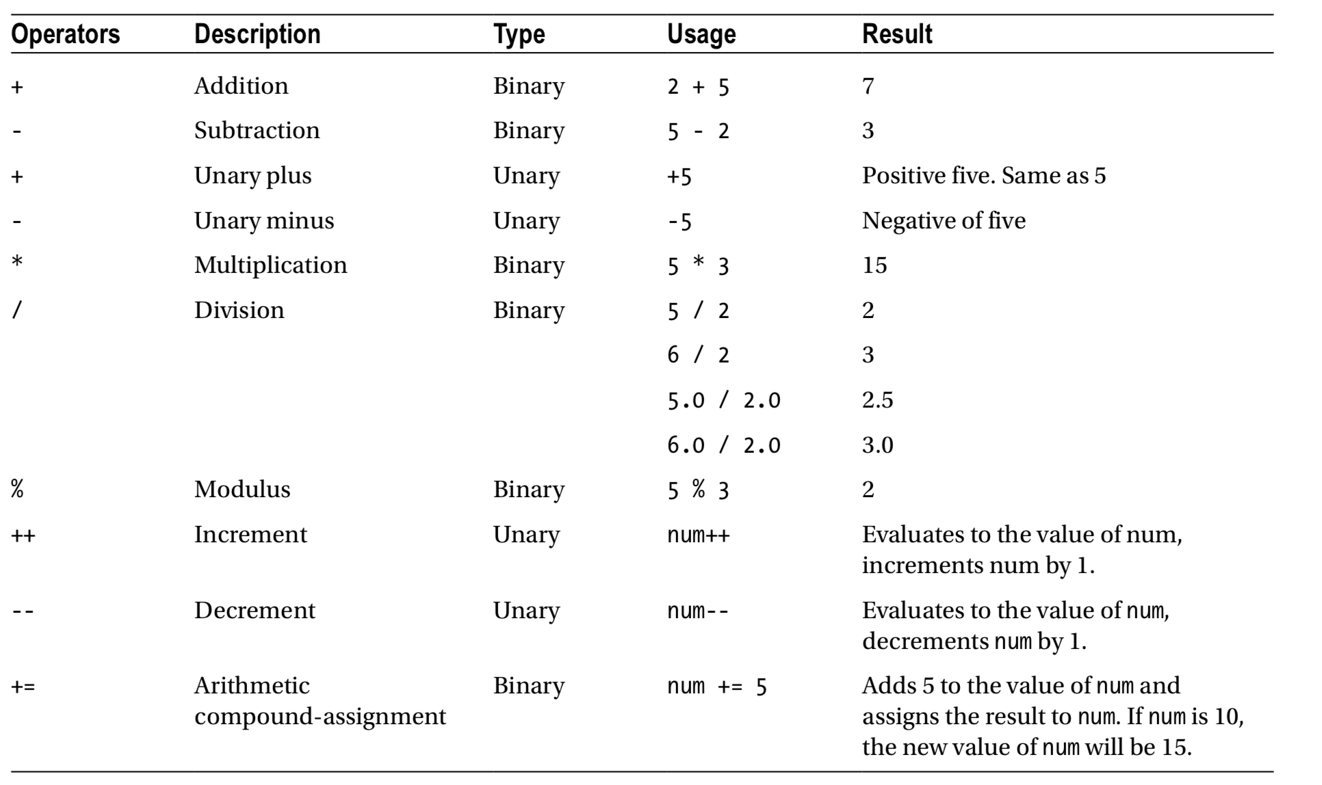
1. OVERVIEW JAVA – OPERATORS
Arithmetic operators
Used for calculations but can only be used on numeric types (byte, short, char, int, long, float)

Slide 35
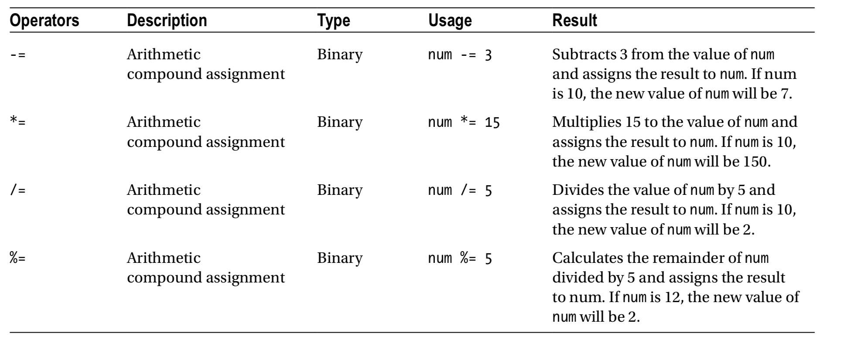
1. OVERVIEW JAVA – OPERATORS

Slide 36
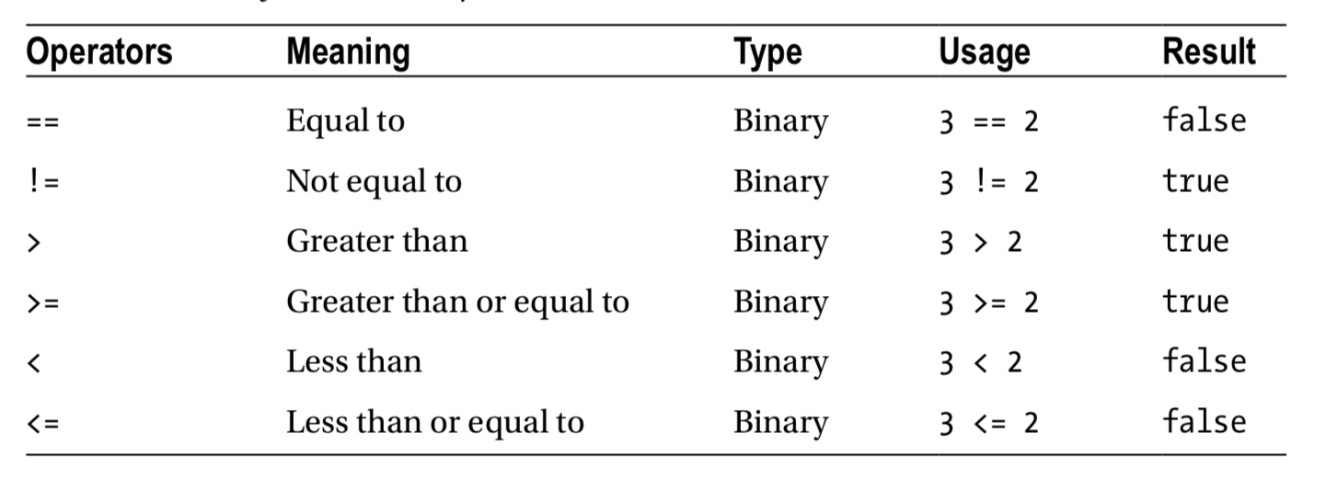
1. OVERVIEW JAVA – OPERATORS
Relational operators

Slide 37
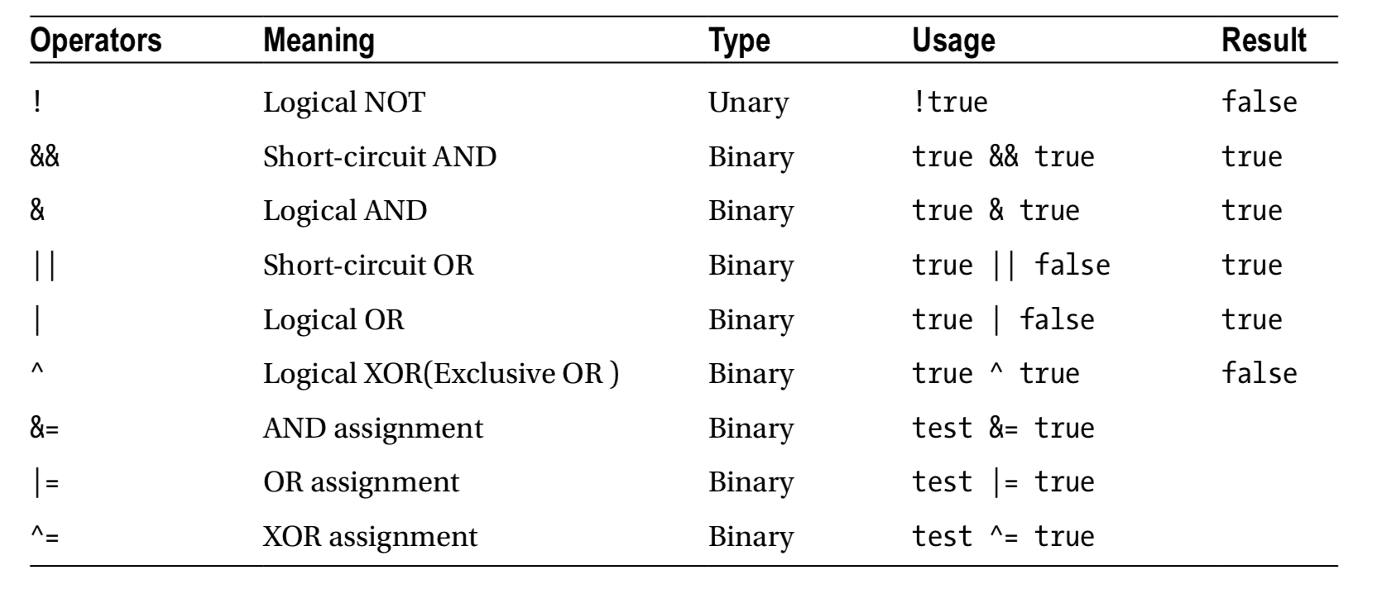
1. OVERVIEW JAVA – OPERATORS
Boolean logical operators (see code examples BooleanLogical and ShortCircuitAnd)

Slide 38
1. OVERVIEW JAVA – CONSTRUCTOR
Constructors are used for creating an instance / object of a Class.
Make sure that when a constructor is executed, the state of the class is complete and all required fields should have a value.
When no constructor is defined a default (no argument) constructor is added by the compiler.
Then name of the constructor is the same as the name of the class
There can be more than 1 constructor (overload)
A constructor is called by using the new keyword
When not set fields will be initialized with a default value

Slide 39
1. OVERVIEW JAVA – STATICS
Statics are declared at a class level, not an object or instance level.
Be careful: statics are shared between objects so can not contain state (hence the name static).
Example:
Public class Person {
public static final int ALLOWED_AGE_TO_DRINK = 18;
private String name;
private int dateOfBirth;
}

Slide 40
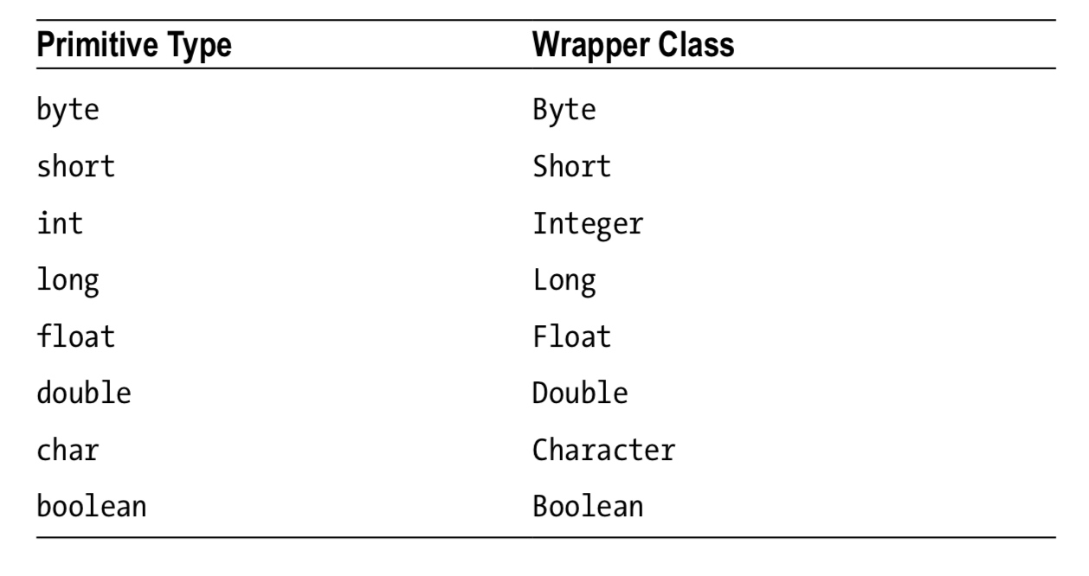
1. OVERVIEW JAVA – WRAPPER CLASSES
Wrapper classes are objects that wrap a primitive (eg. int, long etc.)
They can be assigned null-values (primitives can not).
Since wrapper classes are classes they all start with a capital.
Wrapper classes are immutable.
Two ways to create a instance:
Use the constructor
Using the valueOf()-methods

Slide 41
1. OVERVIEW JAVA – AUTOBOXING
AutoBoxing and unboxing are features added in Java 5 to work with primitive data types and their corresponding wrapper classes. This is done by the compiler and invisible for the developer.
A primitive is automatically converted to a wrapper class and vice versa:
Integer n = 200;
int a = n; // works fine
The compiler will replace the above statement with the following:
Integer n = Integer.valueOf(200);
int a = n.intValue();

Slide 42
1. OVERVIEW JAVA – AUTOBOXING
Beware of Null Values
Autoboxing/unboxing does save you from writing additional lines of codes. It also makes your code look neater.
However, it does come with some surprises.
One of the surprises is getting a NullPointerException where you would not expect it to happen. Primitive types cannot have a null value assigned to them, whereas reference types can have a null value. The boxing and unboxing happens between primitive types and reference types.
Integer n = null; // n can be assigned a null value
int a = n; // will throw NullPointerException at run time (due to n.intValue() )

Slide 43
1. OVERVIEW JAVA – STATEMENTS
Java operators

Slide 44
1. OVERVIEW JAVA – FLOW CONTROL
Java operators help with complex expressions but are limited in program flow.
We can use flow control for conditional execution of code.
If-then-else
Used to execute code under a certain condition
If (booleanExpression) {
// execute if expresision is true
} else {
// execute if expresision is false
}
Remark: curly braces not needed if followed by 1 statement.
Good practice to always add them.

Slide 45
1. OVERVIEW JAVA – FLOW CONTROL
Switch-statement
Can also be used for if-then-else cases
Target variable only of type int/Integer, byte/Byte, short/Short, char/Character, String and enum-values
Use case to check for match
Don’t forget to use break to stop the flow (otherwise next case will be executed!)
Add default when no case-statement will be met (order does not matter)

Slide 46
1. OVERVIEW JAVA – FLOW CONTROL
Example switch-statement:
int dayOfWeek = 5;
switch(dayOfWeek) {
case 0:
System.out.println("Sunday");
break;
case 6:
System.out.println("Saturday");
break;
default:
System.out.println("Weekday");
break;
}

Slide 47
1. OVERVIEW JAVA – FLOW CONTROL
while-statement:
The while-statement is used for a loop and will end when the condition of the while isn’t met anymore.
int counter = 0;
while(counter < 5) {
// do something
counter++; // don’t forget this to prevent an infinite loop
}

Slide 48
1. OVERVIEW JAVA – FLOW CONTROL
do while-loop:
The do-while-loop is also used for a loop. Difference with while is that the do-while is at least executed once.
do {
xxxxxx
} while(counter < 5) {
// do something
counter++; // don’t forget this to prevent an infinite loop
}

Slide 49
1. OVERVIEW JAVA – FLOW CONTROL
basic for-loop:
Used to repeat some code and runs when some condition is true.
for(int i = 0; i < 10; i++) {
System.out.print(i + " ");
}
Syntax:
for(initialization; booleanExpression; updateStatement) {
// body to execute
}

Slide 50
1. OVERVIEW JAVA – FLOW CONTROL
For-each-loop:
Used to iterate over arrays or a collection of objects.
for(Person person: persons) {
System.out.print(person.getName());
}
Syntax:
for(datatype instance : collection) {
// body to execute
}

Slide 51
1. OVERVIEW JAVA – FLOW CONTROL
Break-statement
Used to stop the iteration when a certain condition is met
for(Person person: persons) {
System.out.print(person.getName());
if (person.getAge() > 25) {
break;
}
}

Slide 52
1. OVERVIEW JAVA – FLOW CONTROL
Continue-statement
Used to proceed with the next element in the list (but stay in the loop)
for(Person person: persons) {
if (person.getAge() > 25) {
continue; // skips all persons older than 25
}
}

