Slide 1

1. OVERVIEW JAVA
JAVA is a programming language and computing platform first released by Sun Microsystems in 1995. Today it is owned by Oracle.
Java is free to download and can be used on almost every platform.
Java consists of a JRE (Java Runtime Environment) which consists of:
a Java Virtual Machine (JVM) to run Java on various operating systems
Java platform core classes (eg. java.lang package)
Supporting Java platform libraries

Slide 2
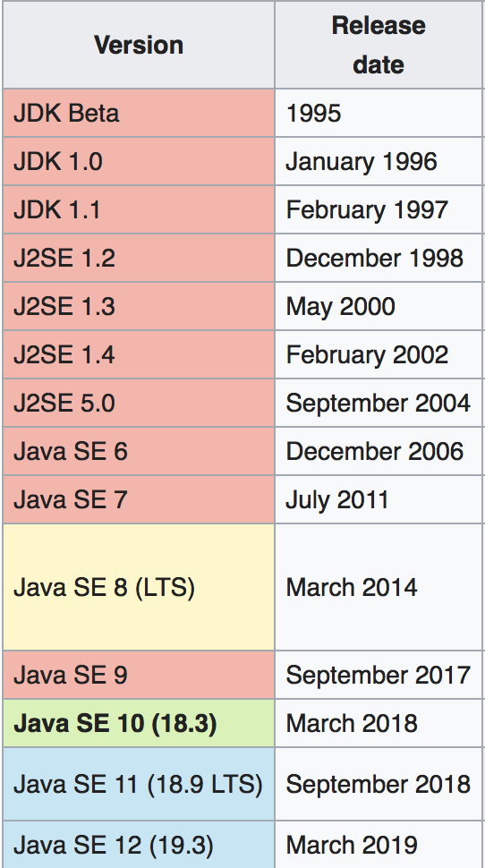
1. OVERVIEW JAVA - CONTINUED
Versions of Java:
Major improvements in version 5.0 (originally 1.5)
Generics (see example)
Autoboxing
Enum
Varargs
Static imports
Java 6.0 performance improvements
Java 7 new io-library
Java 8 lambda’s and streams
Java 9 modularization

Slide 3
1. OVERVIEW JAVA - CONTINUED
The language
Data types - Operators
Keywords - Constructor
Classes - Statics
Packages / imports - Wrapper classes
Fields - Autoboxing
Methods - Date / Time / Calendars / Formatter
Access level - Equals(), hashCode(), toString()

Slide 4
1. OVERVIEW JAVA – DATA TYPES
Data types (primitive)
JAVA supports 8 basic data types known as primitive types. We can see it is a primitive type
because their first letter is lowercase. Later we’ll see Wrapper classes.
Primitive data types always have a value and cannot be null. If not initialized they have a default value.
The basic difference between them is the size of the value they can contain or whether they can contain decimals or not.

Slide 5
1. OVERVIEW JAVA – DATA TYPES
Function and default value of data types

Slide 6
1. OVERVIEW JAVA – DATA TYPES
Scope
Variables within a Java class can have different scopes. If declared within a block, usually between { }, the variable can only be addressed there.
See example.

Slide 7
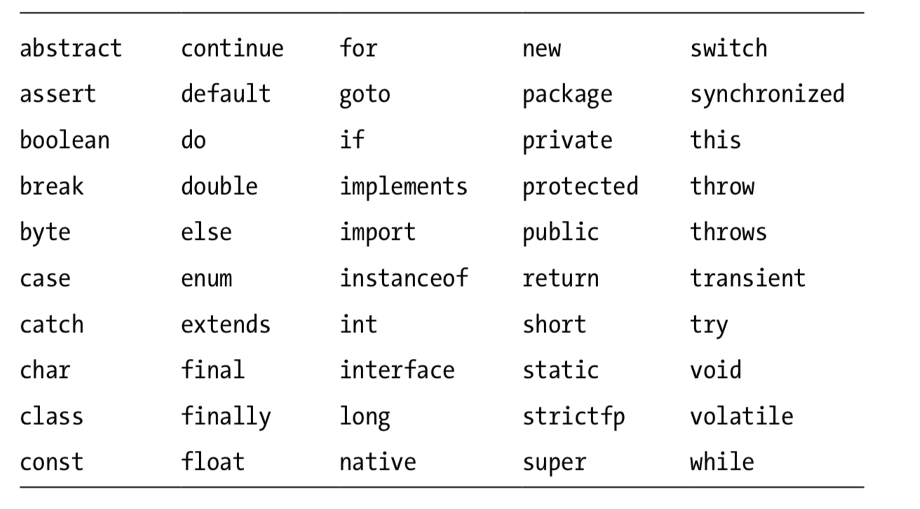
1. OVERVIEW JAVA - KEYWORDS
Keywords:

Slide 8
2. INHERITANCE
OVER
Programming language model organized around objects rather than “actions” and data rather than logic.
Historically, a program has been viewed as a logical procedure that takes input data, processes it, and produces output data. The programming challenge was seen as how to write the logic, not how to define the data. Object-oriented programming takes the view that what we really care about are the objects we want to manipulate rather than the logic required to manipulate them

Slide 9
3. INTERFACES
OVER
Programming language model organized around objects rather than “actions” and data rather than logic.
Historically, a program has been viewed as a logical procedure that takes input data, processes it, and produces output data. The programming challenge was seen as how to write the logic, not how to define the data. Object-oriented programming takes the view that what we really care about are the objects we want to manipulate rather than the logic required to manipulate them

Slide 10
4. EXCEPTION HANDLING
OVER
Programming language model organized around objects rather than “actions” and data rather than logic.
Historically, a program has been viewed as a logical procedure that takes input data, processes it, and produces output data. The programming challenge was seen as how to write the logic, not how to define the data. Object-oriented programming takes the view that what we really care about are the objects we want to manipulate rather than the logic required to manipulate them

Slide 11
5. ENVIRONMENT AND PACKAGING
OVER
Programming language model organized around objects rather than “actions” and data rather than logic.
Historically, a program has been viewed as a logical procedure that takes input data, processes it, and produces output data. The programming challenge was seen as how to write the logic, not how to define the data. Object-oriented programming takes the view that what we really care about are the objects we want to manipulate rather than the logic required to manipulate them

Slide 12
6. BANK-APPLICATION ASSIGNMENT
OVER
Programming language model organized around objects rather than “actions” and data rather than logic.
Historically, a program has been viewed as a logical procedure that takes input data, processes it, and produces output data. The programming challenge was seen as how to write the logic, not how to define the data. Object-oriented programming takes the view that what we really care about are the objects we want to manipulate rather than the logic required to manipulate them

Slide 13
7. CORE JAVA API’S / COLLECTIONS / GENERICS
OVER
Programming language model organized around objects rather than “actions” and data rather than logic.
Historically, a program has been viewed as a logical procedure that takes input data, processes it, and produces output data. The programming challenge was seen as how to write the logic, not how to define the data. Object-oriented programming takes the view that what we really care about are the objects we want to manipulate rather than the logic required to manipulate them

Slide 14
8. PREVIEW JAVA 8
OVER
Programming language model organized around objects rather than “actions” and data rather than logic.
Historically, a program has been viewed as a logical procedure that takes input data, processes it, and produces output data. The programming challenge was seen as how to write the logic, not how to define the data. Object-oriented programming takes the view that what we really care about are the objects we want to manipulate rather than the logic required to manipulate them

Slide 15
9. CLEAN CODE / DO’S AND DON’TS
OVER
Programming language model organized around objects rather than “actions” and data rather than logic.
Historically, a program has been viewed as a logical procedure that takes input data, processes it, and produces output data. The programming challenge was seen as how to write the logic, not how to define the data. Object-oriented programming takes the view that what we really care about are the objects we want to manipulate rather than the logic required to manipulate them

