Slide 1



ACT: Architectural Carbon Modeling Tools
@ MICRO 2022
Tutorial
Udit Gupta

Slide 2




Computing incurs a growing environmental footprint
1.2-2.2 Billion tons of CO₂
On par with the aviation industry’s footprint
2.1 - 3.9% of worldwide emissions (Freitag’21)
Data center
Mobile
Communication
Computing’s emissions are rising given its growing demand!
Notes:
When we aggregate computing environmental impact across mobile, communication, and data centers, studies show that computing accounts for 900 million metric tons of CO2.
That’s on par with the aviation industry’s footprint and around 2-4% of worldwide emissions.
Not only is this a huge amount already but we find that ICT emissions are expected to double over the next decade given the growing demand for computing.
And so it’s crucial that we as a community start think about what it means for computing itself to be sustainable.

Slide 3
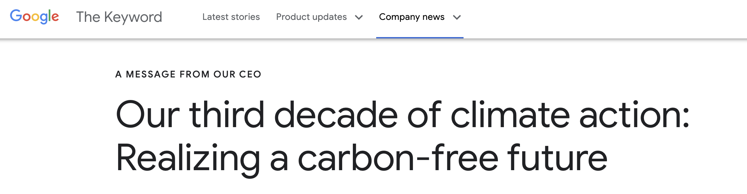
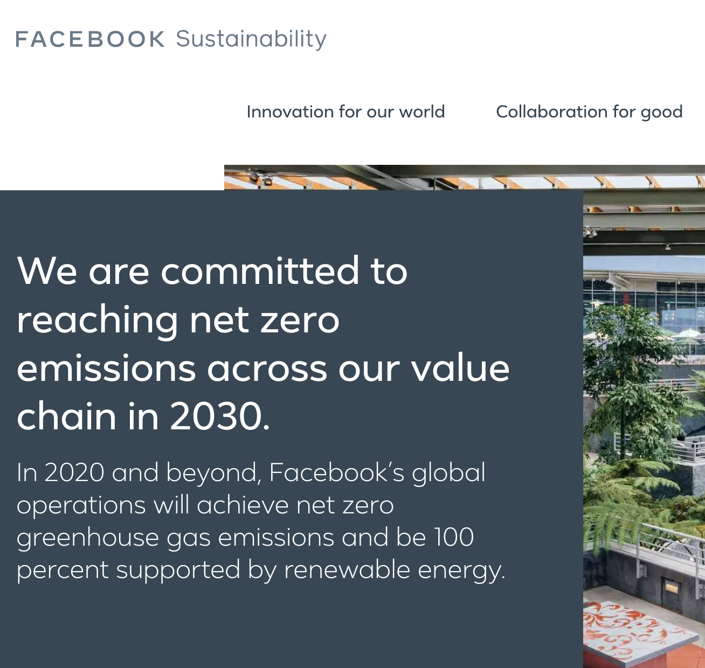
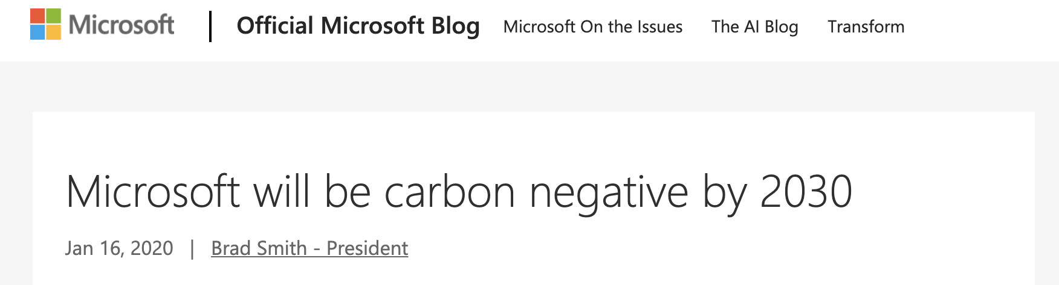
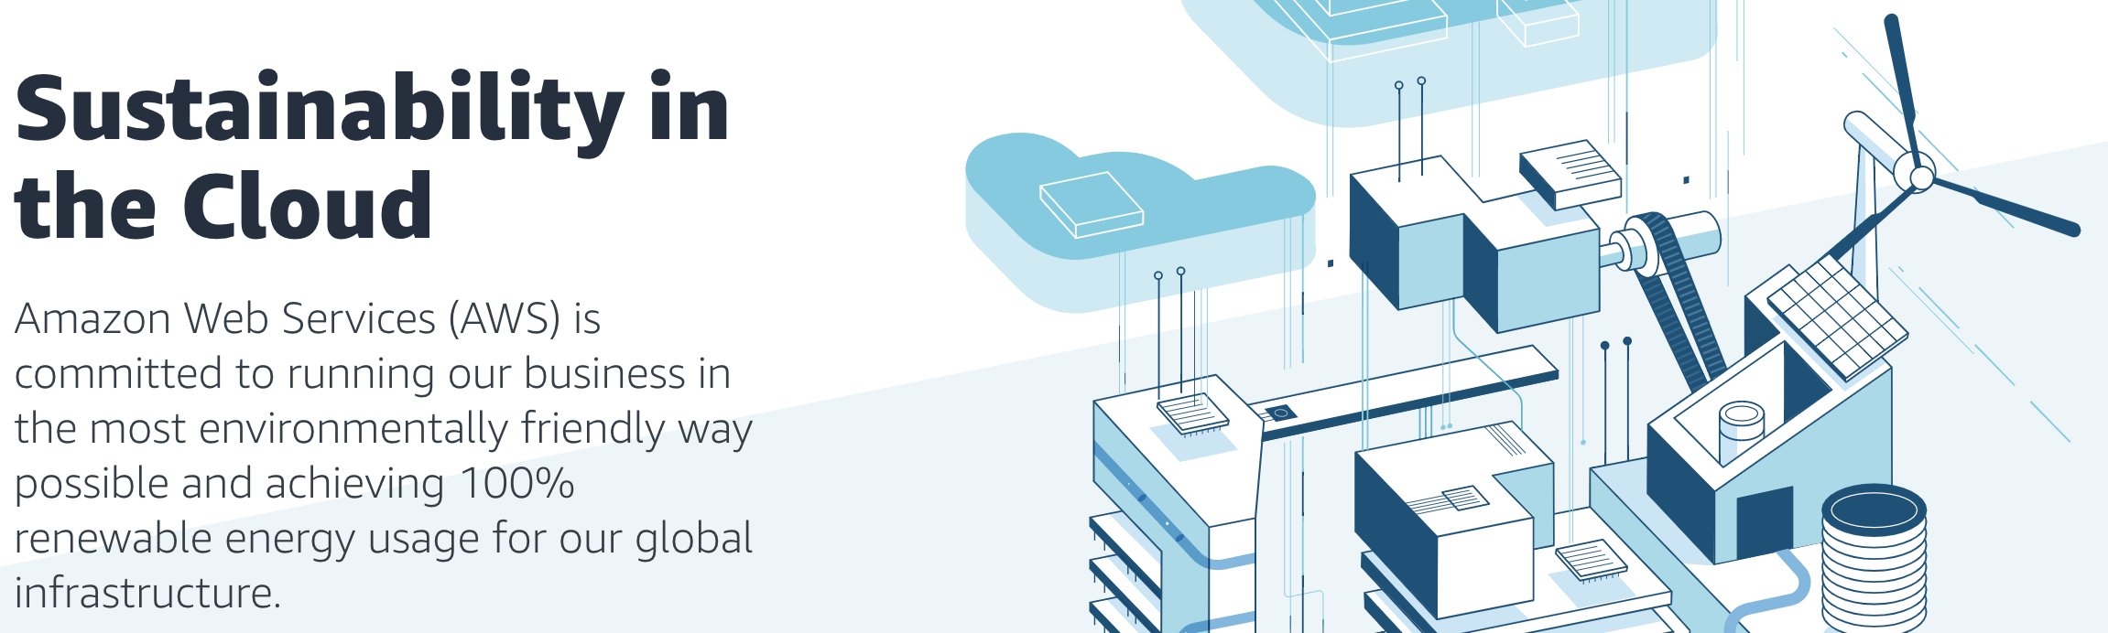
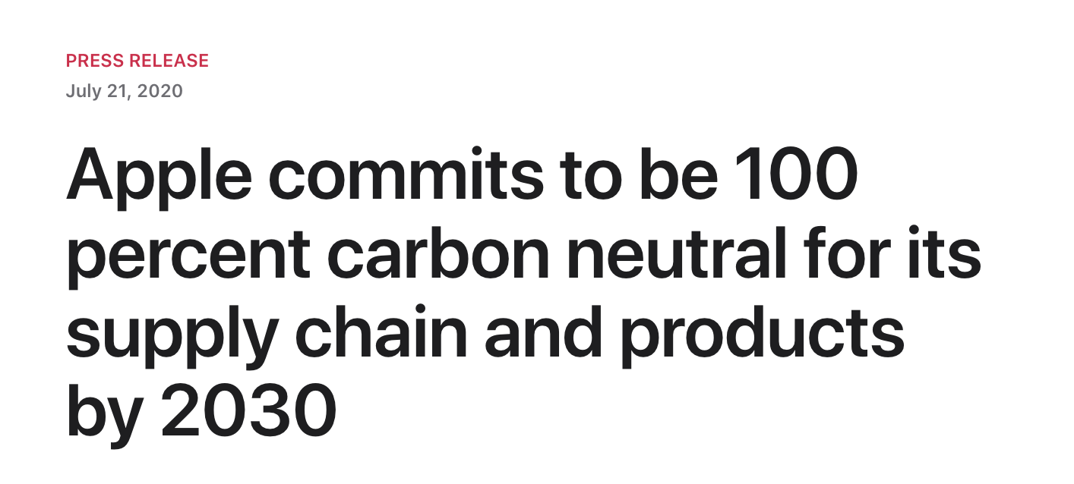
Big Tech. companies are pledging carbon neutrality
Notes:
For instance, Google, Microsoft, Facebook, Apple, Amazon, and others have pledged to reach carbon neutrality over the next decade.
In this talk we explore, what role computer systems and architecture researchers and developers can play in achieving sustainable computing going forward.

Slide 4
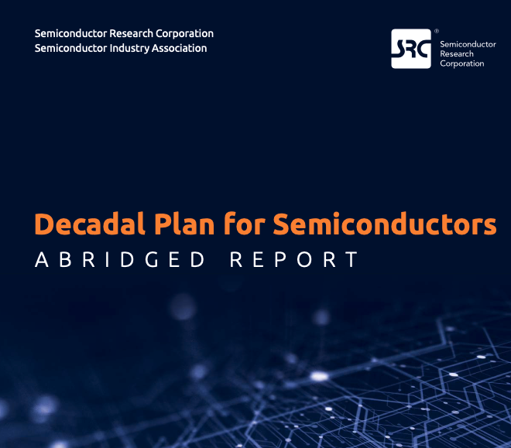
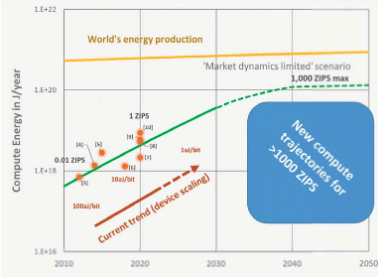
SRC decadal plan calls attention to ICT rising energy footprint
Ever-rising energy demand for computing vs. global energy production is creating new risk,
and new computing paradigms offer opportunities to dramatically improve energy efficiency.
Notes:
Specifically we ask the question, where does computing’s carbon footprint come from?
In our journey to answer this question what we found was quite surprising to some of our collaborators that have spent a lot of time thinking about hardware performance and energy efficiency optimizations.

Slide 5
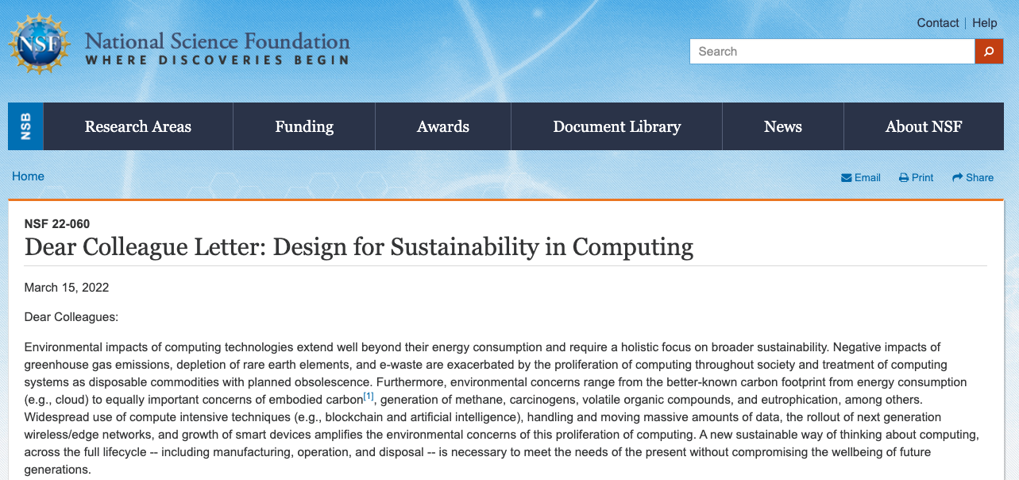
NSF Dear Colleague Letter on Sustainable Computing
DCL
VMWare NGSDI
SRC Decadal Plan
https://www.nsf.gov/pubs/2022/nsf22060/nsf22060.jsp

Slide 6
ACT Tutorial Motivation and Goals
Provide the necessary background and tools to enable researchers to incorporate sustainable as a first order design target
Provide a brief overview of the sustainability implications of modern systems,
Detail the ACT methodology,
Demonstrate how to use ACT,
Demonstrate how to extend ACT
Notes:
Specifically we ask the question, where does computing’s carbon footprint come from?
In our journey to answer this question what we found was quite surprising to some of our collaborators that have spent a lot of time thinking about hardware performance and energy efficiency optimizations.

Slide 7
The journey is only beginning!
Cross-stack carbon accounting and reporting
How do we enable cloud providers to track carbon?
How do we track environmental footprint on mobile app and edge devices?
Unify top-down (systems and platforms) and bottom-up (devices and architecture) modeling methodologies
Emerging technologies
What is the impact of emerging device technologies (e.g., eNVM’s, optical computing)?
What is the impact of chiplet-based technologies?

Slide 8
The journey is only beginning!
Extend ACT to include non-IC components for end-to-end system carbon accounting (e.g., batteries, PCB’s, passive components)
Apply ACT to find exciting new tradeoffs (applications and algorithms, run-time scheduling and mapping, systems and architecture, circuits and devices) between performance, power, and carbon!
Validate ACT across a breadth of product-environmental reports and LCA methodologies (cost-based EIO, database-based LCA’s)
And so much more!

Slide 9

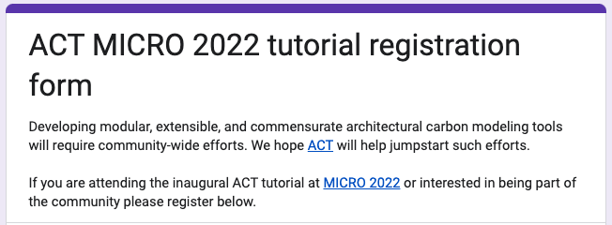
Sing up on our Google form!
https://forms.gle/hEAju2suaeEnisRQA

Slide 10
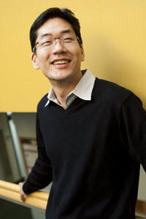
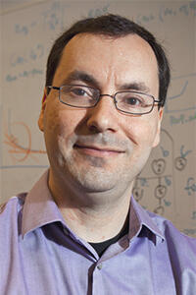
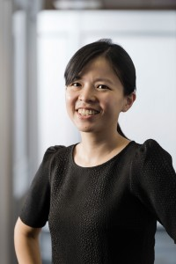
Our other organizers
Gu-Yeon Wei (Harvard) is a Professor of Electrical Engineering at Harvard University. His research interests span a variety of topics such as integrated voltage regulators, flexible voltage stacking, power electronics, low-power computing architectures and circuits, auto-parallelizing compilers, and more.
David Brooks (Harvard) is a Professor of Computer Science at Harvard University. His research focuses on the interaction between the architecture and software of computer systems and underlying hardware implementation challenges, including power, reliability, and variability issues across embedded and high-performance computing systems.
Carole-Jean Wu (FAIR) is a Research Scientist at Meta AI. Her research focus lies in the domain of computer system architecture with particular emphasis on energy- and memory-efficient systems. Her research has pivoted into designing systems for machine learning execution at-scale. In general, she is interested in tackling system challenges to enable efficient, responsible AI execution.

Slide 11

Thank you for attending
Reach out if you want to collaborate on the intersection of computing and sustainability!
Joining Cornell Tech (NYC) as Assistant Professor in ECE summer 2023
Visiting researcher at Meta AI

