Slide 1
Appiaries Developers Workshop
(for Android)
Appiaries Team
1/8/2016

Slide 2
Overview
App development agenda:
- Data Management
- Push Notification

Slide 3

Goal
- Understand where Appiaries plays its part.
- Develop Android App using SDK
- Learn how to look up the official documents provided.

Slide 4
What is Appiaries anyway?

Slide 5
Appiaries is → BaaS
What is ”BaaS” ?
→ A cloud service.
→ Allows you to omit server setups.
What’s so good about Appiaries for developers ?
Appiaries provides TRIAL PLAN for FREE !
→ So you can test out yourself and see how it works

Slide 6
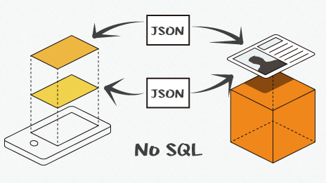
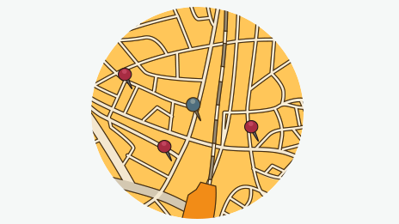

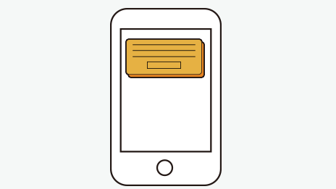

What can you do with Appiaries ?
Datastore
Geo-Location
User Management
Push Notification
SNS Association
→ Read the official documents for feature details.

Slide 7
OK.
What for today?

Slide 8

We’re developing…
“MeetFriend”
→ Is a Meet-up app
→ Can tell others WHERE I AM NOW.

Slide 9
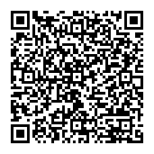
“MeetFriend”
→ Lets you publish the current location of YOU.
→ Shows where YOUR FRIENDS are now.
→ Can receive PUSH NOTIFICATION messages.
Check out the app on Google Play :
Download
https://play.google.com/store/apps/details?id=jp.co.teamegg.meetfriend

Slide 10
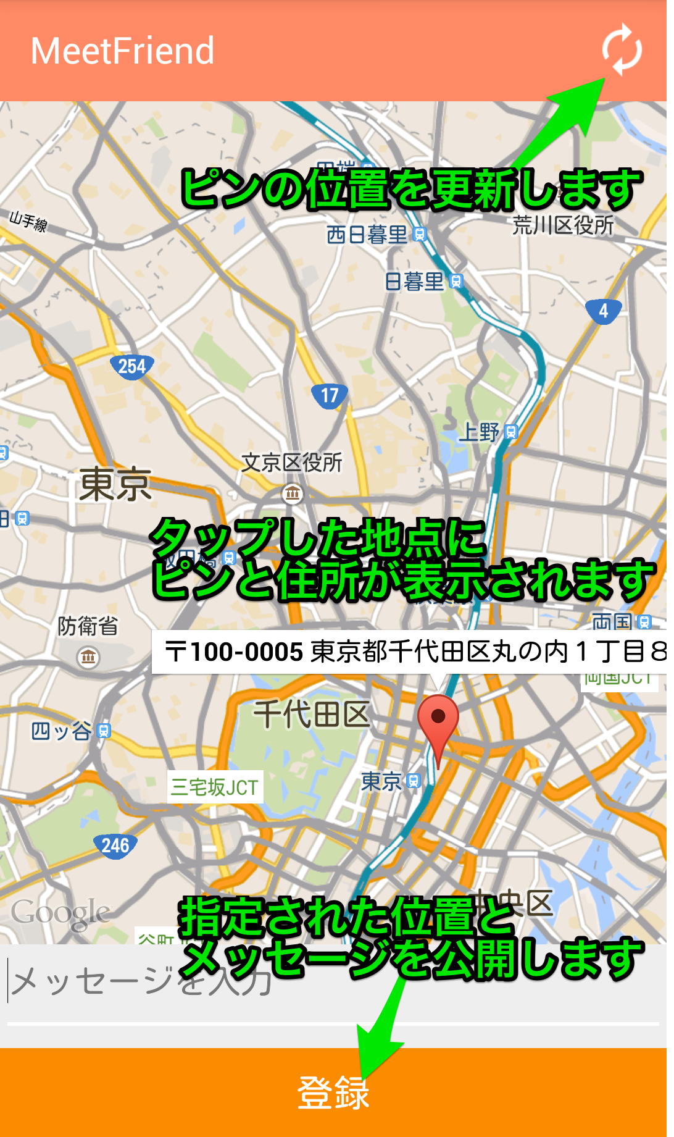
How to Use “MeetFriend” ?
1. Tap to set the location.
Updates the pin.
2. Enter a message.
3. Click REGISTER button
(to share the geo data)
Pin and Address show up where you tapped.
4. Click UPDATE button
(to update where your friends are)
Publish specified Geo locaion information and associated message.
REGISTER

Slide 11
Got it ?
Once you understand how it works, you may uninstall the app. We will create a similar app today using Appiaries SDK !!

Slide 12
What Appiaries does in “MeetFriend” app? → Datastore
“Datastore” (uses JSON collections)
→ Simplifies communication handlings.
→ Handles the data as Java objects (HashMap).

Slide 13

Developing
“MeetFriend”
(Or somewhat similar…)

Slide 14
Some setups you need using Appiaries

Slide 15
Appiaries’ Official Document
We will be frequently looking up the official document website as we develop the app.
Appiaries’ Official Document Website
http://docs.appiaries.com/?lang=en

Slide 16
Creating Your Account
Look up the official documents and…
MENU
→ [ Control Panel ]
→ [ Register Your Account ]

Slide 17
Creating Your App
(else it is sometimes called “Servce”)
Look up the official documents and…
MENU
→ [ Control Panel ]
→ [ Register Your App ]
* Next page tells you what to set !

Slide 18
What do we set for our new App ?
Information to set:
App ID：[ Your Name ]_[ Date ]
ex. “ joseph_20160108 ”
App Name：MeetFriend
Language：English
Invitation Code：(leave it for blank)

Slide 19
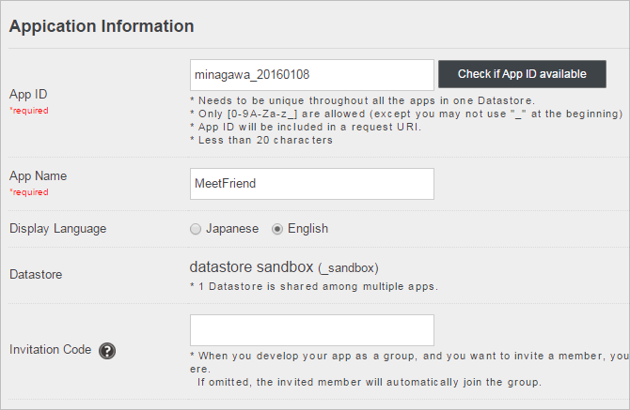
Items to be set
It should look like this. Now, click “Register”.

Slide 20
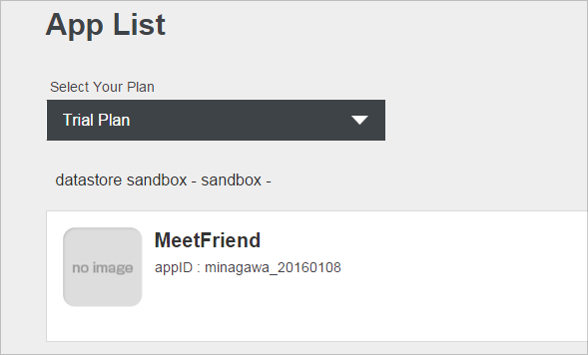
Check if the App is created
Go to [ App List ]. See if the app is created.

Slide 21
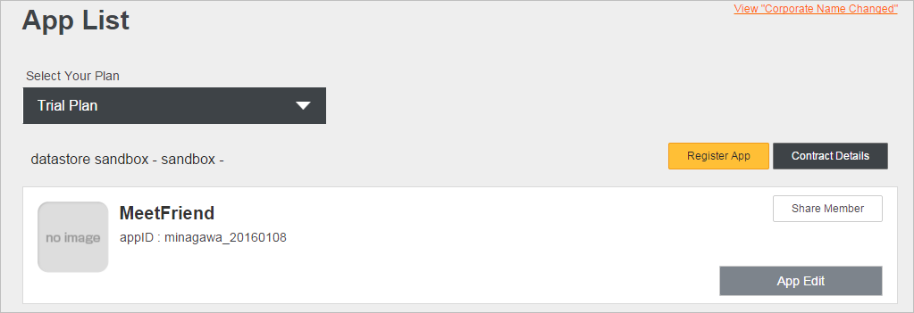
Checking the App Information
Click [ App Edit ] to check the information set for the app created.

Slide 22
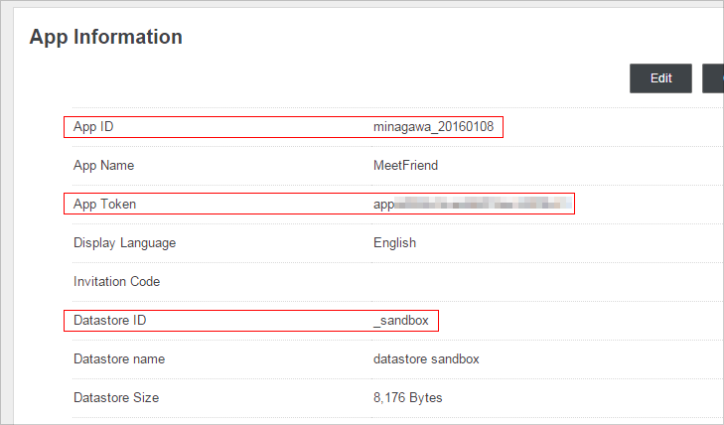
Checking the App Information (2)
We will use Datastore ID, App ID, and App Token later when developing the app.

Slide 23
Some setups you need for Datastore feature.

Slide 24
What can we do with Datastore ?
Handles JSON data.
→ To send where YOU are.
→ To get where YOUR FRIENDS are.

Slide 25
Using the Datastore feature
Here’s what we do:
- Create COLLECTIONS
- Create OBJECTS

Slide 26
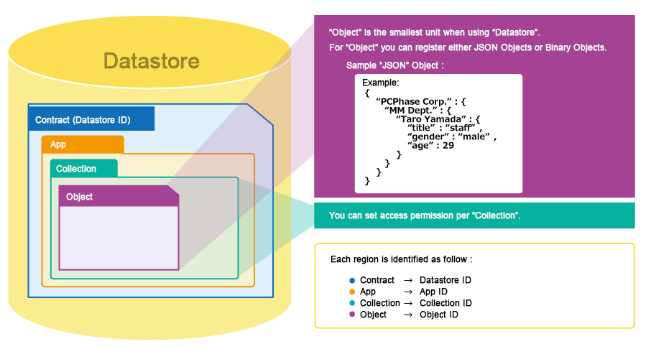
Creating “Collections”
“Collection” is…
- a container to manage data such as JSON
- a basic structure for data management

Slide 27
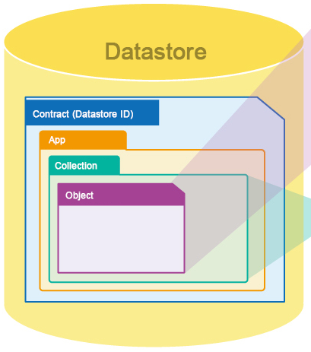
Creating “Objects”
“Object” is… → Data stored in “Collection”.

Slide 28
Creating “Collection” and “Object”
Follow the instructions described in the official document website:
MENU
→ [ Control Panel ]
→ [ Data Management ]
→ JSON
Create Collection
Create JSON Object
* Next page tells you what to set !

Slide 29
What to set for “Collection”
Collection ID：user_location
Collection Type：JSON Data
Permission for “CREATE”：ADMIN
Permission for “READ”：ALL
Permission for “UPDATE”：ALL
Permission for “DELETE”：ADMIN

Slide 30
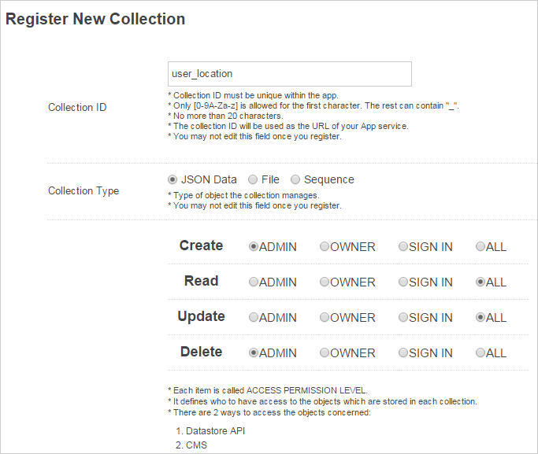
What to set for “Collection” (2)
It should look like this.
Click [Save].

Slide 31
What to set for “Object”
Object ID：place_data
JSON Data：(see bellow)
{
"001data": {
"message": "sample",
"lat": "35.68103884648842",
"long": "139.76699352264404"
}
}
It is the coordinate for “Tokyo Station”.

Slide 32
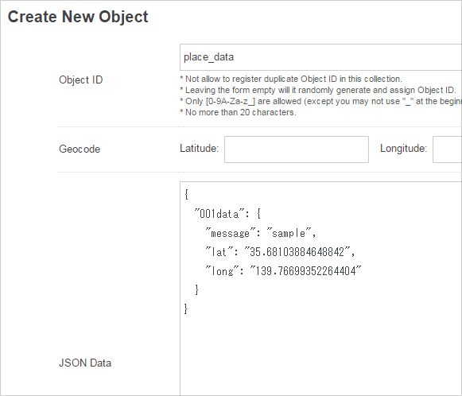
What to set for “Object” (2)
Click [Create].

Slide 33
Expected JSON data (to be created)
Data to be created from the app will look like…
{
"[John's User ID]": {
"long": "[Longitude]",
"lat": "[Latitude]",
"message": "[Message]"
},
"[Mary's User ID]": {
"long": "[Longitude]",
"lat": "[Latitude]",
"message": "[Message]"
}
}

Slide 34
Preparing
The
Sample App

Slide 35
Steps for Sample App preparation:
1. Install and setup “Android Studio”.
2. Prepare your test device.
3. Download the Sample Project.
4. Import the Sample Project.

Slide 36

About “Sample Project”
→ Fully Android Studio compatible.
For this workshop we will be fixing files under the “app” directory.
“libs” → Libraries
“src/main” → Source Codes + Resources
“build.gradle” → App build settings

Slide 37
Download “Sample Project”
Download
https://drive.google.com/uc?export=download&id=0B95up6Ht2SfWaklGUEZxdzhqMkk
( make sure it ends with v2.0.1 )

Slide 38
Preparing “Appiaries Android SDK”
3 easy steps:
(1) Download the SDK.
(2) Add the SDK to your project.
(3) Write necessary settings to “build.gradle”.

Slide 39
Download “Appiaries Android SDK”
Download Appiaries Android SDK from the official document website.
MENU
→ Android SDK
→ Download
→ Download Android SDK
* Choose the latest version for the SDK.

Slide 40
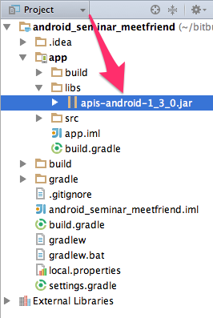
Add Appiaries Android SDK to the Project
Expand the downloaded file.
Copy + paste it to “app/libs” directory.
* Check the red marked area if it says “Android”. If that is the case, rename it to “Project”.

Slide 41
Add settings to “build.gradle”
Modify “app/build.gradle” so that the library is added.
apply plugin: 'com.android.application'
android {
…… (omit) ……
dependencies {
…… (omit) …… compile fileTree(dir: 'libs', include: ['*.jar'])
compile 'com.google.android.gms:play-services:X.X.XX'
compile 'org.apache.httpcomponents:httpclient-android:4.3.5.1'
compile ('org.apache.httpcomponents:httpmime:4.3.4') {
exclude module:'org.apache.httpcompoents:httpcore'
exclude module:'org.apache.httpcompoents:httpclient'
}
compile 'org.codehaus.jackson:jackson-core-asl:1.8.3'
compile 'org.codehaus.jackson:jackson-mapper-asl:1.8.3'
}

Slide 42
Modify “onCreate” method in “PickPlaceMapActivity” class
* You should definitely check your App ID and App Token.
protected void onCreate(final Bundle savedInstanceState) {
super.onCreate(savedInstanceState);
setContentView(R.layout.activity_pick_place_map);
if (savedInstanceState == null) {
getFragmentManager().beginTransaction().add(new PushRegistrationFragment(), "registration").commit();
}
// Initializing Appiaries (Datastore ID, App ID, and App Token)
AB.Config.setDatastoreID("_sandbox");
AB.Config.setApplicationID([ App ID ]);
AB.Config.setApplicationToken( [ App Token ]);
AB.activate(getApplicationContext());
// Message fields
mMessageText = (EditText) findViewById(R.id.place_message);
…… (omit) ……
}

