Slide 2
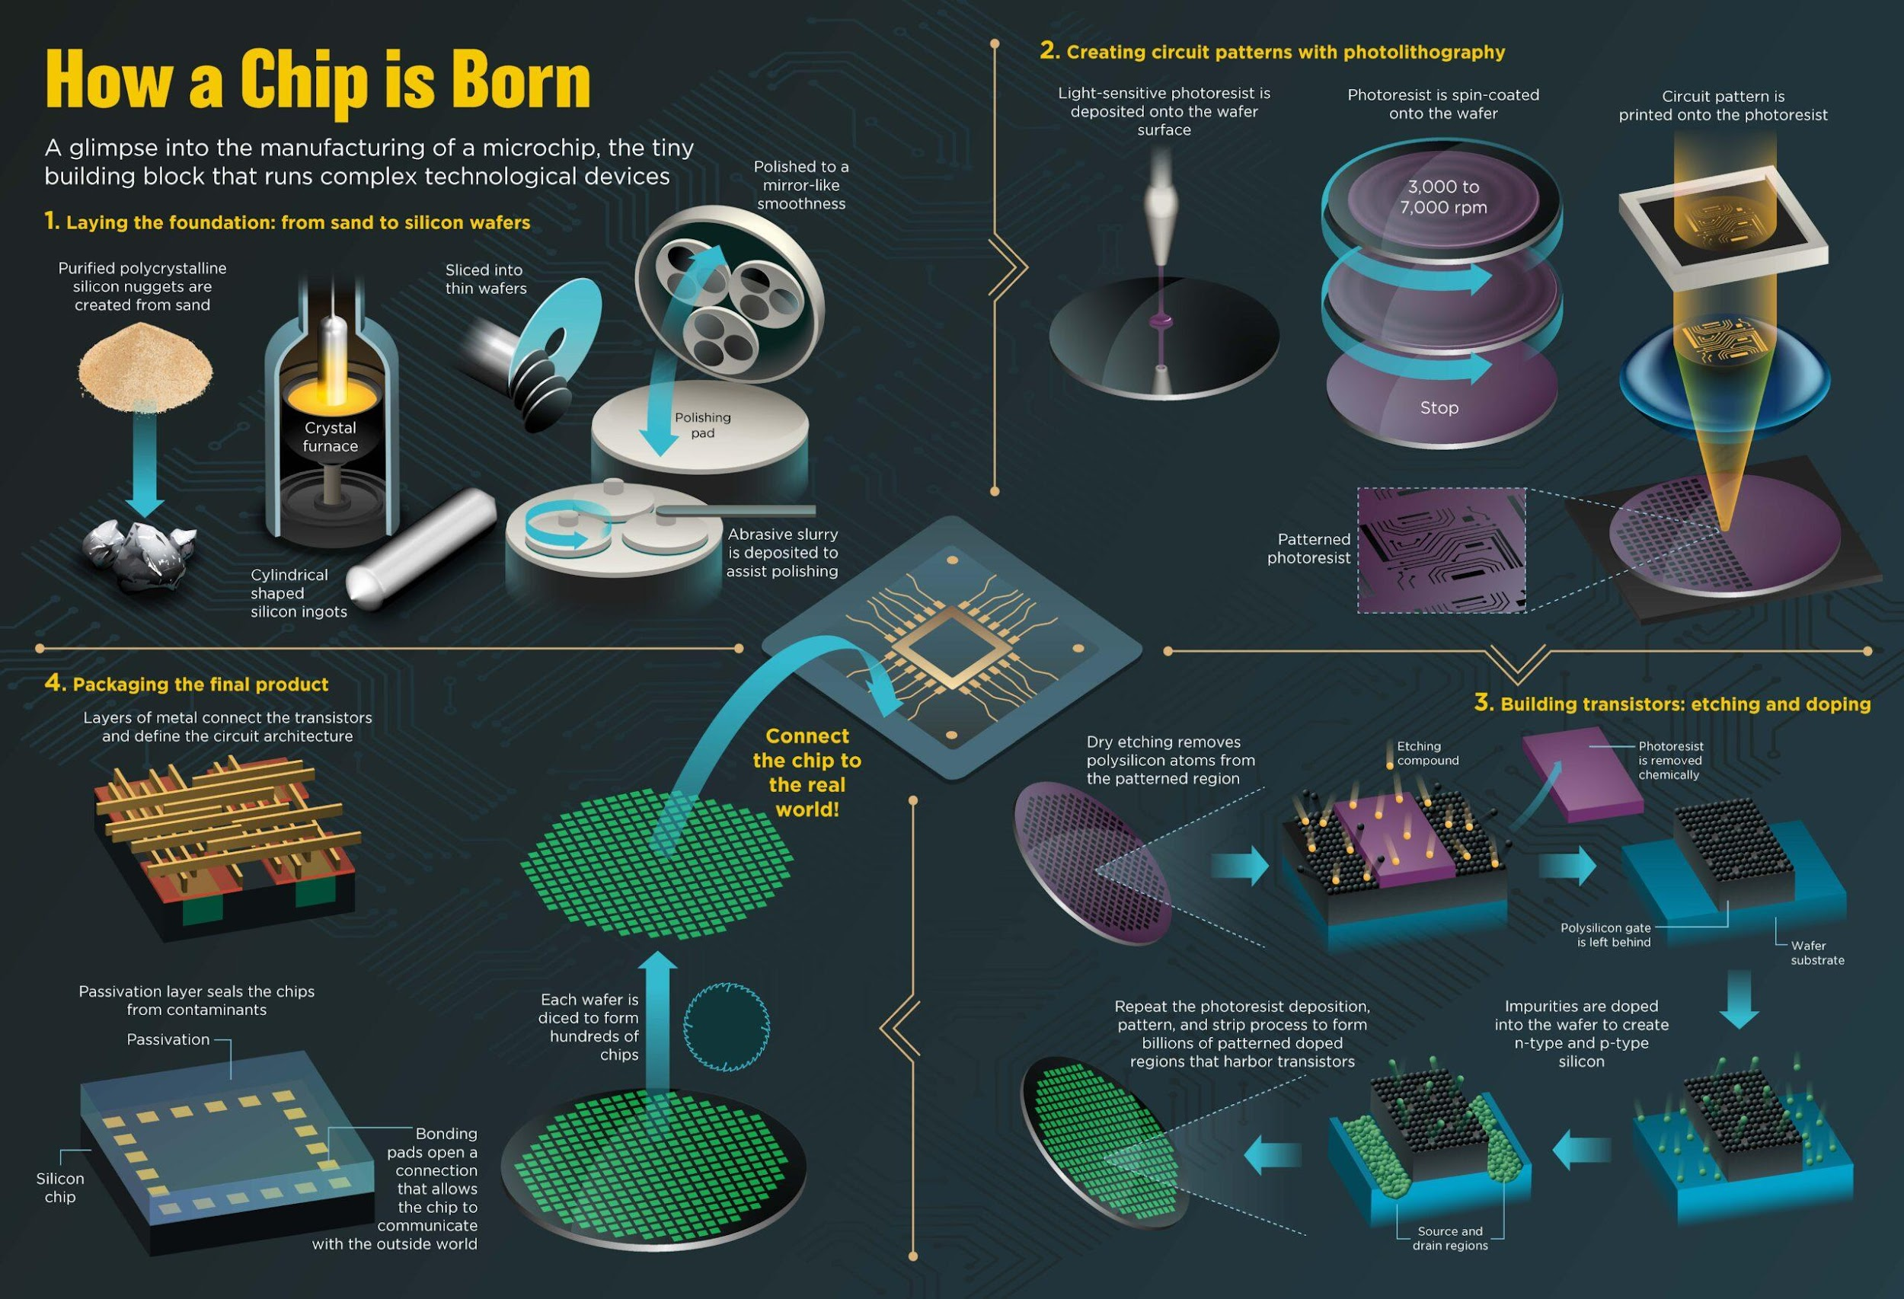
CMOS Fabrication Process(1/8)
The CMOS process requires a large number of steps.
We begin with a brief description of basic fabrication steps, such as:
wafer processing
photolithography
oxidation
ion implantation
deposition
etching

Slide 3
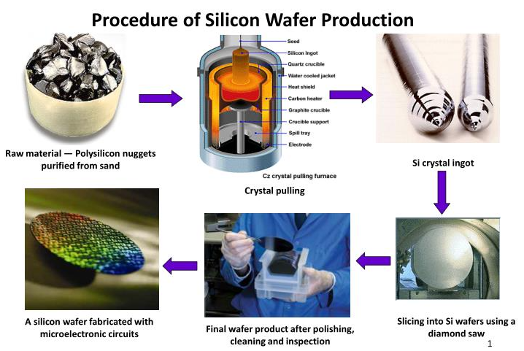
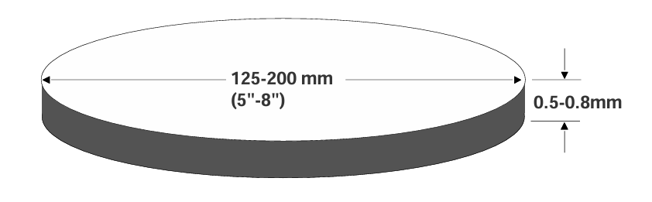
CMOS Fabrication Process(2/8)
Wafer Processing
The silicon is grown by the Czochralskimethod:
● Starts with a single Silicon seed.
● The seed is immersed in molten silicon and slowly rotated and pulled.
● The result is an ingot of single-crystal silicon with few defects. The ingot is sliced into thin wafers that form the starting point for IC fabrication:

Slide 4
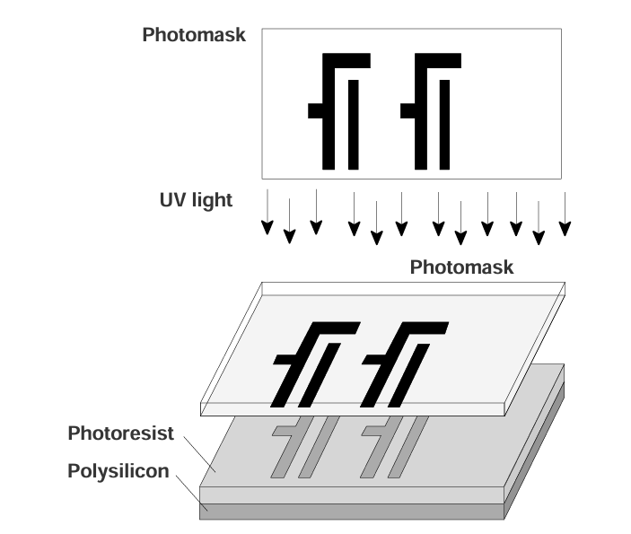
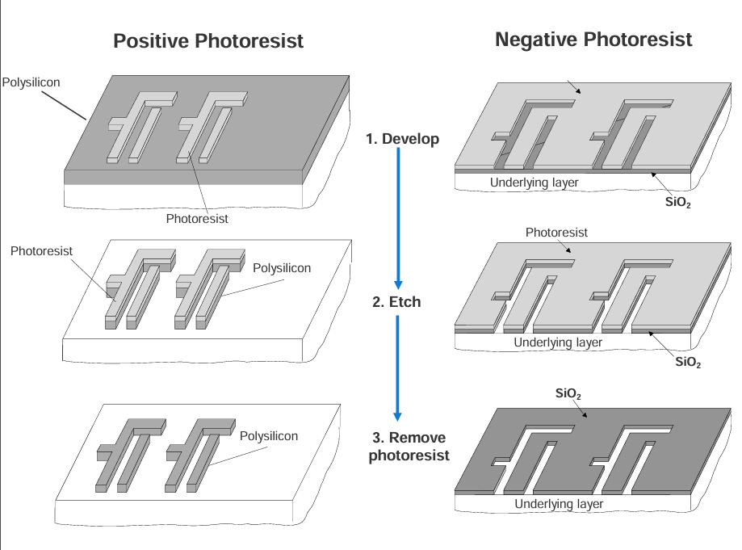
CMOS Fabrication Process(3/8)
Photolithography
The lithography of each layer involves one mask and three processing steps:
● Develop: cover wafer with photoresist and align mask on top and expose to light;
● Etch
● Remove photoresist

Slide 5
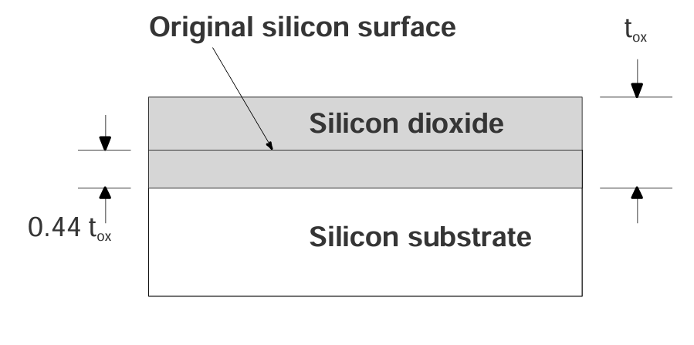
CMOS Fabrication Process(4/8)
Oxidation
Oxidation is the process by which a layer of silicon dioxide is grown on the surface of a silicon wafer:
● It protects the underlying material from contamination.
● It provides isolation between two layers.
● Its thicknesses can vary between 10Å to over 1000Å.
● MOS transistor oxide is the thinnest oxide layer. Field oxide is much thicker.

Slide 6
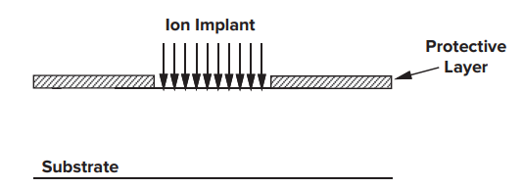
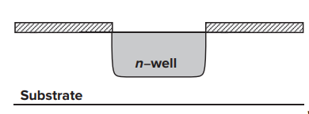
CMOS Fabrication Process(5/8)
Ion Implantation
In ion implantation, dopants are introduced as ions into the material.
The doping atoms are accelerated as a high-energy focused beam, hitting the surface of the wafer and penetrating the exposed areas.

Slide 7
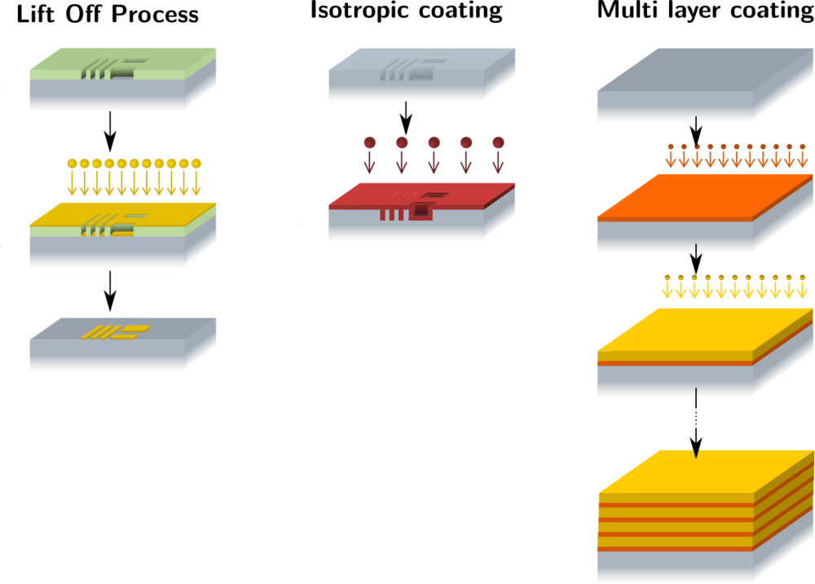
CMOS Fabrication Process(6/8)
Deposition
Any CMOS process requires the repetitive deposition of layers of a material over the complete wafer, to either act as buffers for a processing step, or as insulating or conducting layers (e.g. SiO2 layer).

Slide 8
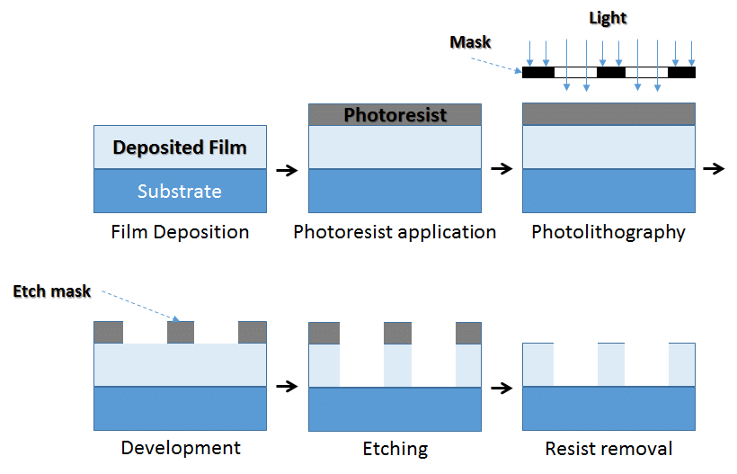
CMOS Fabrication Process(7/8)
Etching
Once a material has been deposited, etching is used to selectively form patterns such as wires and contact holes.
Depending on the speed, accuracy, and selectivity required in the etching step, and the type of material to be etched, one of these methods may be used:
“wet” etching, i.e., placing the wafer in a chemical liquid (low precision);
“plasma” etching, i.e., bombarding the wafer with a plasma gas (high precision);

Slide 9
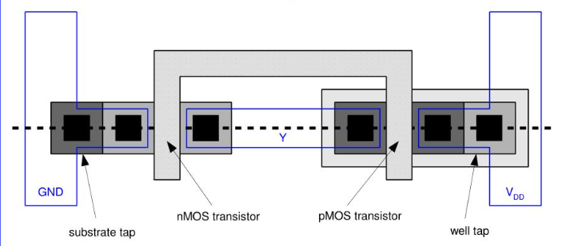
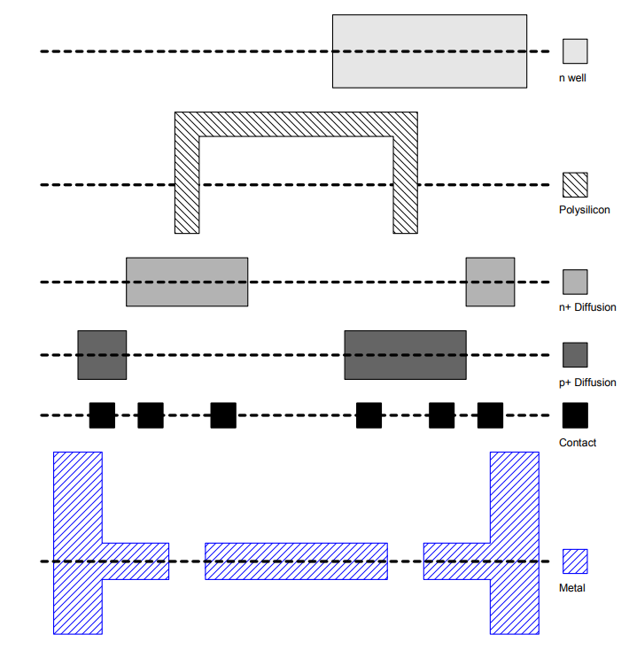
Summary: CMOS Fabrication Process
CMOS fabrication steps
▪ Wafer preparation: Preparing the silicon for use.
▪ Photolithography:Transferring the circuit layout to the wafer:
▪ Oxidation: Forming a very uniform oxide layer on the silicon.
▪ Ion implantation: Doping specific parts of the wafer.
▪ Deposition and etching:Depositing materials on the wafer and removing the unwanted material.

