Slide 1
Chapter 8: Feedback
8.1 General Considerations
8.2 Feedback Topologies
8.3 Effect of Feedback on Noise
8.4 Feedback Analysis Difficulties
8.5 Effect of Loading
8.6 Bode’s Analysis of Feedback Circuits
8.7 Loop Gain Calculation Issues
8.8 Alternative Interpretations of Bode’s Method

Slide 2
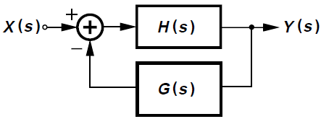

General Considerations
Above figure shows a negative feedback system
H(s) and G(s) are called the feedforward and forward networks respectively
Feedback error is given by X(s) – G(s)Y(s)
Thus
H(s) is called the “open-loop” transfer function and Y(s)/X(s) is called the “closed-loop” transfer function

Slide 3
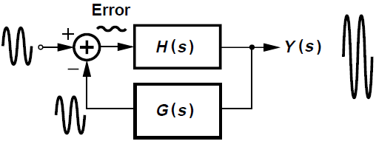
General Considerations
In most cases, H(s) represents an amplifier and G(s) is a frequency-independent quantity
In a well-designed negative feedback system, the error term is minimized, making the output of G(s) an “accurate” copy of the input and hence the output of the system a faithful (scaled) replica of the input
H(s) is a “virtual ground” since the signal amplitude is small at this point
In subsequent developments, G(s) is replaced by a frequency-independent quantity β called the feedback factor

Slide 4
General Considerations
Four elements of a feedback system
  The feedforward amplifier
  A means of sensing the output
  The feedback network
  A means of generating the feedback error, i.e., a subtractor (or an adder)
These exist in every feedback system, though they may not be obvious in some cases

Slide 5
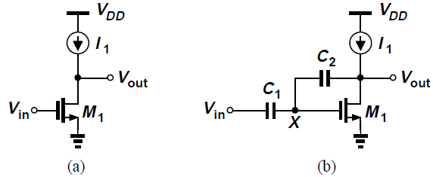
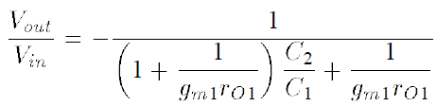
Properties of Feedback Circuits
Gain Desensitization:
In Fig. (a) above, the CS stage has a gain of g_{m1}r_{O1}
Gain is not well-defined since both g_{m1} and r_{O1} vary with process and temperature
In the circuit of Fig. (b), the bias of M₁ is set by a means not shown, the overall voltage gain at low frequencies is given by

Slide 6
Properties of Feedback Circuits
Gain Desensitization:
If g_{m1}r_{O1} is sufficiently large, then
Compared to g_{m1}r_{O1}, this gain can be controlled with higher accuracy since it is a ratio of two capacitors, relatively unaffected by process and temperature variations if C₁ and C₂ are made of the same material
Closed-loop gain is less sensitive to device parameters than the open-loop gain, hence called “gain desensitization”

Slide 7
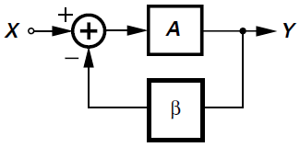
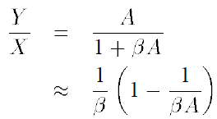
Properties of Feedback Circuits
Frequency stability typically worsens as a result feedback
For a more general case, gain desensitization is quantified by writing
It is assumed βA >> 1; even if open-loop gain A varies by a factor of 2, Y/X varies by a small percentage since 1/(βA) << 1

Slide 8

Properties of Feedback Circuits
Called the “loop gain”, the quantity βA is important in feedback systems
The higher βA is, the less sensitive Y/X is to variations in A, but closed-loop gain is reduced, i.e., tradeoff between precision and closed-loop gain
The output of the feedback network is equal to ssssssssssssssss approaching X as βA becomes much greater than unity

Slide 9
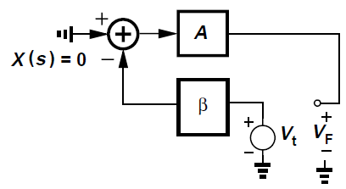

Calculation of Loop Gain
To calculate the loop gain:
  Set the main input to (ac) zero
  Inject a test signal in the “right” direction
  Follow the signal around the loop and obtain the value that returns to the break point
  Negative of the transfer function thus obtained is the loop gain
Loop gain is a dimensionless quantity
In above figure, and hence

Slide 10
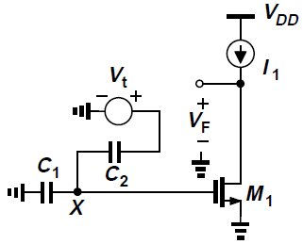



Calculation of Loop Gain: Example
Applying the given procedure to find the loop gain in the circuit above, we can write
That is,
The current drawn by C₂ from the output is neglected

Slide 11
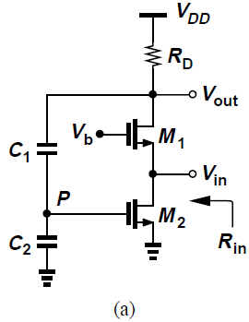
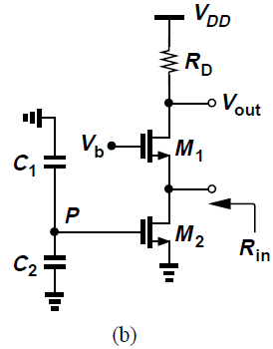

Properties of Feedback Circuits
Terminal Impedance Modification: Input Impedance
In the circuit of Fig. (a), a capacitive voltage divider senses the output voltage of a CG stage and applies the result to the gate of current source M₂ and hence returning a signal to the input
Neglecting channel-length modulation and the current drawn by C₁ and breaking the circuit as in Fig. (b), we can write

Slide 12
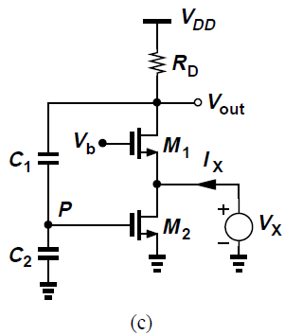


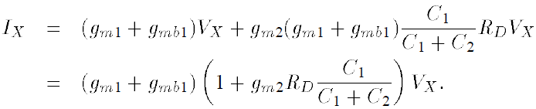
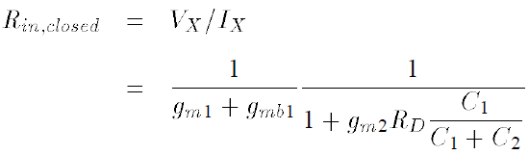
Properties of Feedback Circuits
Terminal Impedance Modification: Input Impedance
Adding the small-signal drain currents of M₁ and M₂,
It follows that
For the closed-loop circuit of Fig. (c),

Slide 13


Properties of Feedback Circuits
Terminal Impedance Modification: Input Impedance
Feedback reduces the input impedance by a factor of s
It can be proved that is the loop gain

Slide 14
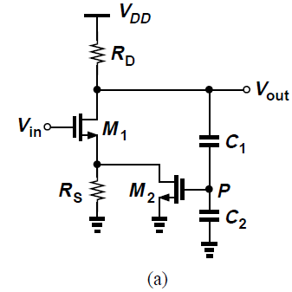
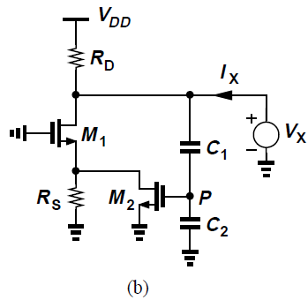

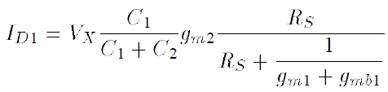
Properties of Feedback Circuits
Terminal Impedance Modification: Output Impedance
In the circuit of Fig. (a), M₁, R_{S} and R_{D} form a CS stage and C₁, C₂ and M₂ sense the output voltage, returning a current to the source of M₁
To find the output resistance at relatively low frequencies, the input is set to zero [Fig. (b)], so that

Slide 15

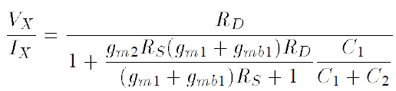
Properties of Feedback Circuits
Terminal Impedance Modification: Output Impedance
Since , we have
This implies that negative feedback decreases the output impedance
It can be verified that denominator is one plus the loop gain

Slide 16
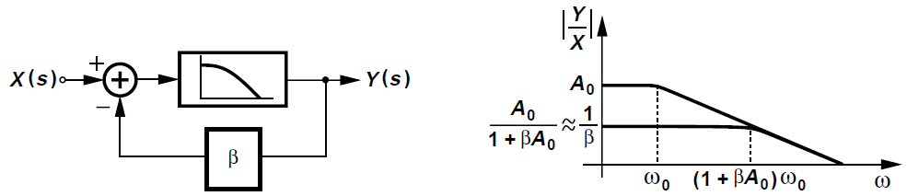

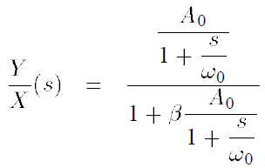
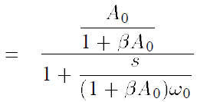
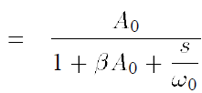
Properties of Feedback Circuits
Bandwidth Modification:
Suppose the feedforward amplifier above has a one-pole transfer function
A₀ is the low-frequency gain and ω₀ is the 3-dB bandwidth
Transfer function of the closed-loop system is

Slide 17


Properties of Feedback Circuits
Bandwidth Modification:
The closed-loop gain at low frequencies is reduced by a factor of , and the 3-dB bandwidth is increased by the same factor, revealing a pole at ssssss
If A is large enough, closed-loop gain remains approximately equal to 1/β even if A experiences substantial variations
At high frequencies, A drops so that βA is comparable to unity and closed-loop gain falls below 1/β

Slide 18
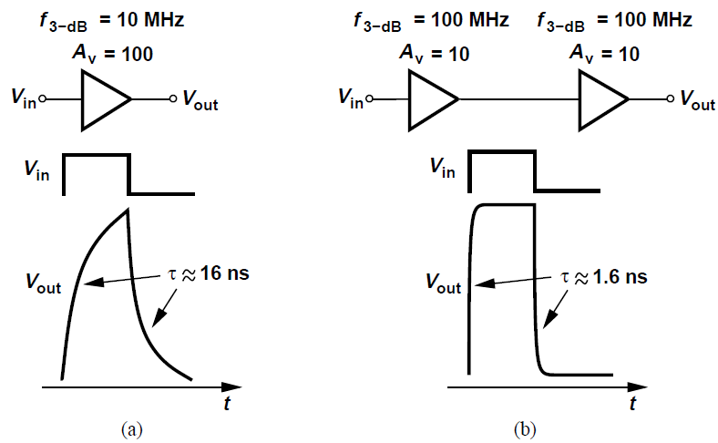
Properties of Feedback Circuits
Bandwidth Modification:
Gain-bandwidth product of a one-pole system is A₀ω₀ and does not change with feedback
For a single-pole amplifier with open loop gain of 100 and 3-dB bandwidth of 10 MHz, the response to a 20 MHz square wave exhibits long rise and fall times [Fig. (a)] with a time constant

Slide 19
Properties of Feedback Circuits
Bandwidth Modification:
If feedback is applied to the amplifier such that the gain and bandwidth are modified to 10 and 100 MHz respectively, two such amplifiers cascaded in series yield a much faster response [Fig. (b)], at the cost of double the power consumption

Slide 20
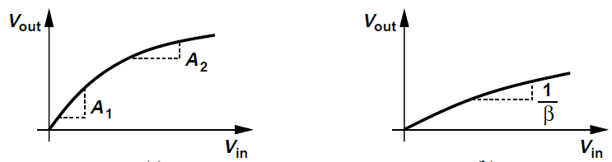
Properties of Feedback Circuits
Nonlinearity Reduction:
Negative feedback reduces nonlinearity in analog circuits
A nonlinear characteristic departs from a straight line, i.e., its slope (or small-signal gain) varies [Fig. (a)]
A closed-loop feedback system incorporating such an amplifier exhibits less gain variation and higher linearity [Fig. (b)]
(a)
(b)

Slide 21


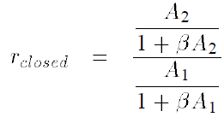

Properties of Feedback Circuits
Nonlinearity Reduction:
In Fig. (a), open-loop gain ratios between regions 1 and 2 is
Assuming A₂ = A₁ – ΔA, we can write
For the amplifier in negative feedback [Fig. (b)], the closed-loop gain ratio is much closer to 1 if the loop gain , is large
(a)
(b)

Slide 22
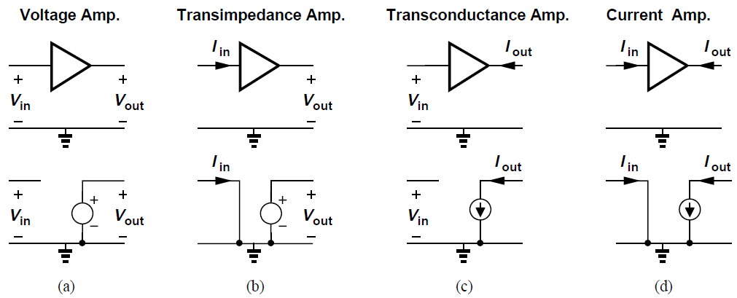
Types of Amplifiers
Four possible amplifier configurations depending on whether the input and output signals are voltage or current quantities
Figs. (a) – (d) show the four amplifier types with the corresponding idealized models

Slide 23
Types of Amplifiers
The four configurations have quite different properties
Circuits sensing a voltage must exhibit a high input impedance whereas those sensing a current must provide a low input impedance
Circuits generating a voltage must exhibit a low output impedance while those generating a current must provide a high output impedance
Gains of transimpedance and transconductance amplifiers have dimensions of resistance and conductance, respectively
Sign conventions must be followed, taking into account the directions of I_{in} and I_{out} in transimpedance and transconductance amplifiers

Slide 24
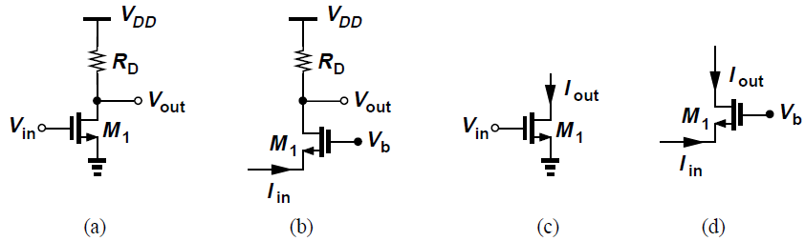
Types of Amplifiers
In Fig. (a), a common-source stage senses and produces voltages
In Fig. (b), a common-gate stage serves as a transimpedance amplifier, converting the source current to a voltage at the drain
In Fig. (c), a common-source transistor operates as a transconductance amplifier (or V/I converter), generating an output current in response to an input voltage
In Fig. (d), a common-gate device senses and produces currents

Slide 25
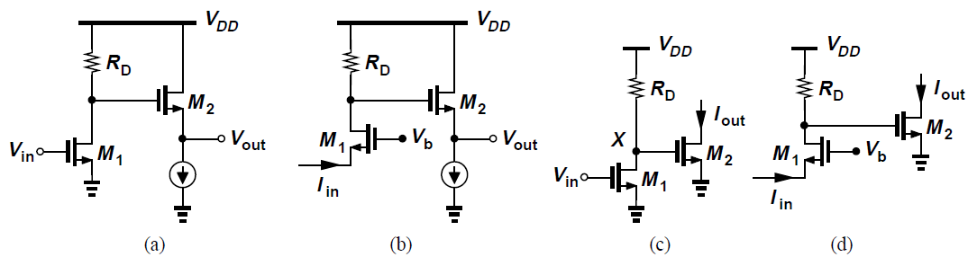
Types of Amplifiers
Figs. (a) – (d) depict modifications to previous amplifier configurations to alter the output impedance or increase the gain

Slide 26
Sense and Return Mechanisms
Placing a circuit in a feedback loop requires sensing an output signal and returning a fraction of it to the summing node at the input
Four types of feedback
  Voltage-Voltage
  Voltage-Current
  Current-Current
  Current-Voltage
First term is the quantity sensed at the output, and the second term is the type of signal returned to the input

Slide 27
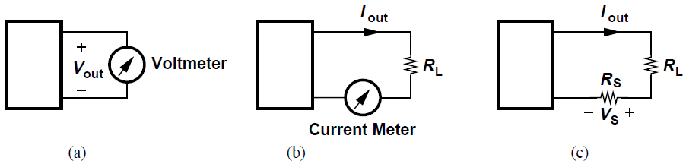
Sense and Return Mechanisms
  To sense a voltage, we place a voltmeter in parallel with the corresponding port [Fig. (a)], ideally introducing no loading, also called “shunt feedback”
  To sense a current, a current meter is inserted in series with the signal [Fig. (b)], ideally exhibiting zero resistance, also called “series feedback”
In practice, the current meter is replaced by a small resistor [Fig. (c)], with the voltage drop as a measure of the output current

Slide 28
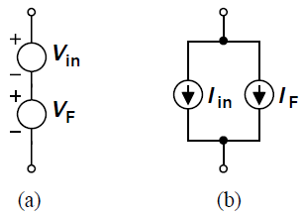
Sense and Return Mechanisms
  Addition of the feedback signal and the input signal can be performed in the voltage or current domains
  Voltages are added in series [Fig. (a)]
  Currents are added in parallel [Fig. (b)]

Slide 29
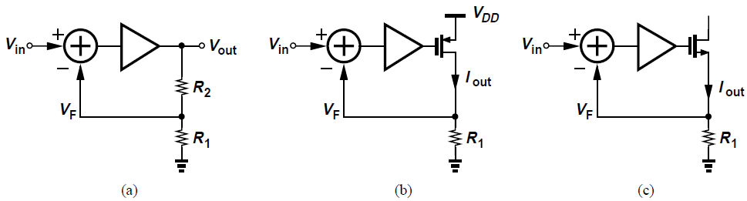
Sense and Return Mechanisms
A voltage can be sensed by a resistive (or capacitive) divider in parallel with the port [Fig. (a)]
A current can be sensed by placing a small resistor in series with the wire and sensing the voltage across it [Figs. (b) and (c)]

Slide 30
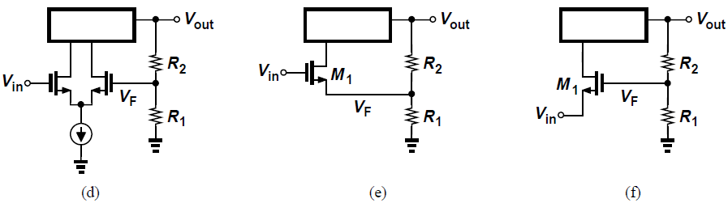
Sense and Return Mechanisms
To subtract two voltages, a differential pair can be used [Fig. (d)]
A single transistor can also perform voltage subtraction [Figs. (e) and (f)] since I_{D1} is a function of V_{in} – V_{F}

Slide 31
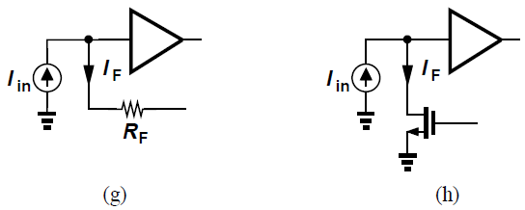
Sense and Return Mechanisms
Current subtraction can be performed as shown in Figs. (g) and (h)
For voltage subtraction, the input and feedback signals are applied to two distinct nodes
For current subtraction, the input and feedback signals are applied to a single node

Slide 32
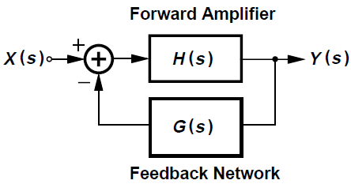
Feedback Topologies
In the above figure, X and Y can be a current or a voltage quantity
Main amplifier is called “feedforward” or simply “forward” amplifier around which feedback is applied
Four “canonical” topologies result from placing each of the four amplifier types in negative feedback

Slide 33
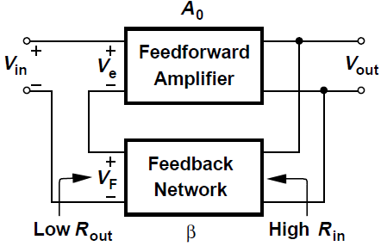
Voltage-Voltage Feedback
This topology senses the output voltage and returns the feedback signal as a voltage
Feedback network is connected in parallel with the output and in series with the input
An ideal feedback network in this case has infinite input impedance (ideal voltmeter) and zero output impedance (ideal voltage source)

Slide 34

Voltage-Voltage Feedback
Also called “series-shunt” feedback; first term refers to the input connection and second to the output connection
We can write V_{F} = βV_{out}, V_{e} = V_{in} – V_{F} , V_{out} = A₀(V_{in} - βV_{out}), and hence
βA₀ is the loop gain and the overall gain has dropped by 1+ βA₀

Slide 35
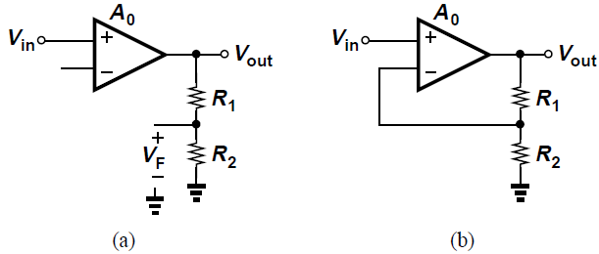
Voltage-Voltage Feedback
As an example of voltage-voltage feedback, a differential voltage amplifier with single-ended output can be used as the forward amplifier and a resistive divider as the feedback network [Fig. (a)]
The sensed voltage V_{F} is placed in series with the input to perform subtraction of voltages

Slide 36
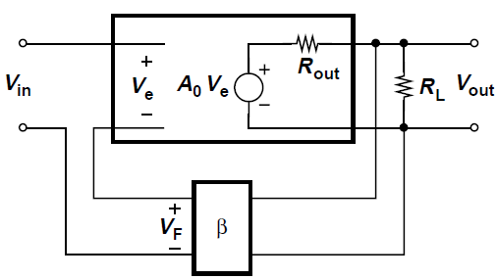
Voltage-Voltage Feedback: Output Resistance
If output is loaded by resistor R_{L}, in open-loop configuration, output decreases in proportion to R_{L}/(R_{L}+R_{out})
In closed-loop V_{out} is maintained as a constant replica of V_{in} regardless of R_{L} as long as loop gain is much greater than unity
Circuit “stabilizes” output voltage despite load variations, behaves as a voltage source and exhibits low output impedance

Slide 37
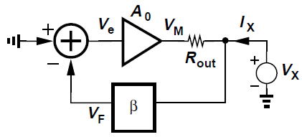

Voltage-Voltage Feedback: Output Resistance
In the above model, R_{out} represents the output impedance of the feedforward amplifier
Setting input to zero and applying a voltage at the output, we write V_{F} = βV_{X}, V_{e} = βV_{X}, V_{M} = βA₀V_{X} and hence I_{X} = [V_{X} – (–βA₀V_{X})]/R_{out} (if current drawn by feedback network is neglected)
It follows that
Output impedance and gain are lowered by same factor

Slide 38
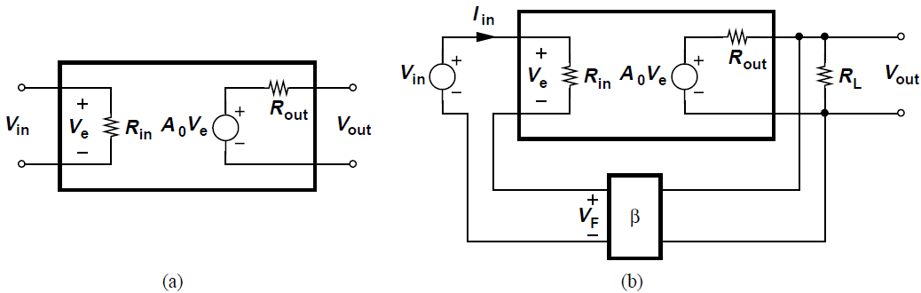
Voltage-Voltage Feedback: Input Resistance
Voltage-voltage feedback also modifies input impedance
In Fig. (a) [open-loop], R_{in} of the forward amplifier sustains the entire V_{in}, whereas only a fraction in Fig. (b) [closed-loop]
I_{in} is less in the feedback topology compared to open-loop system, suggesting increase in the input impedance

Slide 39
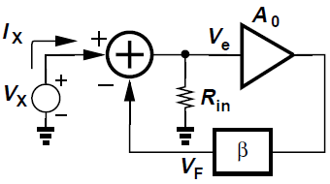

Voltage-Voltage Feedback: Input Resistance
In the above model, V_{e} = I_{X}R_{in} and V_{F} = βA₀I_{X}R_{in}
Thus, we have V_{e} = V_{X} – V_{F} = V_{X} – βA₀I_{X}R_{in}
Hence, I_{X}R_{in} = V_{X} – βA₀I_{X}R_{in} and
Input impedance increases by the factor 1+βA₀, bringing the circuit closer to an ideal voltage amplifier
Voltage-voltage feedback decreases output impedance and increases input impedance, useful as a buffer stage

Slide 40
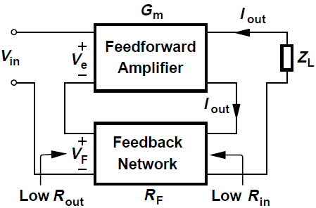
Current-Voltage Feedback
This topology senses the output current and returns a voltage as the feedback signal
The current is sensed by measuring the voltage drop across a (small) resistor placed in series with the output
Feedback factor β has the dimension of resistance and is hence denoted by R_{F}

Slide 41

Current-Voltage Feedback
A G_{m} stage must be terminated by a finite impedance to ensure it can deliver its output current
If Z_{L} = ∞, an ideal G_{m} stage would sustain an infinite output voltage
We write V_{F} = R_{F}I_{out}, V_{e} = V_{in} – R_{F}I_{out} and hence I_{out} = G_{m}(V_{in} – R_{F}I_{out})
It follows that
Ideal feedback network in this case exhibits zero input and output impedances

Slide 42
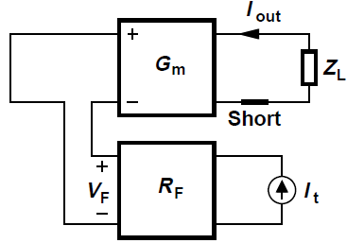
Current-Voltage Feedback: Loop Gain
To calculate the loop gain, the input is set to zero and the loop is broken by disconnecting the feedback network from the output and replacing it with a short at the output (if the feedback network is ideal)
Test signal It is injected, producing V_{F} = R_{F}I_{t} and hence I_{out} = -G_{m}R_{F}I_{t}
Thus, loop gain is G_{m}R_{F} and transconductance of the amplifier is reduced by 1+G_{m}R_{F} when feedback is applied

Slide 43
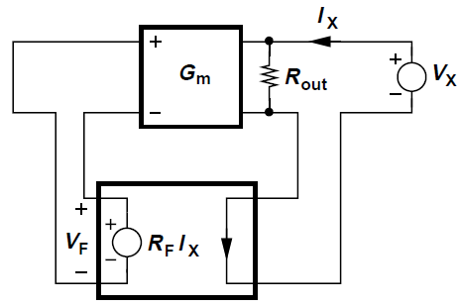
Current-Voltage Feedback: Output Resistance
Sensing the current at the output increases the output impedance
System delivers the same current waveform as the load varies, approaching an ideal current source which exhibits a high output impedance
In the above figure, R_{out} represents the finite output impedance of the feedforward amplifier
Feedback network produces V_{F} proportional to I_{X}, i.e., V_{F} = R_{F}I_{X}

Slide 44

Current-Voltage Feedback: Output Resistance
The current generated by G_{m} equals –R_{F}I_{X}G_{m}
As a result, -R_{F}I_{X}G_{m} = I_{X} – V_{X}/R_{out}, yielding
The output impedance therefore increases by a factor of 1+G_{m}R_{F}

Slide 45
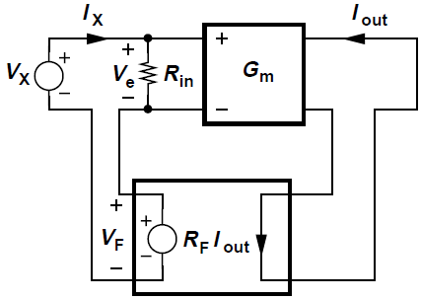
Current-Voltage Feedback: Input Resistance
Current-voltage feedback increases the input impedance by a factor of one plus the loop gain
As shown in the above figure, we have I_{X}R_{in}G_{m} = I_{out}
Thus, V_{e} = V_{X} – G_{m}R_{F}I_{X}I_{in} and
Current-voltage feedback increases both the input and output impedances while decreasing the feedforward transconductance

Slide 46
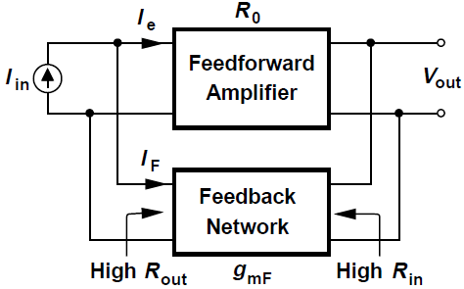
Voltage-Current Feedback
In this type of feedback, the output voltage is sensed and a proportional current is returned to the input summing point
Feedforward path incorporates a transimpedance amplifier with gain R₀ and the feedback factor g_{mF} has a dimension of conductance
Feedback network ideally exhibits infinite input and output impedances
Also called “shunt-shunt” feedback

Slide 47

Voltage-Current Feedback
Since I_{F} = g_{mF}V_{out} and I_{e} = I_{in} – I_{F}, we have V_{out} = R₀I_{e} = R₀(I_{in} – g_{mF}V_{out})
It follows that
This feedback lowers the transimpedance by a factor of one plus the loop gain

Slide 48
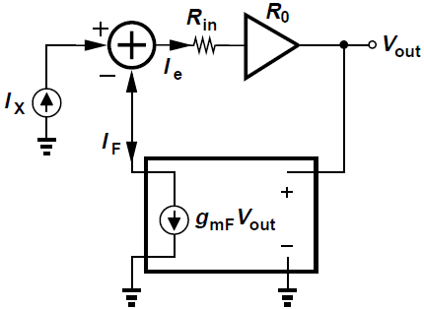

Voltage-Current Feedback: Output Impedance
Voltage-current feedback decreases the output impedance
Input resistance R_{in} of R₀ appears in series with the input port
We write I_{F} = I_{X} – V_{X}/R_{in} and (V_{X}/R_{in})R₀g_{mF} = I_{F}
Thus,

Slide 49
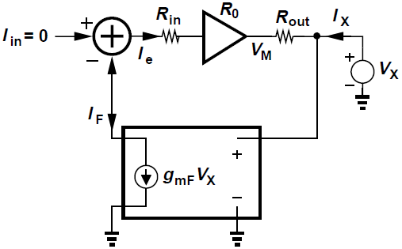

Voltage-Current Feedback: Input Impedance
Voltage-current feedback decreases the input impedance too
From the figure, we have I_{F} = V_{X}g_{mF}, I_{e} = -I_{F}, and V_{M} = -R₀g_{mF}V_{X}
Neglecting the input current of the feedback network, I_{X} = (V_{X} – V_{M})/R_{out} = (V_{X} + g_{mF}R₀V_{X})/R_{out}
Thus,

Slide 50
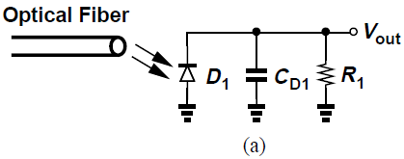
Voltage-Current Feedback: Applications
Amplifiers with low input impedance are used in fiber optic receivers, where light received through a fiber is converted to a current by a reverse-biased photodiode
This current is converted to a voltage for processing by subsequent stages
Fig. (a) show this conversion using a resistor at the cost of bandwidth due to large junction capacitance C_{D1} of the diode

Slide 51
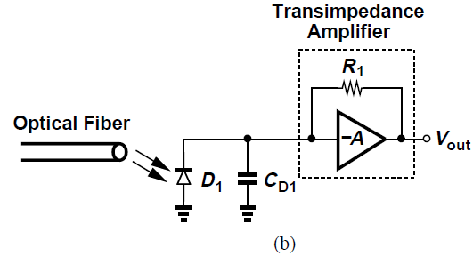
Voltage-Current Feedback: Applications
To improve performance, the feedback topology of Fig. (b) is employed, where R₁ is placed around the voltage amplifier A to form a “transimpedance amplifier” (TIA)
The input impedance is R₁/(1+A) and output voltage is approximately R₁I_{D1}
Bandwidth thus increases from 1/(2πR₁C_{D1}) to (1+A)/(2πR₁C_{D1}) if A itself is a wideband amplifier

Slide 52
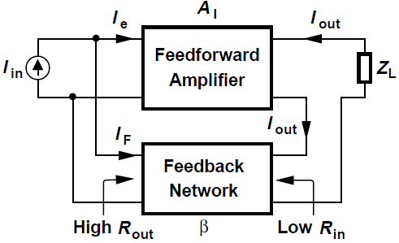
Current-Current Feedback
Output voltage is sensed and a proportional current is returned
Feedforward amplifier is characterized by a current gain A_{I} and feedback network by a current ratio β
It can be proved that the closed-loop current gain is equal to A_{I}/(1+βA_{I}), the input impedance is divided by 1+βA_{I}, and the output impedance is multiplied by 1+βA_{I}

Slide 53
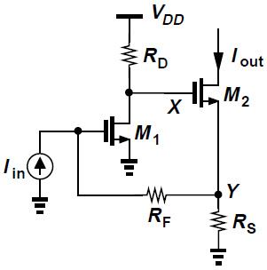
Current-Current Feedback: Example
Above figure shows an example of current-current feedback
Since the source and drain currents of M₁ are equal (at low frequencies), resistor R_{S} is inserted in the source network to monitor the output current
Resistor R_{F} senses the output voltage and returns a current to the input

Slide 54



Effect of Feedback on Noise
Feedback does not improve noise performance of circuits
In Fig. (a), the open-loop amplifier A₁ is characterized by only an input-referred noise voltage and the feedback network is assumed to be noiseless
We have (V_{in} – βV_{out} + V_{n})A₁ = V_{out}, and hence
Circuit can be modified as in Fig. (b), input-referred noise is still V_{n}

Slide 55

Effect of Feedback on Noise
Output of interest may not always be the quantity sensed by the feedback network
In above circuit, output is at the drain of M₁ whereas the feedback network senses source voltage of M₁
Here, input-referred noise of the closed-loop circuit is not equal to that of the open-loop circuit even if the feedback network is noiseless

Slide 56



Effect of Feedback on Noise
Consider only the noise of R_{D}, V_{n,RD} in this circuit
Closed-loop voltage gain of the circuit is
if λ = γ = 0
Input-referred noise voltage due to R_{D} is
Input-referred noise of the open-loop circuit is
As ,whereas

Slide 57
Feedback Analysis Difficulties
Analysis approach used proceeds as follows:
  Break the loop and obtain the open-loop gain and input and output impedances
  Determine the loop gain, βA₀ and hence the closed-loop parameters from their open-loop counterparts
  Use the loop gain to study properties such as stability, etc.
The simplifying assumptions made may not hold in all circuits
Five difficulties arising in the analysis of feedback circuits are discussed subsequently

Slide 58


Feedback Analysis Difficulties: (1)
In the non-inverting amplifier of Fig. (a) and its simple implementation in Fig. (b), the feedback branch consisting of R₁ and R₂ may draw significant signal current from the output, reducing its open-loop gain
In the circuit of Fig. (c), the open-loop gain of the forward CS stage falls if R_{F} is not very large
In all cases, the “output” loading results from non-ideal input impedance of the feedback network

Slide 59

Feedback Analysis Difficulties: (1)
In the circuit of Fig. (d), R₁ and R₂ sense V_{out} and return a voltage to the source of M₁
Since the output impedance of the feedback network may not be sufficiently small, we surmise that M₁ is degenerated considerably even as far as the open-loop forward amplifier is concerned
This is a case of “input loading” due to non-ideal output impedance of the feedback network

Slide 60

Feedback Analysis Difficulties: (2)
Some circuits cannot be clearly decomposed into a forward amplifier and a feedback network
In the above two-stage network, it is unclear whether R_{D2} belongs to the feedforward amplifier or the feedback network
The former may be chosen, reasoning that M₂ needs a load to operate as a voltage amplifier, although this choice is arbitrary

Slide 61

Feedback Analysis Difficulties: (3)
Some circuits do not readily map to the four canonical topologies
A simple degenerated CS stage does not contain feedback because the source resistance measures the drain current, converts it to a voltage, and subtracts the result from the input [Fig. (a)]
It is not immediately clear which feedback topology represents this arrangement because the sensed quantity, I_{D1} is different from the output of interest, V_{out} [Fig. (b)]

Slide 62

Feedback Analysis Difficulties: (4)
General feedback system thus far assumes unilateral stages, i.e., signal propagation in only one direction around the loop
In practice, the loop may contain bilateral circuits, allowing signals to flow from the input, through the feedback network, to the output
In the circuit below, the input travels through R_{F} and alters V_{out}

Slide 63

Feedback Analysis Difficulties: (5)
Some circuits contain multiple feedback mechanisms (loosely called “multiloop circuits”)
In the topology below, for example, R_{F} provides feedback around the circuit, and C_{GS2} around M₂
It might be said that the source follower itself contains degeneration and hence feedback
It is not exactly clear which loop should be broken and the meaning of “loop gain”

Slide 64

Feedback Analysis Difficulties: Summary
The five difficulties in the analysis of feedback circuits are summarized below

Slide 65

Feedback Analysis Methods
We introduce two methods of feedback circuit analysis
  Two-port method
  Bode’s method
The details of the two methods are outlined below

Slide 66


Review of Two-Port Network Models
A two-port linear (and time-invariant) network can be represented by any one of four two-port network models
The “Z model” in Fig. (a) consists of input and output impedances in series with current-dependent voltage sources
The Z model is described by two equations
Each Z parameter has a dimension of impedance and is obtained by leaving one port open, e.g., Z₁₁ = V₁/I₁ when I₂ = 0

Slide 67


Review of Two-Port Network Models
The “Y model” in Fig. (b) comprises input and output admittances in parallel with voltage-dependent current sources
The Y model is described by
Each Y parameter is calculated by shorting one port, e.g., Y₁₁ = I₁/V₁ when V₂ = 0

Slide 68


Review of Two-Port Network Models
The “H model” in Fig. (c) incorporates a combination of impedances and admittances and voltage and current sources
The H model is described by

Slide 69


Review of Two-Port Network Models
The “G model” in Fig. (d) is also a “hybrid model” and is characterized by a combination of impedances and admittances and voltage and current sources
The G model is described by

Slide 70

Loading in Voltage-Voltage Feedback
The Z and H models fail to represent voltage amplifiers if the input current is very small – as in a simple CS stage, therefore the G model is chosen
Fig. (a) shows the complete equivalent circuit, with the forward and feedback network parameters denoted by upper-case and lower-case letters, respectively

Slide 71

Loading in Voltage-Voltage Feedback
The analysis is simplified by neglecting two quantities:
  The amplifier’s internal feedback, G₁₂V_{out}
  The “forward” propagation of the input signal through the feedback network, g₁₂I_{in}
The loop is “unilateralized”
Fig. (b) shows the resulting circuit with intuitive amplifier notations

Slide 72

Loading in Voltage-Voltage Feedback
The closed-loop voltage gain is directly computed recognizing that g₁₁ is an admittance and g₂₂ is an impedance, and by writing a KVL around the input network and a KCL at the output node

Slide 73



Loading in Voltage-Voltage Feedback
Eliminating V_{e},
Expressing this in the form of ,

Slide 74


Loading in Voltage-Voltage Feedback
We can thus write,
The equivalent open-loop gain contains a factor A0, i.e., the original amplifier’s voltage gain (before immersion in feedback)
This gain is attenuated by two factors, and ssss

Slide 75

Loading in Voltage-Voltage Feedback
The loaded forward amplifier is as shown below, excluding the two generators G₁₂V_{out} and g₁₂I_{in}
Allows a quick and intuitive understanding not possible from direct analysis
The finite input and output impedances of the feedback network reduce the output voltage and the voltage seen at the input of the main amplifier respectively

Slide 76



Loading in Voltage-Voltage Feedback
g₁₁ and g₂₂ are computed as follows:
As shown below, g₁₁ is obtained by leaving the output of the feedback network open whereas g₂₂ is calculated by shorting the input of the feedback network
Loop gain is simply the loaded open-loop gain multiplied by g₂₁
Open-loop input and output impedances are scaled by to yield closed-loop values

Slide 77

Loading in Current-Voltage Feedback
In this case, the feedback network appears in series with the output to sense the current
Forward amplifier and feedback network are represented by Y and Z models respectively, neglecting the generators Y₁₂V_{out} and z₁₂I_{in}, as shown below:

Slide 78

Loading in Current-Voltage Feedback
To compute the closed-loop gain I_{out}/V_{in}, and obtain open-loop parameters in the presence of loading, we note that I_{in} = Y₁₁V_{e} and I₂ = I_{in} and write two KVLs:

Slide 79


Loading in Current-Voltage Feedback
Eliminating V_{e}, we get
The loaded open-loop gain and feedback factor can be seen to be

Slide 80



Loading in Current-Voltage Feedback
Y₂₁, the transconductance gain of the original amplifier is attenuated by and , which respectively correspond to voltage division at the input and current division at the output
The loaded open-loop amplifier can be pictured as below

Slide 81

Loading in Current-Voltage Feedback
Since z₂₂ = V₂/I₂ with I₁ = 0 and z₁₁ = V₁/I₁ with I₂ = 0, the conceptual picture below shows how to properly break the feedback
The loop gain is z₂₁G_{m,open}

Slide 82

Loading in Voltage-Current Feedback
In this configuration, the forward (transimpedance) amplifier generates an output voltage in response to the input current and can thus be represented by a Z model
Feedback network lends itself to a Y model since it senses the output voltage and returns a proportional current
The equivalent circuit below ignores the effect of Z₁₂ and y₁₂

Slide 83


Loading in Voltage-Current Feedback
We compute the closed-loop gain, V_{out}/I_{in}, by writing two equations
Eliminating I_{e}, we get

Slide 84


Loading in Voltage-Current Feedback
Thus, the equivalent open-loop gain and feedback factor are given by
Interpreting the attenuation factors in R_{0,open} as current division at the input and voltage division at the output, we arrive at the conceptual view shown below
The loop gain is given by y₂₁R_{0,open}

Slide 85

Loading in Current-Current Feedback
The forward amplifier in this case generates an output current in response to the input current and can be represented by an H model and so can the feedback network
The equivalent circuit with the H₁₂ and h₁₂ generators is shown below

Slide 86


Loading in Current-Current Feedback
We can write
Eliminating I_{e}, we get the closed-loop gain I_{out}/I_{in}

Slide 87


Loading in Current-Current Feedback
As with previous topologies, we define the equivalent open-loop current gain and the feedback factor as
The conceptual view of the broken loop is shown below
The loop gain is equal to h₂₁A_{I,open}

Slide 88

Summary of Loading Effects
Figs. (a) – (d) summarize the loading effects in all four topologies

Slide 89
Summary of Loading Effects
The analysis of loading is carried out in three steps:
  Open the loop with proper loading and calculate the open-loop gain, A_{OL}, and the open-loop input and output impedances
  Determine the feedback ratio β, and hence the loop gain, βA_{OL}
  Calculate the closed-loop gain and input and output impedances by scaling the open-loop values by a factor of 1+βA_{OL}
In the equations defining β, the subscripts 1 and 2 refer to the input and output ports of the feedback network, respectively

Slide 90

Bode’s Analysis of Feedback Circuits: Observations
Consider the general circuit in Fig. (a), where one transistor is explicitly shown in its ideal form
From previous analysis, V_{out} can eventually be expressed as A_{v}V_{in} or H(s)V_{in}
If the dependent current source is denoted by I₁ and we do not make the substitution I₁ = g_{m}V₁, then V_{out} is obtained as a function of both V_{in} and I₁:

Slide 91



Bode’s Analysis of Feedback Circuits: Observations
As an example, in the degenerated CS stage of Fig. (b), we note that the current flowing upward through R_{D} (and downward through R_{S}) is –V_{out}/R_{D} and hence the voltage drop across r_{O} is (-V_{out}/R_{D} – I₁)r_{O}
KVL around the output network gives
In this case, and

Slide 92



Bode’s Analysis of Feedback Circuits: Observations
Next, consider V₁ as the signal of interest, i.e., we wish to compute V₁ as a function of V_{in} in the form of A_{v}V_{in} or H(s)V_{in}
We can pretend that V₁ is the “output”, as in Fig. (c)
In a similar manner, V₁ can be written, if we temporarily forget that I₁ = g_{m}V₁, as
KVL around the output network gives
Hence, and

Slide 93


Interpretation of Coefficients
A is given by
A is obtained as the voltage gain of the circuit if the dependent current source is set to zero, by setting g_{m} = 0
V_{out} in this case can be considered the “feedthrough” of the input signal (in the absence of the ideal transistor) [Fig. (a)]
In the CS example, V_{out} = 0 if I₁ = 0 because no current flows through R_{S}, r_{O}, and R_{D}, i.e., A = 0

Slide 94




Interpretation of Coefficients
As for the B coefficient, we have
We set the input to zero and compute V_{out} as a result of I₁ [Fig. (b)], pretending that I₁ is an independent source
In the CS example,
Thus,

Slide 95


Interpretation of Coefficients
The C coefficient is interpreted as
This is the transfer function from the input to V₁ with the transistor’s g_{m} set to zero [Fig. (c)]
In the CS circuit, no current flows through R_{S} under this condition, yielding V₁ = V_{in} and C = 1

Slide 96




Interpretation of Coefficients
Lastly, the D coefficient is obtained as
As shown in Fig. (d), this represents the transfer function from I₁ to V₁ with the input at zero
In the CS example, under the above condition,
Hence,

Slide 97

Interpretation of Coefficients: Summary
In summary, the A-D coefficients are computed as shown in Figs. (a) and (b)
We disable the transistor by setting its g_{m} to zero and obtain A and C as feedthroughs from V_{in} to V_{out} and to V₁ respectively
We set the input to zero and calculate B and D as the gain from I₁ to V_{out} and to V₁ respectively
The former step finds responses to V_{in} with g_{m} = 0 and the latter to I₁ with V_{in} = 0

Slide 98





Bode’s Analysis
V_{out}/V_{in} is expressed in terms of A-D coefficients
Since
and in the actual circuit, , we have
The closed-loop gain is therefore equal to
The first term represents the input-output feedthrough when g_{m} = 0
We can also write

Slide 99
Bode’s Analysis: Observations
If A = 0, then closed-loop gain equation yields V_{out}/V_{in} = g_{m}BC/(1-g_{m}D), which resembles the generic feedback equation A₀/(1+βA₀)
g_{m}BC is loosely called the “open-loop” gain

Slide 100
Bode’s Analysis: Return Ratio and Loop Gain
The closed-loop gain expression above may suggest that 1 – g_{m}D = 1 + loop gain and hence loop gain = - g_{m}D
In both cases, we set the main input to zero, break the loop by replacing the dependent source with an independent one, and compute the returned quantity
In Bode’s original treatment, the term “return ratio” (RR) is used to refer to – g_{m}D and is ascribed to a given dependent source in the circuit
RR appears to be the same as the true loop gain even if the loop cannot be completely broken
RR is equal to the loop gain if the circuit contains only one feedback mechanism and the loop traverses the transistor of interest

Slide 101

Blackman’s Impedance Theorem
Blackman’s theorem determines the impedance seen at any port of a general circuit
  Can be proved using Bode’s approach
In the general circuit of Fig. (a), the impedance between nodes P and Q is of interest
One of the transistors is explicitly shown by the voltage-dependent current source I₁

Slide 102


Blackman’s Impedance Theorem
Let us pretend that I_{in} is the input signal and V_{in} the output signal so that we can utilize Bode’s results:
It follows that
where g_{m} denotes the transconductance of the transistor modeled in Fig. (a)

Slide 103



Blackman’s Impedance Theorem
Recognizing that V₁/I₁ = D if I_{in} = 0, we call – g_{m}D the “open-circuit loop gain” (because the port of interest is left open) and denote it by T_{oc} [Fig. (b)]
If V_{in} = 0, then I_{in} = (- B/A)I₁ and hence
We call – g_{m} times this quantity the “short-circuit” loop gain (because V_{in} = 0) and denote it by T_{sc} [Fig. (c)]

Slide 104






Blackman’s Impedance Theorem
Both T_{oc} and T_{sc} can be viewed as return ratios associated with I₁ for two circuit topologies
In the third step, we use T_{oc} and T_{sc} to rewrite
A can be roughly viewed as the “open-loop” impedance without the transistor in the feedback loop
In addition, if then and if sssss , then
Closed-loop impedance cannot be expressed as Z_{in} multiplied or divided by (1 + loop gain)

Slide 105
Loop Gain Calculation Issues
Loop gain plays a central role in feedback systems
If poles and zeros in the loop are considered, then the loop gain [called “loop transmission” T(s) in this case] reveals circuit’s stability properties
Loop gain calculation proceeds as
  Break the loop at some point, apply a test signal, follow it around the loop (in the proper direction), and obtain the returned signal
This elicits two questions:
  Can the loop be broken at any arbitrary point?
  Should the test signal be a voltage or current?
In such a test, the actual input and output disappear

Slide 106

Loop Gain Calculation Issues
In the two-stage amplifier of Fig. (a), resistive divider consisting of R₁ and R₂ senses output voltage and returns a fraction to source of M₁
As shown in Fig. (b), we set V_{in} to zero, break the loop at node X, apply a test signal to the right terminal of R₁ and measure the resulting V_{F}
In circuit of Fig. (a), R₁ draws an ac current from R_{D2} but in Fig. (b), it does not
Gain of second CS stage has been altered

Slide 107
Loop Gain Calculation Issues
It is best to break the loop at the gate of a MOSFET
We can break the loop at the gate of M₂ [Fig. (c)] and thus not alter the gain associated with first stage at low frequencies

Slide 108

Loop Gain Calculation Issues
To include C_{GS} of M₂ [Fig. (a)], we break the loop after C_{GS2} [Fig. (b)] to ensure that the load seen by M₁ remains unchanged
It is always possible to break the loop at the gate of a MOSFET
For the feedback to be negative, the signal must be sensed by at least one gate in the loop because only the common-source topology inverts signals

Slide 109

Loop Gain Calculation Issues
Can we apply a test current instead of a test voltage?
We can break the loop at the drain of M₂, inject a current I_{t}, and measure the current returned by M₂ [Fig. (a)]
If drain of M₂ is tied to ac ground, this node does not experience voltage excursions as in closed-loop circuit – when r_{O2} is taken into account
In general, cannot inject I_{t} without altering some aspects of the circuit

Slide 110
Loop Gain Calculation Issues
If controlled current source of M₂ is replaced with an independent current source It, and compute the returned V_{GS} as V_{F} [Fig. (b)]
Since in the original circuit, the dependent source and V_{GS2} were related by a factor of g_{m2}, the loop gain can be written as (- V_{F}/I_{t}) X g_{m2}
This approach is feasible even if M₂ is degenerated
This result is the same as return ratio of M₂

Slide 111
Loop Gain Calculation Issues
In summary, the “best” place to break a feedback loop is
  The gate-source of a MOSFET if voltage injection is desired
  The dependent current source of a MOSFET if current injection is desired (provided that the returned quantity is VGS of the MOSFET)
These two methods are related because they differ only by a factor of g_{m}

Slide 112

Loop Gain Calculation Issues
If we include C_{GD2} in previous circuit and inject a test voltage or current, C_{GD2} does not allow a “clean break”
As shown below, even though gate-source voltage is provided by the independent source V_{t}, C_{GD2} creates “local” feedback from the drain of M₂ to its gate, raising the question whether loop gain should be obtained by nulling all feedback mechanisms

Slide 113

Difficulties with Return Ratio
We may view the return ratio associated with a given dependent source as the loop gain
Circuits containing more than one feedback mechanism exhibit different return ratios for different ratios
In circuit of Fig. (a) below, R₁ and R₂ provide both “global” and “local” feedback (by degenerating M₁)

Slide 114



Difficulties with Return Ratio
Using equivalent circuits of Figs. (a) and (b), it can be shown that return ratios for M₁ and M₂ are given by
Different return ratios obtained because disabling M₁ removes both feedback mechanisms while disabling M₂ still retains degeneration experienced by M₁

Slide 115


Difficulties with Return Ratio
Another method of loop gain calculation is to inject a signal without breaking the loop as shown in figure below and write Y/W = 1/(1 + βA₀) and hence
This method assumes a unilateral loop, yielding different loop gains for different injection points if the loop is not unilateral

Slide 116



Difficulties with Return Ratio
As an example, above circuit can be excited as in Figs. (a) or (b), producing different values for

Slide 117

Alternative Interpretations of Bode’s Method
Asymptotic Gain Form:
From Bode’s results, and (the dependent source is disabled) and (the dependent source is “very strong”)
We denote these values of V_{out}/V_{in} by H₀ and H∞ respectively, and –g_{m}D by T
H₀ can be considered as the direct feedthrough and H∞ as the “ideal gain”. i.e., if the dependent source were infinitely strong (or if the loop gain were infinite)
It follows that

Slide 118

Alternative Interpretations of Bode’s Method
Asymptotic Gain Form (contd.):
Since we have,
Called the “asymptotic gain equation”, this form reveals that the gain consists of an ideal value multiplied by T/(1 + T) and a direct feedthrough multiplied by 1/(1 + T)
Calculations are simpler here if we recognize from ssss that
This is similar to how a virtual ground is created if the loop gain is large

Slide 119
Alternative Interpretations of Bode’s Method
Double Null Method:
From Blackman’s Impedance Theorem, we recognize that [refer Fig. (a)]
  T_{oc} is the return ratio with I_{in} = 0, i.e., T_{oc} denotes the RR with the input set to zero
  T_{sc} is the RR with V_{in} = 0, i.e., T_{sc} represents the RR with the output forced to zero

Slide 120


Alternative Interpretations of Bode’s Method
Double Null Method (contd.):
Making a slight change in our notation, we postulate that the transfer function of a given circuit can be written as
Where A = V_{out}/V_{in} with the dependent source set to zero, and Tout,0 and Tin,0 respectively denote the return ratios for V_{out} = 0 and V_{in} = 0

Slide 121


Alternative Interpretations of Bode’s Method
Double Null Method (proof):
Beginning from
We observe that if
On the other hand, if
Combining these results yields
Division by A in these calculations assumes A ≠ 0

