Slide 1
Chapter 15: Oscillators
15.1 General Considerations
15.2 Ring Oscillators
15.3 LC Oscillators
15.4 Voltage-Controlled Oscillators
15.5 Mathematical Model of VCOs

Slide 2
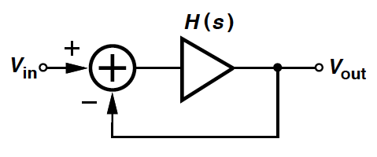
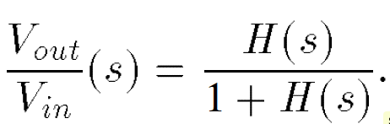
Oscillatory Feedback System
Consider a unity-gain negative feedback circuit:
Recall: Negative feedback systems may oscillate.
If for s = jω₀, H(jω₀) = -1 ➔ close-loop gain -> ∞ at ω₀
➔ its own noise components amplified at ω₀ indefinitely.

Slide 3
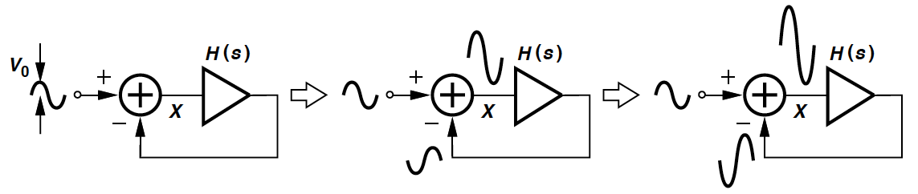

Evolution of Oscillatory System with Time
A noise component at jω₀
- experiences unity gain & a phase shift = 180°.
- returns as a negative replica of the input.
- a larger difference obtained -> continues to grow.
Over many cycles,
- If |H(jω₀)| > 1, the summation diverges.
- If |H(jω₀)| < 1,

Slide 4
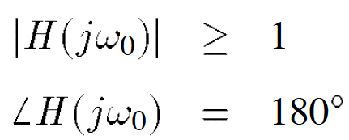
Barkhausen Criteria
A negative-feedback circuit may oscillate at ω₀ if it satisfies:
“Barkhausen criteria.” (necessary but not sufficient.)
May state 2nd criterion as a total phase shift of 360°.
Loop gain typically chosen to be at least 2 or 3 times the required value.

Slide 5
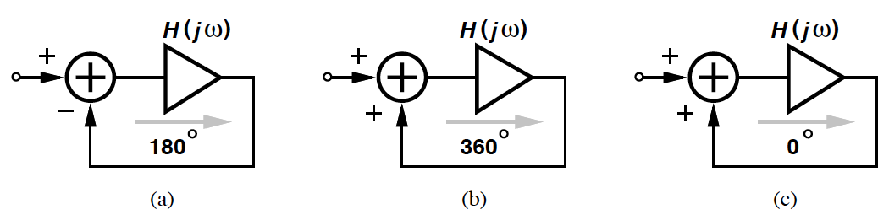
2nd Barkhausen Criterion
Equivalent in terms of the second Barkhausen criterion:
(a): Frequency-dependent phase shift = 180° (arrow), dc phase shift = 180°.
(b): Total phase shift at ω₀ = 360°.
(c): No phase shift at ω₀ is provided.

Slide 6
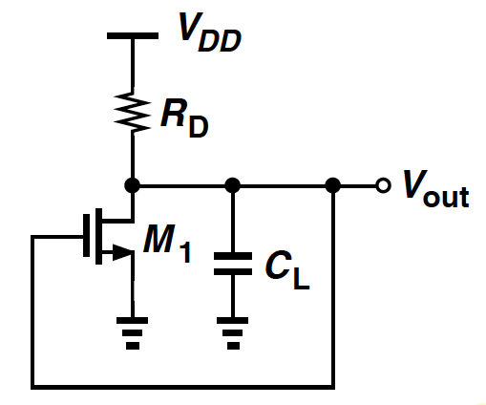
Example 15.1
Explain why a single common-source stage does not oscillate if it is placed in a unity-gain loop?
Solution
Open-loop circuit of a single CS stage contains only one pole.
Maximum frequency-dependent phase shift = 90° (at a frequency of infinity).
DC phase shift = 180°.
Maximum total phase shift = 270° (<360°).
➔ Fail to sustain oscillation growth.

Slide 7
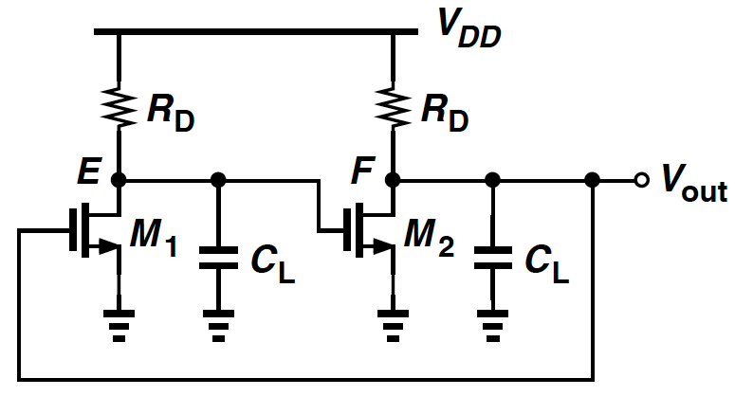
Two-Pole Feedback System
Two significant poles appear in the signal path ➔ frequency-dependent phase shift can approach 180°.
Signal inversion through each common-source stage ➔ positive feedback!
It simply “latches up” rather than oscillates.

Slide 8
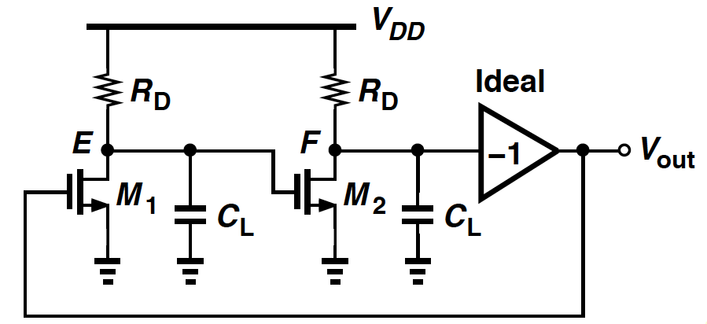
Additional Signal Inversion
This provides negative feedback near zero frequency & eliminates “latch-up”.
Two poles: One at E and another at F.
Does this circuit oscillate?

Slide 9
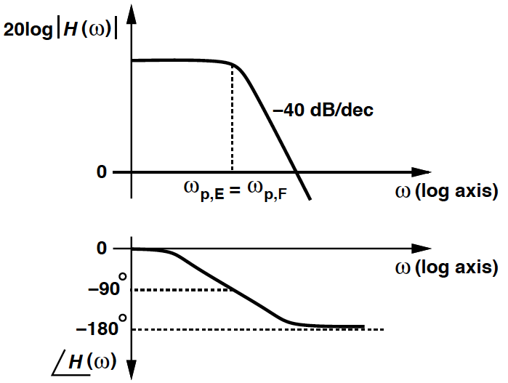
Two-Pole System: Loop Gain Characteristics
Frequency-dependent phase shift reaches 180° but at ω = infinity.
Loop gain vanishes at very high frequencies ➔ the circuit (Slide 8) does not satisfy both Barkhausen criteria at the same frequency.
It fails to oscillate!

Slide 10
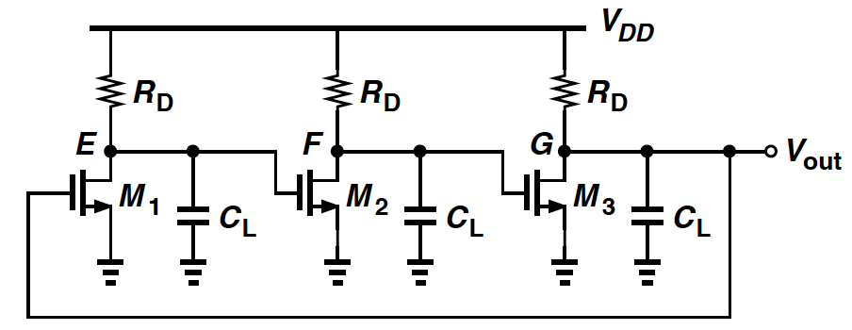
Three-Stage Ring Oscillator
If three stages are identical, total phase shift around the loop (ϕ) = -135° at ω = ω_{p,E}(= ω_{p,F} = ω_{p,G}) and -270° at ω = ∞.
ϕ = 180° at ω < ∞, where the loop gain can be still ≥ 1.

Slide 11
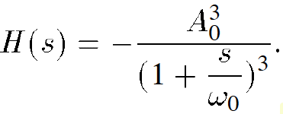
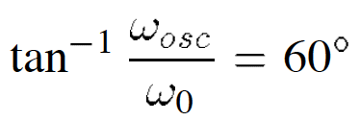

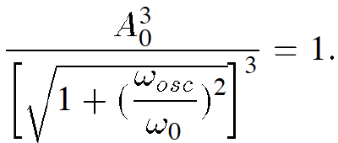

Minimum Voltage Gain Per Stage
For the three-stage ring oscillator, denote the transfer function of each stage by –A₀/(1+s/ω₀) and the loop gain is:
The circuit oscillates if each stage contributes 60°:
➔
Minimum voltage gain per stage (A₀) is such that the magnitude of the loop gain at ω_{OSC} is unity:
➔

Slide 12
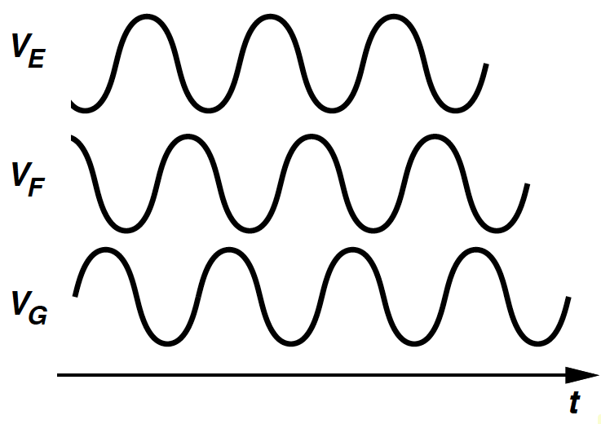
Waveforms of Three-Stage Ring Oscillator
Each stage contributes a frequency-dependent shift of 60° and a dc signal inversion.
Thus the waveform at each node is 240° (or 120°) out of phase with respect to its neighboring nodes.

Slide 13
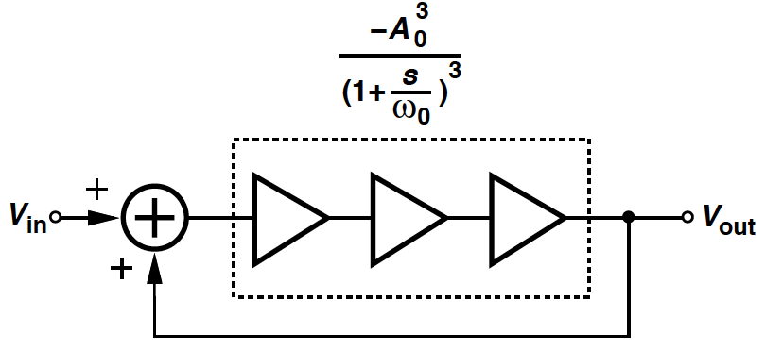
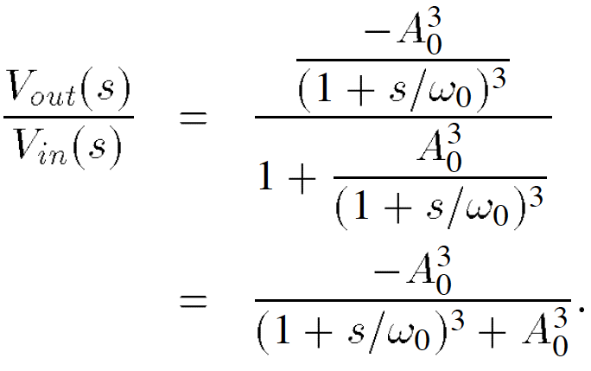

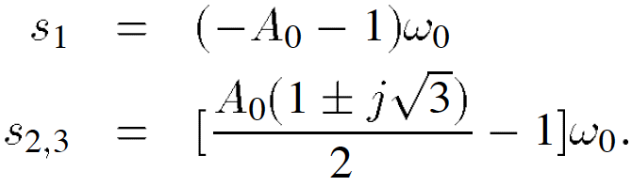
Linear Model of Three-Stage Oscillator
The close-loop transfer function of the linear feedback model is:
Expand the denominator as:
➔ 3 Poles:

Slide 14
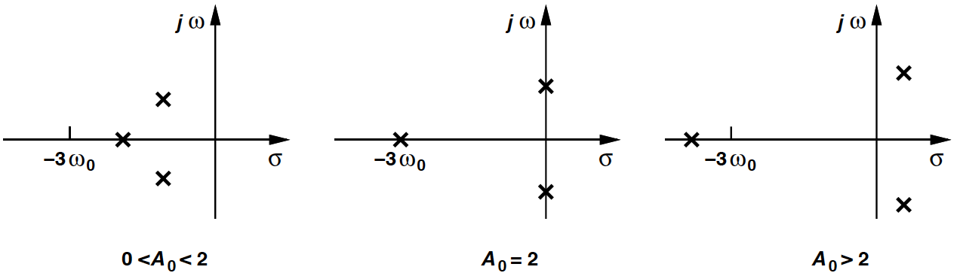

Poles of Three-Stage Ring Oscillator
For A₀ > 2, the two complex poles exhibit a positive real part, which give rise to a growing sinusoid.
Express the output waveform as: (neglect effect of s₁.)
➔ The exponential envelope grows to infinity if A₀ > 2.

Slide 15
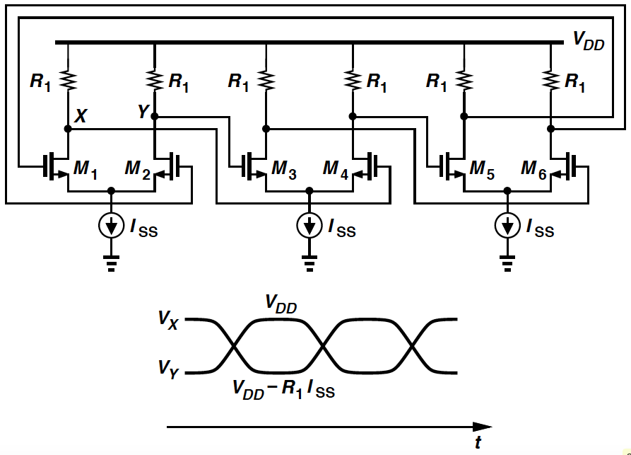
Example 15.2
For a differential implementation of the three-stage ring oscillator, what is the maximum voltage swing of each stage?
Solution
If the gain per stage is well above 2, the amplitude grows until each differential pair experiences complete switching.
The swing at each node is equal to I_{SS}R₁.
As shown in the waveforms, each stage is in its high-gain region for only a fraction of the period.

Slide 16
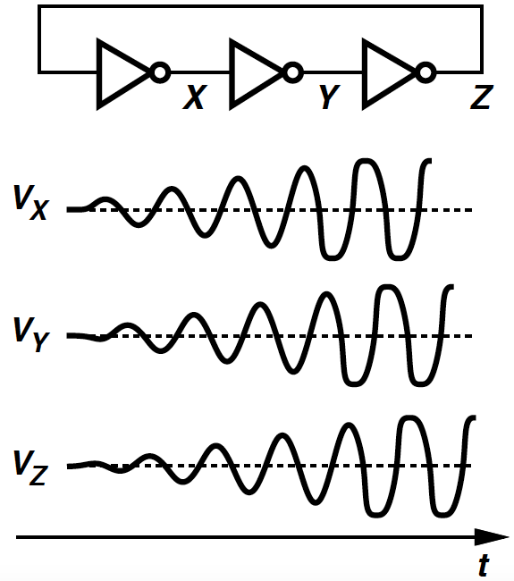
Ring Oscillator Using CMOS Invertors (I)
The circuit is released with an initial voltage at each node = V_{trip}.
Noise components disturb each node voltage, yielding a growing waveform.
The signal eventually exhibits rail-to-rail swings.

Slide 17
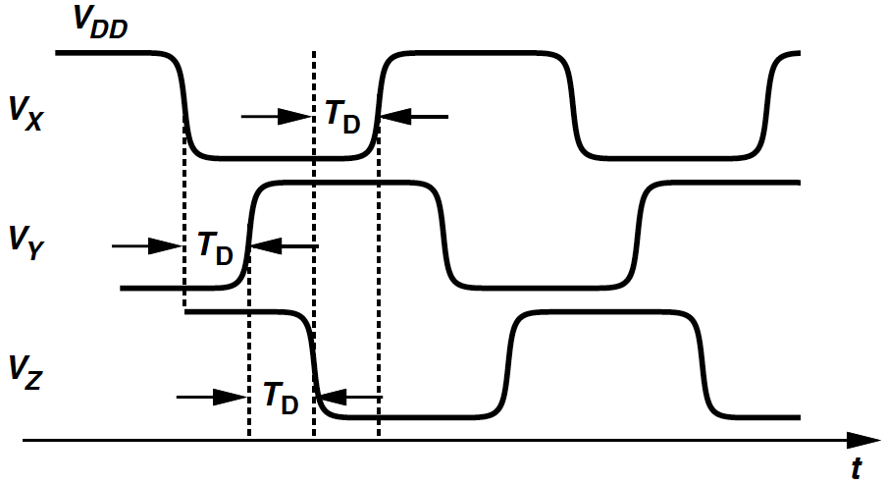
Ring Oscillator Using CMOS Invertors (II)
Begin with V_{X} = V_{DD} ➔ V_{Y} = 0, V_{Z} = V_{DD}.
V_{X} begins to fall to zero when the circuit is released
➔ forces V_{Y} to rise to V_{DD} after one T_{D,} and V_{Z} to fall to zero after another T_{D}.
Oscillate with a delay of T_{D} between consecutive node voltages ➔ period = 6T_{D}.

Slide 18
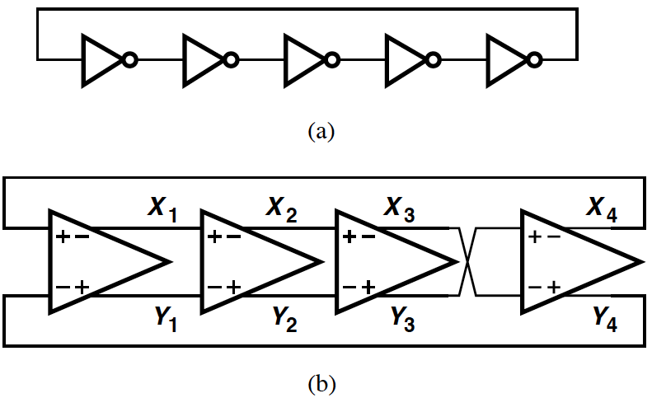
Ring Oscillators: More Than Three Stages
Total number of inversions in the loop must be odd to prevent “latch-up”.
(a): a ring incorporates five inverters ➔ frequency = 1/(10T_{D}).
(b): The differential implementation can utilize an even number of stages by configuring one stage such that it does not invert.

Slide 19
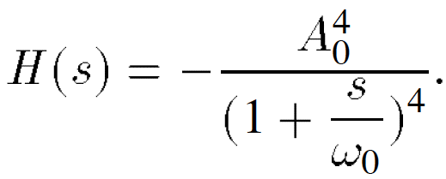
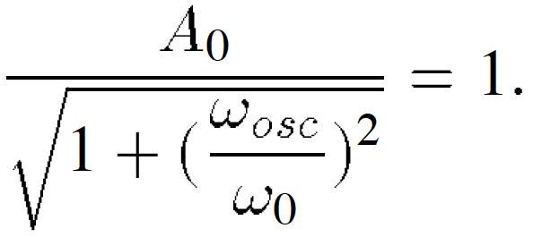

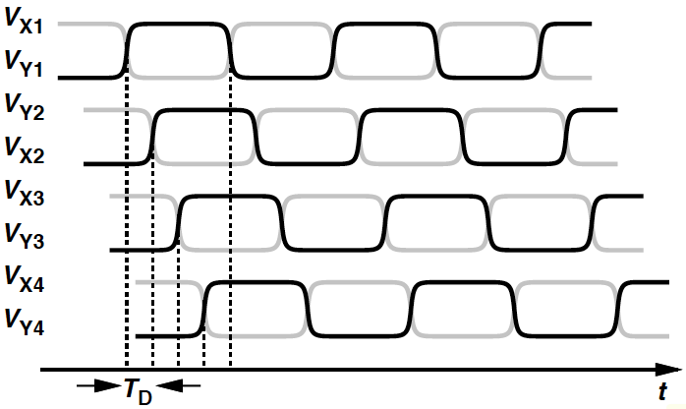
Example 15.3
What is the minimum required voltage gain per stage in circuit (b) (Slide 18)? How many signal phases are provided by the circuit?
Solution
Using similar notation as before, we have:
For the circuit to oscillate, each stage must contribute a frequency-dependent phase shift of 180°/4 = 45°.
tan⁻¹ω_{osc}/ω₀ = 45° ➔ ω_{osc} = ω₀ ➔
➔ minimum voltage gain:
The oscillator provides four
phases and their complements,
as illustrated in the figure.

Slide 20
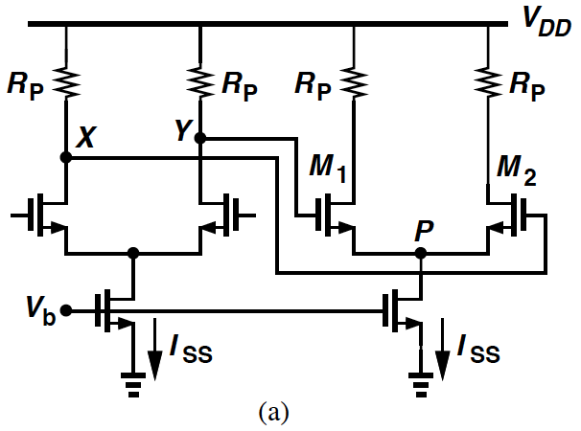
Example 15.4 (I)
Determine the maximum voltage swings and minimum supply voltage of a ring oscillator incorporating differential pairs with resistive loads if no transistor must enter the triode region.
Solution
In (a), complete switching ➔ V_{X} or V_{Y} varies between V_{DD} and V_{DD} – I_{SS}R_{P}.
M₁ fully on: Its gate and drain voltages are equal to V_{DD} and V_{DD} – I_{SS}R_{P}, respectively.
To remain in saturation, I_{SS}R_{P} ≤ V_{TH}.
The peak-to-peak at each swing at each drain must not exceed V_{TH}.

Slide 21
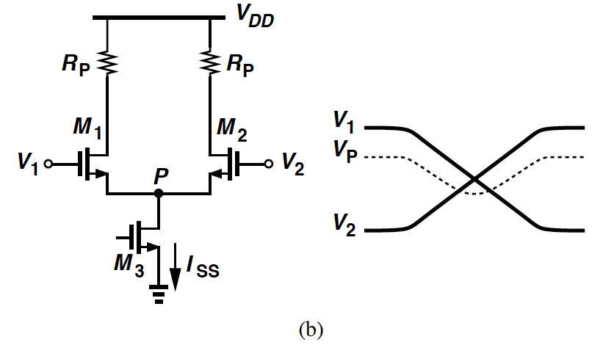
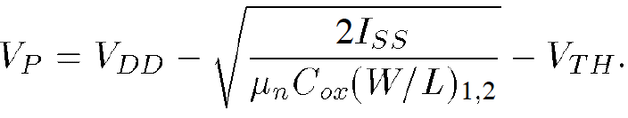

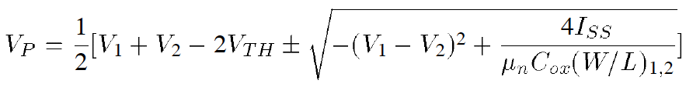
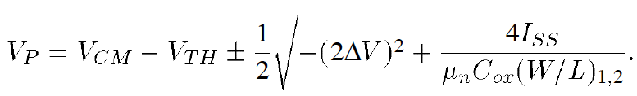
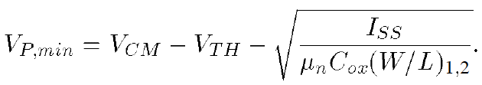
Example 15.4 (II)
In (b), assume the inputs vary between V_{DD} and V_{DD} – I_{SS}R_{P}.
When V₁ is equal to V_{DD} and M₁ carries all of I_{SS}, we have:
When the difference between V₁ and V₂ reaches , M₂ turns on. Calculate V_{P} after this point:
 ➔
 ➔
If V₁ = V_{CM} + ΔV and V₂ = V_{CM} – ΔV, where V_{CM} = V_{DD} – I_{SS}R_{P}/2,
➔                ➔
                      

Slide 22
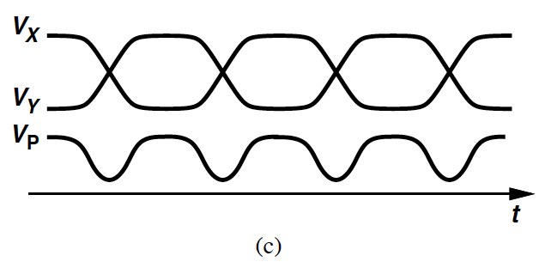
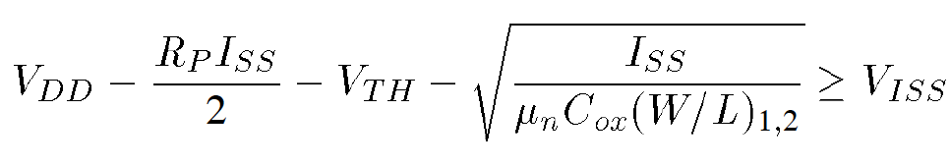
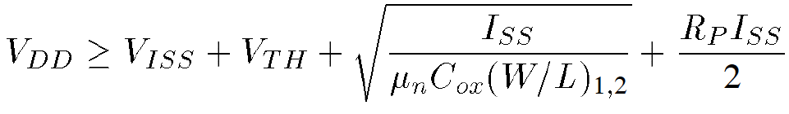
Example 15.4 (III)
(c) shows typical waveforms in the oscillator.
V_{P} varies at twice the oscillation frequency.
Write V_{P,min} ≥ V_{ISS}, where V_{ISS} denotes the minimum required voltage across I_{SS}. Thus,
and

Slide 23
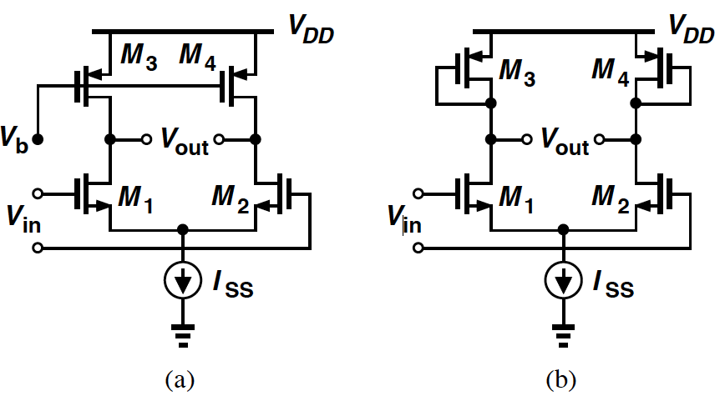
Differential Stage Using PMOS Loads (I)
(a): A PMOS transistor operating in the deep triode region can serve as the load.
(b): Diode-connected load, at the cost of one threshold voltage in the headroom.

Slide 24
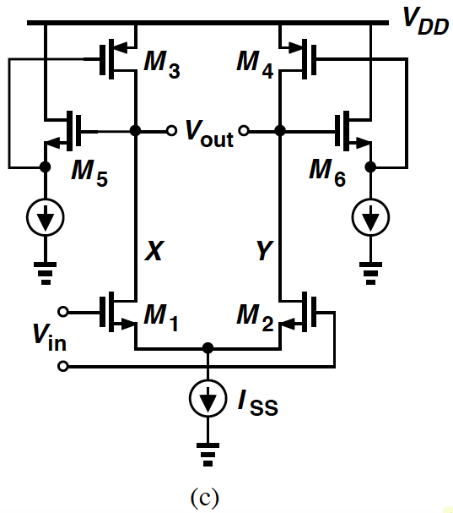
Differential Stage Using PMOS Loads (II)
(c): A more efficient load where NMOS source followers are inserted.
M₃ & M₄ consume only a voltage headroom = |V_{DS3,4}|.
If V_{GS5} ≈ V_{TH3} ➔ M₃ operates at the edge of triode region and the small-signal resistance of the load ≈ 1/g_{m3}.
Gate-source capacitance of M₃ driven by the source follower ➔ time constant associated with the load is smaller than that of a diode-connected transistor.

Slide 25
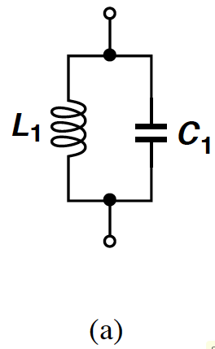

Ideal LC Tank
(a): L₁ in parallel with C₁ (ideal LC tank), resonates at .
At ω_{res}, impedances jL₁ω_{res} and 1/(jC₁ω_{res}) are equal and opposite, ➔ infinite impedance ➔ infinite quality factor, Q.

Slide 26
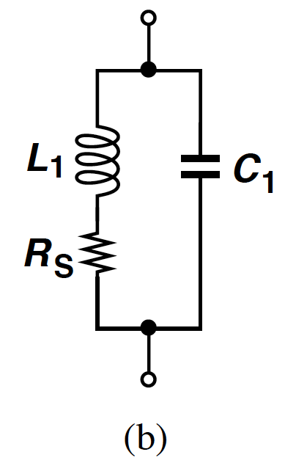
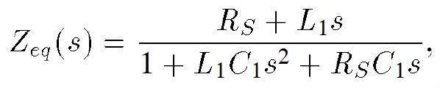
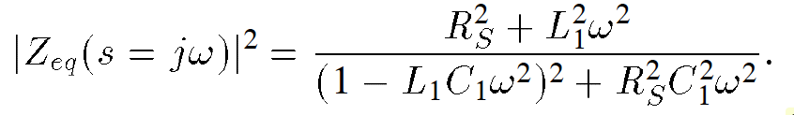
Realistic LC Tank
In practice, inductors (and capacitors) suffer from resistive components.
Series resistance of the metal wire used in the inductor can be modeled as (b).
Define Q of the inductor as L₁ω/R_{S}.
The equivalent impedance is:
➔
Impedance never goes to infinity. The circuit has a finite Q.

Slide 27
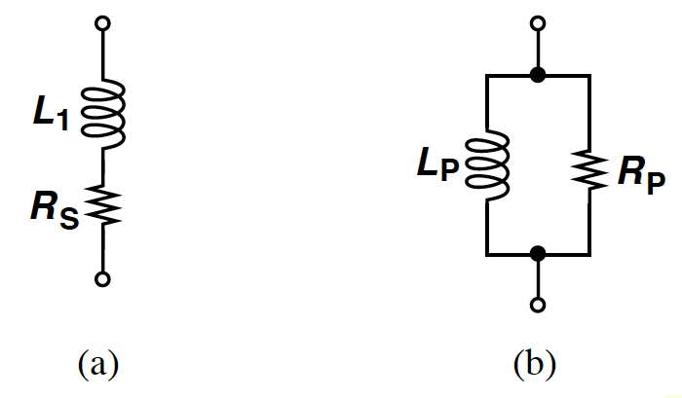
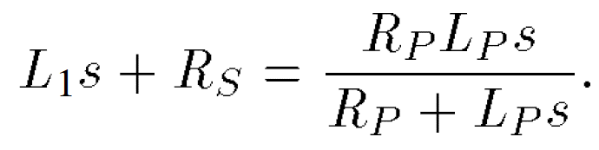
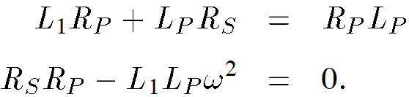
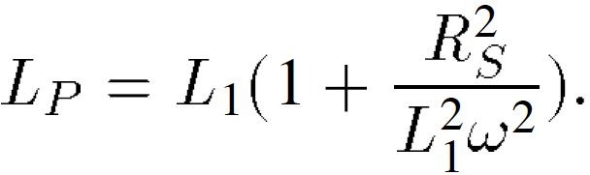

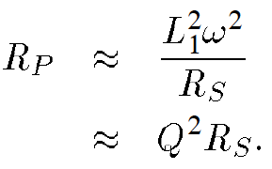
Conversion of Series to Parallel Combination
For the two impedances to be equivalent:
Assuming s = jω:
This relationship must hold for all ω (in a narrow range):
              ➔
Recall L₁ω/R_{S} = Q, typically greater than 3 for monolithic inductors ➔   and

Slide 28
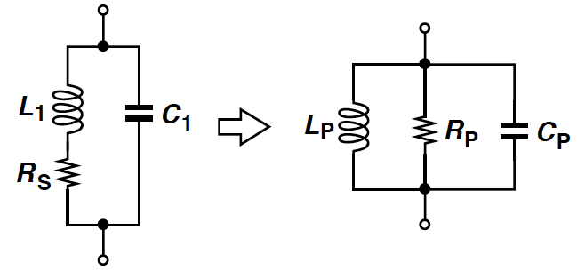

Conversion of Tank to Parallel Components
The previous series/parallel transformation allows this conversion, and C_{P} = C₁.
The equivalence of course breaks down as ω departs substantially from the resonance frequency.
At , the tank reduces to a simple resistor.

Slide 29
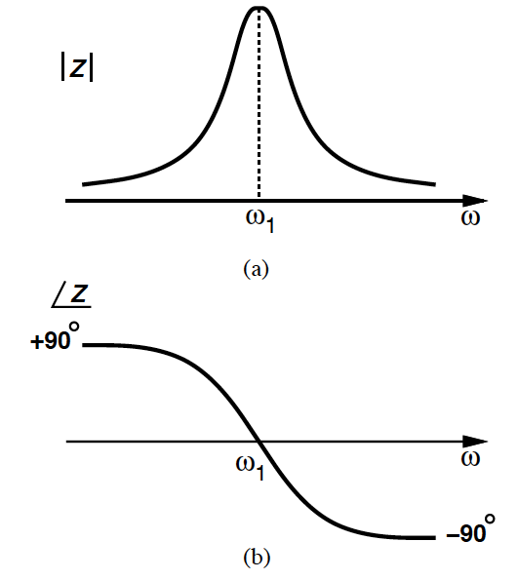
Tank Impedance vs. Frequency
Plotting magnitude of the tank impedance vs. frequency in (a), we note that the behavior is:
- inductive for ω < ω₁.
- capacitive for ω > ω₁.
➔ surmise that the phase of the impedance is positive for ω < ω₁ and negative for ω > ω1, as in (b).

Slide 30
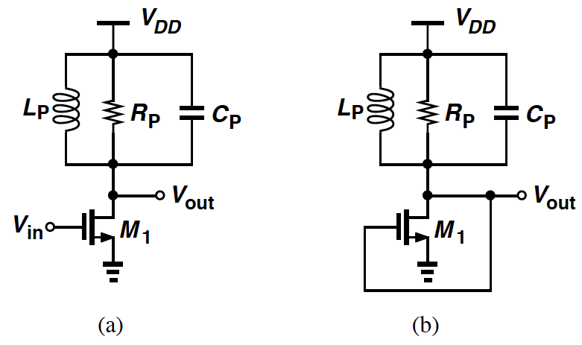
Tuned Gain Stage
(a): At resonance, jL_{p}ω = 1/(jC_{p}ω), voltage gain equals -g_{m1}R_{P}.
From (b), the frequency-dependent phase shift of the tank never reaches 180°.
➔ circuit (b) does not oscillate.

Slide 31
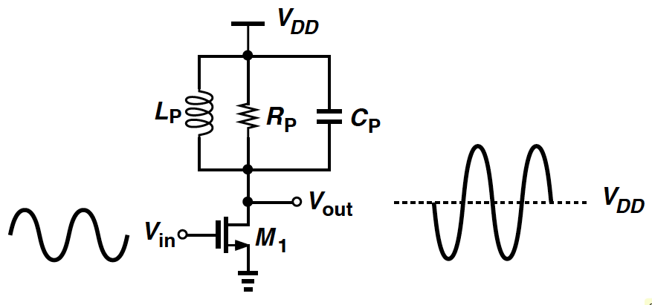
Output Signal Levels in Tuned Stage
The stage is biased at a drain current I₁.
If the series resistance of L_{p} is small, dc level of V_{out} is close to V_{DD}.
Apply a small sinusoidal voltage at the resonance frequency at input ➔ V_{out}: An inverted sinusoid with an average value near V_{DD}.
The peak output level exceeds the supply voltage.

Slide 32
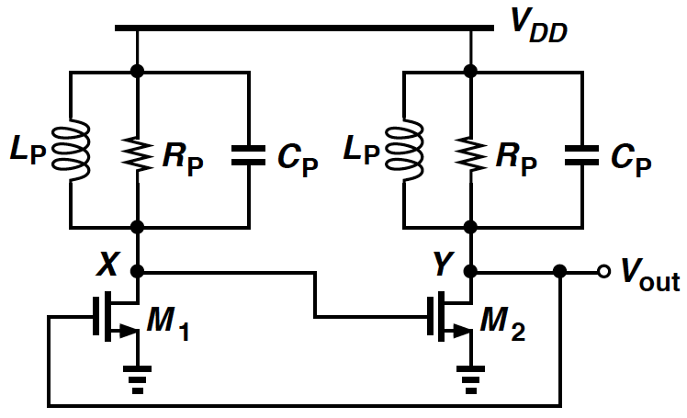
Two Tuned Stage in Feedback Loop
This configuration does not latch up because its low-frequency gain is very small.
At resonance, total phase shift around the loop is zero.
If g_{m1}R_{P}g_{m2}R_{P} ≥ 1, then the loop oscillates.

Slide 33

Example 15.5
Sketch the open-loop voltage gain and phase of the previous circuit. Neglect transistor capacitances.
Solution
The magnitude has a shape with sharper rise and fall because it results from the product of those of the two stages.
The total phase at low frequency is given by signal inversion by each cs-stage plus a 90° phase shift due to each tank. A similar behavior occurs at high frequencies.

Slide 34

Crossed-Coupled Oscillator
The previous circuit (Slide 35) is sometimes drawn as in above configuration (a) or (b).
However, the drain currents of M₁ and M₂ and hence the output swings heavily depend on V_{DD}.
The waveforms at X and Y are differential ➔ (b) suggests that M₁ and M₂ can be converted to differential pair as depicted in Example 15.6.

Slide 35


Example 15.6
For the circuit configuration (c), plot V_{X} and V_{Y} and I_{D1} and I_{D2} as the oscillation begins.
Solution
The oscillation amplitude grows until the loop gain drops at the peaks.
In fact, if g_{m1,2}R_{P} is large enough, the difference between V_{X} – V_{Y} reaches a level that steers the entire tail current to one transistor, turning the other off.
In the steady state, I_{D1} and I_{D2} vary between 0 and I_{SS}.

Slide 36

Tuned Stage with Feedback (I)
(a): We surmise that if the drain voltage is returned to the source rather than the gate, the circuit may oscillate.
Capacitor incorporated to avoid disturbing the bias point of M₁.
Unfortunately, the circuit does not oscillate due to insufficient loop gain.

Slide 37


Tuned Stage with Feedback (II)
Apply an input current as in (b).
M₁ and C₂ directly conduct the input current to the tank.
Obtain the close-loop gain as:
Since the close-loop gain cannot be equal to infinity at any frequency, the circuit fails to oscillate.

Slide 38

Example 15.7
Why the input to the feedback system is realized as a current source applied to the source of the transistor rather than a voltage source applied to its gate?
Solution
With a finite variation of V_{in}, the change in I_{b} is still zero if the bias current source is ideal.
Neglect source-bulk junction capacitance of M₁ ➔ change in tank current is zero, yielding V_{out}/V_{in} = 0.
V_{X} does vary with V_{in}, but M₁ generates a small-signal current that cancels that through C2.
V_{X}/V_{in} = g_{m}/(g_{m} + C₂s).

Slide 39


Colpitts Oscillator (I)
Add C₁ to node X and remove C_{P} as shown in (a).
Approximating M₁ by a single voltage-dependent current source, we construct equivalent circuit (b).
We obtain:

Slide 40



Colpitts Oscillator (II)
We sum all of the currents at the output node:
➔
The circuit oscillates if the close-loop transfer function goes to infinity at an imaginary value of s, s_{R} = jω_{R}.
➔
With typical values, g_{m}L_{P} << R_{P}(C₁ + C₂), we obtain:
and

Slide 41


Colpitts Oscillator (III)
g_{m}R_{P} is the voltage gain from the source of M₁ to the output. C₁/C₂ for minimum required gain occurs for C₁/C₂ = 1, requiring
If the capacitance that appears in parallel with the inductor, C_{P}, is included in the equivalent circuit, ω_{R}² is modified as: , whereas remains unchanged.
➔ C_{P} is simply included in parallel with the series combination of C₁ and C₂.

Slide 42

Decaying Impulse Response of Tank
(a): A simple tank that is stimulated by a current impulse.
The tank responds with a decaying oscillatory behavior.
In every cycle, some of the energy that reciprocates between the capacitor and the inductor is lost in the form of heat in the resistor.

Slide 43


One-Port Oscillator
(b): R_{P}||(-R_{P}) = ∞ ➔ the tank oscillates indefinitely.
(c): A one-port circuit exhibiting a negative resistance placed in parallel with a tank ➔ the combination may oscillate.
(c) is called a one-port oscillator.

Slide 44






Negative Resistance
(a): Implement the feedback by a common-gate stage and add I_{b} to provide the bias current of M₂.
From the equivalent circuit in (b), we have:
and
➔
➔ If g_{m1} = g_{m2} = g_{m},

Slide 45

Oscillator Using Negative R_{in} (I)
R_{P} denotes the equivalent parallel resistance of the tank.
For oscillation build-up, R_{P} – 2/g_{m} ≥ 0.
If the small-signal resistance represented by M₁ and M₂ to the tank is less negative than -R_{P} ➔ the circuit experiences large swings such that each transistor is nearly off for part of the period.
This yields an “average” resistance of -R_{P}.

Slide 46

Oscillator Using Negative R_{in} (II)
The circuit (Slide 45) can be redrawn as (a).
(b) is obtained, if the drain current of M₁ flows through a tank and the resulting voltage is applied to the gate of M_{2.}

Slide 47

Negative-G_{m} Oscillator
We ignore bias paths and merge the two tanks in previous topology (b) (Slide 46) into one, as shown above.
To enable oscillation, the cross-coupled pair must provide a negative resistance of -R_{P} between nodes X and Y.
-R_{P} = -2/g_{m} and hence it is necessary that R_{P} ≥ 1/g_{m}.
Also called a “negative-G_{m} oscillator”.

Slide 48



Another Way to Create Negative R (I)
(a) shows another method of creating negative resistance. We have:
➔
This impedance consists of a negative resistance equal to -g_{m}/(C₁C₂ω²) in series with the series combination of C₁ and C₂, as in (b).
(c): If an inductor is placed between the gate and drain of M₁, the circuit may oscillate.

Slide 49

Another Way to Create Negative R (II)
Three oscillator topologies derived from pervious circuit (c) (Slide 48).
(a): Based on a source follower.
(b): Colpitts oscillator.

Slide 50

Example 15.8
Redraw the three circuits (Slide 49) with proper biasing.
Solution

Slide 51


Voltage-Controlled Oscillator: Definition
Ideal voltage-controlled oscillator (VCO): Output frequency is a linear function of its control voltage:
ω₀: Intercept corresponding to V_{cont} = 0.
K_{VCO}: “Gain” or “sensitivity” of the circuit.
ω₂ – ω₁: “Tuning range”.

Slide 52



Example 15.9
In the negative-G_{m} oscillator (Slide 35), C_{P} = 0, consider only C_{DB} of M₁ and M₂. Explain why V_{DD} can be viewed as the control voltage. Calculate the gain of the VCO.
Solution
C_{DB} varies with V_{DB} ➔ ω_{res} changes with V_{DD}.
The average voltage across C_{DB} ≈ V_{DD}, we write:
and
➔
The relationship between ω_{out} and V_{cont} is nonlinear because K_{VCO} varies with V_{DD} and ω_{out}.

Slide 53

Parameters of VCO (I)
Center Frequency:
determined by the environment in which the VCO is used.
can achieve as high as hundreds of gigahertz.
Tuning Range:
The required tuning range is dictated by:
- (1) variation of the VCO center frequency with process and temperature.
- (2) frequency range necessary for the application.
Noise in the output frequency is proportional to K_{VCO} because ω_{out} = ω₀ + K_{VCO}V_{cont}.
To minimize the effect of noise in V_{cont} ➔ VCO gain must be minimized, which conflicts with the required tuning range.
If allowable range of V_{cont}: From V₁ to V₂, tuning range must span at least ω₁ to ω₂ ➔

Slide 54

Parameters of VCO (II)
Tuning Linearity:
Tuning characteristics of VCOs exhibit nonlinearity, i.e., their gain, K_{VCO}, is not constant.
Actual oscillator characteristics typically exhibit a high gain region in the middle of the range and a low gain at the two extremes.
As shown on the right, compared to a
linear characteristics (gray line), the
actual behavior displays a maximum
gain greater than that predicted by

Slide 55
Parameters of VCO (III)
Output Amplitude:
Desirable to achieve a large output oscillation amplitude ➔ Waveform less sensitive to noise.
Trades with power dissipation, supply voltage, and tuning range.
Power Dissipation:
Oscillators suffer from trade-offs between speed, power dissipation, and noise.
Supply and Common-Mode Rejection:
Oscillators are quite sensitive to noise, especially when realized in single-ended form.
Output Signal Purity:
Even with a constant V_{cont}, the output waveform of a VCO is not perfectly periodic.

Slide 56



Differential Pair with Variable Output τ
M₃ and M₄ operate in the triode region, each acting as a variable resistor controlled by V_{cont}.
If M₃ and M₄ remain in the deep triode region:
➔
Delay of the circuit is roughly proportional to τ₁, yielding:

Slide 57


Example 15.10
For given device dimensions and bias currents in previous circuit (Slide 56), determine the maximum allowable value of V_{cont}. What happens if M₃ and M₄ enter saturation?
Solution
Assume: M₃ and M₄ remain in the deep triode region if |V_{DS3,4}| ≤ 0.2 × 2|V_{GS3,4} – V_{THP}|.
If each stage has complete switching ➔ maximum drain current of M₃ and M₄ is I_{SS}.
To satisfy the above condition, we must have I_{SS}R_{on3,4} ≤ 0.4(V_{DD} – V_{cont} - |V_{THP}|) ➔
➔      
If V_{cont} exceeds this level, M₃ and M₄ eventually enter saturation. Each stage then requires common-mode feedback to produce the output swings around a well-defined CM Level.

Slide 58

Replica Circuit for Stages of Ring Oscillator
(a): M₅ operates in the deep triode region and amplifier A₁ applies negative feedback to the gate of M₅.
If the loop gain is sufficiently large, the differential input voltage of A₁ must be small ➔ V_{P} ≈ V_{REF} and |V_{DS5}| ≈ V_{DD} – V_{REF}.
The feedback ensures a relatively constant drain-source voltage even if I₁ varies.
I₁ decreases ➔ A₁ rises the gate voltage of M₅ such that R_{on5}I₁ ≈ V_{DD} – V_{REF}.

Slide 59

Replica Biasing to Define Voltage Swing
(b): To “servo” the on-resistance of M₃ and M₄ to that of M₅ and vary the frequency by adjusting I₁ and I_{SS} simultaneously.
If M₃ and M₄ are identical to M₅ and I_{SS} to I₁ ➔ V_{X} and V_{Y} vary from V_{DD} to V_{DD} – V_{REF} as M₁ and M₂ steer the tail current to one side or the other.
If process and temperature variations, say, decrease, I₁ and I_{SS} ➔ A₁ increases the on-resistance of M₃-M₅, forcing V_{p} and hence V_{X} and V_{Y} = V_{REF}.

Slide 60


Example 15.11
How does the oscillation frequency depend on I_{SS} for a VCO incorporating the stage of previous topology (b) (Slide 59).
Solution
R_{on3,4}I_{SS} ≈ V_{DD} – V_{REF}, we have R_{on3,4} ≈ (V_{DD} – V_{REF})/I_{SS} and hence:
Thus, the characteristic is relatively linear.

Slide 61

Differential Stage with Variable -R Load
(a): As I₁ increases,
- the small-signal differential resistance -2/g_{m3,4} becomes less negative.
- from the half circuit (b), equivalent resistance R_{P}||(-1/g_{m3,4}) = R_{P}/(1 – g_{m3,4}R_{P}) increases ➔ lower the frequency of oscillation.
In (a), as I₁ varies, so do the currents steered by M₃ and M₄ to R₁ and R₂ ➔ the output voltage swing is not constant across the tuning range.

Slide 62

Differential Pair to Steer Current
The below circuit is to employ a differential pair M₅-M₆ to steer I_{T} to M₁-M₂ or M₃-M4, so I_{SS} + I₁ = I_{T}.
I_{T} must flow through R₁ and R₂. If M₁-M₄ experience complete switching in each cycle of oscillation ➔ I_{T} is steered to R₁ in half a period and to R₂ in the other half, giving a differential swing of 2R_{P}I_{T}.
V_{cont1} and V_{cont2} are differential control lines if they vary by equal and opposite amounts ➔ higher noise immunity.
As V_{cont1} decreases and V_{cont2} increases ➔ cross-coupled pair exhibits a greater transconductance ➔ raise the time constant at the output nodes.

Slide 63


Example 15.12
Calculate the minimum value of I_{H} in previous circuit (Slide 62) to guarantee a low-frequency gain of 2 when all of I_{T} is steered to the cross-coupled pair.
Solution
The small-signal voltage gain of the circuit = g_{m1,2}R_{P}/(1 – g_{m3,4}R_{P}).
Assuming square-law devices, we have
That is,

Slide 64

Headroom Calculation
for M₅ to remain in saturation, V_{P} must be sufficiently higher than V_{N}.
When V_{cont1} = V_{cont2}, minimum allowable V_{DS} of M₅ is equal to its equilibrium overdrive voltage.
If V_{cont1} or V_{cont2} is allowed to vary above its equilibrium value by more than V_{TH}, M₅ or M₆ enters the triode region.
To minimize the sensitivity, the transconductance of M₅-M₆ must be minimized.
However, for a given tail current, g_{m} = 2I_{D}/(V_{GS} – V_{TH}), indicating a large equilibrium overdrive for M₅-M₆ and a correspondingly higher value for the minimum required supply voltage.

Slide 65

Current Folding
(a): I₁ + I₂ = I_{SS}, I_{out1} = KI₁, I_{out2} = KI₂ ➔ I_{out1} + I_{out2} = KI_{SS}.
(a) has a behavior similar to that of a differential pair.
(b): Application of current folding to current steering. The circuit operates from a low supply voltage.
However in (b), the devices in the control path contribute substantial noise ➔ modulate the oscillation frequency.

Slide 66

Interpolating Delay Stage (I)
(a): at one extreme of V_{cont}, only the fast path is on and the slow path is disabled, yielding the maximum oscillation frequency shown in (b).
At the other extreme in (a), only the slow path is on and the fast path is off, providing the minimum oscillation frequency as shown in (c).
If V_{cont} lies between the 2 extremes, each path is partially on and total delay = weighted sum of their delays.

Slide 67


Interpolating Delay Stage (II)
(a): Simply shorting the outputs of two differential pairs performs the current addition.
The overall interpolating stage therefore assumes the configuration (b).
(b): Gain of each stage varied by the tail current to achieve interpolation.
But it is desirable to maintain constant voltage swings.
The gain of the differential pair M₅-M₆ need not be varied because even if only the gain of M₃-M₄ drops to zero, the slow path is fully disabled.

Slide 68

Interpolating Delay Stage with I Steering
The circuit employs the differential pair M₇-M₈ to steer I_{SS} between M₁-M₂ and M₃-M₄.
If V_{cont} is very negative ➔ M₈ off and only the fast path amplifies the input.
If V_{cont} is very positive ➔ M₇ off and only the slow path is enabled.
Since the slow path employs more stage than the fast path, the VCO achieves a tuning range of roughly two to one.

Slide 69
Example 15.13 (I)
Combine the two previously discussed tuning techniques, as shown in the following two circuit topologies, to achieve a wider tuning range.

Slide 70


Example 15.13 (II)
Interpolate the second tuning technique and add a cross-coupled pair to the output nodes, depicted in (a).
However, to obtain constant voltage swings, the resulting configuration (b) steers the current to M₁-M₂ to speed up the circuit and to M₃-M₄ and M₁₀-M₁₁ to slow down the circuit.
The tail current source dimensions satisfy I_{SS1} = I_{SS2} + I_{SS3}.

Slide 71

Wide-Range Tuning
In applications where the frequency must be varied by orders of magnitude, the topology (left) can be used.
Driven by the input, the additional PMOS transistors M₅ and M₆ pull each output node to V_{DD}.
These create a relatively constant output swing even with large variations in I_{SS}.
The oscillation frequency of a ring incorporating this stage can be varied by more than four orders of magnitude with less than a twofold variation in the amplitude.

Slide 72

Varactor
Difficult to vary the value of monolithic inductors, so we simply change the tank capacitance to tune the oscillator.
A reversed-biased pn junction can serve as a voltage-dependent capacitor, called a “varactor”:
- C₀: Zero-bias value.
- V_{R}: Reverse-bias voltage.
- ϕ_{B}: Built-in potential of the junction.
- m: Typically between 0.3 and 0.4.
Important drawback of LC oscillators: At low supply voltages V_{R} has a very limited range ➔ a small range for C_{var} and hence for f_{osc}.

Slide 73

Example 15.14
Suppose in the equation of C_{var}, ϕ_{B} = 0.7 V, m = 0.35, V_{R} can vary from zero to 2 V. How much tuning range can be achieved?
Solution
For V_{R} = 0, C_{j} = C₀ and .
For V_{R} = 2 V, C_{j} ≈ 0.62C₀ and
.
Thus, the tuning range is approximately equal to 27%.

Slide 74

LC Oscillator Using Varactor Diodes
To avoid forward-biasing D₁ and D₂ significantly, V_{cont} must not exceed V_{X} or V_{Y} by more than a few hundred mV.
If the peak amplitude at each node = A, then 0 < V_{cont} < V_{DD} – A + 300 mV.
The circuit suffers from a trade-off between output swing and tuning range.
The capacitance of D₁ and D₂ varies with time due to typically large swings at X and Y.
“Average” value of the capacitance is still a function of V_{cont}.

Slide 75


Diodes Realized in CMOS Technology
2 types of pn junctions: (a) the anode is inevitably grounded, (b) both terminals are floating.
First drawback of (b): n-well material has a high resistivity ➔ create a resistance in series with the reverse-biased diode, lower Q factor of the capacitance.
Another drawback of (b): n-well displays substantial capacitance to the substrate, C_{n} (right) ➔ contribute a constant capacitance to the tank, limit the tuning range.

Slide 76

Reduction of Series Resistance
(a): Used to decrease the series resistance of the second pn junction type (Slide 78).
In (a), p⁺ region surrounded by an n⁺ ring ➔ the displacement current flowing through the junction capacitance see a low resistance in all four directions.
Many of these units of (a) can be placed in parallel, as in (b).

Slide 77

Tuning in LC Oscillators
Examine unwanted capacitances in the circuit (Slide 74). We identify three such capacitances:
- capacitance between n-well and substrate associated with D₁ & D₂;
- C_{GD}, 2C_{GD}, and C_{DB};
- parasitic capacitance of the inductor itself.
Monolithic inductors typically implemented as metal spiral structure (right)
- relatively large dimensions
(S ≈ 100-200 μm).

Slide 78

Use of PMOS to Eliminate n-well Capacitance
Desirable to connect the anode of the diodes to X & Y ➔ eliminate the parasitic n-well capacitances from the tank.
Here, the cross-coupled pair incorporates PMOS devices, providing swings around the ground potential.
Use of PMOS devices also leads to less flicker noise appearing around the oscillation frequency.

Slide 79

MOS Varactor
(a): Recall C_{GS} of MOSFETs varies with V_{GS}.
(b): An NMOS transistor can be placed inside an n-well, forming an “accumulation-mode” varactor.
(c) shows how the capacitance of structure (b) varies monotonically with V_{GS}.

Slide 80



Phase for Signal
Consider V₀(t) = V_{m}sinω₀t, and the phase varies linearly with time at a slope of ω₀ (left).
Every time ω₀t crosses an integer multiple of π, V₀(t) crosses 0.
Now consider V₁(t) = V_{m}sin[ϕ₁(t)] and V₂(t) = V_{m}sin[ϕ₂(t)], where ϕ₁(t) = ω₁t, ϕ₂(t) = ω₂t, and ω₁ < ω₂ (right).
ϕ₂(t) crosses integer multiples of π faster than ϕ₁(t) does, yielding faster variations in V₂(t) ➔V₂(t) accumulates phase faster.
The frequency can be defined as

Slide 81



Example 15.15
(a) shows the phase of a sinusoidal waveform with constant amplitude as a function of time. Plot the waveform.
Solution
Taking the time derivative of ϕ(t), we obtain (b).
The frequency periodically toggles between ω₁ and ω₂, yielding the waveform in (c).
If the frequency of a waveform is known as a function of time, the phase can be computed as
For a VCO, ω_{out} = ω₀ + K_{VCO}V_{cont,} we have:

Slide 82

Example 15.16
The control line of a VCO senses a rectangular signal toggling between V₁ and V₂ at a period T_{m}. Plot the frequency, phase, and output waveform as a function of time.
Solution
ω_{out} = ω₀ + K_{VCO}V_{cont} ➔ the output frequency toggles between ω₁ = ω₀ + K_{VCO}V₁ and ω₂ = ω₀ + K_{VCO}V₂, as shown in the V₀(t) waveform.
The phase is equal to the time integral of this result, rising linearly with time at a slope of ω₁ for half the input period and ω₂ for the other half.
A VCO can operate as a frequency modulator.

Slide 83




Example 15.17
A VCO senses a small sinusoidal control voltage V_{cont} = V_{m}cosω_{m}t. Determine the output waveform and its spectrum.
The output is expressed as
If V_{m} is small enough that K_{VCO}V_{m}/ω_{m} << 1rad, then
The output consists of three sinusoids having frequencies of ω₀, ω₀ – ω_{m} and ω₀ + ω_{m}. The spectrum is:

Slide 84

Expression of Phase
Explain why this is incorrect: The output frequency of a VCO is ω₀ + K_{VCO}V_{cont}, then the output waveform can be written as V_{m}cos[(ω₀ + K_{VCO}V_{cont})t].
Compute the frequency as derivative of the phase:
The first term in the above expression vanishes only if dV_{cont}/dt = 0.
➔ In general case, the phase cannot be written as product of time & frequency.

Slide 85
Output Harmonics
In practice, output of the VCO may contain significant harmonics, even approaching a rectangular waveform.
We expect V_{out}(t) expressed as a Fourier series:
If V_{cont} varies by ΔV ➔ frequency of the first harmonic varies by K_{VCO}ΔV, frequency of the second harmonic by 2K_{VCO}ΔV, etc.
Often limit calculations to the 1st harmonic.

