Slide 1
Chapter 16: Phase-Locked Loops
16.1 Simple PLL
16.2 Charge-Pump PLLs
16.3 Nonideal Effects in PLLs
16.4 Delay-Locked Loops
16.5 Applications

Slide 2

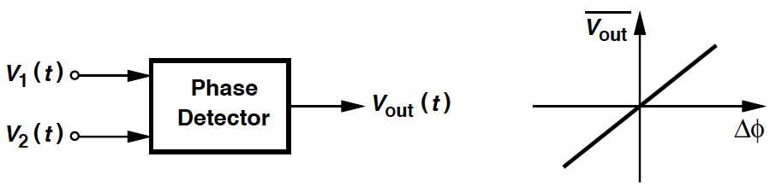
Phase Detector (PD) Definition
PLL: A feedback system that compares the output phase with the input phase.
Phase detector: A circuit whose is linearly proportional to the phase difference, Δϕ, between its two inputs:
K_{PD}: “Gain” of the PD = Slope of the line (V/rad).

Slide 3
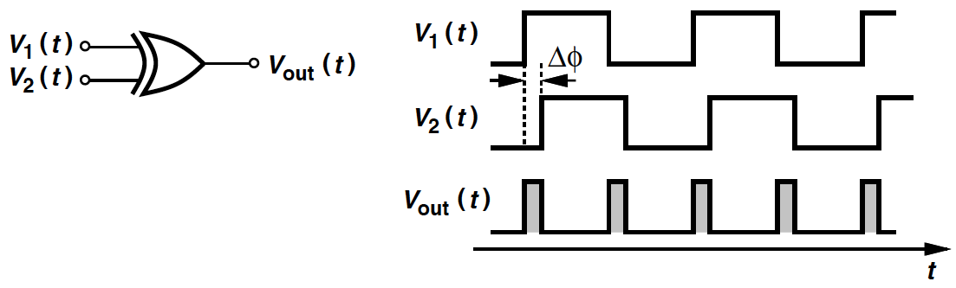
XOR Gate as PD
As Δϕ varies, so does the width of the output pulses ➔ dc level proportional to Δϕ.
XOR circuit produces error pulses on both rising and falling edges.
Other PDs may respond only to positive or negative transitions.

Slide 4
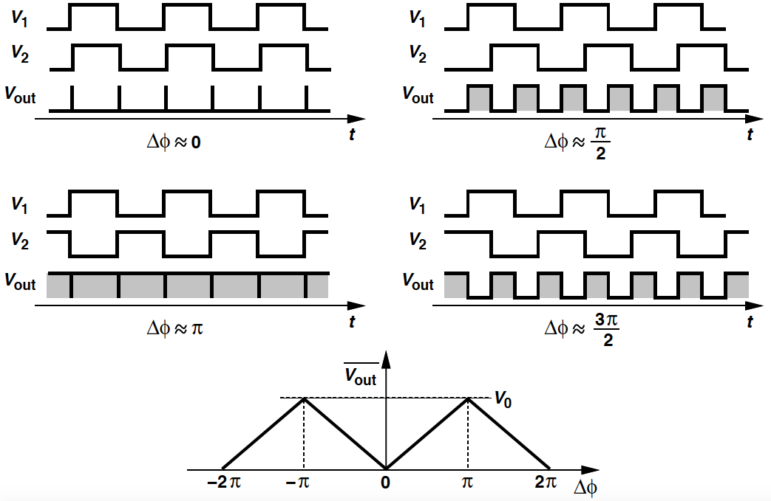
Example 16.1
If output swing of the XOR = V₀ volts, what is a the gain of a phase detector? Plot the input-output characteristics of the PD.
Solution:
Gain = V₀/π.
The input-output characteristics are plotted on the left: - The average output voltages rises to [V₀/π] × π/2 = V₀/2 for Δϕ = π/2 and V₀ for Δϕ = π. - For Δϕ > π, the average begins to drop.
Periodic characteristic: Both negative and positive gains.

Slide 5
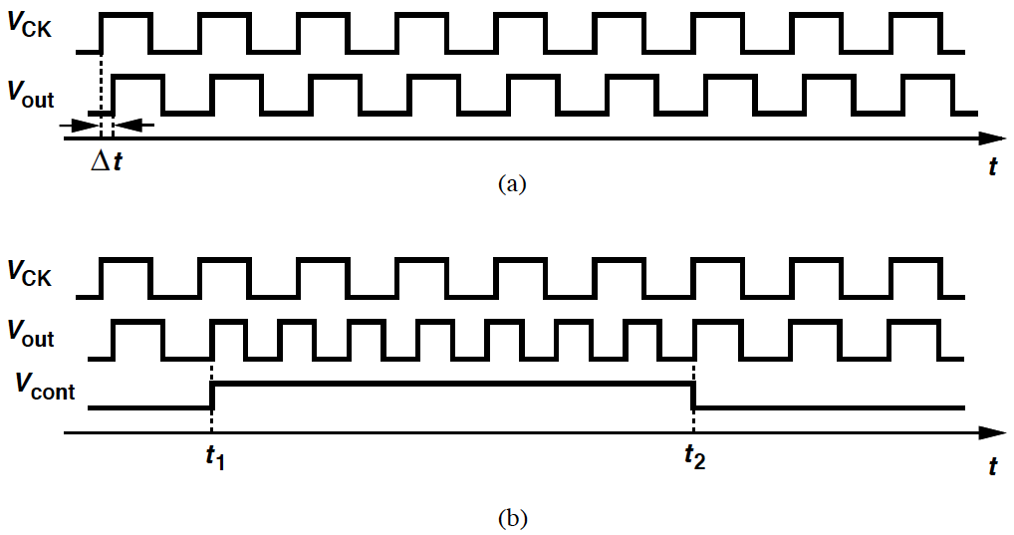

Skewed Waveforms Alignment
(a): Rising edges of V_{out} “skewed” by Δt seconds with respect to V_{CK}.
Assume the VCO has a single V_{cont}. To vary the phase, we must vary the frequency and allow .
(b): At t = t₁, the VCO frequency stepped to a higher value ➔ phase accumulated faster and phase error decreases ➔ t = t₂: phase error = 0.

Slide 6
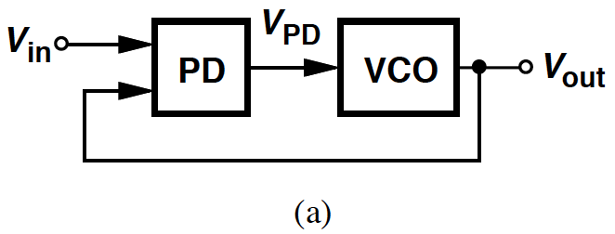
PD & VCO in Feedback Loop
Output phase of a VCO can be aligned with phase of reference if
- (1) frequency of the VCO is changed momentarily,
- (2) a phase detector is used to determine when they are aligned.
Task of “phase locking”.
(a): The PD compares the phase of V_{out} and Vin ➔ generates an error that varies the frequency until the phases are aligned.

Slide 7
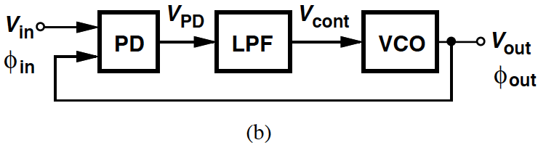



Basic PLL Topology
Topology (a) (Slide 6) must be modified because V_{PD}
- (1) consists of a dc component (desirable) & high-frequency components (undesirable),
- (2) must be filtered as V_{cont} must remain quiet in the steady state.
(b): Basic PLL topology.
We define the loop of (b) to be locked if is constant:
➔

Slide 8
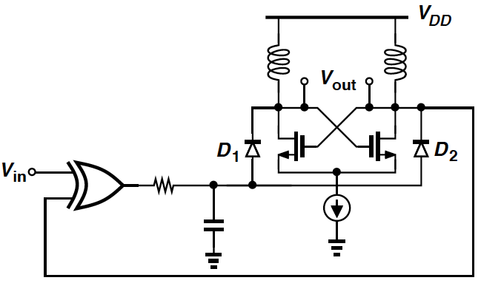
Example 16.2
Implement a simple PLL in CMOS technology.
Solution
Utilize an XOR gate as the phase detector.
The VCO configured as a negative-G_{m} LC oscillator whose frequency is tuned by varactor diodes.

Slide 9
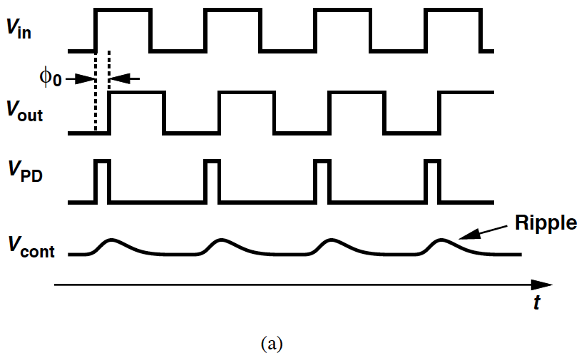
PLL Waveforms in Locked Condition
(a): V_{in} & V_{out} exhibit a small phase difference but equal frequencies.
PD: Pulses as wide as the skew between input & output.
Low-pass filter extracts the dc component of V_{PD} ➔ apply result to the VCO (Assume gain of LPF = 1).
“Ripple”: Small pulses in V_{LPF}.

Slide 10
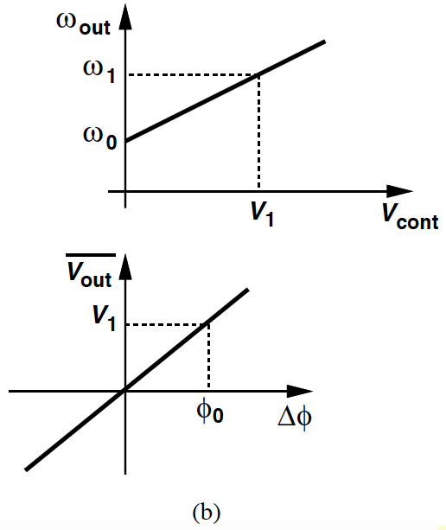



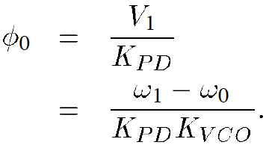
Calculation of Phase Error
(b): VCO and PD characteristics.
If input/output frequencies = ω₁, the required V_{cont} is unique and = V₁.
Since and
➔ we can write:
and
Two important points:
- Phase error varies as input frequency of the PLL varies.
- To minimize phase error ➔ K_{PD}K_{VCO} maximized.

Slide 11
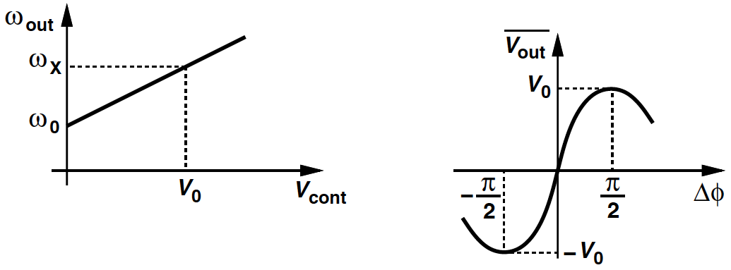
Example 16.3
A PLL incorporates a VCO and a PD having the characteristics shown below. Explain what happens as the input frequency varies in the locked condition.
Solution
PD characteristic is relatively linear near the origin but exhibits a small-signal gain of zero if Δϕ = ±π/2, where the average output is equal to ±V₀.
If the input frequency is high enough (= ω_{x}) to dictate V_{cont} = V₀, the PD must operate at the peak of its characteristic, at which, however, PD gain = 0 and the feedback loop fails.
The circuit cannot lock if the input frequency reaches ω_{x}.

Slide 12
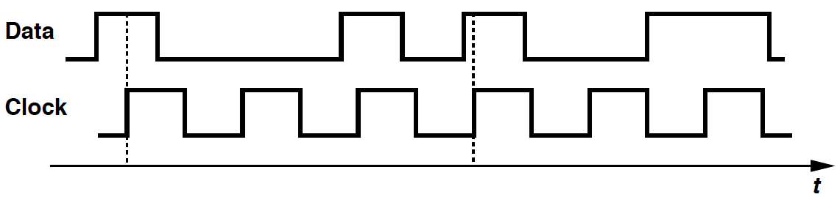
Equality of Input & Output Frequencies (I)
The exact equality of the input and output frequencies of a PLL in the locked condition is a critical attribute.
Even a very small (deterministic) frequency error may prove unacceptable.
E.g. (below): A data stream is to be processed synchronously by a clocked system. Even a slight difference between the data rate and the clock frequency results in a “drift” ➔ errors.

Slide 13
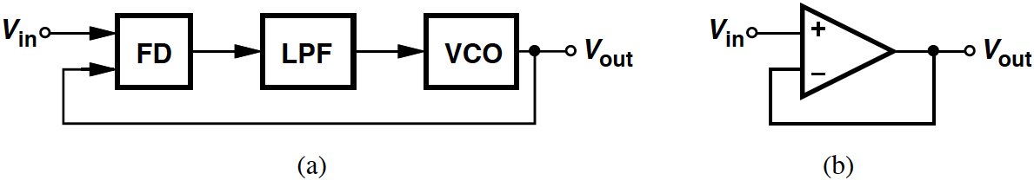
Equality of Input & Output Frequencies (II)
The equality would not exist if the PLL compared the input and output frequencies rather than phases.
(a): A loop employing a FD would suffer from a finite difference between ω_{in} and ω_{out} due to various mismatches and other nonidealities.
(b): An analogy with the unity-gain feedback circuit. Even if the op-amp’s open-loop gain is infinity, the input-referred offset voltage leads to a finite error between V_{in} and V_{out}.

Slide 14
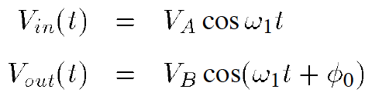
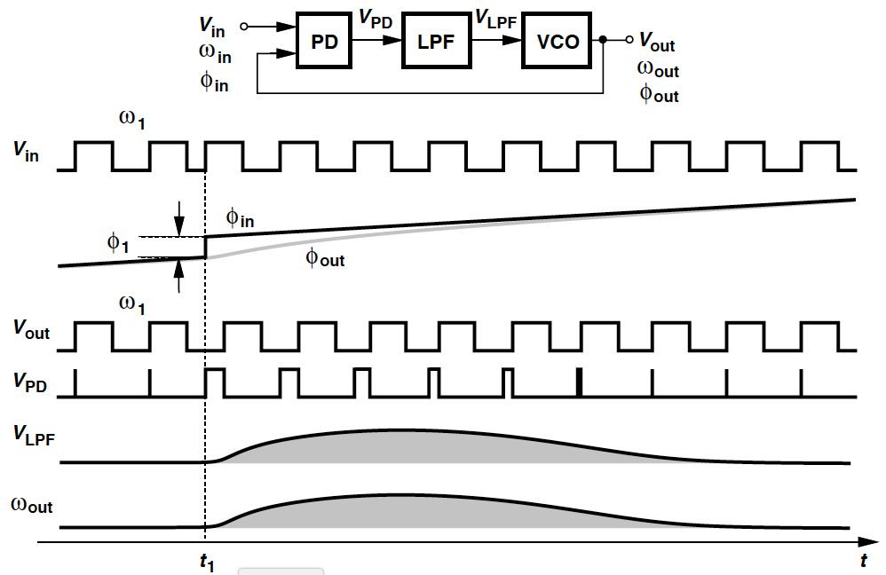
Response of PLL to Phase Step (I)
For a PLL in the locked condition, assume:
The input experiences a phase step of ϕ₁ at t = t₁. The phase step manifests itself as a rising edge in V_{in} that occurs earlier (or later) than the periodicity would dictate.

Slide 15

Response of PLL to Phase Step (II)
Output of the LPF does not change instantaneously ➔ the VCO initially continues to oscillate at ω₁.
The growing phase difference between input & output creates wide pulses at the output of PD ➔ force V_{LPF} to rise.
VCO frequency begins to change, to minimize the phase error.
Then if the loop is to return to lock, ω_{out} eventually goes back to ω₁ ➔ V_{LPF} & ϕ_{out} – ϕ_{in} also returns to original values.
The variation in the VCO frequency is such that:
➔ when the loop settles, the output is:
➔ ϕ_{out} gradually “catches up” with ϕ_{in}.

Slide 16
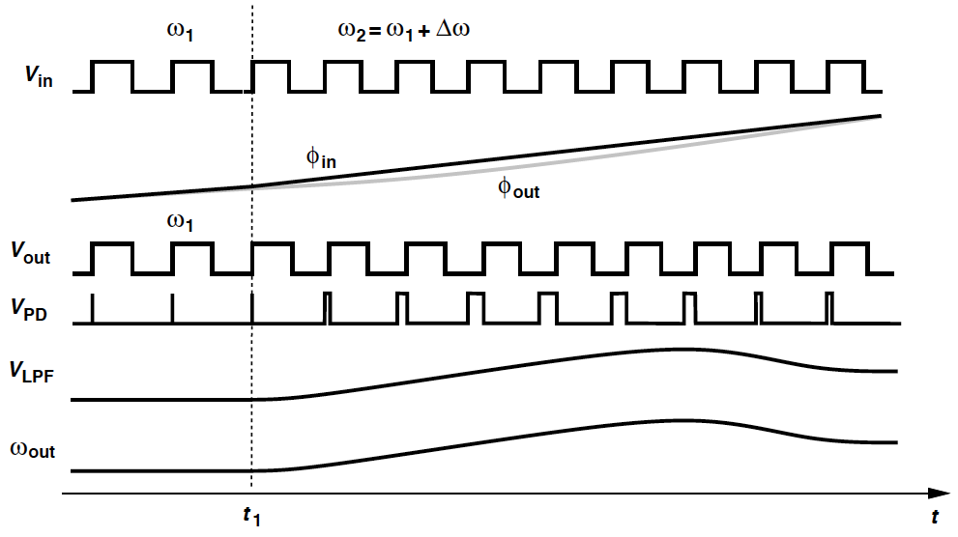

Response of PLL to Small Frequency Step
Examine the response of PLLs to Δω at t = t₁:
The VCO continues to oscillate at ω₁ immediately after t₁.
➔ PD generates increasingly wider pulses, V_{LPF} rises with time.
As ω_{out} -> ω₁ + Δω, the width of the pulses generated by the PD decreases, eventually settling to
If the input frequency is varied slowly, ω_{out} simply “tracks” ω_{in}.

Slide 17
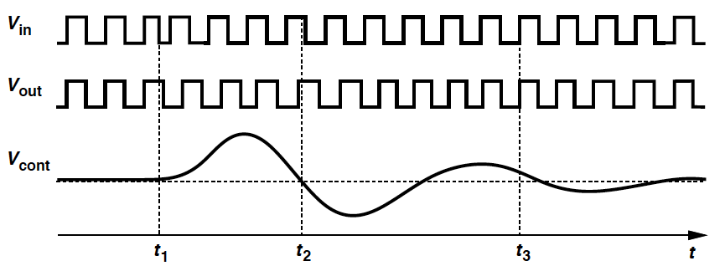
Example of Phase Step Response
At t = t₂, output frequency equals its final value, but the loop continues the transient because the phase error deviates from the required value.
At t = t₃, the phase error is equal to its final value but the output frequency is not.
For the loop to settle, both the phase and the frequency must settle to proper values.

Slide 18
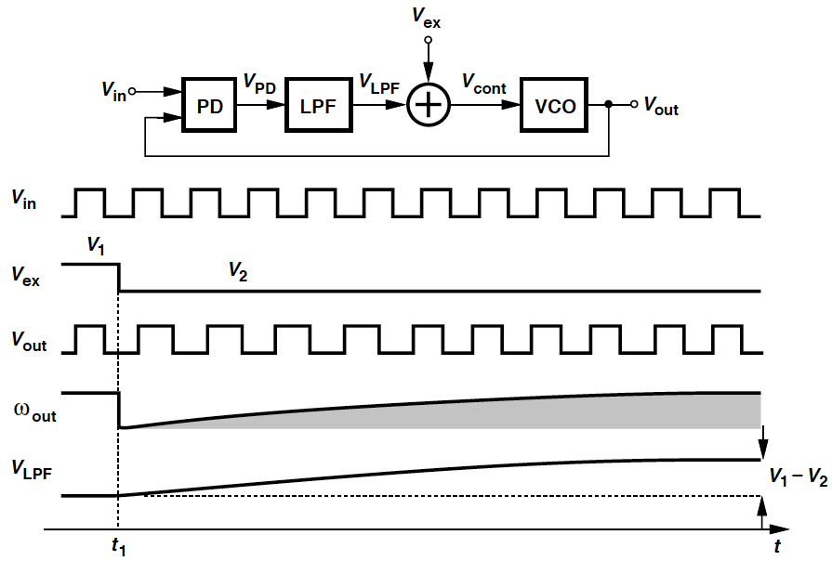
Example 16.4 (I)
In the below PLL, V_{ex} is added to the output of the low-pass filter. (a) Determine the phase error and V_{LPF} if the loop is locked and V_{ex} = V₁. (b) Suppose V_{ex} steps from V₁ to V₂ at t = t₁. How does the loop respond?

Slide 19
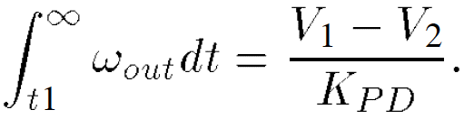
Example 16.4 (II)
Solution
(a) If the loop is locked, ω_{out} = ω_{in}, V_{cont} = (ω_{in} – ω₀)/K_{VCO}.
➔ V_{LPF} = (ω_{in} – ω₀)/K_{VCO} – V₁, Δϕ = V_{LPF}/K_{PD} = (ω_{in} – ω₀)/(K_{PD}K_{VCO}) – V₁/K_{PD}.
(b)
- When V_{ex} steps from V₁ to V₂, V_{cont} immediately goes from (ω_{in} – ω₀)/K_{VCO} to (ω_{in} – ω₀)/K_{VCO} + (V₂ – V₁) ➔ change the VCO frequency to ω_{in} – K_{VCO}(V₁ – V₂).
- V_{LPF} cannot change instantaneously ➔ PD begins to generate increasingly wider pulses, increasing V_{LPF} & ω_{out}.
- When the loop returns to lock, ω_{out} = ω_{in}, V_{LPF} = (ω_{in} – ω₀)/K_{VCO} – V₂. Phase error also changes to (ω_{in} – ω₀)/(K_{PD}K_{VCO}) – V₂/K_{PD}.
Change in the phase error:

Slide 20
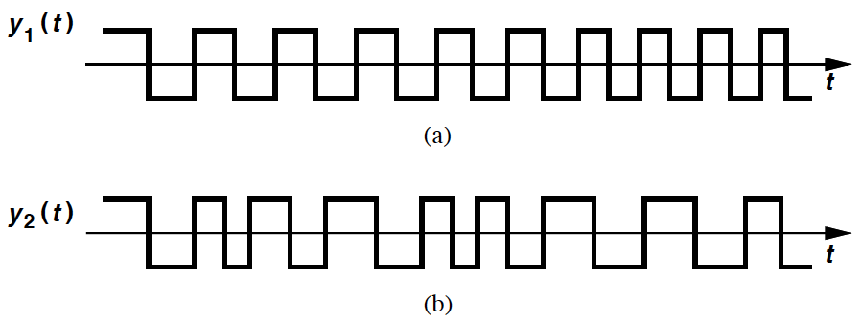
Variation of the Excess Phase with Time
Assume the loop is initially locked and treat the PLL as a feedback system ➔ output quantity is the (excess) phase of the VCO.
ϕ_{out}(s)/ϕ_{in}(s): How the output phase tracks the input phase if the latter changes slowly or rapidly.
y₂(t) has faster phase variations than does y₁(t).

Slide 21
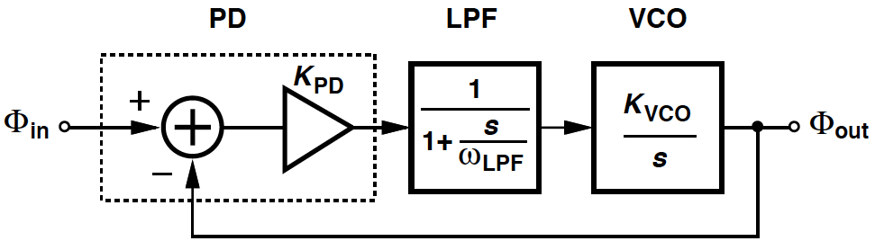
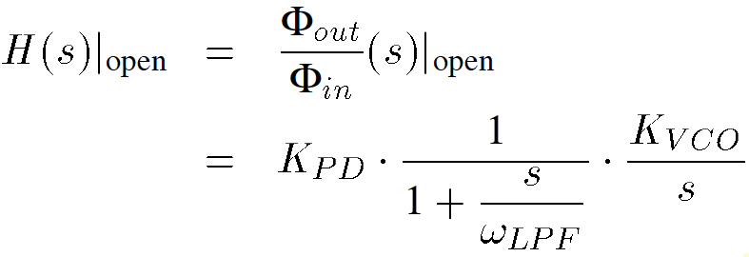
Linear Model of Type I PLL (I)
The overall PLL model consists of: Phase subtractor + LPF + VCO.
In LPF transfer function, ω_{LPF} is -3-dB bandwidth.
ϕ_{in} and ϕ_{out}: Excess phases of the input and output waveforms, respectively.
Open-loop transfer function:
Two poles: s = -ω_{LPF}, s = 0. (Pole at the origin ➔ “type I” system).

Slide 22
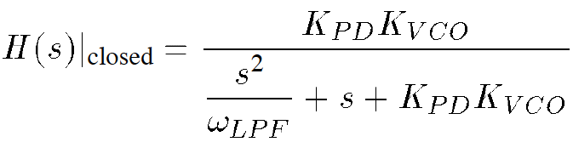
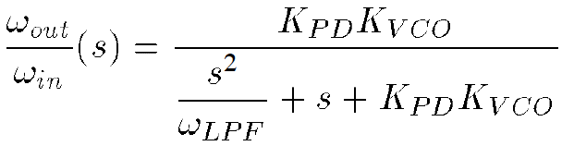
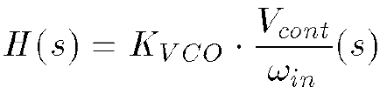
Linear Model of Type I PLL (II)
Close-loop transfer function:
If s -> 0, H(s) -> 1 because of the infinite loop gain. (Simply denote H(s)|_{closed} by H(s).)
H(s) also applies to:
- If ω_{in} changes very slowly (s -> 0) ➔ ω_{out} tracks ω_{in}.
- If ω_{in} changes abruptly but the system is given enough time to settle (s -> 0) ➔ change in ω_{out} equals that in ω_{in}.
We also have:

Slide 23
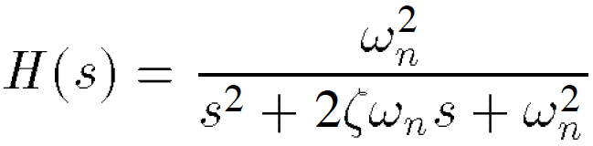
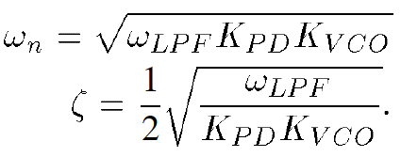
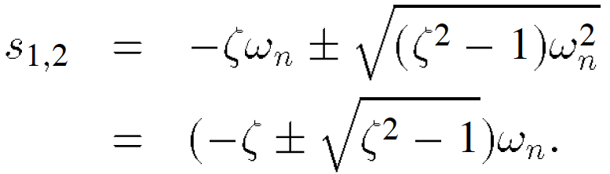
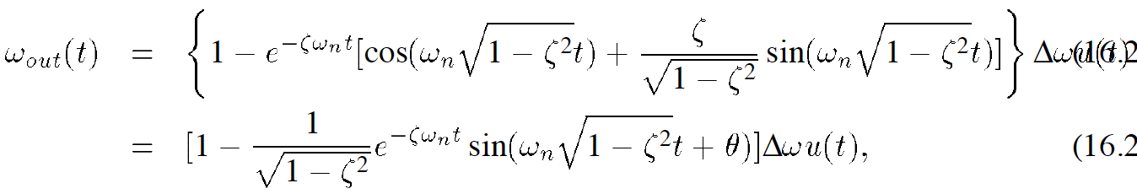
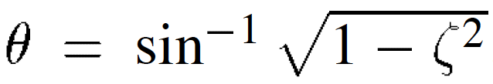
Linear Model of Type I PLL (III)
Rewrite H(s) as:
- where “natural frequency”:
- Two poles:
If ζ > 1, real poles ➔ system is overdamped.
If ζ < 1, complex poles ➔ response to ω_{in} = Δωu(t) is:
- where

Slide 24
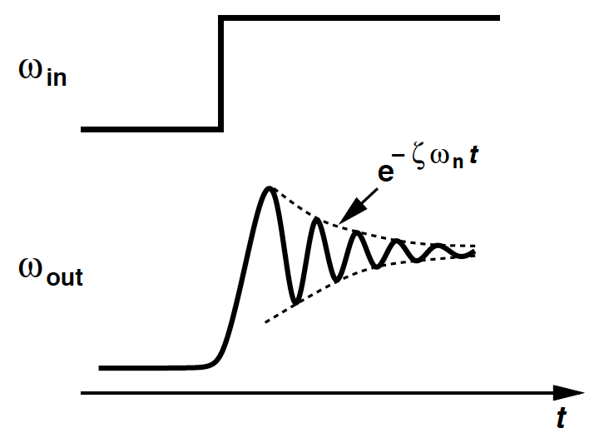

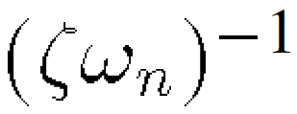

Underdamped Step Response of PLL
The step response contains a sinusoidal component with frequency that decays with time constant .
To maximize settling speed of PLLS ➔ is maximized.
Trade-off between the settling speed and the ripple on the VCO control line.

Slide 25
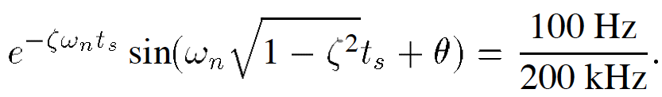

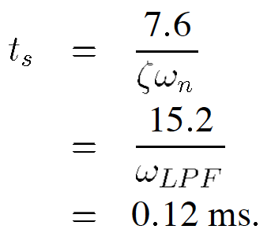
Example 16.5
Consider a 900-MHz PLL. ω_{LPF} = 2π × (20 kHz). Output frequency changes from 901 MHz to 901.2 MHz. How long does it take to settle within 100 Hz of its final value?
Solution
Step size = 200 kHz
➔
➔
In the worse case, the sinusoid is unity and
That is,

Slide 26
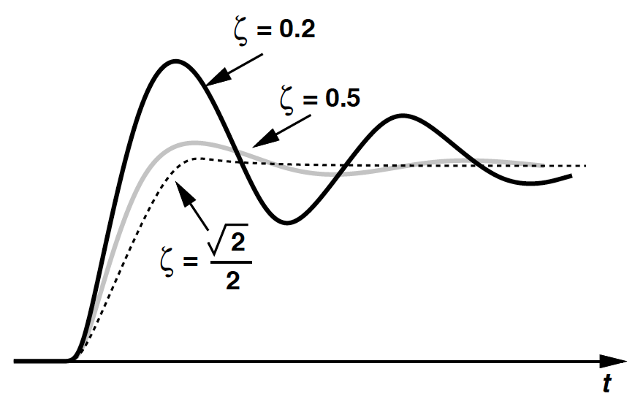
Underdamped Step Response for Various ζ
Severe ringing for ζ < 0.5.
Trade-offs assciated with choice of ζ:
- Reduce ω_{LPF} to minimize ripple on V_{cont} ➔ stability degrades.
- Lower phase error ➔ system less stable.
(Phase error and ζ inversely proportional to K_{PD}K_{VCO}.)

Slide 27
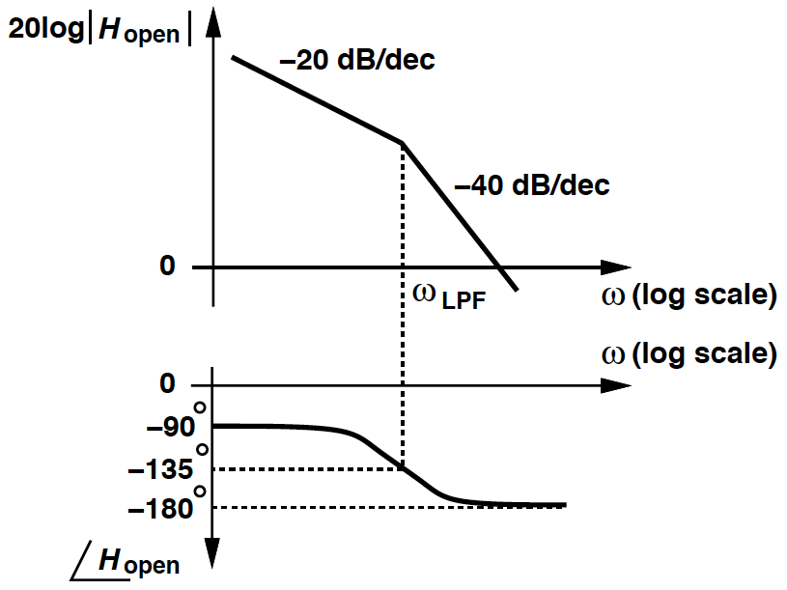
Bode Plots of Type I PLL
A higher K_{PD}K_{VCO} to minimize ϕ_{out} – ϕ_{in} ➔ gain plot shifted up & gain crossover to the right ➔ phase margin degrades.
The above is consistent with dependence of ζ upon K_{PD}K_{VCO}.

Slide 28
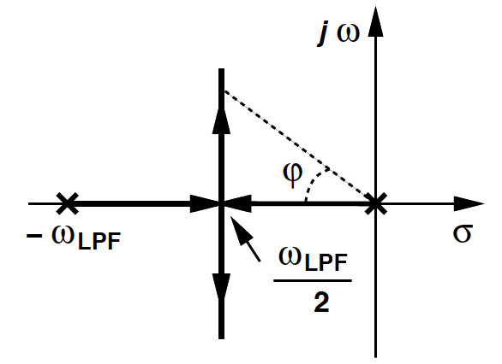
Root Locus of Type I PLL
K_{PD}K_{VCO} = 0 ➔ loop is open, ζ = ∞, and s₁ = -ω_{LPF}, s₂ = 0.
K_{PD}K_{VCO} increases ➔ ζ drops and the two poles move toward each other on the real axis.
- For ζ = 1 (i.e., K_{PD}K_{VCO} = ω_{LPF}/4), s₁ = s₂ = -ζω_{n} = -ω_{LPF}/2.
K_{PD}K_{VCO} increases further ➔ two poles become complex with real part equal to -ζω_{n} = -ω_{LPF}/2, , moving in parallel with jω axis.
s₁ and s₂ moves away from the real axis ➔ system less stable.

Slide 29


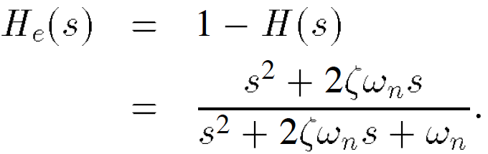
PLL Transfer Function of Phase Error
Another transfer function involves the error at the output of the phase subtractor:
H_{e}(s) can be obtained by
and from
As expected, H_{e}(s) -> 0 if s -> 0.

Slide 30

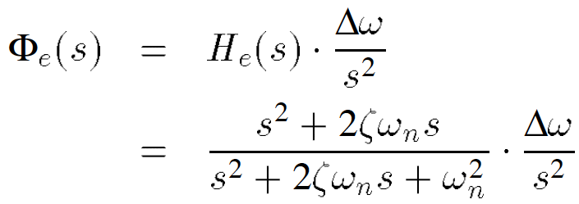
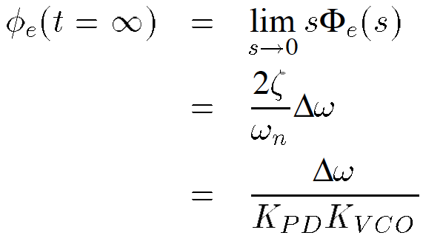
Example 16.6
A type-I PLL experiences a frequency step Δω at t = 0. Calculate the change in the phase error.
Solution
The Laplace transform of the frequency step = Δω/s.
➔
 ➔ From the final value theorem,

Slide 31
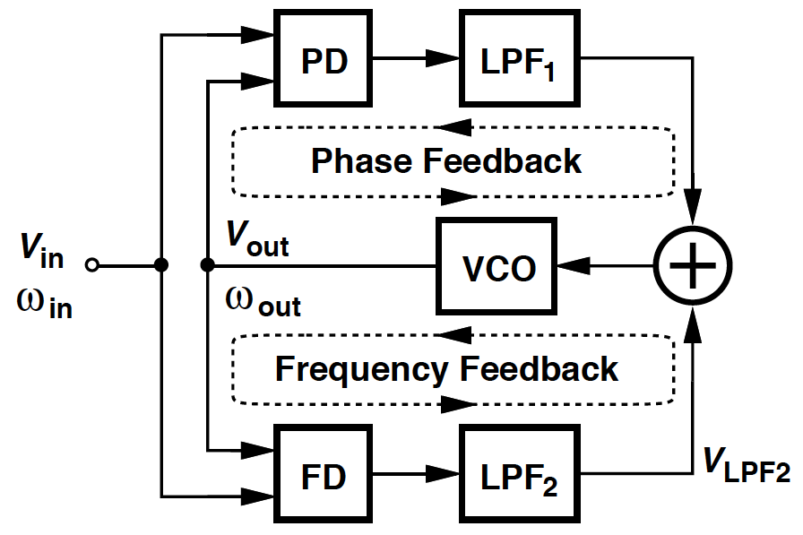
Aided Acquisition
Problem of lock acquisition: The loop locks only if the difference between ω_{in} and ω_{out} is less than ~ ω_{LPF}.
Aided acquisition:
- Compare ω_{in} and ω_{out} by frequency detector.
- Generate a dc component V_{LPF2} proportional to ω_{in} – ω_{out}
 ➔ applied to VCO in a negative-feedback loop.
- Initially, FD drives ω_{out} toward ω_{in}, & PD output remains “quiet”.
- As |ω_{out} – ω_{in}| sufficiently small ➔ PLL takes over ➔ Lock!

Slide 32
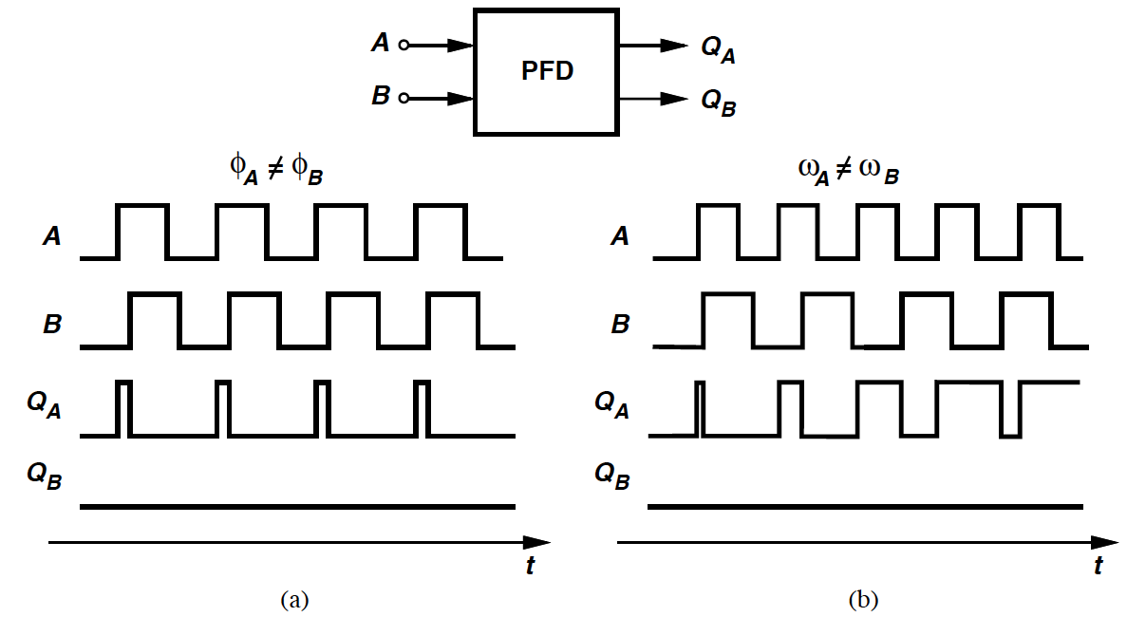
Phase/Frequency Detector (PFD)
If a rising edge on A followed by a rising edge on B ➔ Q_{A} goes high and returns to low, Q_{B} = 0. (Similar behavior for input B.)
In (a), A leads B with equal frequencies ➔ Q_{A} continues to produce pulses with width proportional to ϕ_{A} – ϕ_{B}, Q_{B} = 0.
In (b), A has a higher frequency & Q_{A} generates pulses, Q_{B} = 0.
If A lags B or has a lower frequency than B ➔ Q_{B} produces pulses, Q_{A} = 0.
Q_{A}: “UP” pulse, Q_{B}: “DOWN” pulse.

Slide 33
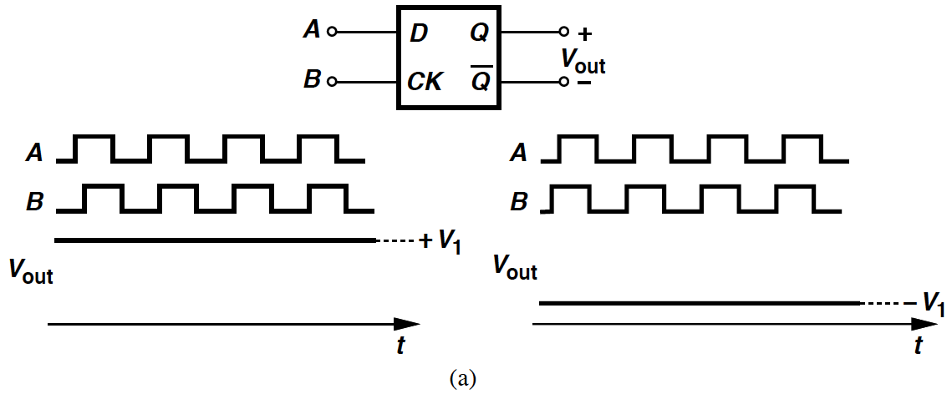
Example 16.7 (I)
Explain whether a master-slave D flipflop can operate as a phase detector or a frequency detector.
Solution
In (a), first apply inputs with equal equal frequencies & finite phase difference.
If A leads B ➔ V_{out} remains high indefinitely because flipflop continues to sample high levels of A.
If A lags B ➔ V_{out} remains low.

Slide 34
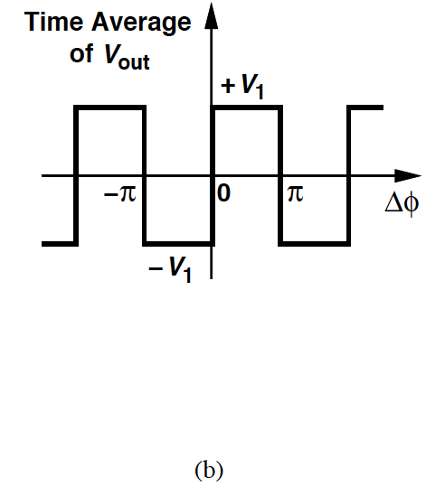
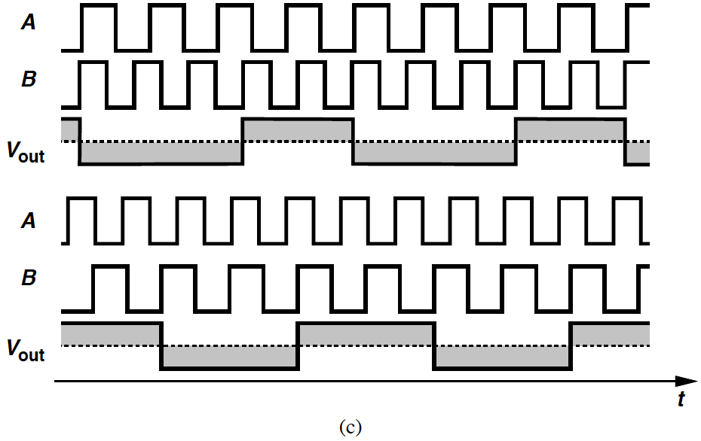
Example 16.7 (II)
(b): High gain at Δϕ = 0, ±π, …, zero gain at other Δϕ.
D flipflop is called a “bang-bang” phase detector: The avergae value of V_{out} jumps from –V₁ to +V₁ as Δϕ varies from 0⁻ to 0⁺.
If the flipflop is to behave as a frequency detector, then average value of V_{out} has different polarities for ω_{A} > ω_{B} & ω_{A} < ω_{B}.
However, in (c), the average value of V_{out} is zero for both ω_{A} > ω_{B} & ω_{A} < ω_{B}.

Slide 35
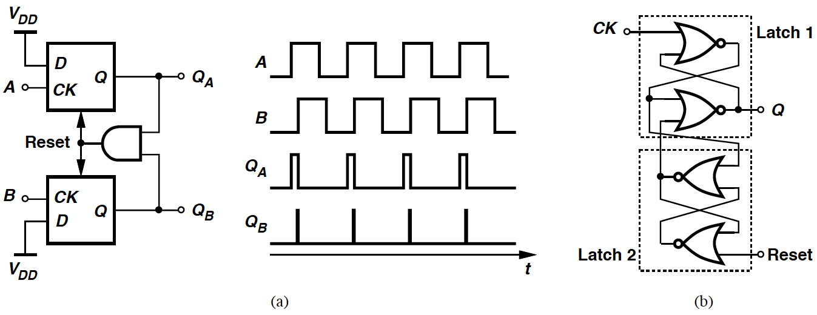
Implementation of PFD
Simple implementation of PFD in (a): D inputs of two flipflops tied to logical ONE, A & B as clocks of the flipflops.
If Q_{A} = Q_{B} = 0 & A goes high ➔ Q_{A} rises. Then if followed by rising on B ➔ Q_{B} goes high and the AND gate resets both flipflops.
Each flipflop can be implemented as (b): Cross-coupled Latch 1 & Latch 2 respond to rising edges of CK and Reset, respectively.

Slide 36



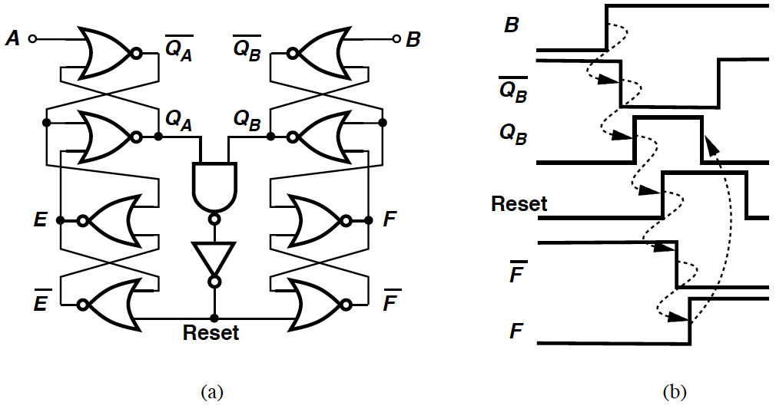
Example 16.8
Determine the width of the narrow reset pulse that appear in the Q_{B} waveform in figure (a) (Slide 35).
Solution
(a) shown below illustrates the overall PFD at the gate level.
If it begins with A = 1, Q_{A} = 1, and Q_{B} = 0, a rising edge on B forces to go low and, one gate delay later, Q_{B} to go high.
In (b), this transition propagates to Reset, and , E & F, and finally to Q_{A} and Q_{B}.
The width of the pulse on Q_{B} ≈ 5 gate delays.

Slide 37
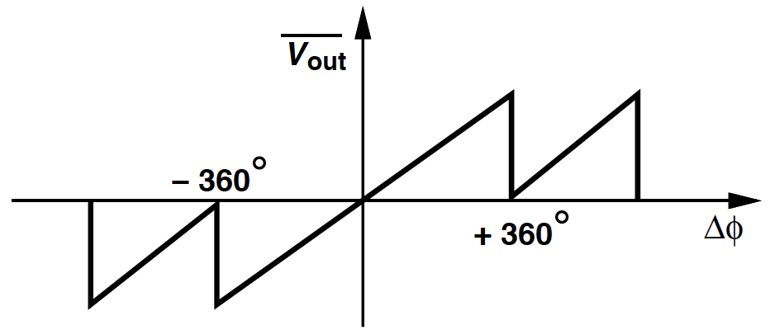
Input-output Characteristic of 3-state PFD
Define output as the difference between average values of Q_{A} and Q_{B} when ω_{A} = ω_{B}.
The output varies symmetrically as |Δϕ| begins from zero.
For Δϕ = ±360°, V_{out} reaches extrema and subsequently changes sign.
Slope of this characteristic = gain.

Slide 38
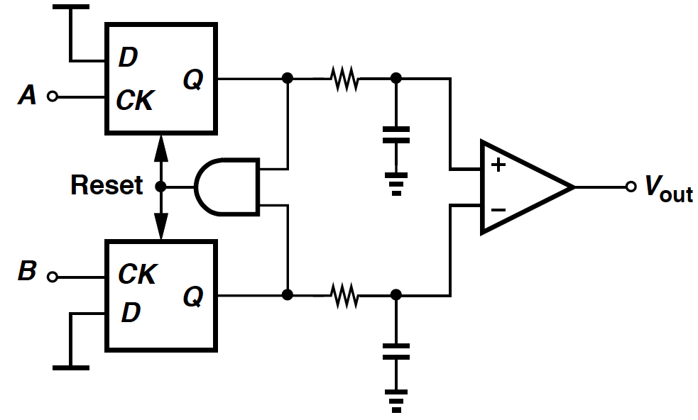
PFD Followed by Low-Pass Filters
The difference between average values of Q_{A} and Q_{B} is of interest ➔ Two outputs low-pass filtered and sensed differently.
A PLL with such topology always locks.
Suffers from a finite phase error due to finite K_{PFD}V_{VCO}.

Slide 39
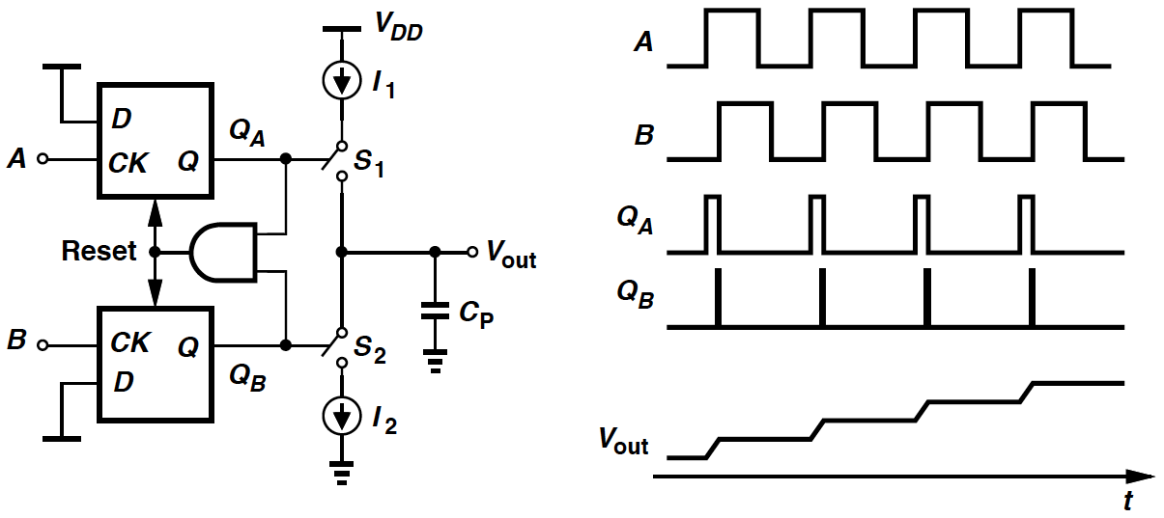
PFD with Charge Pump
To raise the loop gain to infinity, we first interpose a “charge pump” (CP) between PFD and loop filter.
Q_{A} = Q_{B} = 0 ➔ S₁ & S₂ off, V_{out} remains constant.
Q_{A} = 1, Q_{B} = 0 ➔ I₁ charges C_{P}.
Q_{A} = 0, Q_{B} = 1 ➔ I₂ discharges C_{P}.
E.g., A leads B ➔ Q_{A} continues to produce pulses, V_{out} rises steadily.

Slide 40

Example 16.9
What is the effect of the narrow pulses that appear in the Q_{B} waveform (Slide 39)?
Solution
Q_{A} and Q_{B} are simultaneously high for a finite period (Example 16.8) ➔ the current supplied by the charge pump to C_{P} is affected.
If I₁ = I₂, current through S₁ simply flows through S₂ during the narrow reset pulse ➔ no current to charge C_{P}.
V_{out} remains constant after Q_{B} goes high.

Slide 41

Basic Charge-Pump PLL
Charge-pump PLL:
- Senses transitions at input and output.
- Detects phase/frequency differences.
- Activates the charge pump accordingly.
As ω_{out} approaches ω_{in} and when close enough ➔ PFD operates as phase detector, performing phase lock.
When the loop is locked, V_{cont} is finite. ➔ Input phase error must be exactly zero (in contrast to type-I PLL).

Slide 42


Dynamics of CPPLL
To test linearity of PFD/CP/LPF combination: Double input phase difference and see if V_{out} exactly doubles.
The flat sections of V_{out} double but not the ramp sections.
The current charging/discharging C_{P} is constant ➔ constant slope for the ramp.
Not linear in the strict sense.
Approximate the output waveform by a ramp in (b) ➔ linear relationship between V_{out} and Δϕ.

Slide 43




Step Response of PFD/CP/LPF Combination
Assume input period = T_{D} & charge pump provides ±I_{P} to the capacitor.
Begin with zero phase difference, Δϕ = ϕ₀u(t) ➔ Q_{A} or Q_{B} continues to produce pulses of ϕ₀T_{in}/(2π) seconds wide.
Approximated by a ramp ➔
The impulse response:
➔ Transfer function:

Slide 44


Example 16.10
Suppose the output quantity of interest in the circuit below is the current injected by the charge pump into the capacitor. Determine the transfer function from Δϕ to this current, I_{out}.
Solution
V_{out}(s) = I_{out}/(C_{P}s)
 
 ➔

Slide 45



Linear Model of Charge-pump PLL (I)
The linear model of charge-pump PLLs has an open-loop transfer function:
Loop gain has two poles at the origin ➔ “type II” PLL.
Close-loop transfer function:

Slide 46



Linear Model of Charge-pump PLL (II)
H(s) contains two imaginary poles at: s_{1,2} =
➔ unstable system.
In (a): constant total phase shift of 180° ➔ system oscillates at gain
crossover frequency.
To stabilize the system, phase shift < 180° at the gain crossover.
(b): Accomplished by introducing a zero in loop gain, i.e., by adding a resistor in series with capacitor C_{P}.

Slide 47





Linear Model of Charge-pump PLL (III)
In this circuit, transfer function of PFD/CP/LPF now becomes:
and
➔
Close-loop system contains a zero at s_{z} = -1/(R_{P}C_{P}).
Using the same notation as before, we have:

Slide 48





Charge-pump PLL: Stability Issues
In Bode plots of the loop gain: I_{P}K_{VCO} decreases ➔ gain crossover frequency moves toward the origin ➔ phase margin degrades.
In root locus of the close-loop system in complex plane:
- I_{P}K_{VCO} = 0 ➔ loop open, both poles at the origin.
- I_{P}K_{VCO} > 0 ➔
- Complex poles if I_{P}K_{VCO} is small.
- I_{P}K_{VCO} increases ➔ s₁, s₂ move on a circle centered at
& radius =
For ζ ≥ 1, poles are real.
For complex s₁, s_{2,} ζ = cosψ: I_{P}K_{VCO} exceeds zero ➔ more stable.

Slide 49
Example 16.11
Explain the flaw: A student considers the Bode plots and observes that at ω₁, the loop gain > 1 & phase shift = -180°. Then the PLL must oscillate at this frequency.
Solution
The phase shift is in fact slightly less than zero unless ω₁ = 0.
Using Nyquist’s approach (Chapter 10), a system containing two integrators and one zero does not oscilate.
 

Slide 50

Charge-pump PLL: Addition of C₂
For the compensated type-II PLL: V_{cont} experiences large jump ➔ disturb VCO.
A second capacitor added in parallel with R_{P} and C_{P} ➔ suppress the initial step.
Third-order PLL. If C₂ is about 1/5 to 1/10 of C_{P} ➔ close-loop time and frequency responses remain relatively unchanged.
In reality, R_{P} becomes very large ➔ stability degrades again.

Slide 51


PFD/CP Nonidealities
If A & B rise simultaneously, so do Q_{A} & Q_{B} ➔ activate reset.
(a): A hypothetical PFD that produces no pulses for a zero input phase difference.
(b): The circuit generates very narrow pulses on Q_{A} or Q_{B}.

Slide 52

Dead Zone in Charge Pump Current
If Δϕ falls below ϕ₀ ➔ output volatage of PFD/CP/LPF combination is no longer a function of Δϕ.
For |Δϕ| < ϕ₀, charge pump injects no current ➔ loop gain drops to zero and output phase is not locked.
Thus PFD/CP circuit suffers from a dead zone equal to ±ϕ₀ around Δϕ = 0.

Slide 53

Jitter from Dead Zone
Dead zone allows VCO to accumulate as much random phase error as ϕ₀ with respect to input while receiving no corrective feedback.
The zero crossing points of the VCO output experience substantial random variations ➔ “jitter.”

Slide 54

Response of Actual PD to a small Δϕ
The coincident pulses on Q_{A} and Q_{B} can eliminate dead zone.
An infinitesimal increment in Δϕ ➔ proportional increase in net current produced by the charge pump.

Slide 55



Effect of Skew
(a): M₁ & M₂ as Current sources, M₃ & M₄ as Switches. Output Q_{A} is inverted. Q_{A} goes high ➔ M₄ turns on.
Issue of (a): As in (b), net current injected by the charge pump into loop filter jumps to +I_{P} & -I_{P} ➔ disturb V_{cont} periodically.
(c) can equalize the delays and suppress the above effect.

Slide 56

Effect of UP & DOWN Current Mismatch
(a): Even with perfect alignment of UP & DOWN pulses, net current ≠ 0 ➔ charge V_{cont} by a constant increment at each phase comparison instant.
For the loop to remain locked, average value of V_{cont} must remain constant ➔ (b): PLL creates a phase error between input & output such that net current in every cycle = 0.

Slide 57

Charge Sharing between C_{P}, C_{X} & C_{Y}
Suppose in (a), S₁ & S₂ off ➔ M₁ discharge X to ground, M₂ charge Y to V_{DD}.
(b): Next phase comparison instant, both S₁ & S₂ on ➔ V_{X} rises, V_{Y} falls, V_{X} ≈ V_{Y} ≈ V_{cont}.
Even if C_{X} = C_{Y}, change in V_{X} is not equal to that in V_{Y} ➔ difference between the two changes must be supplied by C_{P} ➔ a jump in V_{cont}.

Slide 58

Bootstrapping
Charge sharing can be suppressed by “bootstrapping.”
When S₁ & S₂ off, S₃ & S₄ on ➔ allow unity-gain amplifier to hold V_{X} & V_{Y} at V_{cont}.
Next phase comparison instant, S₁ & S₂ on, S₃ & S₄ off ➔ V_{X} & V_{Y} begin with V_{cont} ➔ no charge sharing between C_{P} and capacitances at X & Y.

Slide 59

Ideal vs. Jittery Waveforms
Strictly periodic x₁(t) contains zero crossings evenly spaced in time.
Nearly periodic x₂(t) displaces zero crossings from ideal points.
We say x₂(t) suffers from jitter.
From plots of ϕ_{out} and ϕ_{ex}, jitter manifests itself as variation of ϕ_{ex} with time.

Slide 60

Slow vs. Fast Jitter
y₁(t): instantaneous frequency varies slowly from one period to the next ➔ “slow jitter.”
y₂(t): “fast jitter.”
Rate of change is also evident from ϕ_{ex} plots of the two waveforms.
Slow jitter at input propagates to output unattenuated but fast jitter does not.

Slide 61


Effect of VCO Jitter
Suppose input is strictly periodic but VCO suffers from jitter.
In this model, x_{in}(t) = A cosωt, a random component Φ_{VCO} is added to the output of VCO to represent its jitter.
➔ For type-II PLL:
The characteristic has a high-pass nature ➔ slow jitter components generated by VCO are suppressed but fast jitter components are not.

Slide 62

Response of PLL to Input Jitter & VCO Jitter
Depending on the application and the application, one or both sources (input jitter & VCO jitter) may be significant, requiring an optimum choice of the loop bandwidth.

Slide 63

Generation of Clock Edges
(a): Four clock phases with ΔT = 1 ns between consecutive edges.
(b): To generate phases in (a), use a two-stage differential ring oscillator, locked to a 250-MHz reference ➔ output period is exactly 4 ns.

Slide 64

Simple Delay-Locked Loop (DLL)
(a) also generates the clock phases (Slide 63): Apply input clock to four delay stages in a cascade.
- Does not produce a well-defined edge spacing.
(b): Simple delay-locked loop (incorporates VCDL not a VCO)
- Phase difference between Ck_{in} and CK₄ sensed by a PD.
- A proportional average voltage, V_{cont}, generated.
- Delay adjusted with negative feedback.
- Large loop gain ➔ small phase difference between Ck_{in} & CK₄
➔ establish precise edge spacing.

Slide 65

Example 16.12
Explain qualitatively what type of transfer function the DLL shown below has.
Solution
For slow phase fluctuations on input:
- Phase error sees a high gain through PD/CP/LPF.
- Delay of the line is adjusted so as to minimize this error.
➔ ϕ_{out} tracks ϕ_{in}, gain is about unity.
For very fast phase changes on input:
- Feedback loop has little gain, V_{cont} relatively constant.
- Input phase variations directly propagates to output
➔ gain of about unity.
The DLL exhibits all-pass response, but the response may have a dip or a peak for moderately fast phase changes.

Slide 66


Frequency Multiplication
(a) Voltage amplification: A feedback system amplifies V_{in} by a factor M if R₂/(R₁ + R₂) = 1/M, and compare the result with V_{in}.
(b) Frequency multiplication: f_{out} of a PLL divided by M and applied to the phase detector ➔ f_{out} = Mf_{in}.
Rewrite the equation on Slide 50 as:
Compare the denominators of two equations of H(s) ➔ frequency division in the loop manifests itself as division of K_{VCO} by M.

Slide 67




VCO/Divider combination
For the VCO/divider cascade, we have:
This combination is equivalent to a VCO with an intercept frequency = ω₀/M and gain = K_{VCO}/M.
Then we can rewrite:
Decay time constant is modified to
➔ Inserting a divider in a type-II loop degrades both stability and settling speed.

Slide 68

Phase-Locked Frequency Synthesizer
Channel control input: A digital word that defines value of M.
f_{out} = Mf_{REF}, the relative accuracy of f_{out} is equal to that of f_{REF}.
➔ f_{REF} derived from a stable, low-noise oscillator.

Slide 69

Skew between Data and Buffered Clock
A synchronous pair of data and clock lines enter a large digital chip.
The clock typically drives a large number of transistors and long interconnects ➔ be the first applied to a large buffer.
The clock distributed on the chip may suffer from substantial skew, ΔT, with respect to the data.

Slide 70

Use of PLL to Eliminate Skew
An CK_{in} is applied to an on-chip PLL and the buffer is placed inside the loop.
The PLL guarantees a nominally-zero phase difference between Ck_{in} and CK_{B} ➔ skew is eliminated.
Constant phase shift introduced by buffer is divided by infinite loop gain of the feedback system.

Slide 71



Example 16.13
Construct the voltage-domain counterpart of the loop (Slide 70).
Solution
The buffer creates a constant phase shift in the signal generated by VCO.
➔ voltage-domain counterpart assumes the below topology:
We have:
➔
As A -> ∞, V_{out} -> V_{in}.

Slide 72


Jitter Reduction
Jittery waveforms: Typically “retimed” by a low-noise clock.
(a): Resample the midpoint of each bit by a D flipflop driven by the clock.
- However the clock may not be available independently.
Modified as (b): A “clock recovery circuit” (CRC) produces clock from the data.
➔ minimize effect of input jitter on the recovered clock.

