Slide 1
Chapter 5: Current Mirrors and Biasing
Techniques
5.1 Basic Current Mirrors
5.2 Cascode Current Mirrors
5.3 Active Current Mirrors
5.4 Biasing Techniques

Slide 2
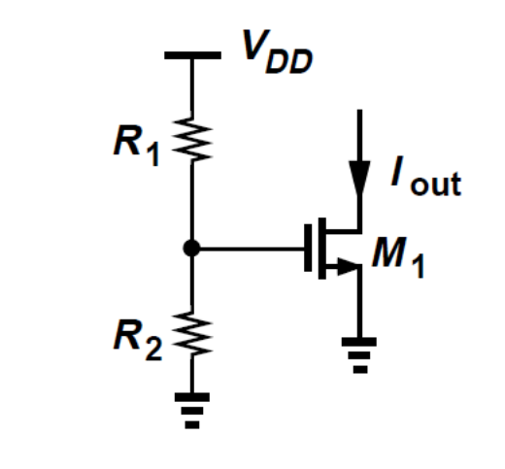
Basic Current Mirrors
AssumingM1 is in saturation, we can write
The threshold voltage may vary by 50 to 100 mV from wafer to wafer
Both μn and VTH exhibit temperature dependence
We must seek other methods of biasingMOS current sources.

Slide 3
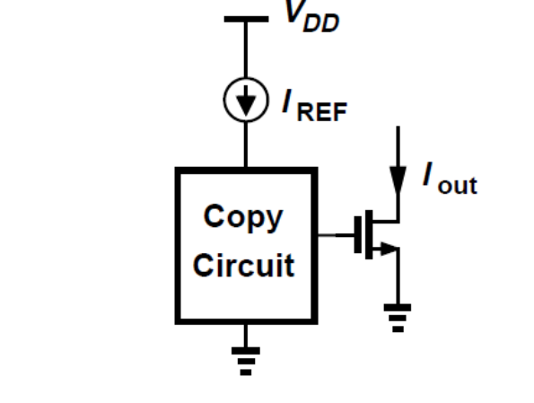
Conceptual means of copying currents
Use of a reference to generate various currents.
Two identical MOS devices that have equal gate-source voltages and operate in saturation carry equal currents

Slide 4
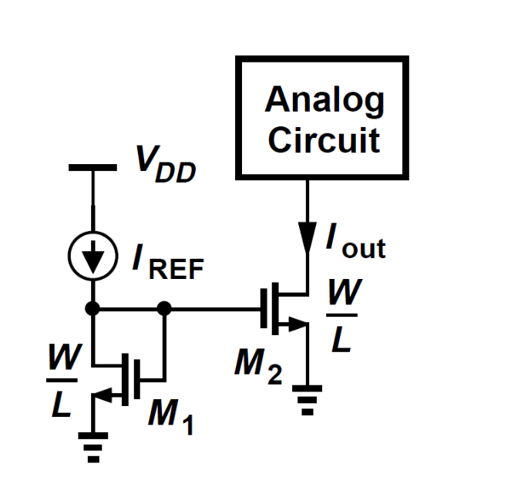
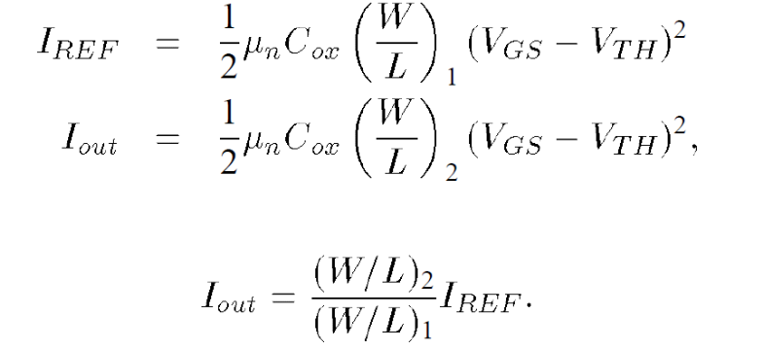
Effect of Channel-Length Modulation
Neglecting channel-length modulation, we can write
Allows precise copying of the current with no dependence on process and temperature

Slide 5
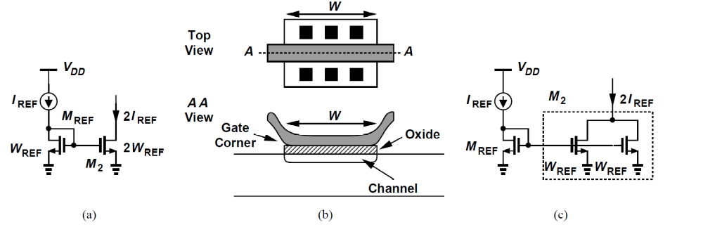
Sizing issues
Current mirrors usually employ the same length for all of the transistors.
Current ratioing is achieved by only scaling the width of transistors.
Direct scaling of the width also faces difficulties.
We thus prefer to employ a “unit” transistor and create copies by repeating such a device.

Slide 6
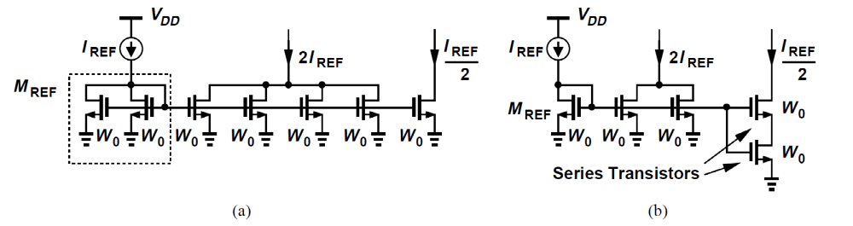
Sizing Issues
How do we generate a current equal to I_{REF} /2=2 from I_{REF} ?
(a) half-width device, and (b) series transistors
Approach (b) preserves an effective length of (Ldrawn-2LD) for each unit, yielding an equivalent length of 2(Ldrawn - 2LD)
Current mirrors can process signals as well, example next slide.

Slide 7
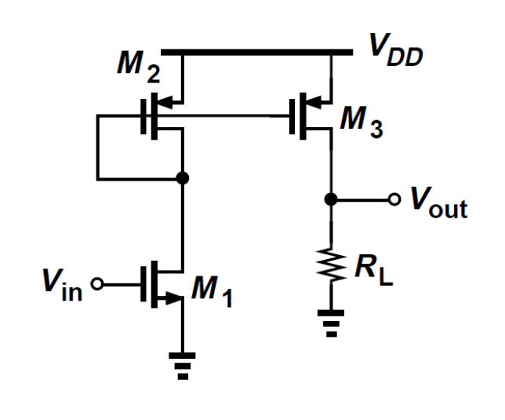


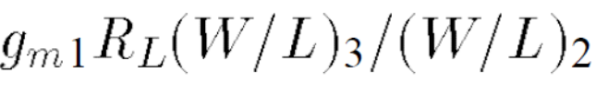
Example
Calculate the small-signal voltage gain of the circuit shown in Figure.
Gain=

Slide 8


Cascode Current Mirrors
While , may not equal
We can (a) force VDS2 to be equal to VDS1, or (b) force VDS1 to be equal to VDS2.

Slide 9
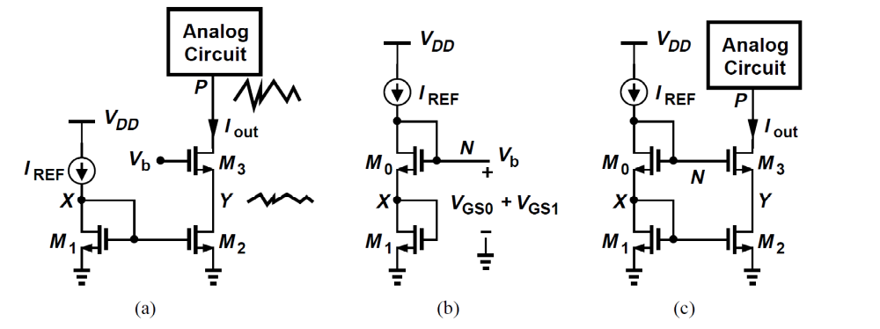
First Approach
A cascode device can shield a current source, thereby reducing the voltage variations across it.
But, how do we ensure that VDS2 = VDS1?
We must generate Vb such that Vb - VGS3 = VDS1(= VGS1)

Slide 10

Example
sketch VX and VY as a function of IREF. If IREF requires 0.5 V to operate as a current source, what is its maximum value?

Slide 11
Example
the minimum allowable voltage at node P is equal to
The cascode mirror “wastes” one threshold voltage in the headroom.
Because VDS2 = VGS2, whereas VDS2 could be as low as VGS2-VTH while maintaining M2 in saturation.

Slide 12
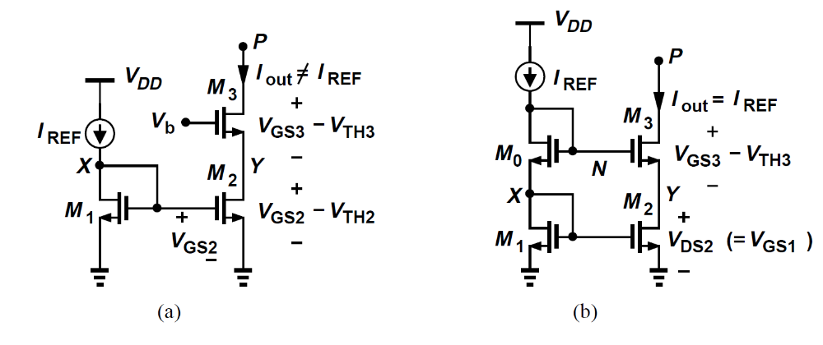
Approach summary
In Fig(a), Vb is chosen to allow the lowest possible value of VP but the output current does not accurately track IREF.
In Fig(b), a higher accuracy is achieved, but the minimum level at P is higher by one threshold voltage.

Slide 13
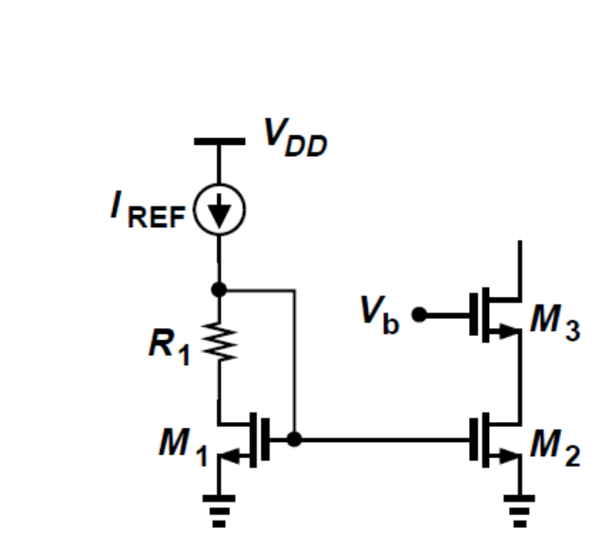


Second Approach
Consider the branch shown in Fig. 5.16(b)
As a candidate and write Vb = VGS5 + R6I6.

Slide 14
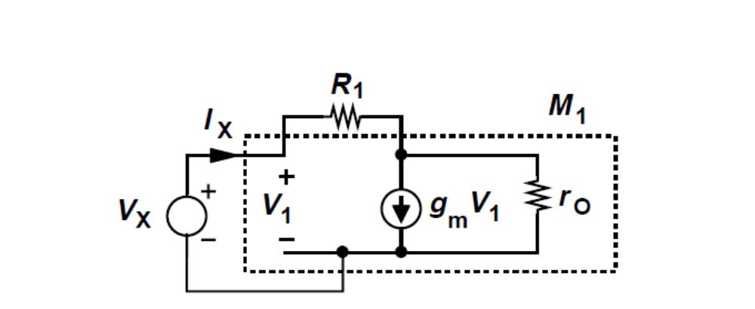


Small signal Model
Reduces to 1/gm in the absence of channel-length modulation.
Thus, from a small-signal point of view, the combination is close to a diode-connected device.
But
(1) It may be difficult to guarantee that
(2) The generation of
is not straightforward.

Slide 15
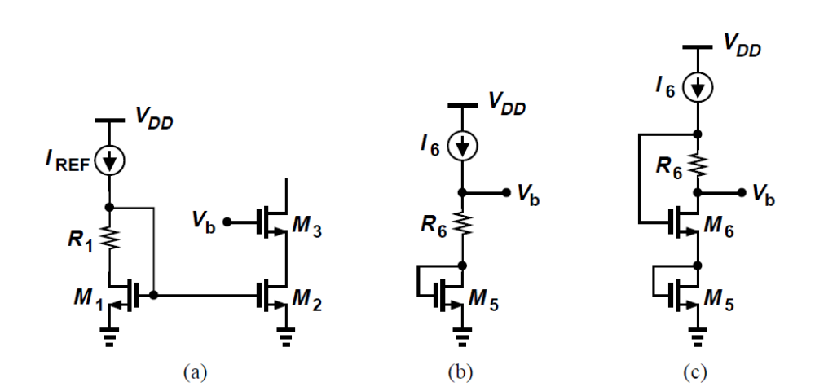
Generate Vb
Consider the branch shown in Fig(b) as a candidate and write Vb = VGS5 + R6I6.
VGS5 = VGS3
However, the condition I is hard to meet.

Slide 16
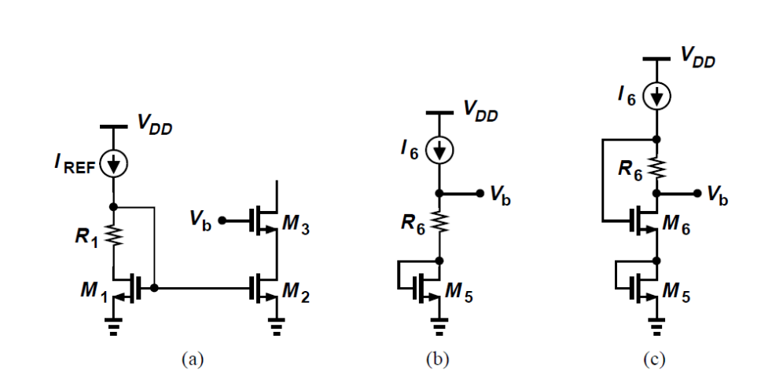
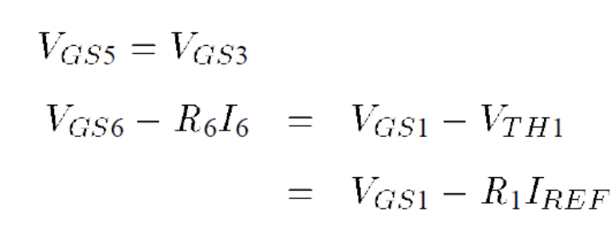
Generate Vb
It is now possible to ensure that VGS6 and VGS1 track each other.
For example, we may simply choose I6 = IREF , R6 = R1, and (W/L)6 = (W=/L)1

Slide 17
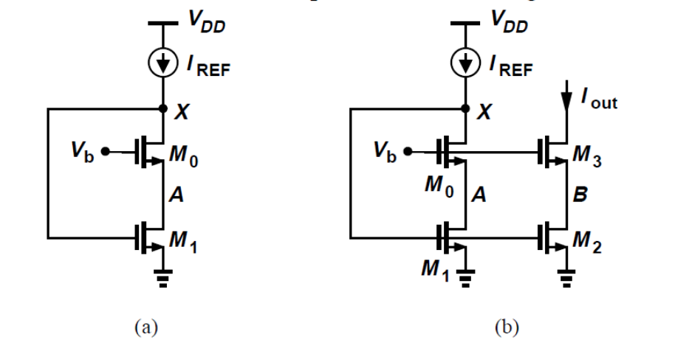



Another circuit topology
In this case
Must have for M0 to be saturated and for M1 to be saturated.
A solution exists if
We must therefore sizeM0 to ensure its overdrive is well below VTH1.

Slide 18
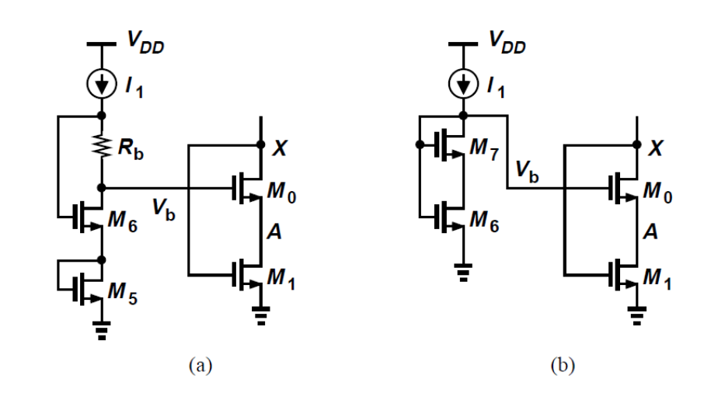

How to generate Vb
In figure (a)
Some inaccuracy nevertheless arises because M5 does not suffer from body effect whereas M0 does.
Also, the magnitude of R6*I1 is not well-controlled.
A simpler alternative is shown in Fig(b)

Slide 19
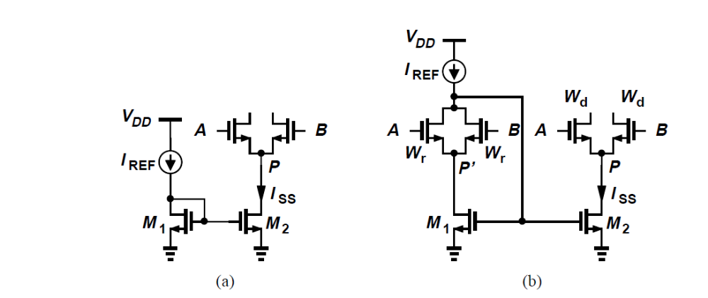
Example
Voltage headroom is too small to allow the use of a cascode current source. Devise a method to reduce the current mirror error due to channel-length modulation.
The voltages at P0 and P track even if the CM level at A and B varies.
The two differential pairs must incorporate the same lengths and scale their widths according to Wr/Wd = IREF/ISS.

Slide 20
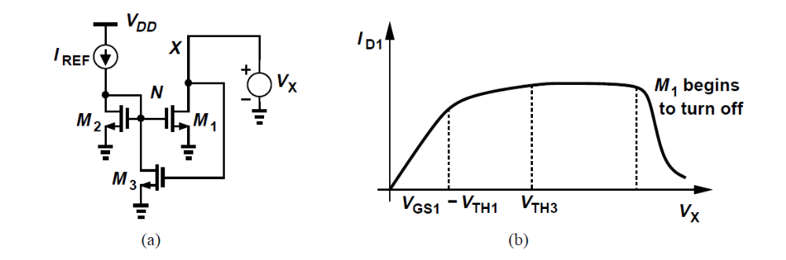

Example
An alternative current mirror exhibiting a high output impedance.
Small signal: If we choose the net change in ID1 is small.
Figure b for large signal.
The above circuit does pose its own voltage headroom limitation: VX must exceed VTH3.

Slide 21
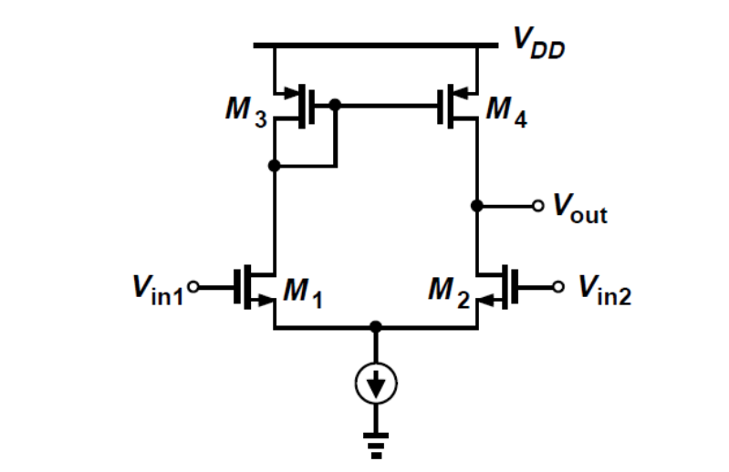
Active Current Mirrors
A five-transistor “operational transconductance amplifier” (OTA).
Note that the output is single-ended, hence the circuit is sometimes used to convert differential signals to a single-ended output.

Slide 22
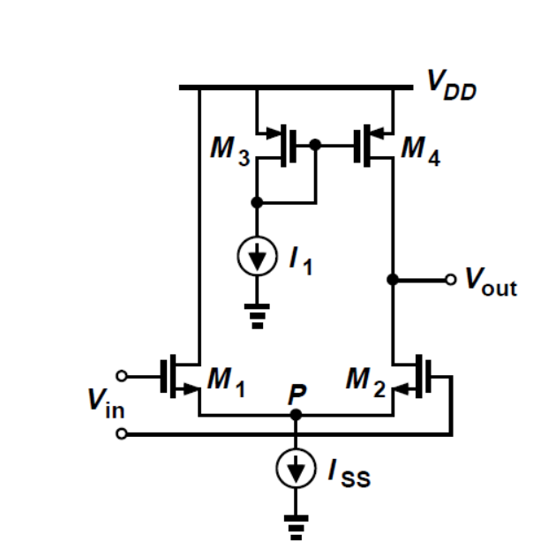

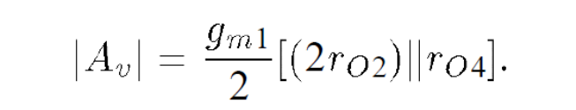
Quick Calculation
We may simply discard one output of a differential pair as shown in Fig.
What is the small-signal gain?

Slide 23
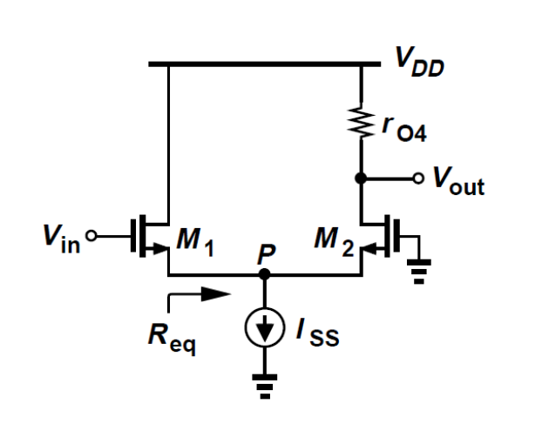
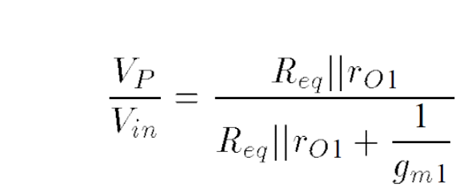
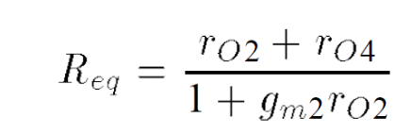
Second Approach
We calculate Vp /Vin and Vout/Vp
Caculate Vout/Vp

Slide 24
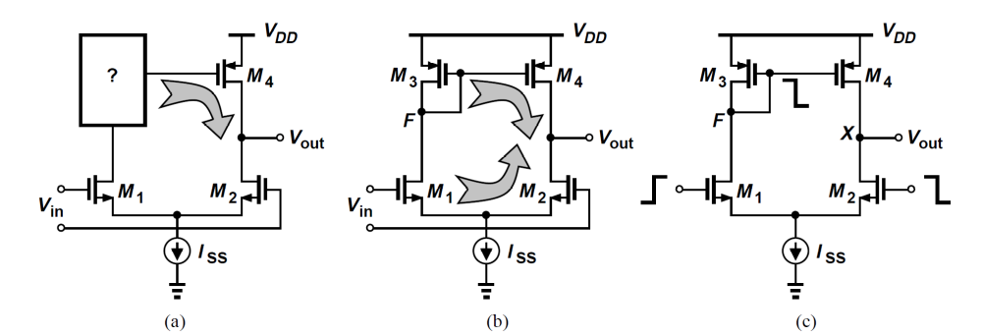
Differential Pair with Active Load
The small-signal draincurrent of M1 is “wasted.”
It is desirable to utilize this current with proper polarity at the output.
This can be accomplished by the five-transistor OTA.
M3 enhances the gain.
The five-transistor OTA is also called a differential pair with active load.

Slide 25
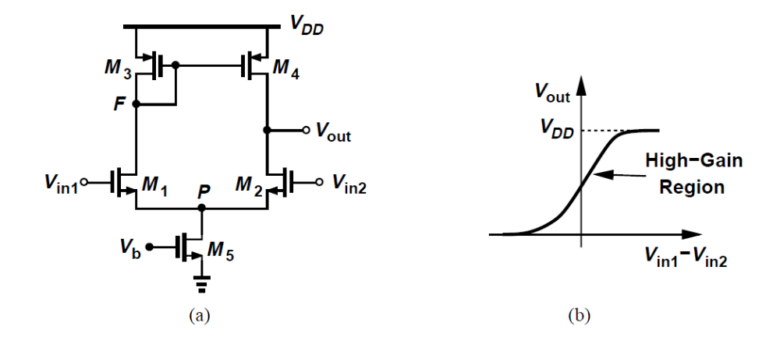
Large-Signal Analysis
If Vin1 is much more negative than Vin2, Vout = 0.
As Vin1 approaches Vin2, The output voltage then depends on the difference between ID4 and ID2. For a small difference between Vin1 and Vin2, both M2 and M4 are saturated, providing a high gain.
As Vin1 becomes more positive than Vin2, allowing Vout to rise and eventually driving M4 into the triode region .

Slide 26
Example
For VDD = 3 V, symmetry requires that Vout = VF.
As VF and Vout fall below +1:5 V -VTH, M1 and M2 enter the triode region, but their drain currents are constant if M5 is saturated.
Eventually M5 into the triode region. Thereafter, the bias current of all of the transistors drops, lowering the rate at which Vout decreases.

Slide 27
Example
Sketch the large-signal input-output characteristic of the unity-gain buffer shown in Fig if the op amp is realized as a five-transistor OTA.
We begin with Vin = 0 and note that M1,M3, and M4 are off.
As Vin rises, Vout ≈ Vin. This unity-gain action continues as Vin increases.
For a sufficiently high Vin: M1 and M4 went to triode region.

Slide 28
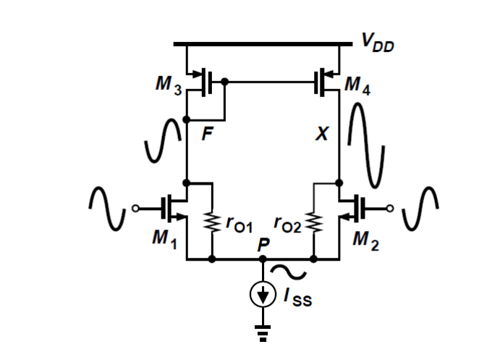
Small-Signal Analysis
With small differential inputs, the voltage swings at nodes F and X are vastly different.
The effects of VF and VX at node P (through rO1 and rO2, respectively) do not cancel each other and this node cannot be considered a virtual ground.

Slide 29
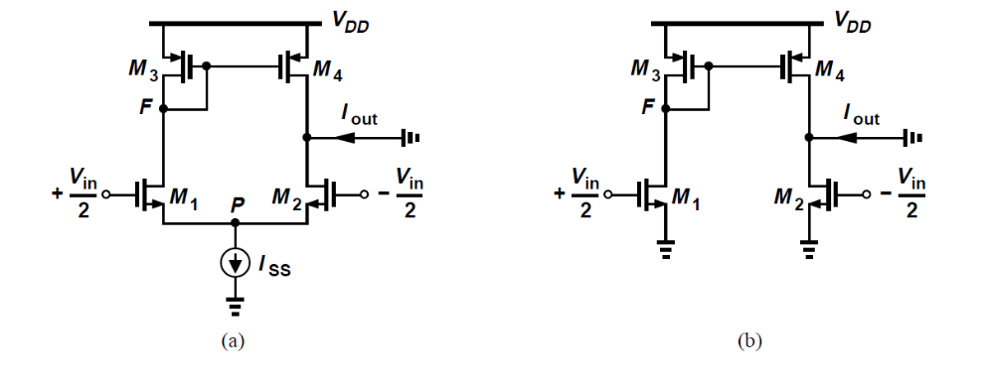

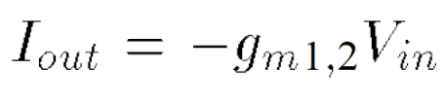

Approximate Analysis
Node P can be approximated by a virtual ground.

Slide 30
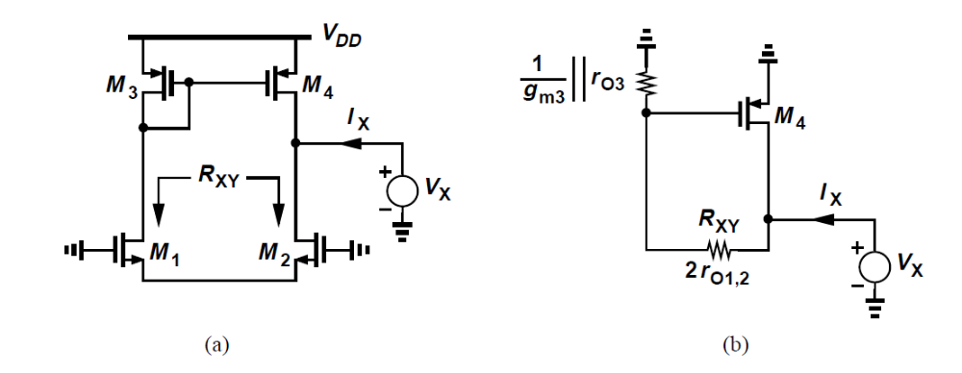

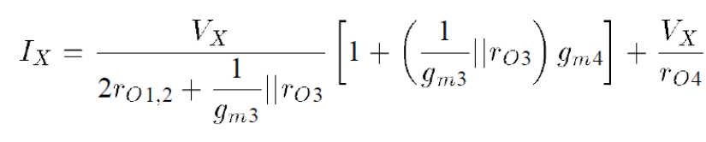

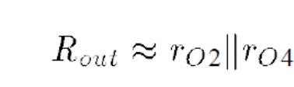
Calculation of Rout
Any current flowing intoM1 must flow out of M2, and the role of the two transistors can be represented by a resistor
The current drawn from VX by RXY is mirrored byM3 ontoM4 with unity gain.
For

Slide 31
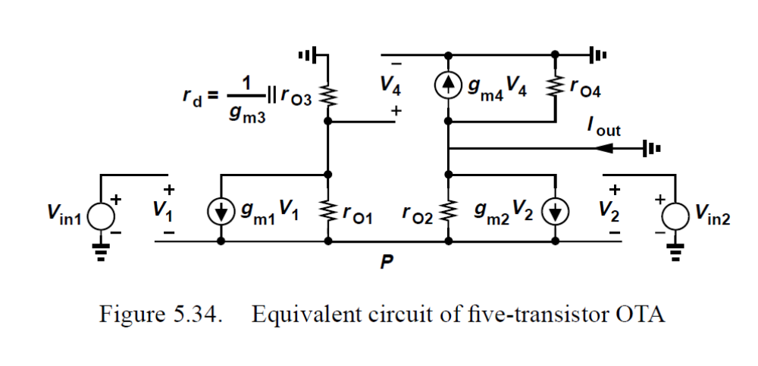
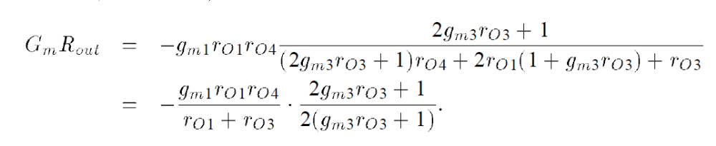
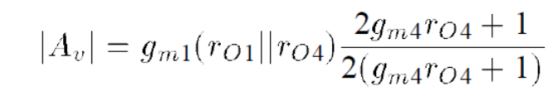

Exact Analysis
We can viewthis result as our approximate solution, . multiplied by a “correction” factor that is less than unity.

Slide 32
Headroom Issues
The five-transistor OTA does not easily lend itself to low-voltage operation.
The value of I1 must be much less than ISS/2.
Insert a resistor in series with the gate and draw a constant current from it.

Slide 33
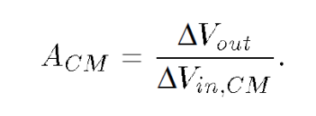
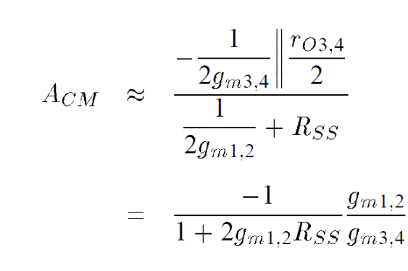
Common-Mode Properties

Slide 34
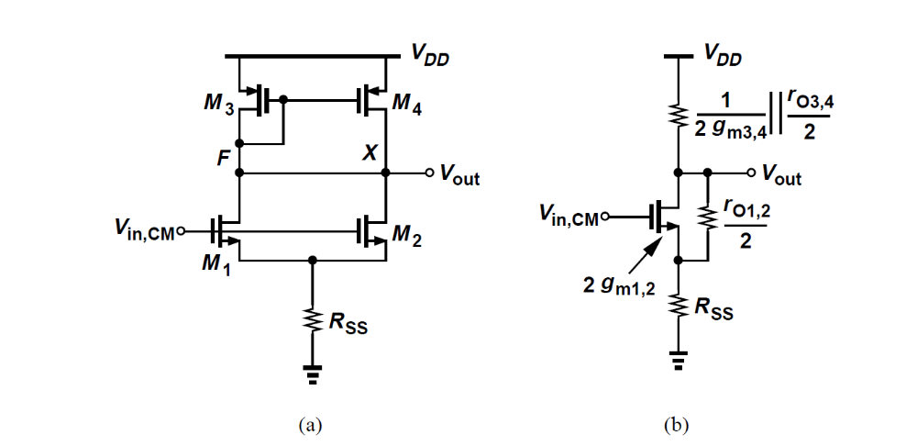
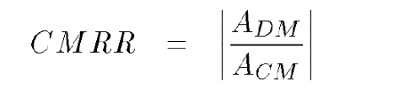
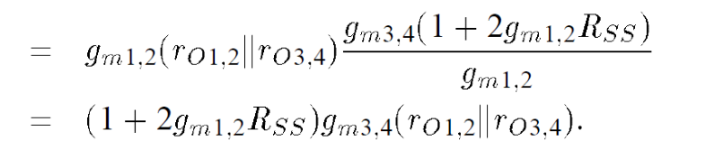
CMRR
Even with perfect symmetry, the output signal is corrupted by input CM variations.

Slide 35
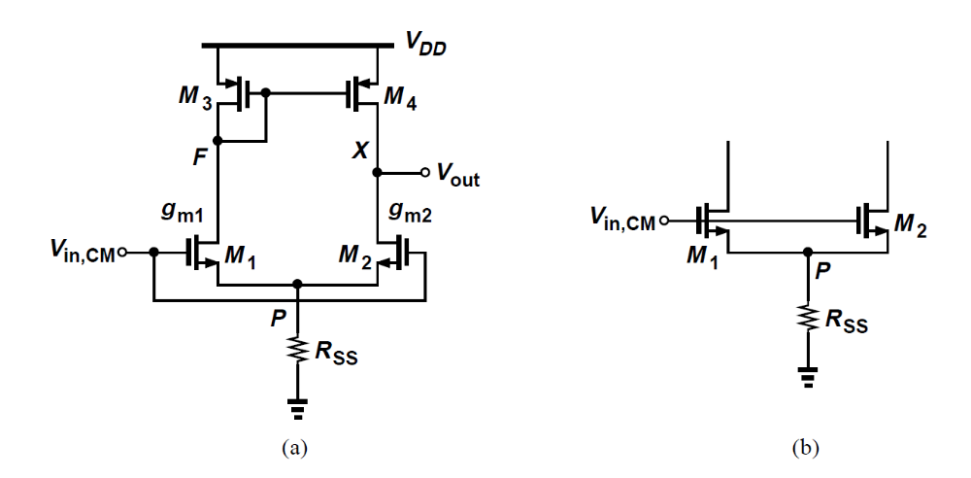

Effect of Mismatches
we consider the case where the input transistors exhibit slightly different transconductances。
How does Vout depend on Vincm?
This result contains the additional term

Slide 36
Other Properties
A finite CMRR even with perfectly matched transistors.
The supply rejection of this OTA is inferior.
Change VDD by a small amount, how much does VF change?

Slide 37
Other Properties
For (a), The gain from VDD to Vout is about unity.
Now consider the fully-differential topology in Fig(b).
In this case, too, the output voltages change by ∆VDD but their difference remains intact.
This circuit requires common-mode feedback.

Slide 38
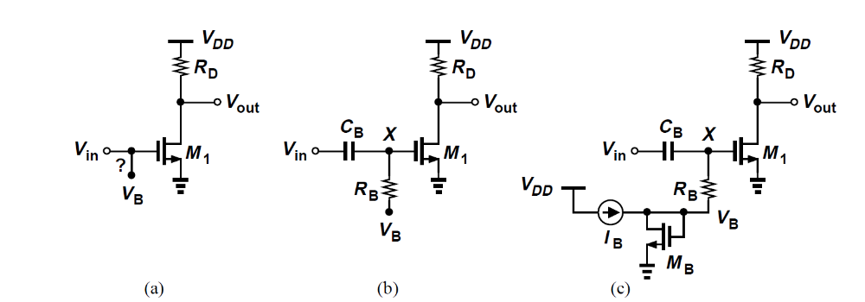
Biasing Techniques
Simple CS Stage
How do we ensure that VB does not “fight” Vin?
Couple Vin capacitively and establish a high impedance for VB.
Node X in Fig (b) must have a dc path to a voltage.
The bias voltage must be generated by a diode-connected device
Typically select IB about one-tenth to one-fifth of ID1 so as to minimize the power.

Slide 39
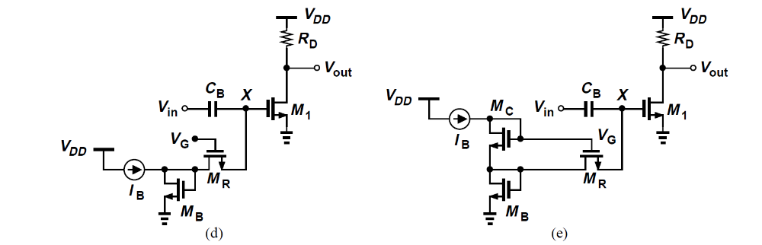
Biasing Using a MOSFET
The capacitor and the resistor may occupy a large chip area.
The capacitor introduces its own parasitics.
In applications requiring a large RC product, one can replace RB with a long, narrow MOSFET.
But how do we guarantee that MR does not turn off?
The overdrive of MR must be well controlled. This difference can be created by means of a diode-connected device.

Slide 40
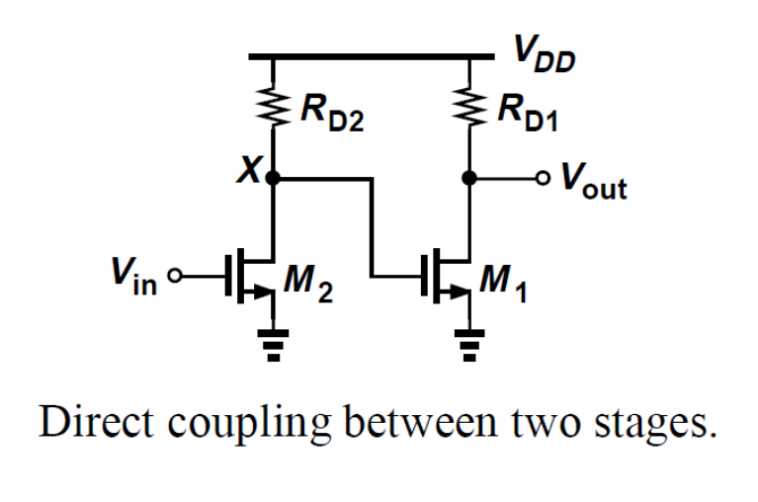
Direct Coupling
Possible to remove the input coupling capacitor and provide the bias voltage from the preceding stage?
The bias conditions of M1 are influenced by those of M2.
The PVT variations are amplified.
One can employ direct coupling between two stages if each has a low gain.

Slide 41
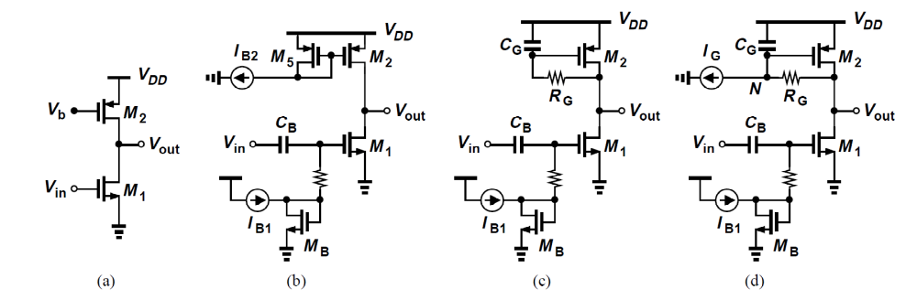

CS Stage with Current-Source Load
If the copied currents in Fig (b) are not exactly equal, each transistor wants to impose its own current.
To resolve this issue, we modify the circuit as shown in Fig (c).
Select
We can draw a constant current of IG from RG, so that Vout is higher.

Slide 42
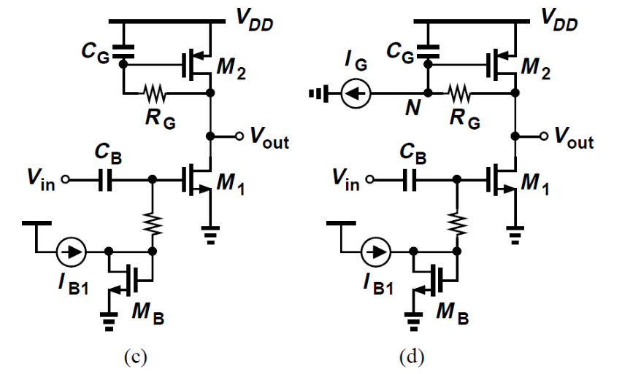
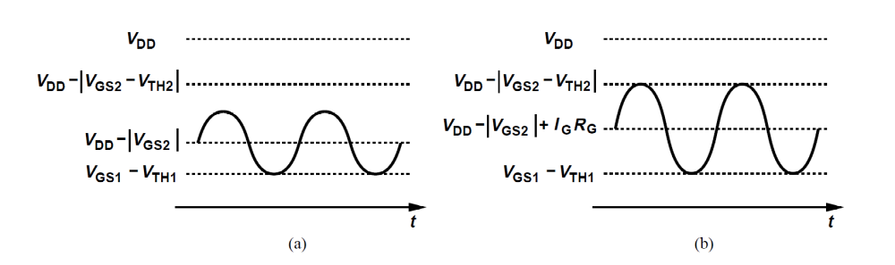
Example
Compare the maximum allowable voltage swings.
In Fig (c), the up-swing cannot reach its maximum.
In Fig. 5.45(d), on the other hand, I­­_{G}R_{G} can shift the operating point such that the down-swing and the up-swing are approximately equal.

Slide 43
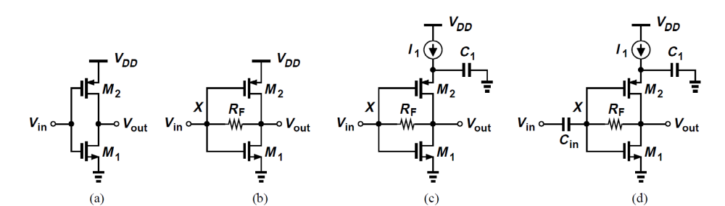
Complementary CS Stage
Shown in Fig. (b), each transistor is configured as a diode-connect device and guaranteed to operate in saturation.
Self-biased topology.
To define the bias current accurately, we modify the circuit as shown in Fig. (c).
Since the bias voltage at node X must track Vout, the input must be capacitively coupled.

Slide 44
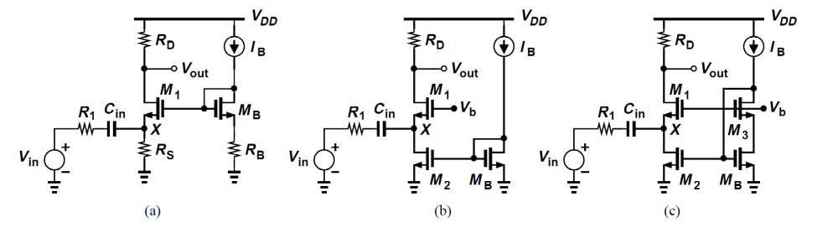

CG Biasing
The circuit of Fig. (a) faces difficulties in low-voltage design.
RS may reach or even exceed RD.
Replace RS with a current source.

Slide 45

Source Follower Biasing
In applications where the input dc voltage may vary considerably, capacitive coupling can be used.
Study the performance with and without capacitive coupling between the two stages.

Slide 46

Use of SF
In Fig (a), the minimum drain voltage of M3 is given by VGS1 + VDS2min, leaving little for the allowable voltage drop across RD.
Fig (b), on the other hand, the first stage’s gain can be independently maximized.

Slide 47

Differential Pair Biasing
Since the bias currents of M1 and M2 in Fig. (a) are relatively insensitive to their gate voltages, we can directly connect their gates to the preceding stage.
If the bias value of VX and VY is chosen equal to two overdrives above ground, then it is an excessively low common-mode level for the second stage.
May resort to capacitive coupling in some cases.

