Slide 1
Chapter 6: Frequency Response of Amplifiers
6.1 Basic Current Mirrors
6.2 Common-Source Stage
6.3 Source Followers
6.4 Common-Gate Stage
6.5 Cascode Stage
6.6 Differential Pair
6.7 Gain-Bandwidth Trade-Offs

Slide 2
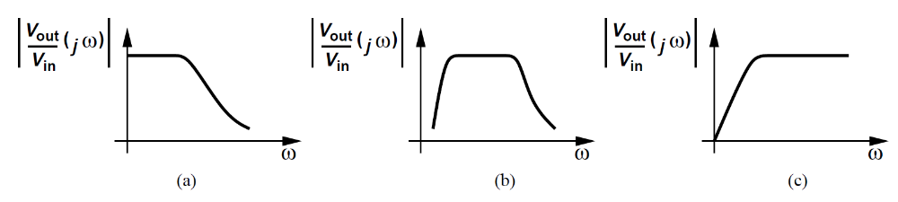

General Considerations
In this chapter, we are primarily interested in the magnitude of the transfer function.
The magnitude of a complex number a + jb is given by .
Zeros and poles are respectively defined as the roots of the numerator and denominator of the transfer function.

Slide 3
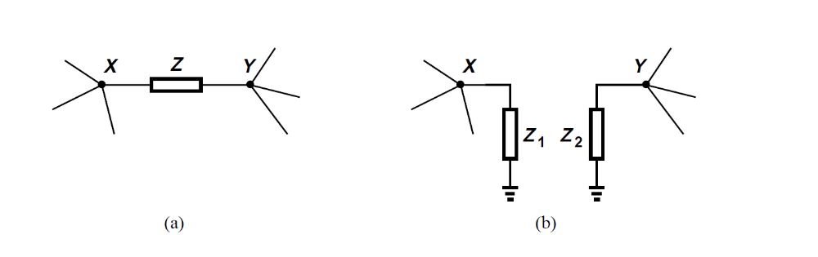
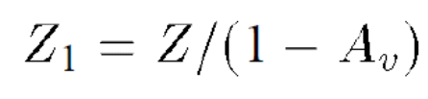

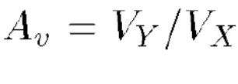
Miller effect
If the circuit of Fig (a) can be converted to that of Fig (b), then

Slide 4
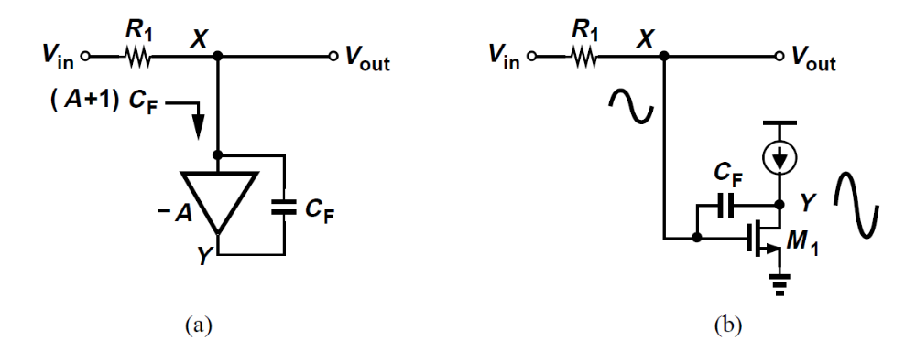
Example
A student needs a large Capacitor and decides to utilize the Miller multiplication
What is the issues in this approach?

Slide 5
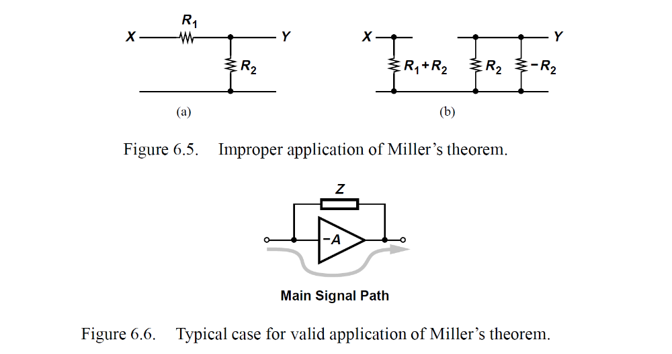

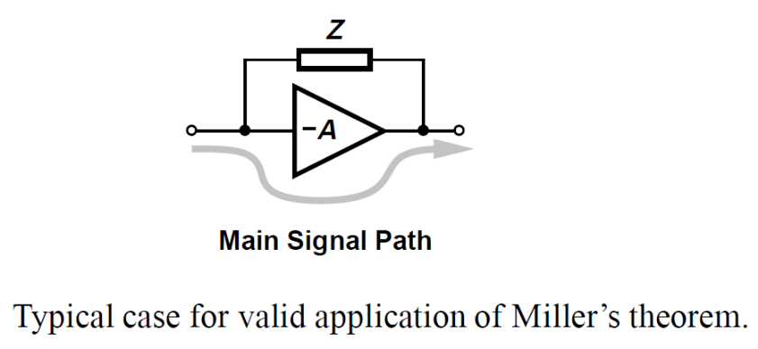
Miller’s theorem does not stipulate the conditions under which this conversion is valid.
If the impedance Z forms the only signal path between X and Y , then the conversion is often invalid.

Slide 6
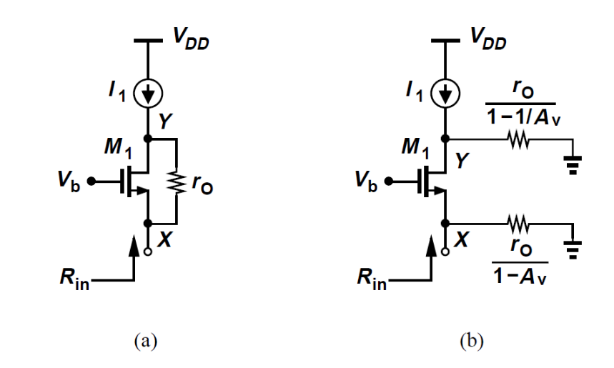


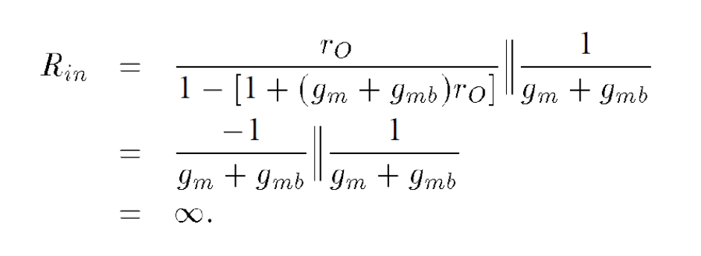
Example
Calculate the input resistance of the circuit shown.
Since Av is usually greater than unity, is a negative resistance.
Av =

Slide 7
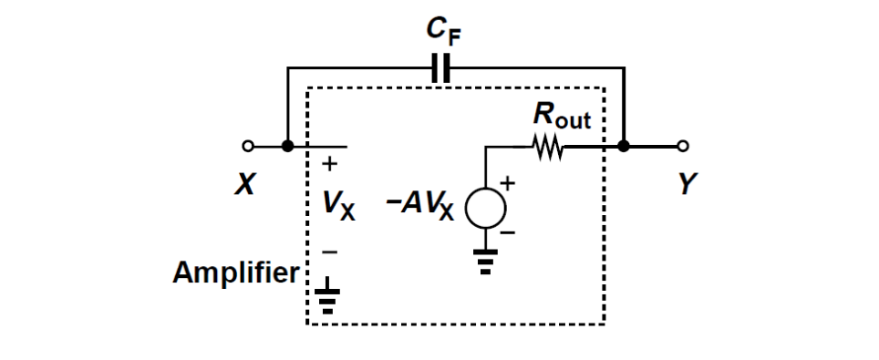

Example
The value of Av = VY / VX must be calculated at the frequency of interest.
In the figure, the equivalent circuit reveals that at high frequencies.
In many cases we use the low-frequency value of VY / VX to gain insight.
We call this approach “Miller’s approximation.”

Slide 8
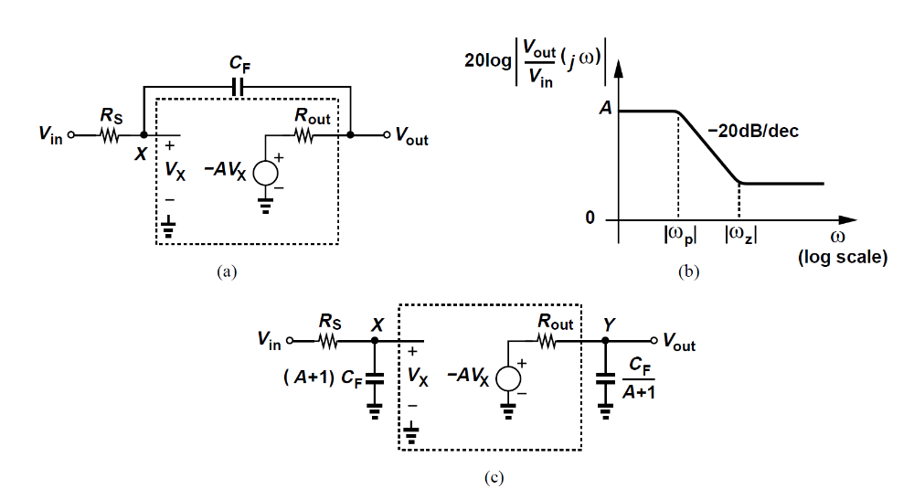
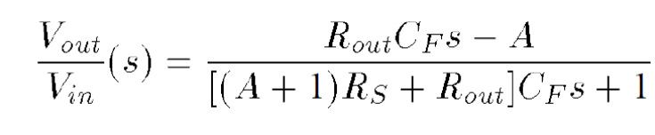
Example
Direct Calculation:
Miller Aproximation:
Miller’s approximation has eliminated the zero and predicted two poles for the circuit!

Slide 9
Example
Actual Rout =r0
Miller’s approximation:
(1) it may eliminate zeros
(2) it may predict additional poles
(3) it does not correctly compute the “output” impedance.

Slide 10
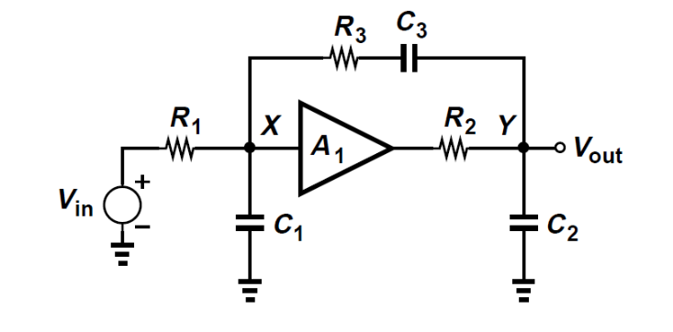
Association of Poles with Nodes
The overall transfer function can be written as
Each node in the circuit contributes one pole to the transfer function.
Not valid in general. Example:

Slide 11
Example
At node X:
At node Y:
The overall transfer funtion:

Slide 12
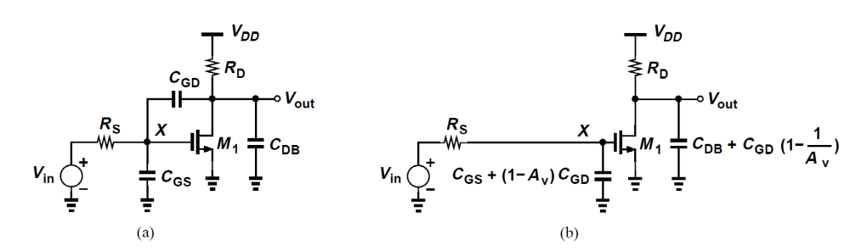
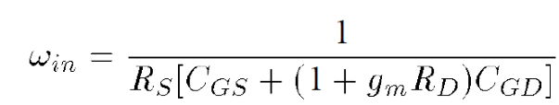
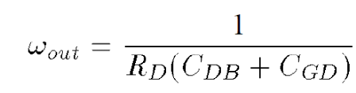
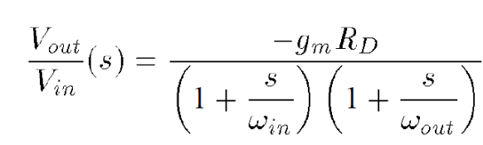
Common-Source Stage
The magnitude of the “input” pole
At the output node

Slide 13
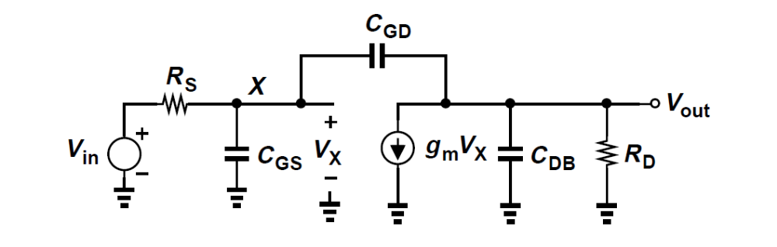

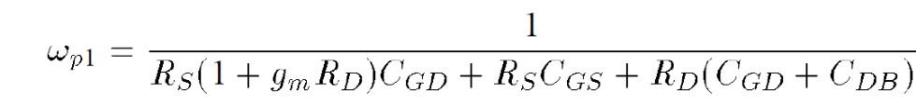
Direct Analysis
While the denominator appears rather complicated, it can yield intuitive expressions for the two poles.
“Dominant pole” approximation.
The intuitive approach provides a rough estimate with much less effort.

Slide 14
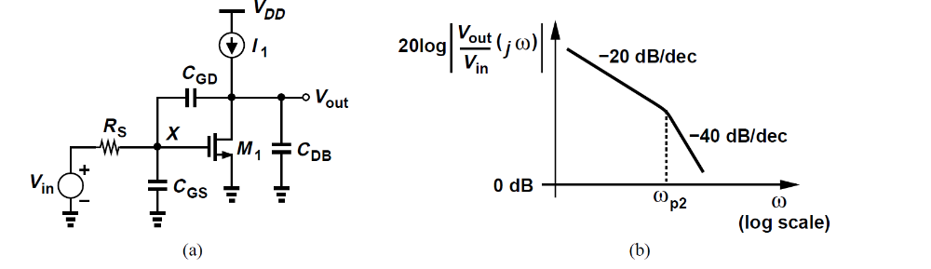
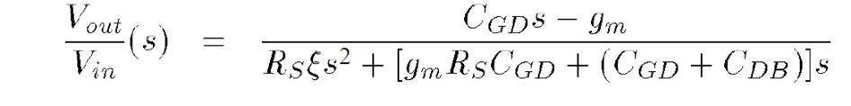
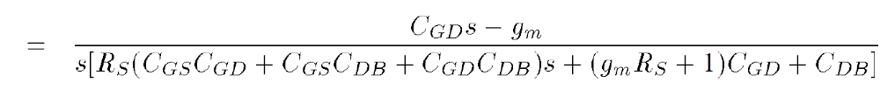
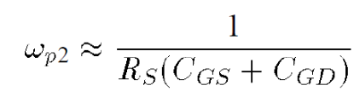
Example
One pole is at the origin because the dc gain is infinity.
For a large CDB or load capacitance
No miller multiplication. Why?

Slide 15
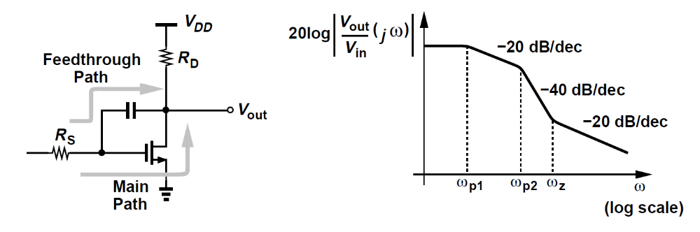

Zero in Transfer Function
The transfer function of exhibits a zero given by
CGD provides a feedthrough path that conducts the input signal to the output at very high frequencies.

Slide 16
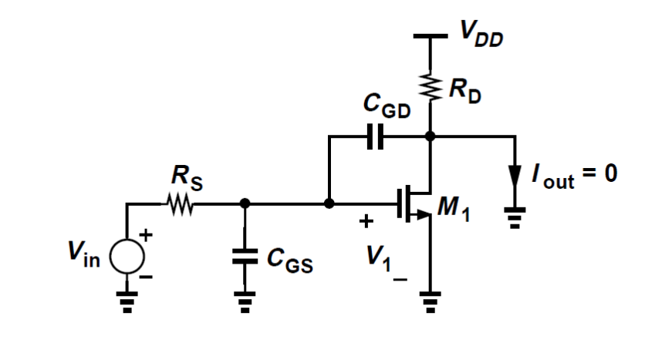
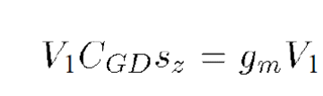

Calculating zero in a CS stage
The transfer function Vout(s)=Vin(s) must drop to zero for s = sz.
Therefore, the currents through CGD and M1 are equal and opposite:
That is

Slide 17
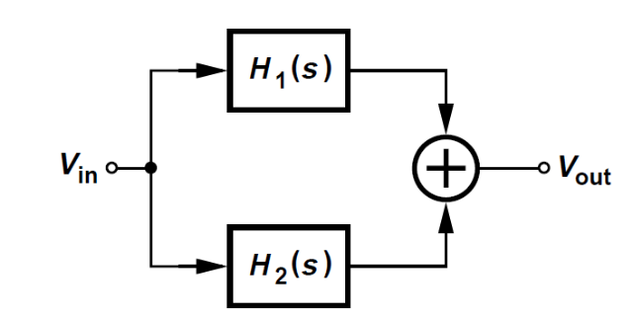


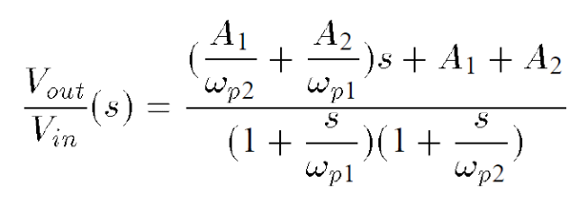
Example
Can this (the zero) occur if H1(s) and H2(s) are first-order low-pass circuits?
H1= and H2=
The overall transfer function contains a zero.

Slide 18
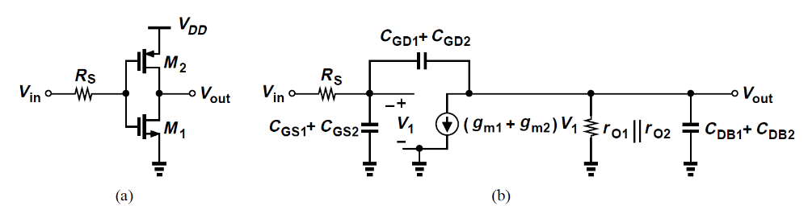
Example
Since the corresponding terminals ofM1 and M2 are shorted to one another in the small-signal model, we merge the two transistors.
The circuit thus has the same transfer function as the simple CS stage.

Slide 19
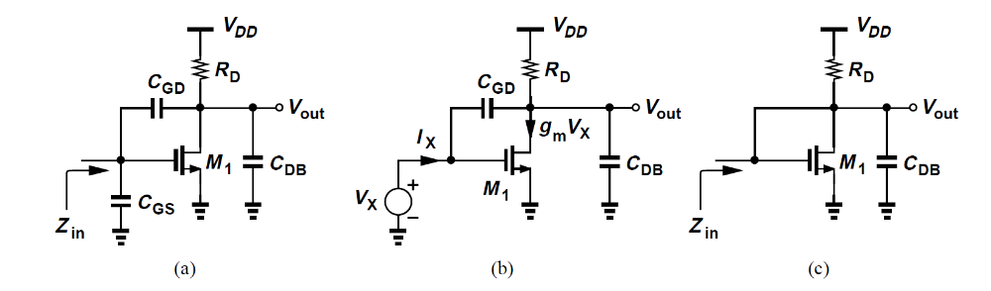
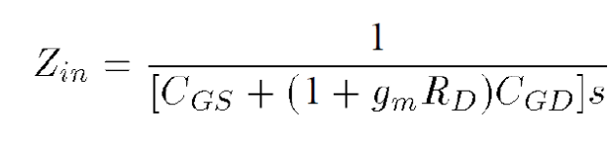
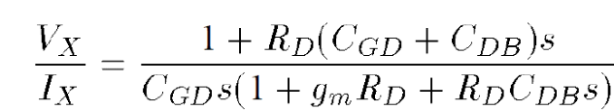
Miller’s Approximation
With the aid of Miller’s approximation,
But at high frequencies, the effect of the output node capacitance must be taken into account.
Ignore CGS
if CGD is large, it provides a low impedance path between the gate and drain of M1.

Slide 20
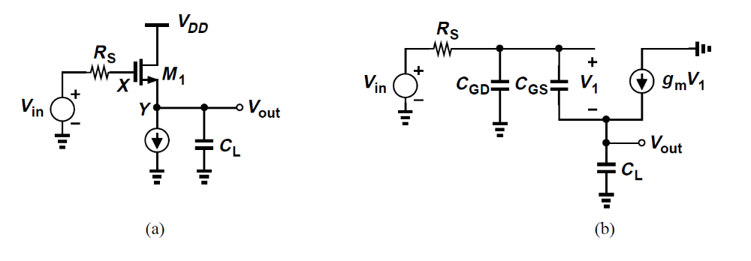
Source Followers
The strong interaction between nodesX and Y through CGS in makes it difficult to associate a pole with each node.
Contains a zero in the left half plane. Why?

Slide 21
Example
Transfer function if CL = 0?
CGS disappear
In the absence of channel-length modulation and body effect, the voltage gain from the gate to the source is equal to unity.

Slide 22
Input impedance
CGD simply shunts the input and can be ignored initially.
If gmb = 0 and CL = 0, then Zin = ∞
CGS is entirely bootstrapped by the source follower and draws no current from the input.
At Low frequency the overall input capacitance is equal to CGD plus a fraction of CGS.

Slide 23

Input Impedance
At high frequencies,
A source follower driving a load capacitance exhibits a negative input resistance, possibly causing instability.

Slide 24
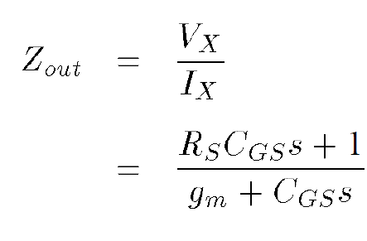
Output Impedance
At low frequency:
At very high frequencies,
Because CGS shorts the gate and the source.
Which one of these variations is more realistic?

Slide 25
Output Impedance
Since the output impedance increases with frequency, we postulate that it contains an inductive component.

Slide 26
Example
Can we construct a (two-terminal) inductor from a source follower?
Yes, but non-ideal.
It also incurs a parallel resistance and a series resistance.
The inductance can partially cancel the load capacitance, CL, at high frequencies, thus extending the bandwidth.

Slide 27
Common-Gate Stage
A transfer function
No Miller multiplication of capacitances.
RD is typically maximized, so the dc level of the input signal must be quite low.
As an amplifier in cases where a low input impedance is required
In cascode stages.

Slide 28
Example
Why Zin becomes independent of CL as this capacitance increases?
As CL or s increases, Zin approaches 1/(gm + gmb)
CL lowers the voltage gain of the circuit, thereby suppressing the effect of the negative resistance introduced by Miller effect through rO.

Slide 29
CG Stage
The bias network providing the gate voltage exhibits a finite impedance.
Consider only CGS here.
Lowering the pole magnitude.
Output impedance of the circuit drops at high frequencies.

Slide 30
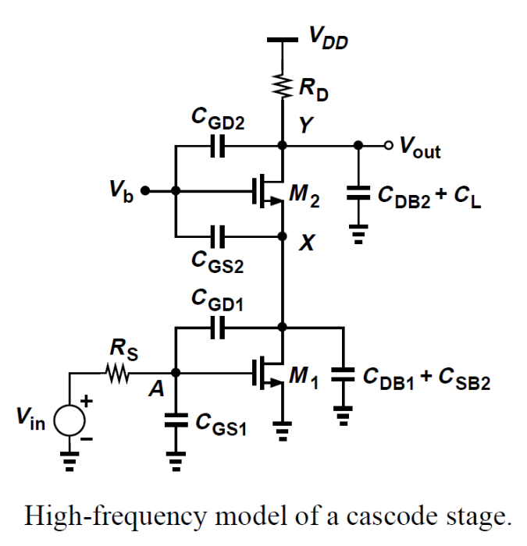
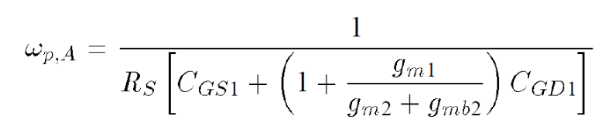

Cascode Stage
Miller effect is less significant in cascode amplifiers than in common-source stages.
But I is typically quite higher than the other two.
What if RD is replaced by a current source?
Pole at node X may be quite lower, but transfer function will not affect much by this. See example.

Slide 31
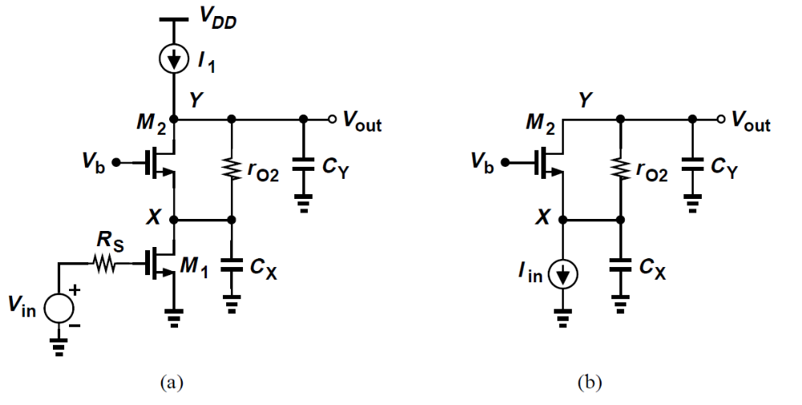
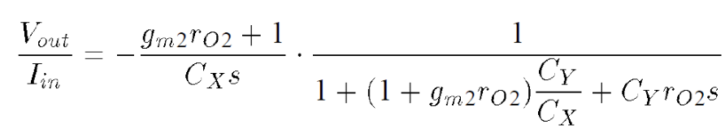

Example
Compute the transfer function.
For
The magnitude of the pole at node X is still given by gm2/CX. Why?

Slide 32
Differential Pair
For differential signals, the response is identical to that of a common-source stage.
the common-mode rejection of the circuit degrades considerably at high frequencies.
Channel-length modulation, body effect, and other capacitances are neglected.

Slide 33

Differential Pair
This transfer function contains a zero and a pole.
The magnitude of the zero is much greater than the pole.
Common-mode disturbance at node P translates to a differential noise component at the output, if the supply voltage contains high-frequency noise and the circuit exhibits mismatches.
Trade-off between voltage headroom and CMRR.

Slide 34
Diff Pair
Frequency response of differential pairs with high-impedance loads.
Fig (b) CGD3 and CGD4 conduct equal and opposite currents to node G, making this node an ac ground.
The differential half circuit is depicted in Fig. (c).
More on chapter 10

Slide 35
Differential Pair with Active Load
How many poles does this circuit have?
The severe trade-off between gm and CGS of PMOS devices results in a pole that impacts the performance of the circuit.
The pole associated with node E is called a “mirror pole.”

Slide 36


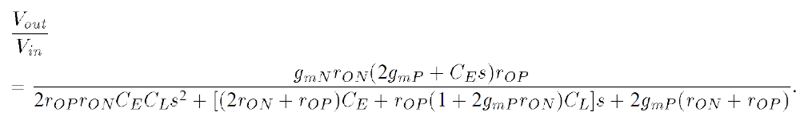
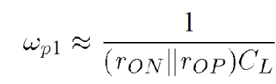
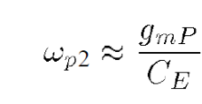
Active Load
Replacing Vin, M1, and M2 by a Thevenin equivalent.

Slide 37
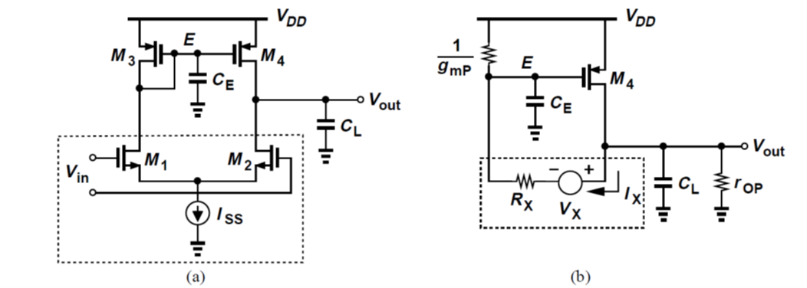



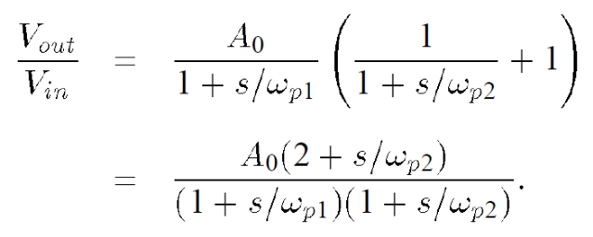
Active Load
A zero with a magnitude of in the left half plane.
The appearance of such a zero can be understood by noting that the circuit consists of a “slow path” (M1,M3 and M4) in parallel with a “fast path” (M1 and M2) by and

Slide 38
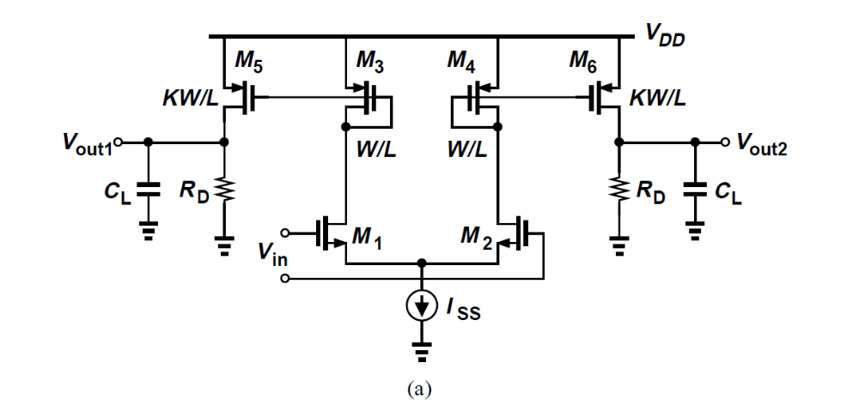
Example
Not all fully differential circuits are free from mirror poles.
Estimate the low-frequency gain and the transfer function of this circuit.

Slide 39
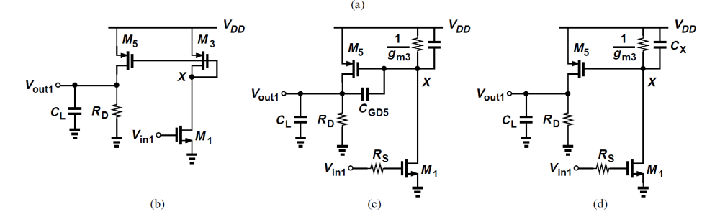


Example
M5 multiplies the drain current of M3 by K.
Assume RDCL is relatively small so that the Miller multiplication of CGD5 can be approximated as
The overall transfer function is then equal to
Vx/Vin1 multiplied by Vout1/Vx.

Slide 40
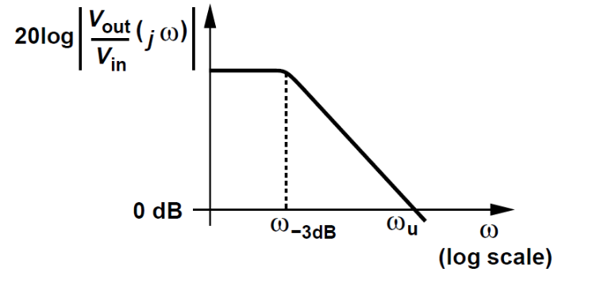


Gain-Bandwidth Trade-Offs
We wish to maximize both the gain and the bandwidth of amplifiers.
we are interested in both the 3-dB bandwidth, , and the “unity-gain” bandwidth,

Slide 41
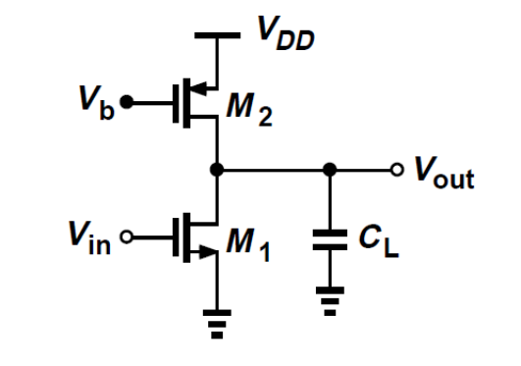
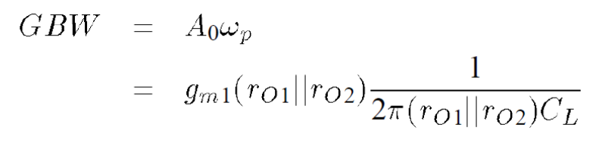
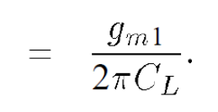
One pole circuit

Slide 42
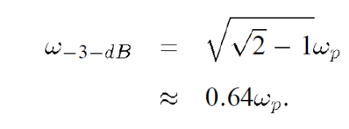

Multi-Pole Circuits
It is possible to increase the GBW product by cascading two or more gain stages.
Assume the two stages are identical and neglect other capacitances.
While raising the GBW product, cascading reduces the bandwidth.

Slide 43



Appendix A: Extra Element Theorem
Suppose the transfer function of a circuit is known and denoted by H(s). Add an extra impedance Z1 between two nodes of the circuit.
New transfer function:
Particularly useful for frequency response analysis.

Slide 44





Example 1
Find the transfer function.
The negative sign of Zout,0 does not imply a negative impedance between A and B, since

Slide 45



Example 2
Include CB, from node B to ground.

Slide 46

Appendix B: Zero-Value Time Constant
Suppose a circuit contains one capacitor and no other storage elements.
Wish to determine the pole of the system.
Set the input to zero, compute the resistance, R1, seen by C1, and express the pole as 1/(R1C1).

Slide 47




Example
If only CGD is considered, determine the pole frequency.
The pole is given by

Slide 48


Example
Writing a KVL around Vin, R1, R2, and Vout gives
The dominant pole is indeed equal to the inverse of the sum of the zero-value time constants. (need to prove)
The ZVTC method proves useful if we wish to estimate the 3-dB bandwidth of a circuit.

Slide 49

Example
Approximation of the frequency and time responses by one-pole counterparts.

Slide 50



Example 1
Estimate the 3-dB bandwidth.
Begin with the time constant associated with CGS and set CGD and CL to zero.
The resistance seen by CL is simply equal to RD.

Slide 51

Example2
Find 3-dB band width of a common-gate stage containing a gate resistance of RG and a source resistance of RS.
The resulting equivalent circuits are identical for CS and CG stages, yielding the same time constants and hence the same bandwidth.
Does this result contradict our earlier assertion that the CG stage is free from the Miller effect?
No. Why?

