Slide 1
CMOS VLSI
Analog Design

Slide 2
Outline
Overview
  Small signal model, biasing
Amplifiers
  Common source, CMOS inverter
  Current mirrors, Differential pairs
  Operational amplifier
Data converters
  DAC, ADC
RF
  LNA, mixer

Slide 3
CMOS for Analog
MOS device can be used for amplification as well as switching
  Typical: operate devices in saturation, gate voltage sets current
Benefits
  Cheap processes (compared to BJT)
  Integrated packages
Challenges
  Low gain
  Coupling issues
  Tolerances

Slide 4
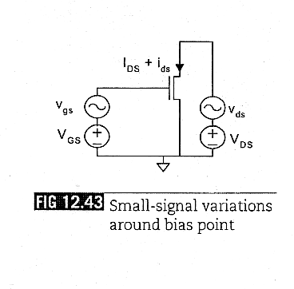
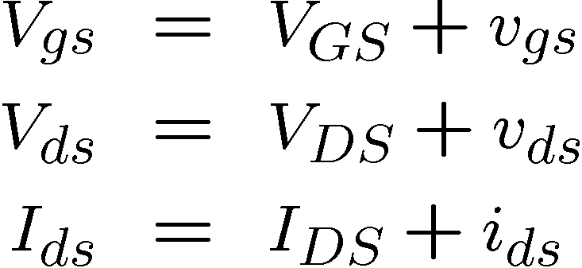
MOS Small Signal Model

Slide 5
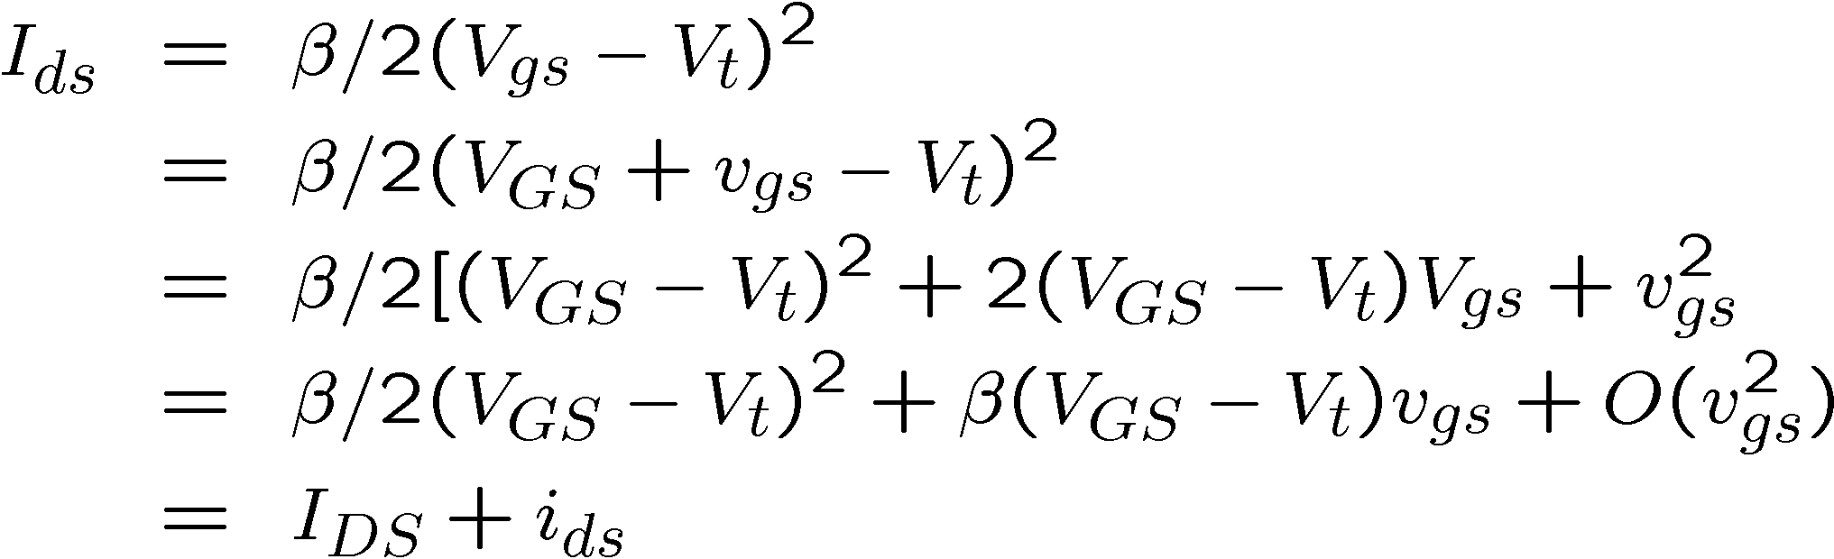
MOS Small Signal Model
From first order saturation equations:
Rewrite in terms of sensitivities:
So

Slide 6

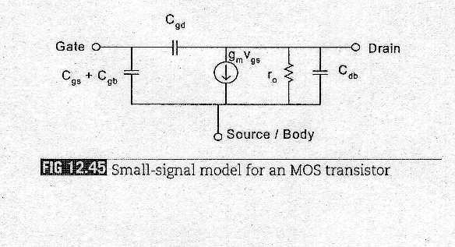
Channel Length Modulation
In reality output current does change with V_{ds}
Output resistance

Slide 7
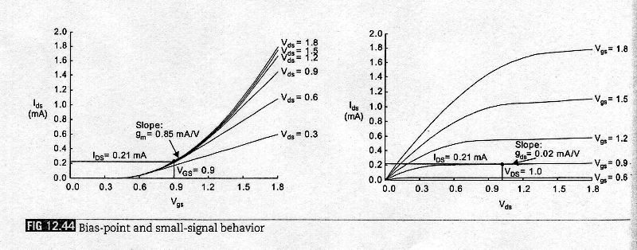
Bias Point
Standard circuits for biasing
  Compute parameters from I-V curves

Slide 8
Outline
Overview
  Small signal model, biasing
Amplifiers
  Common source, CMOS inverter
  Current mirrors, Differential pairs
  Operational amplifier
Data converters
  DAC, ADC
RF
  LNA, mixer

Slide 9
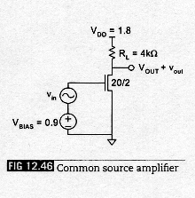
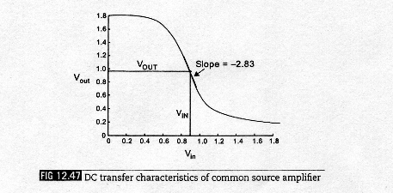
Common Source Amplifier
Operate MOS in saturation
  Increase in V_{gs} leads to drop in v_{out}
  Gain A = v_{out}/v_{in}

Slide 10
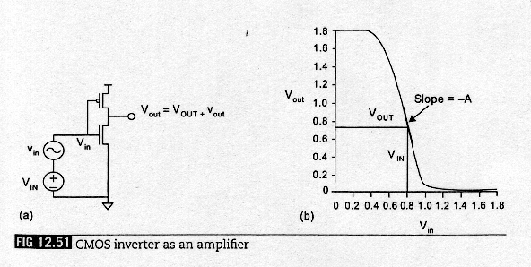
CMOS Inverter as an Amplifier
Can use pMOS tied to V_{dd} for resistive load in common source amplifier
  Do better by having an “active load”: increase load resistance when V_{in} goes up

Slide 11
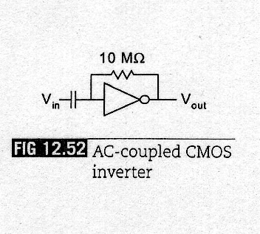
AC Coupled CMOS Inverter
How to get maximum amplification?
  Bias at V_{inv} using feedback resistor
  Use capacitor to AC couple the input

Slide 12
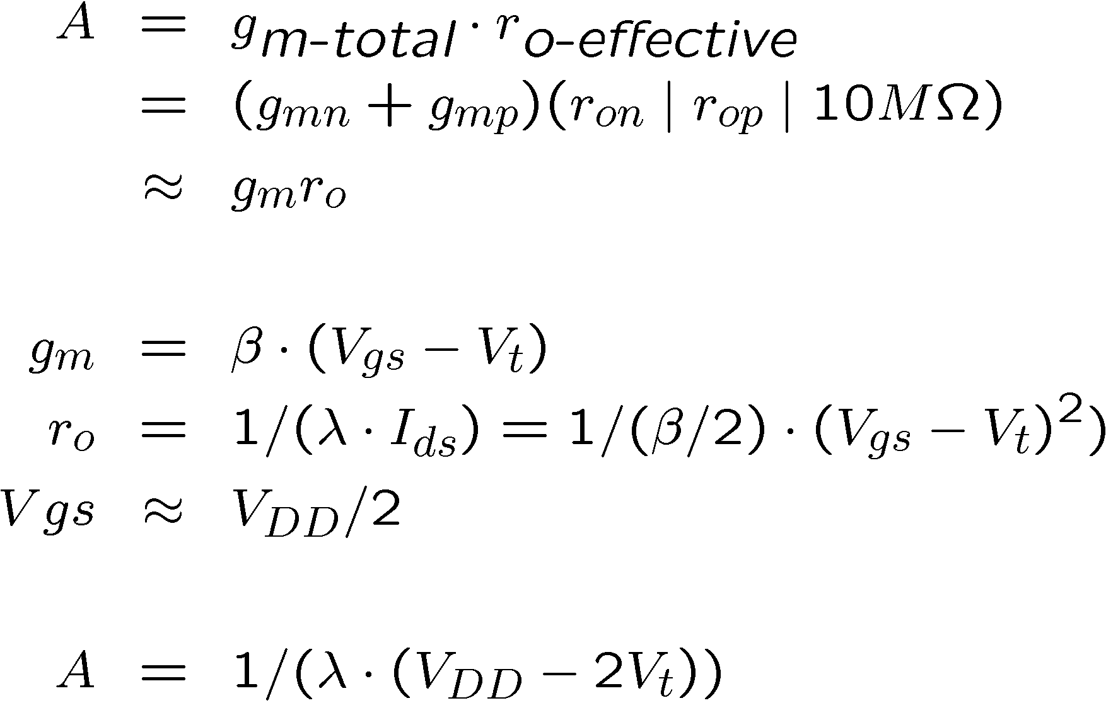
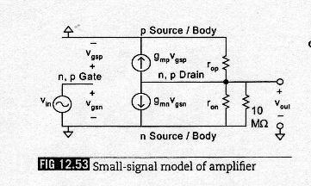
AC Coupled CMOS Inverter

Slide 13
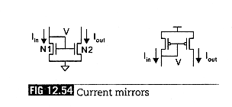
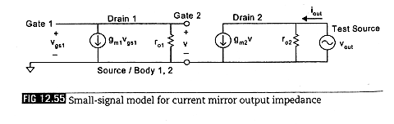
Current Mirrors
Replicate current at input at output
Ideally, I_{out} = I_{in} in saturation, so infinite output impedance
  Channel length modulation: use large L

Slide 14
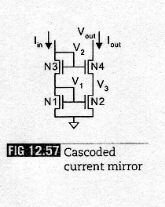
Cascoded Current Mirror
Key to understanding: N1 and N2 have almost same drain and gate voltage
  Means high output impedance
Raise output impedance
using a cascoded current mirror

Slide 15
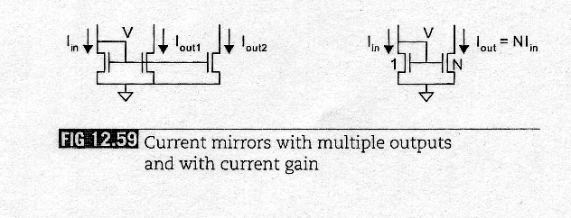
Current Mirror
Can use multiple output transistors to create multiple copies of input current
  Better than using a single wider transistor, since identical transistors match better

Slide 16
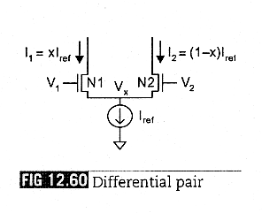
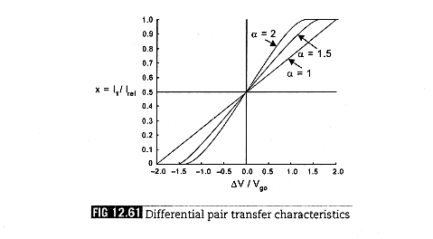
Differential Pair
Steers current to two outputs based on difference between two voltages
  Common mode noise rejection

Slide 17
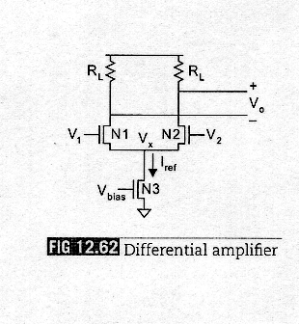
Differential Amplifier
Use resistive loads on differential pair to build differential amplifier

Slide 18
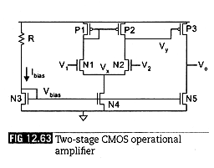
CMOS Opamp
Differential amplifier with common source amplifier
  Diff amp uses pMOS current mirror as a load to get high impedance in a small area
  Common source amp is P3, loaded by nMOS current mirror N5
  Bias voltage and current set by N3 and R
  A = v_{o} / (v₂ – v₁) = g_{mn2} g_{mp3} (r_{on2} | r_{op2}) (r_{op3} | r_{on5})
Opamp: workhorse of analog design

Slide 19
Outline
Overview
  Small signal model, biasing
Amplifiers
  Common source, CMOS inverter
  Current mirrors, Differential pairs
  Operational amplifier
Data converters
  DAC, ADC
RF
  LNA, mixer

Slide 20
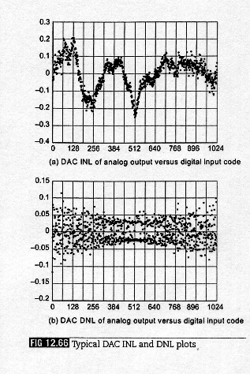
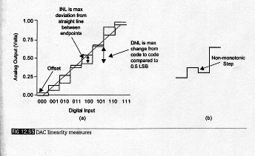
Data Converters
DACs pretty easy to design, ADCs harder
  Speed, linearity, power, size, ease-of-design
Parameters
  Resolution, FSR
  Linearity: DNL, INL, Offset

Slide 21
Noise and Distortion Measures
DAC: apply digital sine wave, measure desired signal energy to harmonics and noise
ADC: apply analog sine wave, do FFT on the stored samples
  Measure total harmonic distortion (THD), and spurious free dynamic range (SFDR)

Slide 22
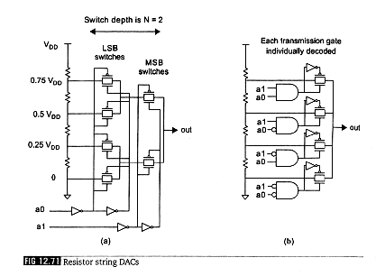
DAC
Resistor String DACs
  Use a reference voltage ladder consisting of 2^{N} resistors from V_{DD} to GND for an N-bit DAC
  Presents large RC, needs high load resistance
  Use: reference for opamp, buffer, comparator

Slide 23
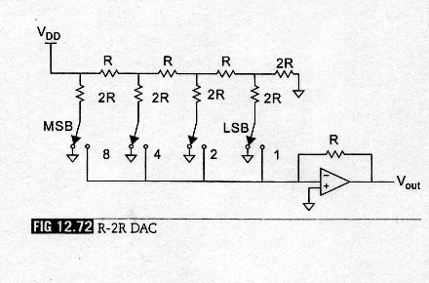
DAC
R-2R DACs
  Conceptually, evaluating binary expression
  Much fewer resistors than resistor string DACs

Slide 24
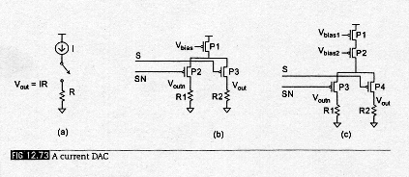
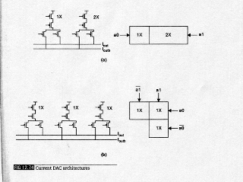
DAC
Current DAC: fastest converters
  Basic principle
  Different architectures

Slide 25
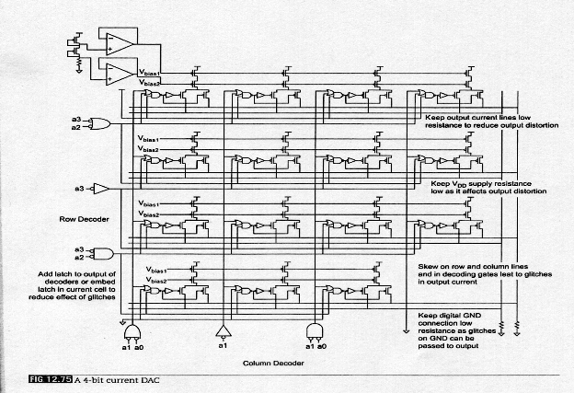
DAC
Full implementation: 4-bit current DAC

Slide 26
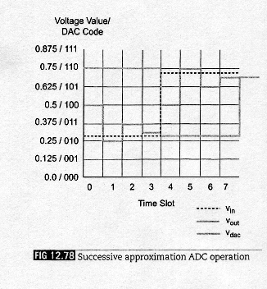
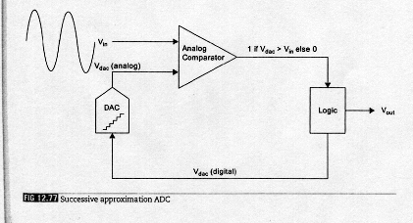
ADC
Speed of conversion, number of bits (≠ ENOBs)
Easy ADC: Successive Approximation

Slide 27
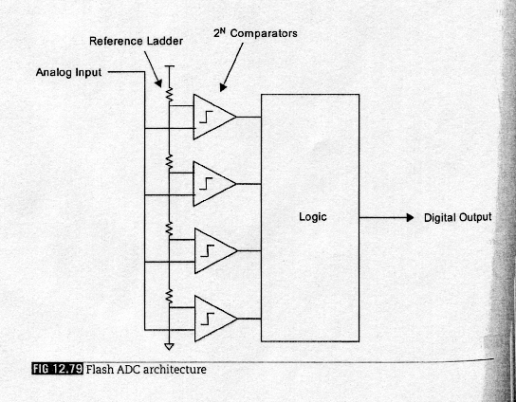
ADC
Flash ADC: highest performance

Slide 28
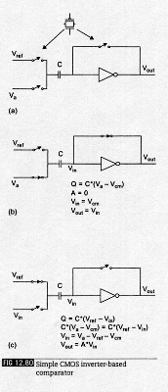
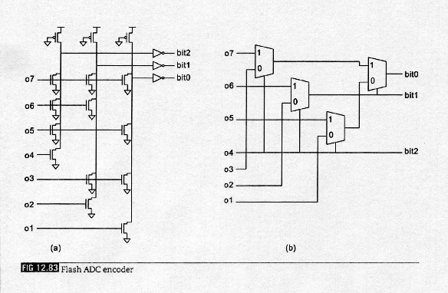
ADC
Crucial components: comparator, encoder

Slide 29
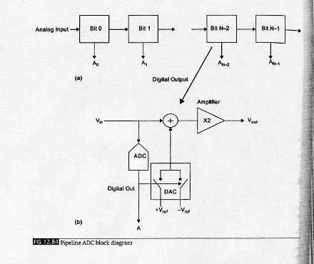
ADC
Pipeline ADC
  Amounts to a distributed successive approx ADC
  Trades flash speed and low latency for longer latency and slightly lower speed
  Much less power

Slide 30
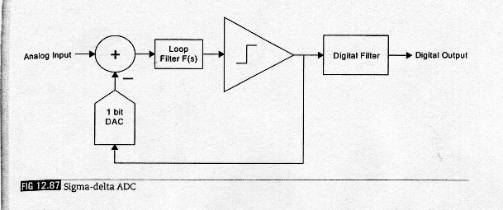
ADC
Sigma-delta converter
  Suitable for processes where digital is cheap
    CD players: audio frequencies, 20 bit precision
    RF (10MHz): 8-10 bit precision

Slide 31
Outline
Overview
  Small signal model, biasing
Amplifiers
  Common source, CMOS inverter
  Current mirrors, Differential pairs
  Operational amplifier
Data converters
  DAC, ADC
RF
  LNA, mixers

Slide 32
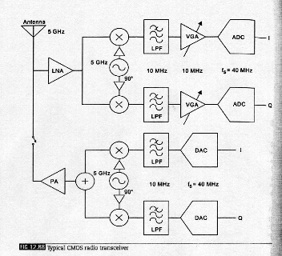
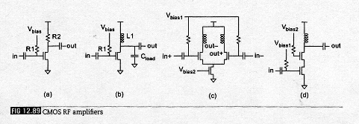
RF
Low in device count, very high in effort
  Sizing, component selection very involved

Slide 33
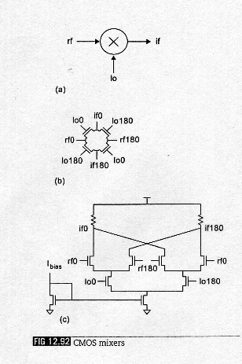
Mixers
Analog multiplier, typically used to convert one frequency to another
Various ways to implement multipliers
  Quad FET switch
  Gilbert cell

Slide 34
Noise
Thermal noise
  v^2 = 4kTR (Volt^2/Hz)
Shot noise
  i^2 = 2qI (Amp^2/Hz)
1/f noise
  Very complex phenomenon
  Proportional to 1/f
Makes RF design very difficult

