Slide 1
VLSI Communication Systems
Adnan Aziz
The University of Texas at Austin

Slide 2
Outline
Prerequisites: VLSI design, Signals and Systems
Examples:
  802.11a WLAN, Juniper M160
Overview of material
  Individual topics
Course organization
  Website,TA, office hours, grading

Slide 3
Systems vs Chips
This course: designing hardware building blocks for communication systems
  Part of a system:
    Router:
      Hardware: line cards, switch fabric, pkt processor, buffers
      Software: routing, billing, management, security
    Telecom network – planning, maintanence, business models/relationships
  Chip companies: Broadcom, Agere, Intel
  System companies: Cisco, Lucent
  Service providers: Cingular, MCI
Example: high-end data switch
  Marketing gives range of specs, architect tries to meet them
  Off the shelf chips, embedded software

Slide 4
Course relevance
2007 world wide sales of chips: ~250B$
  Primarily digital
  High-margin business
  Basis for systems
Most VLSI graduates work in
  Processors: Intel, AMD, Sun
  Communications: Qualcomm, TI, Cisco
  Consumer electronics: Sony, nVidia
  Embedded: GM, Bosch

Slide 5
What Will We Cover?
Review of communications
  Modulation, channels
VLSI design of communication systems components
  Arithmetic, FFT, filter design and implementation, equalizers, timing recovery, ECC
  Focus: digital, custom (some discussion of programmable)
Broader implications
  Filters: speech recognition, MPEG compression
  Switching: PCI-Express, Network-on-a-chip
Key issues:
  High performance, low cost
    Performance: bit-error-rate, packets-per-second
    Cost: VLSI area, delay, power

Slide 6
General Principles
Technology changes fast, so it is important to understand the general principles which would span technology generations
  optimization, tradeoffs
Concepts remain the same:
  Example: relays -> tubes -> BJTs ->MOS transistors
Notes:
Putting together a system with networks of relays is similar to doing it with MOS transistors (or tube-based logic gate blocks).
How do you think the term “switching theory” originated? Relay computers from Bell Labs. and others

Slide 7
Course Information
Instructor: Adnan Aziz
  (512) 475-9774, Adnan@ece.utexas.edu
  http://www.ece.utexas.edu/~adnan
Course Web Page
  Link from my page
Books
  Filtering: Parhi, VLSI DSP Systems, John-Wiley, 1999
  VLSI: Weste and Harris, CMOS VLSI Design: A Circuits and Systems Perspective, AW, 3rd edition, 2005
  Communications: Leung, VLSI for Wireless Communications, Prentice-Hall, 2004
  Switching: Dally and Poulton, Principles and Practices of Interconnection Networks, Morgan Kaufmann, 2004

Slide 8
Goals of this Course
Learn to design and analyze state-of-the-art comm chips
Will use many abstractions
  Understand design constraints at the CMOS logic level and requirements from the and their implications to chip architecture
Won’t cover
  Detailed math, networking, processors, software
  Limited treatment of CMOS physics & circuits, communications theory

Slide 9
Work in the Course
Lectures:
  partly from text, partly from papers
Written Homework:
  VLSI & Comm Theory, FFT, Filter implementation
Labs:
  Modulation, Filtering, Equalization, Timing recovery
  Matlab simulation, with pencil and paper estimation of hardware costs

Slide 10
Exams and Grading
Two tests
  Start of Unit 4, End of Unit 5
  In class, open book/notes
Weights for
Final Grade
Homework | 15%
Midterms 1-2 | 40%
Labs | 35%

Slide 11
Academic Honesty
Cheating will not be tolerated
Feel free to discuss homework, laboratory exercises with classmates, TA and the instructors
  However: write the homework and lab exercises by yourself
We will check for cheating, and any incident will be reported to the department

Slide 12
Review of CMOS VLSI
MOS physics, equations
Digital design
  Combinational logic
  Sequential logic
  Datapath
  Memories
Analog design
  Amplifiers
  Data converters
  RF

Slide 13
Need for transistors
Cannot make logic gates with voltage/current source, RLC components
  Consider steady state behavior of L and C
Need a “switch”: something where a (small) signal can control the flow of another signal

Slide 14

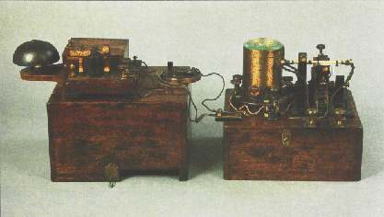
Coherers and Triodes
Hertz: spark gap transmitter, detector
  Verified Maxwell’s equations
  Not practical Tx/Rx system
Marconi: “coherer” changes resistance after EM pulse, connects to solenoid
Triode: based on Edison’s bulbs!
    See Ch. 1, Tom Lee, “Design of CMOS RF ICs”

Slide 15
A Brief History of MOS
Some of the events which led to the microprocessor
Photographs from “State of the Art: A photographic history of the integrated circuit,” Augarten, Ticknor & Fields, 1983.
They can also be viewed on the Smithsonian web site, http://smithsonianchips.si.edu/

Slide 16
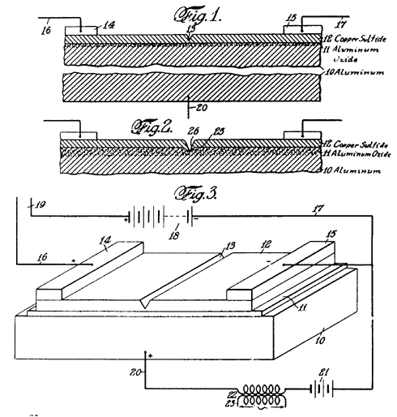
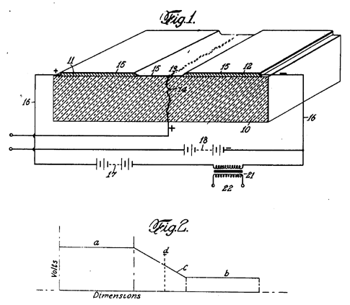
Lilienfeld patents
  1930: “Method and apparatus for controlling electric currents”, U.S. Patent 1,745,175
  1933: “Device for controlling electric current”, U. S. Patent 1,900,018

Slide 17
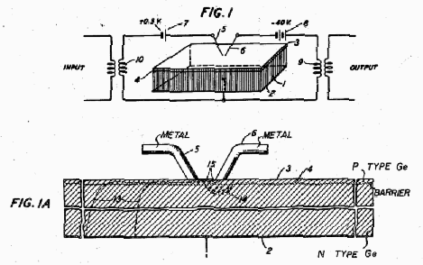
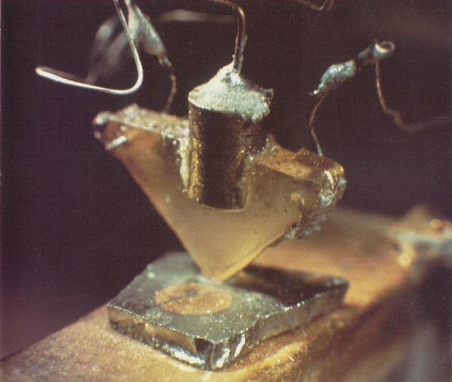
Bell Labs
1940: Ohl develops the PN Junction
1945: Shockley's laboratory established
1947: Bardeen and Brattain create point contact transistor (U.S. Patent 2,524,035)
Diagram from patent application
Notes:
When Noyes came to MIT, much to his surprise, few people had even heard about the transistor

Slide 18
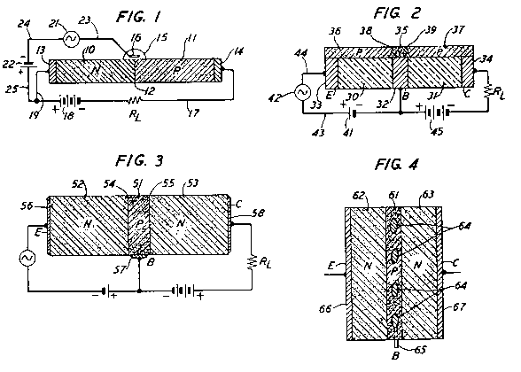
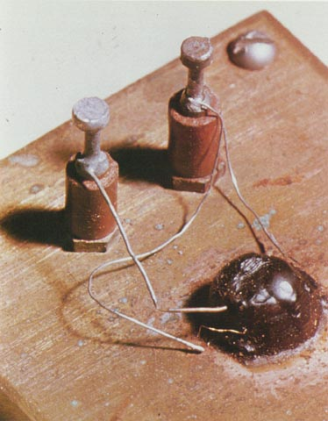
Bell Labs
1951: Shockley develops a junction transistor manufacturable in quantity (U.S. Patent 2,623,105)
Diagram from patent application

Slide 19
1950s – Silicon Valley
1950s: Shockley in Silicon Valley
1955: Noyce joins Shockley Laboratories
1954: The first transistor radio
1957: Noyce leaves Shockley Labs to form Fairchild with Jean Hoerni and Gordon Moore
1958: Hoerni invents technique for diffusing impurities into Si to build planar transistors using a SiO₂ insulator
1959: Noyce develops first true IC using planar transistors, back-to-back PN junctions for isolation, diode-isolated Si resistors and SiO₂ insulation with evaporated metal wiring on top
Notes:
Price of first silicon transistor from TI: $2.50

Slide 20
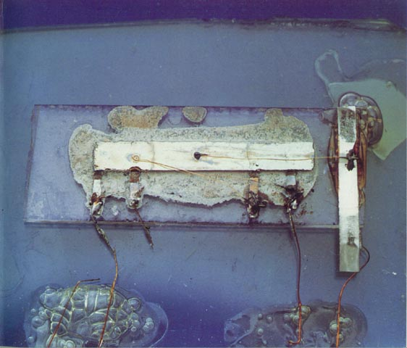
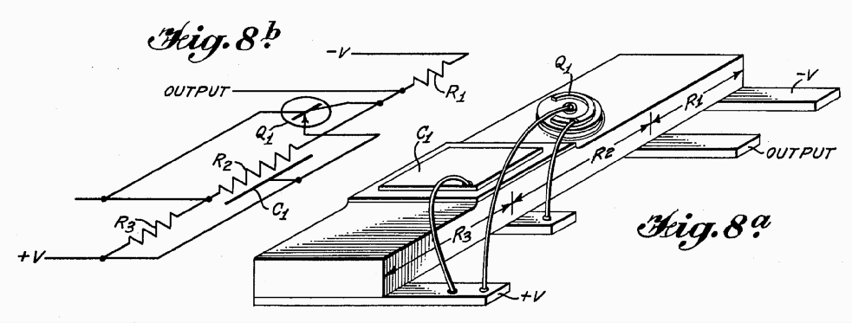
The Integrated Circuit
1959: Jack Kilby, working at TI, dreams up the idea of a monolithic “integrated circuit”
  Components connected by hand-soldered wires and isolated by “shaping”, PN-diodes used as resistors (U.S. Patent 3,138,743)
Diagram from patent application

Slide 21
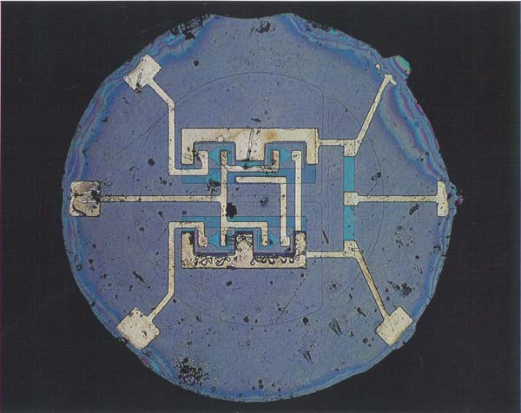
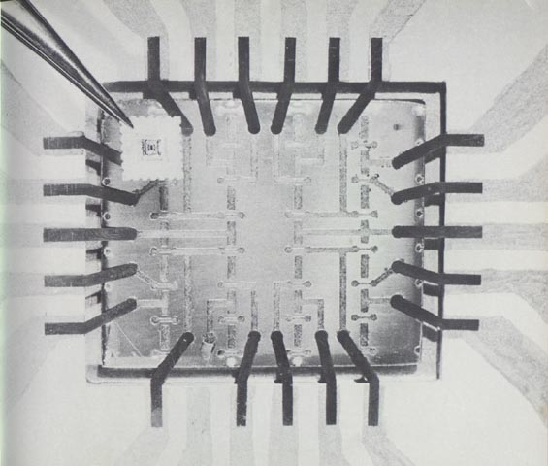
Integrated Circuits
1961: TI and Fairchild introduce the first logic ICs ($50 in quantity)
1962: RCA develops the first MOS transistor
Fairchild bipolar RTL Flip-Flop
RCA 16-transistor MOSFET IC
Notes:
Fairchild developed ICs based on Resistor-Transistor Logic
On the Fairchild IC, the irregular black specks are imperfections in the chip's surface.

Slide 22
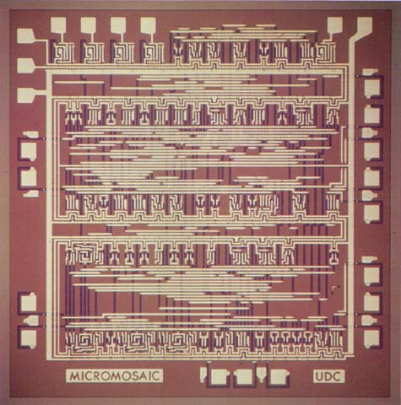
Computer-Aided Design
1967: Fairchild develops the “Micromosaic” IC using CAD
  Final Al layer of interconnect could be customized for different applications
1968: Noyce, Moore leave Fairchild, start Intel

Slide 23
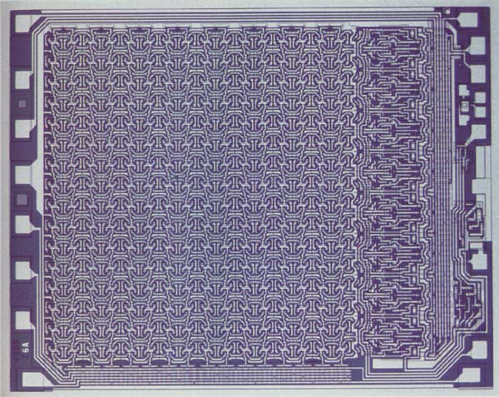
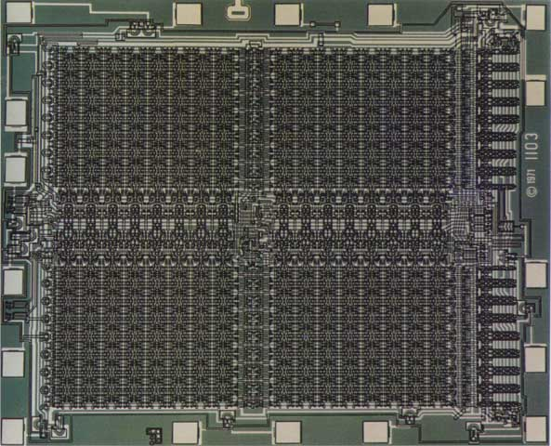
RAMs
1970: Fairchild introduces 256-bit Static RAMs
1970: Intel starts selling1K-bit Dynamic RAMs
Fairchild 4100 256-bit SRAM
Intel 1103 1K-bit DRAM

Slide 24
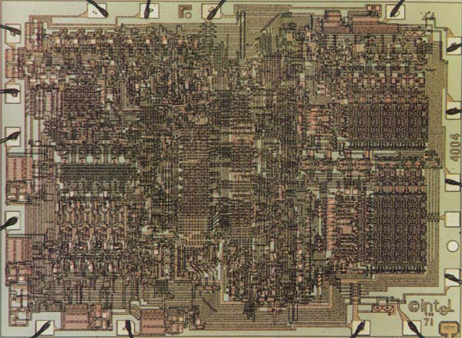
The Microprocessor
1971: Intel introduces the 4004
  General purpose programmable computer instead of custom chip for Japanese calculator company

Slide 25
Types of IC Designs
IC Designs can be Analog or Digital
Digital designs can be one of three groups
Full Custom
  Every transistor designed and laid out by hand
ASIC (Application-Specific Integrated Circuits)
  Designs synthesized automatically from a high-level language description
Semi-Custom
  Mixture of custom and synthesized modules

Slide 26
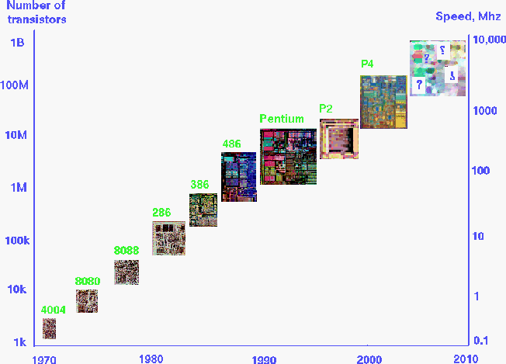
MOS Technology Trends

Slide 27
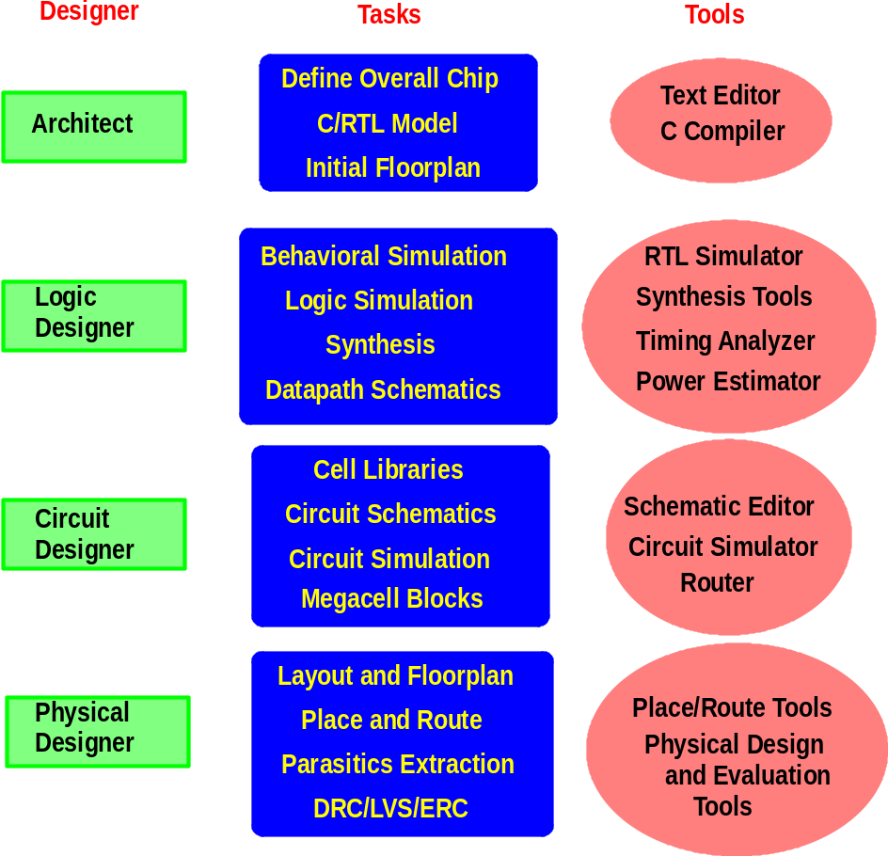
Steps in Design

Slide 28
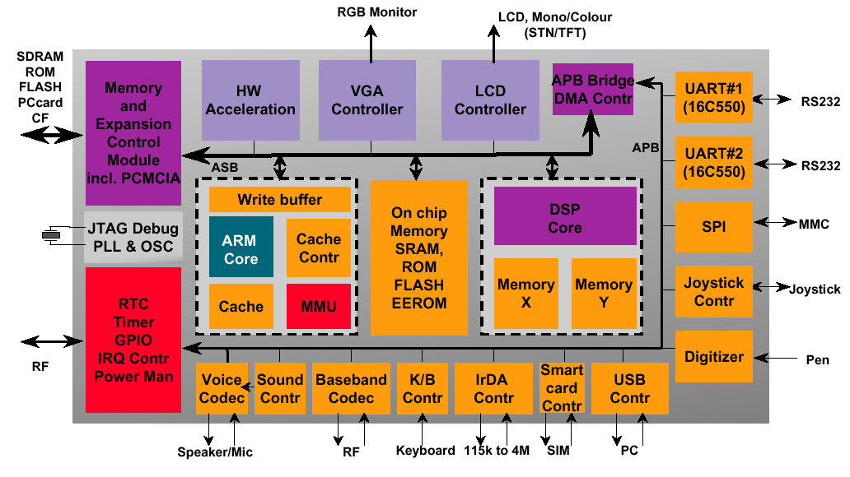
System on a Chip
Source: ARM
Notes:
Many systems include Analog and Digital functions.
This course will deal only with digital designs.

