Slide 1
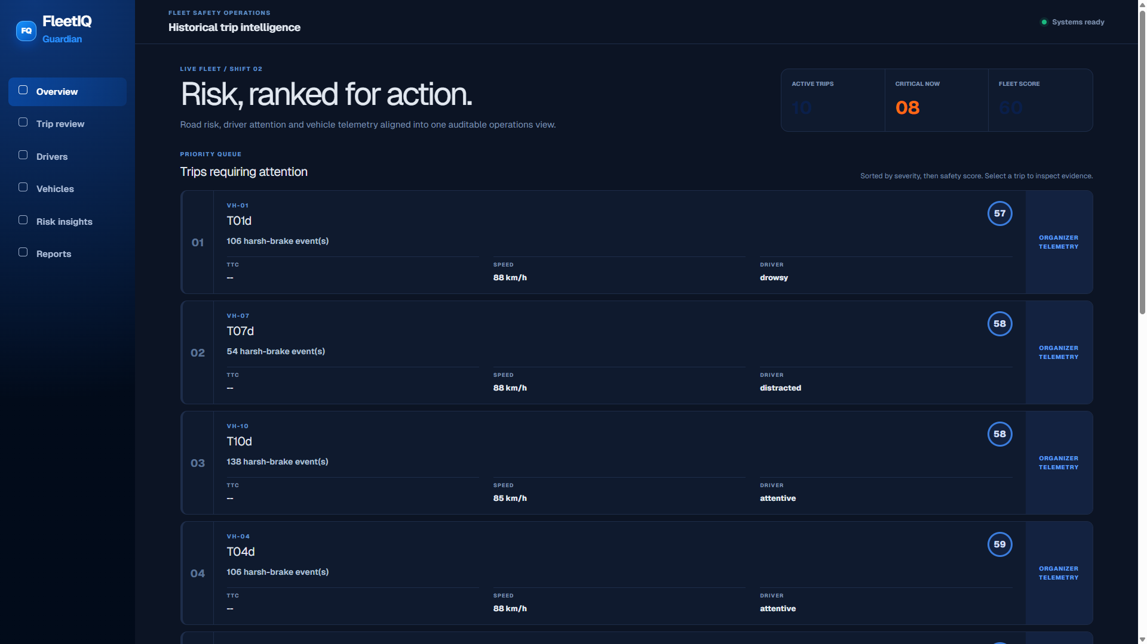
FINAL ROUND 2 | V1.0.0
FLEETIQ
GUARDIAN
Remote Driver Intelligence & Collision Risk Platform
Challenge #3: Driver Intelligence Platform
Challenge #1 scoring + Challenge #2 TTC as core engines
LIVE OPS CONSOLE
10
17,999
1
BLIND-TEST TRIPS RANKED
CUSTOM YOLO LABELS
AUDITABLE RISK VIEW
Team UchiHahaha | Phi, Trung, Dung, Kha, Tu
Live local dashboard screenshot, build v1.0.0
UchiHahaha | FleetIQ Guardian | Automotive Hackathon 2026
01

Slide 2
WHY FLEETIQ CAN BE VERIFIED
KHONG CHI LA AI: DAY LA WORKFLOW CO BANG CHUNG
Mỗi claim được map tới output, route/API, artifact và limitation để BGK kiểm tra nhanh.
01
INNOVATION
02
FEASIBILITY
Fusion road risk + driver state + telemetry into one evidence-first decision.
Custom detector, deterministic fusion, Docker Compose and static artifact fallback.
03
TECHNICAL DEPTH
04
BUSINESS VALUE
Stereo/depth TTC proxy, DMS state, event schema, API replay and CSV output.
Fleet ranking, incident review and targeted coaching instead of raw video review.
REVIEW PATH: dashboard -> risky trip -> synchronized evidence -> score explanation -> coaching context
UchiHahaha | FleetIQ Guardian | Automotive Hackathon 2026
02

Slide 3
DATA ADVANTAGE
5 LUONG TIN HIEU, 1 QUYET DINH VAN HANH
Challenge #3 dùng trọn bộ dữ liệu thay vì biến một model đơn lẻ thành sản phẩm.
ROAD
DRIVER
DEPTH
TELEMETRY
LABELS
Stereo road cameras
In-cabin camera
Depth + calibration
Vehicle signals
GT / fusion metadata
Object + context
Attention state
Distance / TTC
Speed + handling
Validate + align
17,999
10
1,800
5
CUSTOM ROAD-OBJECT LABELS
SCORED TRIPS IN FLEET VIEW
FRAMES PER SUBMISSION FILE
ACCEPTED DRIVER STATES
Inputs: organizer starter kit; output contract: predictions/UchiHahaha/T01d.csv ... T10d.csv
UchiHahaha | FleetIQ Guardian | Automotive Hackathon 2026
03

Slide 4
FLEET MANAGER PROBLEM
RAW VIDEO KHONG PHAT SINH QUYET DINH AN TOAN
Fleet manager cần biết xe nào rủi ro, vì sao, lúc nào và hành động tiếp theo là gì.
01
02
03
DATA PHAN MANH
ALERT THIEU NGU CANH
KHONG CO EVIDENCE
Camera, DMS, depth và telemetry nằm ở luồng riêng; reviewer không thể kể lại sự kiện.
Một TTC đơn lẻ hoặc một frame DMS không đủ để đánh giá mức độ rủi ro.
Không có timestamp, score impact và visual evidence thì coaching không thể audit.
FLEETIQ BIEN 'NHIEU TIN HIEU' THANH 'MOT QUYET DINH CO THE KIEM TRA'
UchiHahaha | FleetIQ Guardian | Automotive Hackathon 2026
04

Slide 5
FLEET OVERVIEW
RISK, RANKED FOR ACTION
Trang đầu tiên là operations console: đội xe được xếp theo severity và safety score, không phải landing page.
LIVE FLEET VIEW
Một màn hình để chọn đúng trip cần xem trước.
Mỗi card nối score, speed, driver state và trigger sự kiện. Reviewer có thể drill-down trực tiếp vào evidence.
10
08
60
ACTIVE TRIPS
CRITICAL NOW
FLEET SCORE
Live local Docker dashboard screenshot: http://localhost:3000/ | build v1.0.0
UchiHahaha | FleetIQ Guardian | Automotive Hackathon 2026
05

Slide 6
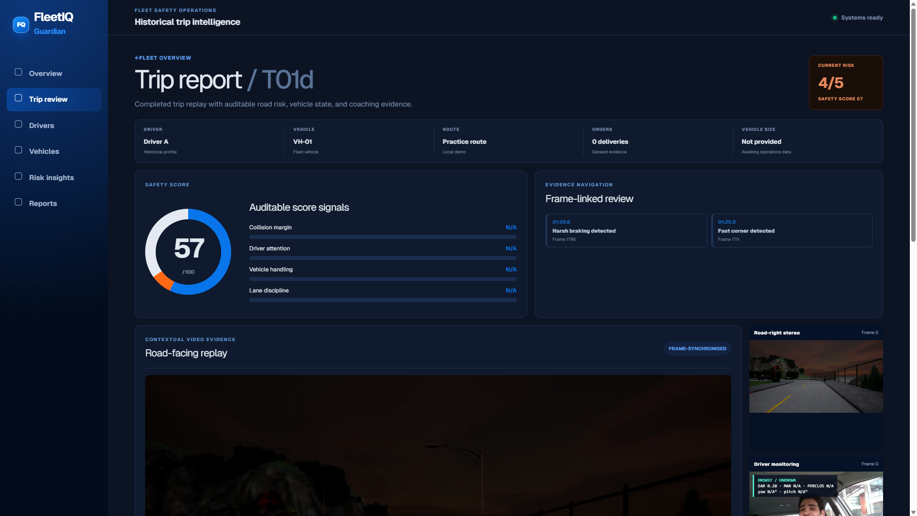
TRIP DRILL-DOWN
T01d: SCORE -> EVENT -> EVIDENCE
Trip report giữ evidence navigation, replay và score explanation trên cùng luồng review.
57/100
SAFETY SCORE
Risk card gives a reviewer one starting signal.
4/5
CURRENT RISK
Severity is traceable to road, driver and telemetry artifacts.
2
FRAME-LINKED EVENTS
Harsh brake and fast corner point to specific frame ranges.
Live local Docker dashboard screenshot: /trips/T01d | actual UI state is shown, including any N/A detail fields.
UchiHahaha | FleetIQ Guardian | Automotive Hackathon 2026
06

Slide 7
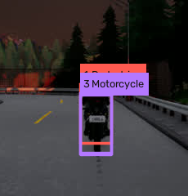
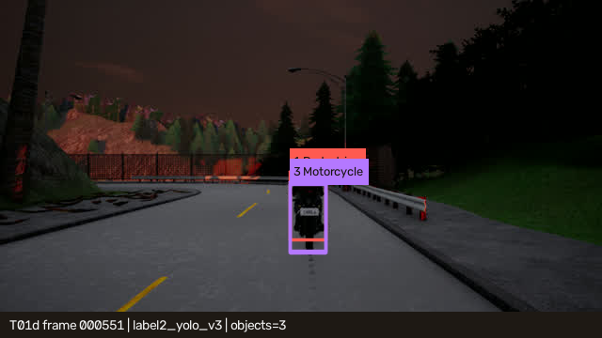
EVIDENCE-FIRST PERCEPTION
MOTORCYCLE EVIDENCE, NOT A BLACK-BOX ALERT
Frame 551 turns a model output into an inspectable road-risk record.
Motorcycle
confidence 0.3941
5.02 m
depth ROI estimate
SCENE
ENLARGED TARGET
DISCLOSURE
The same frame has an overlapping pedestrian false positive. We keep it visible rather than hide it.
artifacts/trips/T01d/analysis/road/000551.json | label2_yolo_v3/000551.txt | rendered evidence frame
UchiHahaha | FleetIQ Guardian | Automotive Hackathon 2026
07

Slide 8
SYSTEM ARCHITECTURE
FROM SENSORS TO A FLEET ACTION
The intelligence layer carries one event schema: severity, confidence, score impact, explanation and evidence.
01 INPUTS
Road stereo
Driver camera
Depth + calib
Telemetry + labels
02 ENGINES
TTC proxy
Driver state
Handling events
Trip scoring
03 INTELLIGENCE
Canonical events
Fusion
Risk score
Evidence link
04 OUTPUTS
Fleet ranking
Trip detail
Coach context
CSV/report
Runtime: precomputed artifacts -> FastAPI -> Next.js | Workers use bounded JSON/JSONL and compose profiles.
UchiHahaha | FleetIQ Guardian | Automotive Hackathon 2026
08

Slide 9
PRACTICE-TRIP EVALUATION
IMPROVE ERROR AND RECALL; DISCLOSE THE TRADE-OFF
Organizer evaluation on full-GT T01-Sample only. This is not a blind-test score for T01d-T10d.
CRITICAL TTC MAE
CRITICAL TTC F1
58.595s
0.125
0.240
Organizer SGBM baseline
BASELINE
CUSTOM
19.612s
Custom detector + depth ROI
66.5% lower critical-zone MAE
TTC composite: 30.6 baseline vs 28.3 custom
Reason: custom path has higher false-positive rate (0.058 vs 0.008).
artifacts/evaluation/T01-Sample_baseline_evaluation.json | T01-Sample_custom_evaluation.json
UchiHahaha | FleetIQ Guardian | Automotive Hackathon 2026
09

Slide 10
TEAM-OWNED DELTA
BTC CUNG CAP DATA; UCHiHAHAHA CUNG CAP WORKFLOW
Giá trị không nằm ở việc gọi một model, mà ở integration để Fleet Manager hành động được.
STARTER / BASELINE
TEAM-OWNED
Road, driver, depth, calibration, telemetry
17,999 custom YOLO v3 labels + selected checkpoint
Team-kit fixed-ROI StereoSGBM baseline
Road/DMS/fusion artifacts and depth-TTC evidence
Redacted scored-trip ground truth
Fleet ranking, replay, video-range and overlay routes
YOLOP road/lane segmentation
Submission exporter, validator, evaluation evidence and package
REMOVE OUR INTEGRATION -> raw data remains, but the reviewer loses ranked risk, synchronized evidence and auditable CSV outputs.
UchiHahaha | FleetIQ Guardian | Automotive Hackathon 2026
10

Slide 11
DEPLOYABLE BY DESIGN
DEMO HAY HANDOFF: CUNG MOT BUILD, CUNG MOT EVIDENCE
Release v1.0.0 separates source, organizer data and runtime artifacts so reviewers can rerun the final workflow.
RUN
REVIEW
SCALE
Docker Compose
Evidence package
OEM / fleet path
API, web, MinIO, Redis, PostgreSQL, MQTT, model mock and CarSky bridge.
Models, trip artifacts, evaluator reports, predictions and SHA-256 manifest.
Input, engine, intelligence and output layers can expand without replacing the workflow.
TEAM OWNERSHIP
Phi: roadface + automotive | Trung: DMS | Dung: agent/coaching | Kha: CV/ML + depth | Tu: backend + dashboard
CarSky disclosure: bridge is part of the build; Android Automotive end-to-end HMI must be demonstrated separately before claiming it.
UchiHahaha | FleetIQ Guardian | Automotive Hackathon 2026
11

Slide 12
REVIEW IN 3 MINUTES
FROM RISK QUEUE
TO COACHING CONTEXT
FINAL DISCLOSURE
- Redacted trips have no local ground truth.
- Practice evaluation is not blind-test accuracy.
- Frame 551 false positive is kept visible.
- CarSky HMI remains partial until recorded.
01
Open fleet ranking
02
Select T01d
03
Inspect timeline + replay
v1.0.0
Source + runtime handoff
for reproducible review
04
Open frame-linked evidence
05
Assign targeted coaching
THANK YOU
Release runbook: docs/runbooks/final-release.md
UchiHahaha | FleetIQ Guardian | Automotive Hackathon 2026
12

