Slide 1
Milestones
Distributed Sorting
Le Minh Hoang
Nov 3, 2016

Slide 2

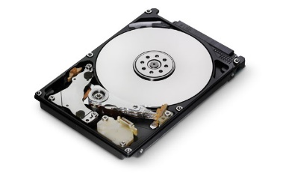
Data Flow
PartitionSender
Input
PartitionSender
Partitioner
Shuffler
FileSplitter
PartitionManager
PartitionReceiver
Sorter
FileWriter
Merger

Slide 3
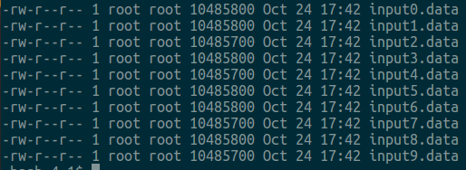
Test with input 100mb
Total Size = 104857600 bytes

Slide 4

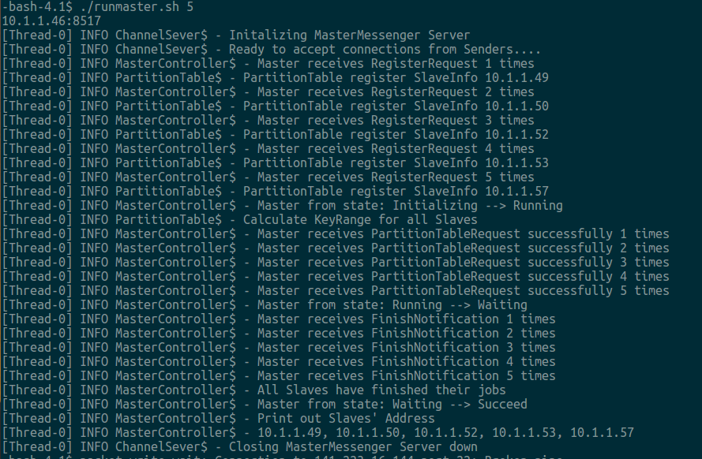




Experiment: Input 100MB
Test with 1 master (grey16) and 5 slaves (grey17-21)
Total Records = 210164 + 225541 + 224643 + 195093 + 193135 = 1048576
→ Total Size = 1048576 x 100 = 104857600 bytes = Input

Slide 5
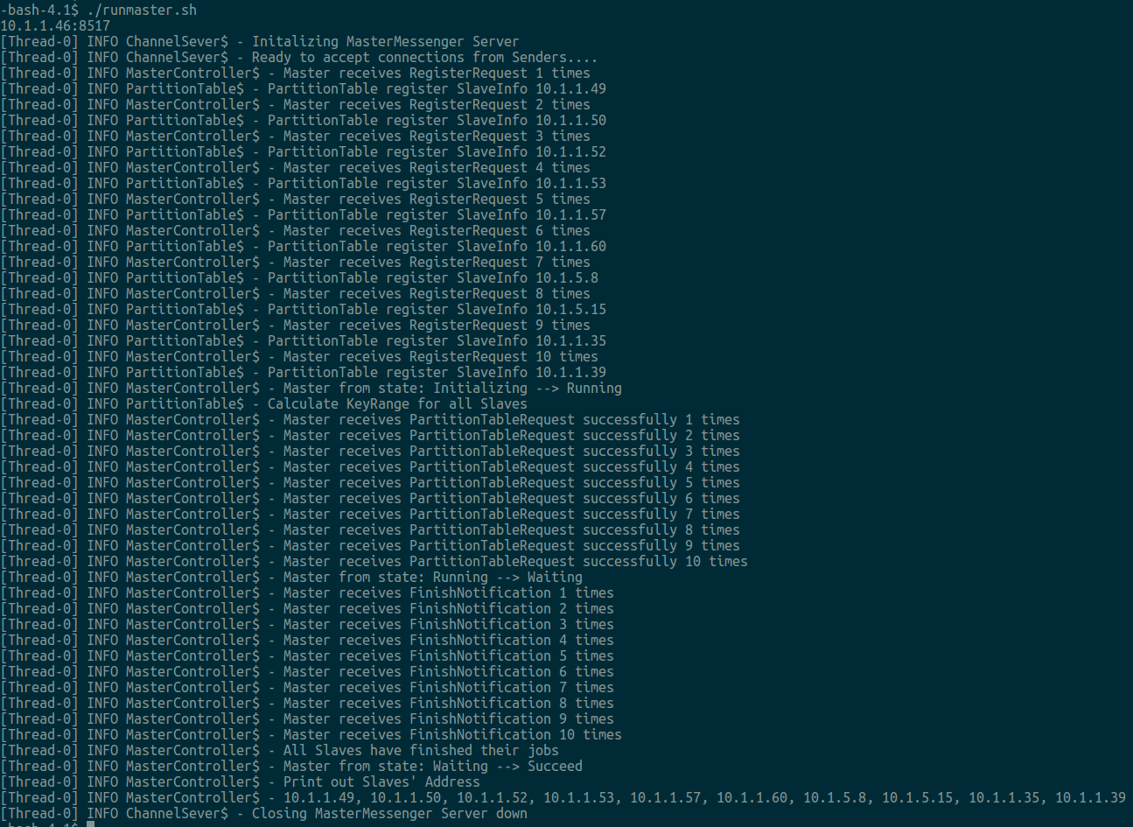










Experiment: Input 100MB
Test with 1 Master and 10 Slaves
Total Records = 105015 + 98692 + 115178 + 97306 + 113397 + 101513 + 94963 + 107308 + 120613 + 94591= 1048576
→ Total Size = 1048576 x 100 = 104857600 bytes = Input

Slide 6
Disadvantages
Too Slow → takes ~ 2 hours to finish 100MB input
The most of time spent on the Shuffling stage

