Slide 1

Fraudulent Credit Card
Transaction Detection
Min Luo
Department of Statistics and Data Science
University of Central Florida

Slide 2

Introduction
According to statistics in 2018
Over 40 billions credit card transactions made in the US
$3.8 trillion in dollar volume
Credit card fraud increased by 18.4 % in 2018
Payment card fraud resulted in lost of $24.26 Billion worldwide
Credit card companies need to identify fraudulent transactions quickly to mitigate the loss of credit card holders
Did you make that transaction?

Slide 3
Data
Kaggle Credit Card Fraud Detection Dataset
2 days of credit cards transactions in September 2013 in Europe
284,807 observations, 31 variables
Target variable: Class 1 = Fraud, 0 = Normal
30 predictor variables
V1 to V28: 28 variables masked via PCA due to privacy protection
Time: Number of seconds elapsed between this transaction and the first transaction in the dataset
Amount: transaction amount

Slide 4
Data Exploratory Analysis
Challenges
Dataset is highly unbalanced
Only 0.1727% (n = 492) of the transactions are fraudulent
Lots of outliers
V1 to V28 masked
Limited ability to do feature engineering using domain knowledge

Slide 5
Data Exploratory Analysis
Class (1=fraud, 0=normal)
Highly imbalance data
 | Count
1 = Fraudulent | 284,315 (99.8%)
0 = Normal | 492 (0.17%)

Slide 6
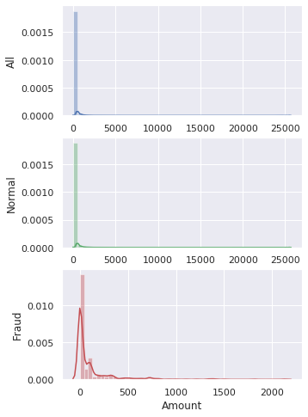
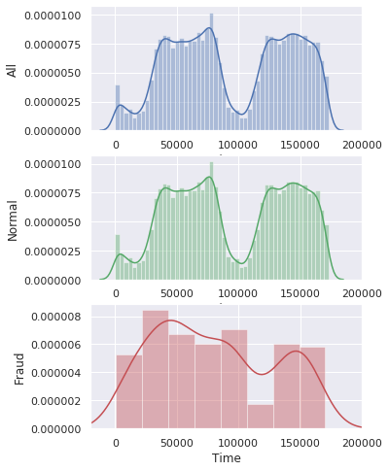
Data Exploratory Analysis
Amount, Time
Amount by Class
 | Fraud | Normal
mean | 122.211 | 82.291
std | 256.683 | 250.105
min | 0 | 0
max | 2125.87 | 25691.16
Amount
Time

Slide 7
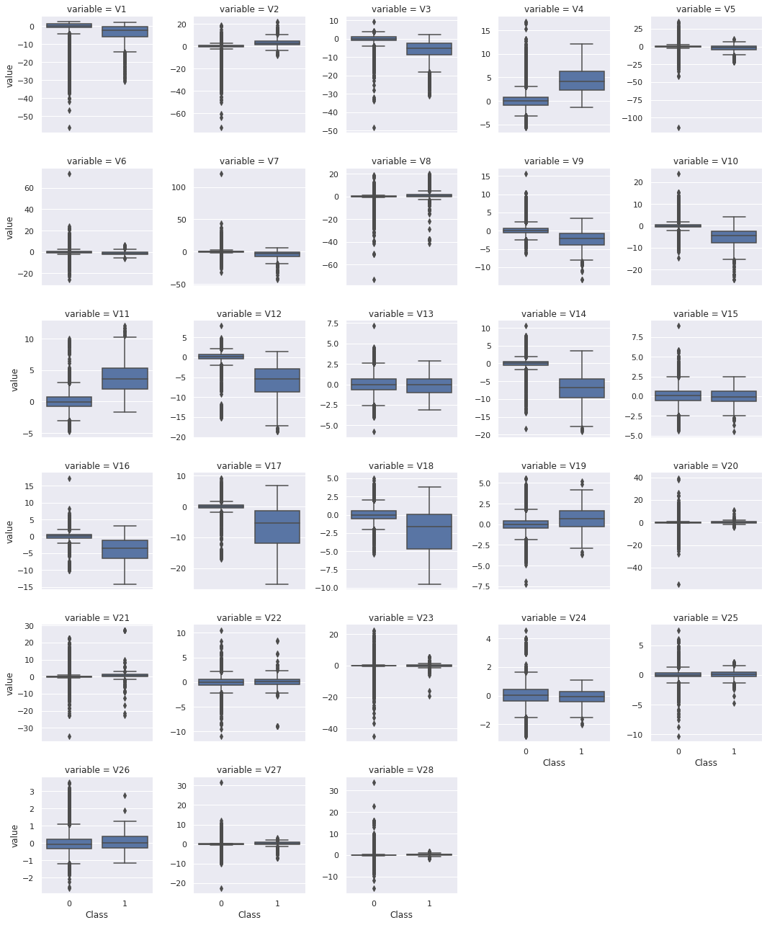
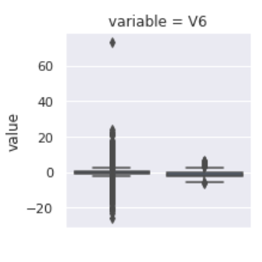
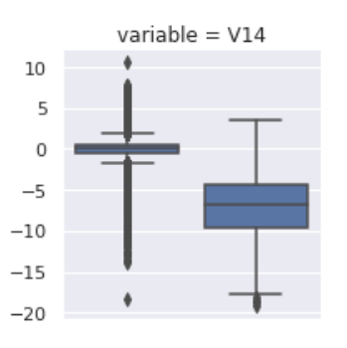
Boxplot of masked variables V1 - V28 by class

Slide 8
Models Selection
XGBoost (eXtreme Gradient Boosting)
Advanced implementation of gradient boosting machine (GBM)
Flexible model not bounded by structure of data
Imbalance data
Rebalancing data via under- or over-sampling
Cost sensitive learning by assigning different cost/weight to each class

Slide 9
Models Selection
Model “pipeline” using scikit-learn in python
Round 1: proof of concept/prototyping via 5-fold cross validation
Round 2: hyperparameter tuning via grid search 5-fold cross validation
Metrics
Precision, recall, and , AUC

Slide 10
Model Selection Pipelines Round 1: Prototyping (5-fold CV)
1
Standardization (Robust)
Weighted Classes
XGBoost
Model 1
2
Standardization (Robust)
SMOTE
XGBoost
Model 2
3
Standardization
SMOTE
XGBoost
Model 3
4
Standardization (Robust)
Random Undersampling
XGBoost
Model 4
5
Standardization (Robust)
XGBoost
Model 5
Notes:
For 200k observations with 5-fold cv, each fold takes at least 40 seconds to train, i.e. 5*40 = 200 seconds or 3.33 minutes. Adding grid search with a 5 hyperparameters and 3 values each, that’s 3^5 models, resulting in at least 13 hours of training time

Slide 11
Model Selection Pipelines Round 2: Hyperparameter Tuning (Grid Search 5-fold CV)
1
Standardization (Robust)
Weighted Classes
XGBoost
Model 1
2
Standardization (Robust)
SMOTE
XGBoost
Model 2
5
Standardization (Robust)
XGBoost
Model 5
Notes:
For 200k observations with 5-fold cv, each fold takes at least 40 seconds to train, i.e. 5*40 = 200 seconds or 3.33 minutes. Adding grid search with a 5 hyperparameters and 3 values each, that’s 3^5 models, resulting in at least 13 hours of training time

Slide 12
Result
 |  |  | Model 1 Weighted Class |  | Model 2 SMOTE |  | Model 5 No Re-balance
AUC | Train |  | 0.9989 |  | 0.9988 |  | 0.9863
 | Test |  | 0.9711 |  | 0.9726 |  | 0.9644
Precision | Train |  | 0.9470 |  | 0.9785 |  | 0.8343
 | Test |  | 0.8317 |  | 0.8730 |  | 0.7758
Recall | Train |  | 0.8599 |  | 0.3058 |  | 0.9788
 | Test |  | 0.6445 |  | 0.1967 |  | 0.8340
Notes:
SMOTE also had the longest training time

Slide 13
Summary
An xgboost model with carefully tuned hyperparameters out performed other xgboost models with re-balancing
scikit-learn does not support GPU
To fully take advantage of xgboost, there are other libraries that support that
In terms of application, a fraud detection model should focus on minimizing the false negative rate rather than increasing the accuracy

Slide 14
Questions?

Slide 15
Sources Cited
Altini, Marco. Dealing with Imbalanced Data: Undersampling, Oversampling and Proper Cross-Validation. 17 Aug. 2015, https://www.marcoaltini.com/blog/dealing-with-imbalanced-data-undersampling-oversampling-and-proper-cross-validation.
Analytics Vidhya. (2019). How to handle Imbalanced Classification Problems in machine learning?. [online] Available at: https://www.analyticsvidhya.com/blog/2017/03/imbalanced-classification-problem/ [Accessed 24 Nov. 2019].
Brownlee, Jason. “A Gentle Introduction to XGBoost for Applied Machine Learning.” Machine Learning Mastery, 21 Aug. 2019, https://machinelearningmastery.com/gentle-introduction-xgboost-applied-machine-learning/.
Credit Card Fraud Statistics. (2019, October). Retrieved November 2019, from https://shiftprocessing.com/credit-card-fraud-statistics/.
Holmes, Tamara E. “Credit Card Market Share Statistics.” CreditCards.com, 12 Sept. 2019, www.creditcards.com/credit-card-news/market-share-statistics.php.
“Introduction to Boosted Trees.” Introduction to Boosted Trees - Xgboost 1.0.0-SNAPSHOT Documentation, https://xgboost.readthedocs.io/en/latest/tutorials/model.html.
Machine Learning Group. “Credit Card Fraud Detection.” Kaggle, 23 Mar. 2018, www.kaggle.com/mlg-ulb/creditcardfraud
Mishra, Satwik. Handling Imbalanced Data: SMOTE vs. Random Undersampling. International Research Journal of Engineering and Technology, Aug. 2017, https://www.irjet.net/archives/V4/i8/IRJET-V4I857.pdf.
Image
“thief” by By Adrien Coquet/ CC BY

Slide 16
Supplementary Slides

Slide 17
Model Selection Sklearn Pipeline
xgb_model = XGBClassifier(random_state=42)
xgb_model1= XGBClassifier(random_state=42, scale_pos_weight=90)
undersampler = RandomUnderSampler(random_state=42)
smote = SMOTE(random_state=42)
model1_steps = [("RobustScaler", RobustScaler()), ("xgboost", xgb_model1)]
model2_steps = [("RobustScaler", RobustScaler()), ("SMOTE", smote), ("xgboost", xgb_model)]
model3_steps = [("StandardScaler", StandardScaler()), ("UnderSampler", undersampler), ("xgboost", xgb_model)]
model4_steps = [("RobustScaler", RobustScaler()), ("UnderSampler", undersampler), ("xgboost", xgb_model)]
model5_steps = [("RobustScaler", RobustScaler()), ("xgboost", xgb_model)]

Slide 18
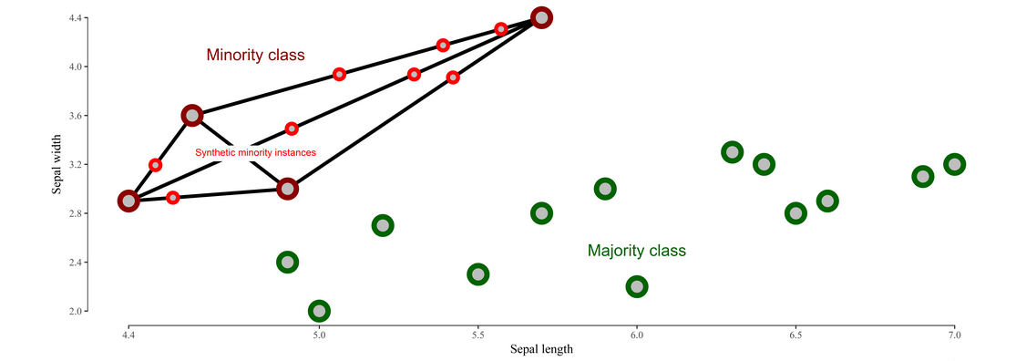
SMOTE
Synthetic Minority Over-sampling TEchnique
Synthesize new instances of minority class between existing minority instances
http://rikunert.com/SMOTE_explained

Slide 19
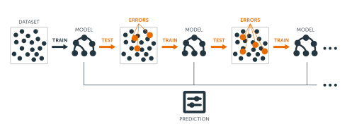
Gradient Boosting Machine (GBM)
Ensemble model of a sequence of decision trees where each tree after the first one focuses on the error from the previous tree
http://uc-r.github.io/gbm_regression

