Slide 1
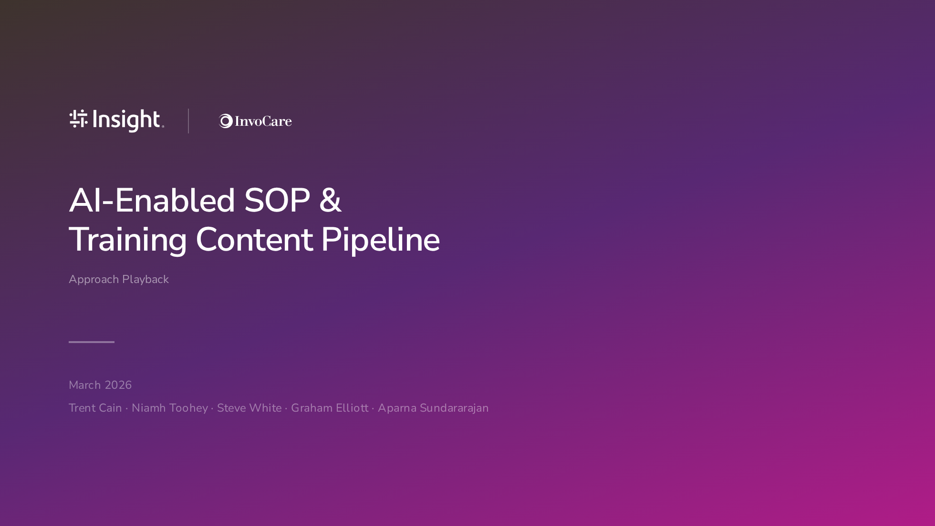
Notes:
Title slide — Insight gradient, dual branded. Keep it brief. "Approach Playback" sets the informal tone.

Slide 2
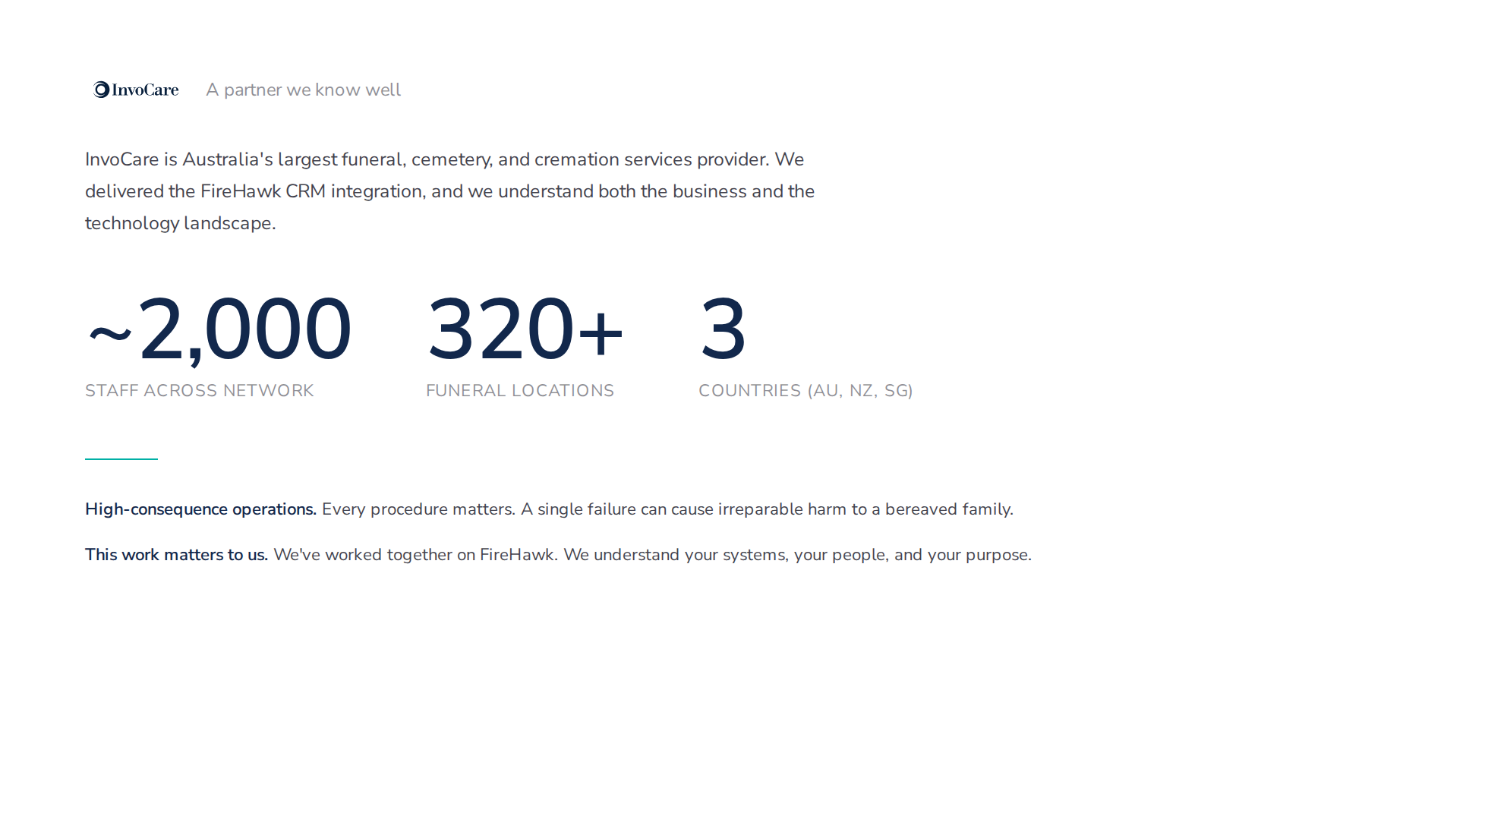
Notes:
Context slide. Keep it warm and brief. Two key messages: high-consequence environment, existing relationship.

Slide 3
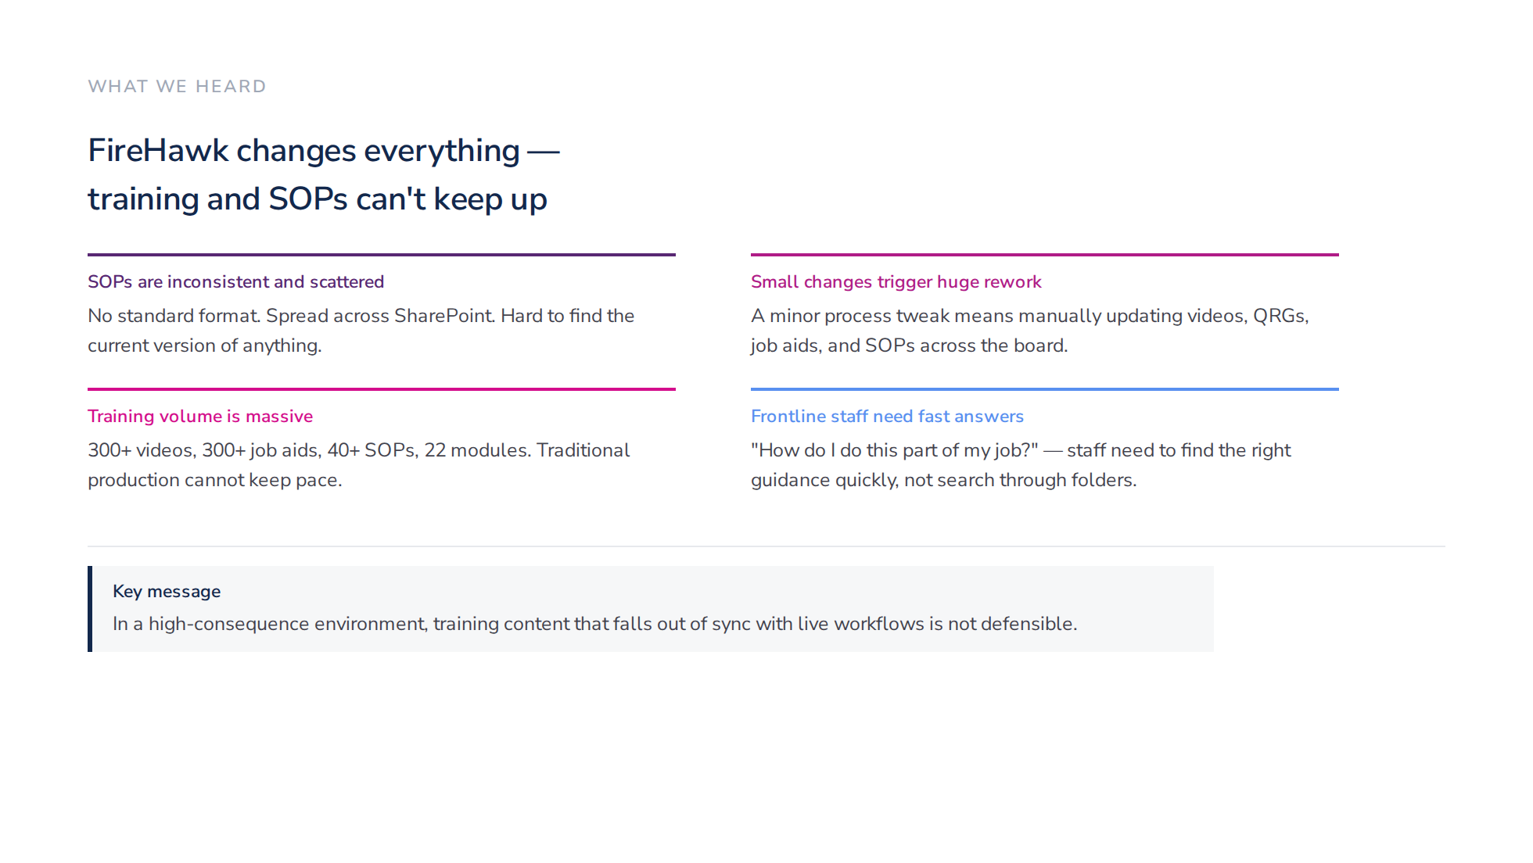
Notes:
Grounded in what Joanne and the team actually described. Four problems in 2x2 cards, then a key message callout box (UWA style). Don't rush — let the audience see themselves in these problems.

Slide 4
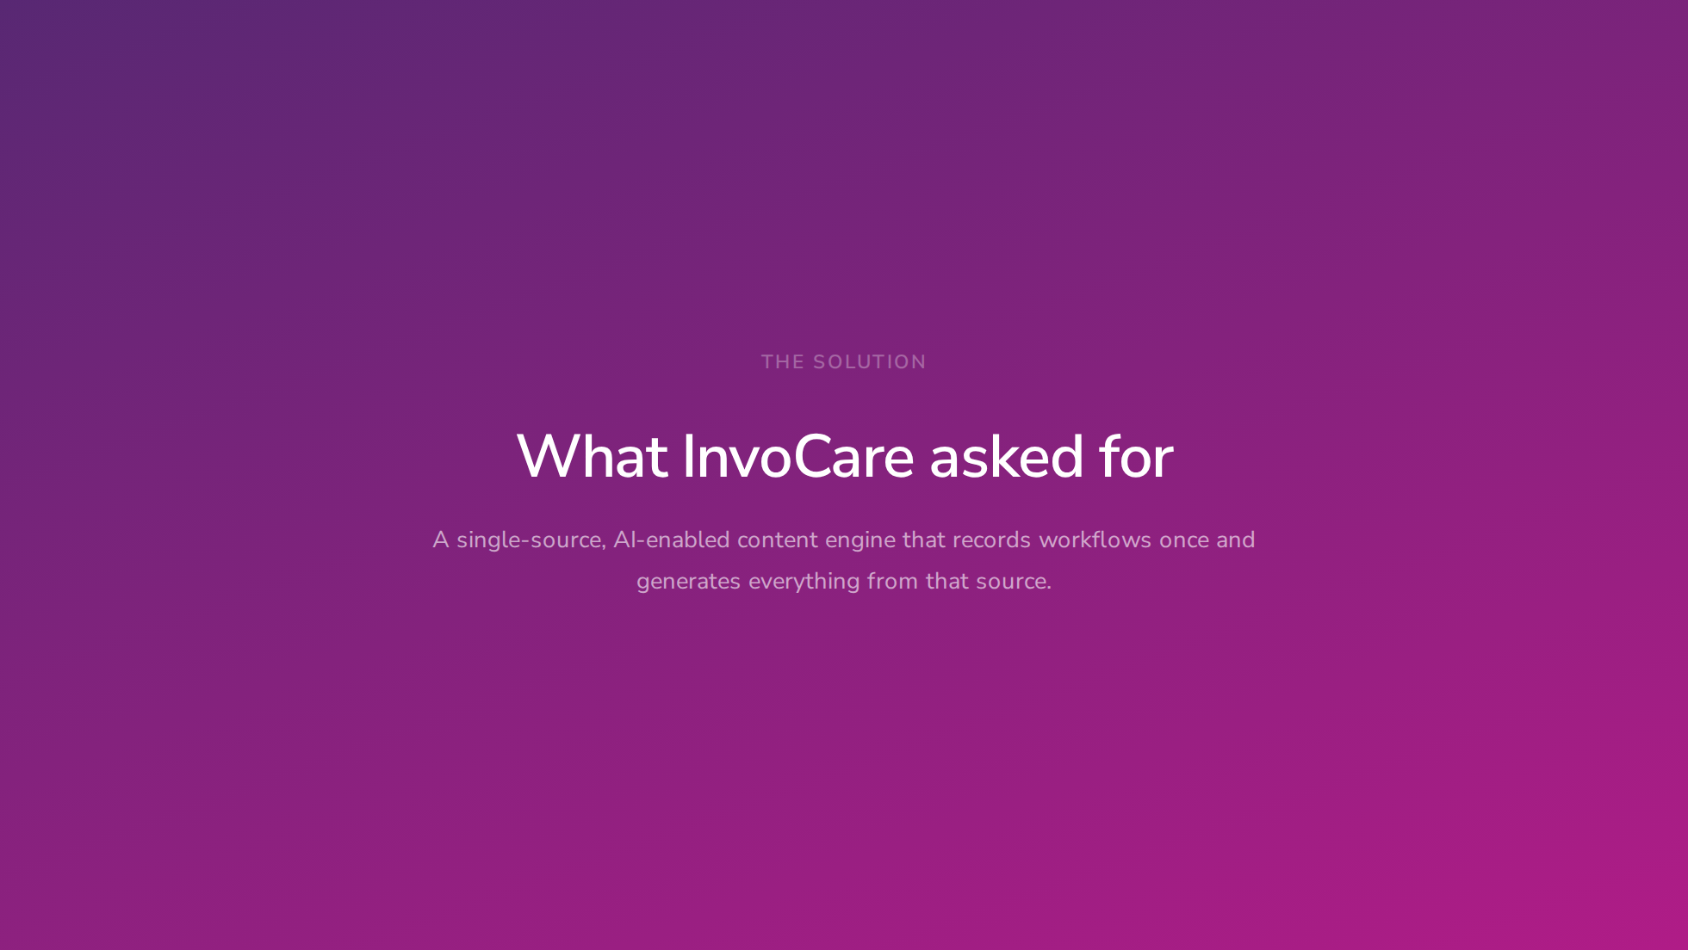
Notes:
Section divider — UWA style gradient slide. Transition from problems to solution. One sentence summary.

Slide 5
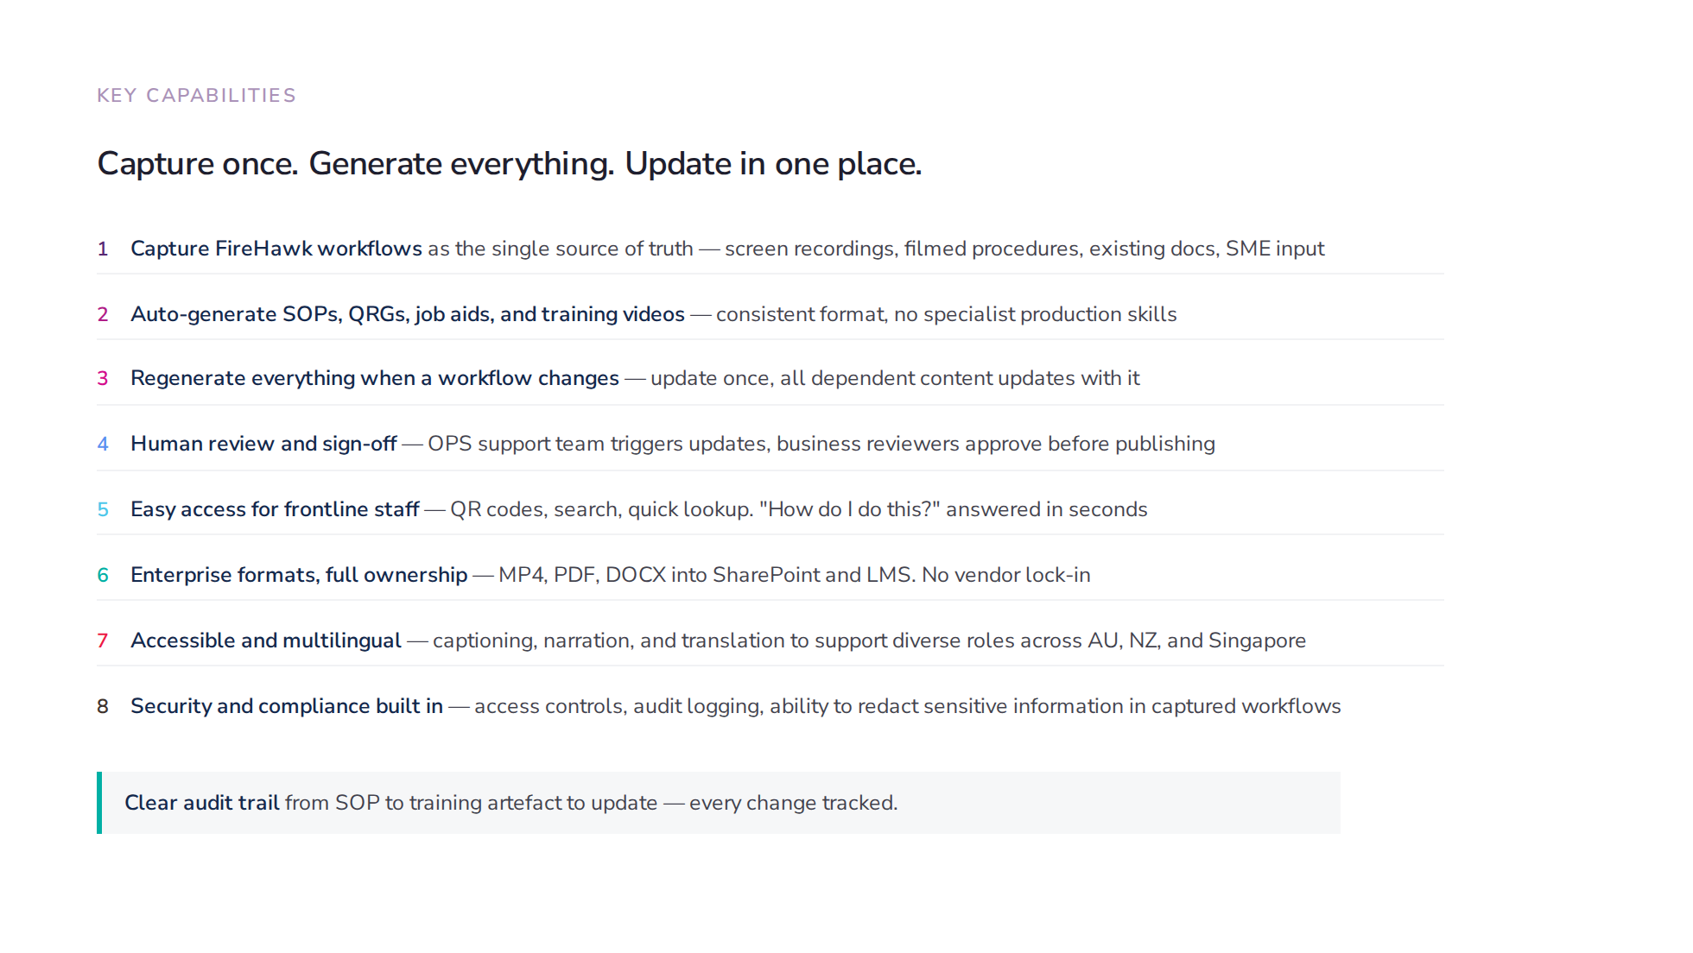
Notes:
Plain language features, numbered, tied directly to what Joanne described. No invented capabilities. No buzzwords. Each line maps to something from the requirements session.

Slide 6
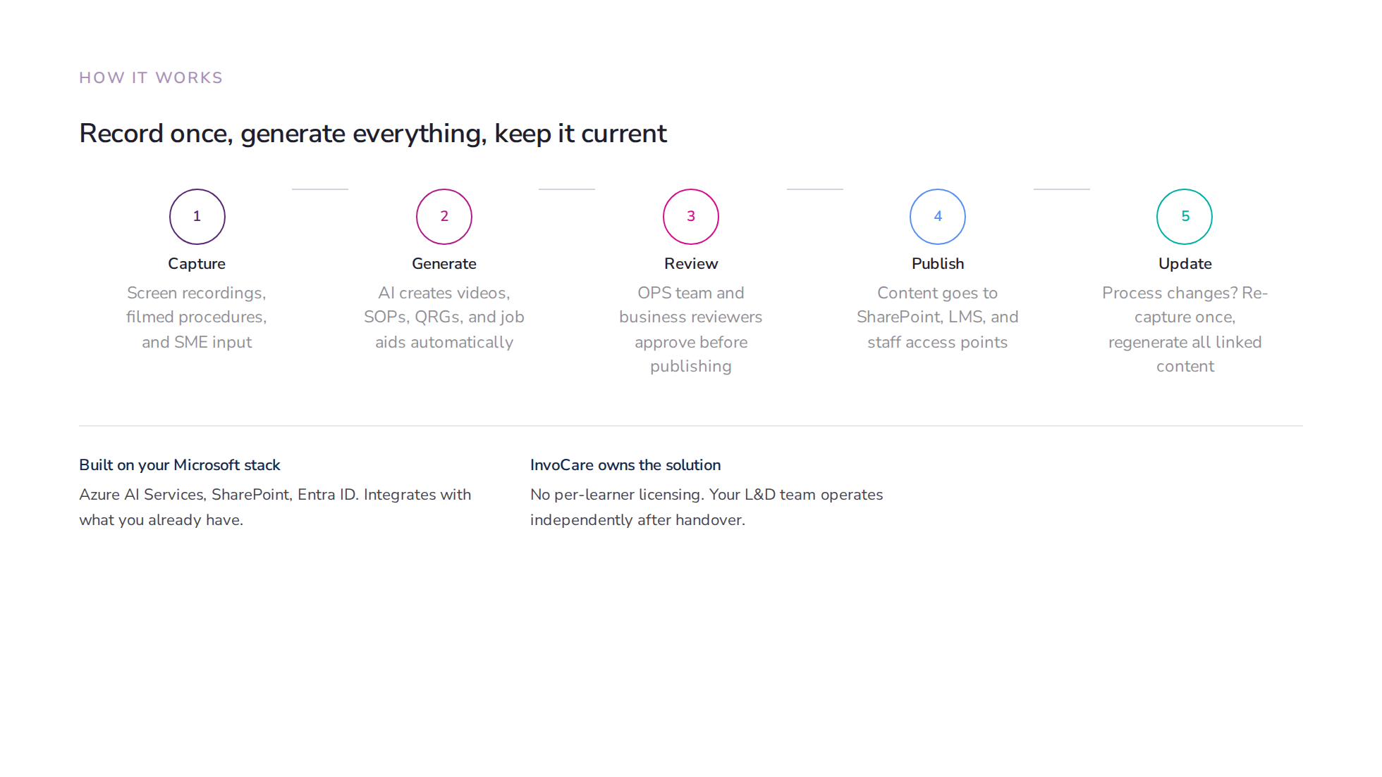
Notes:
Simplified pipeline. No "knowledge graph" language. Capture → Generate → Review → Publish → Update. Maps directly to what Joanne described: record, generate, review, publish, re-trigger on change.

Slide 7
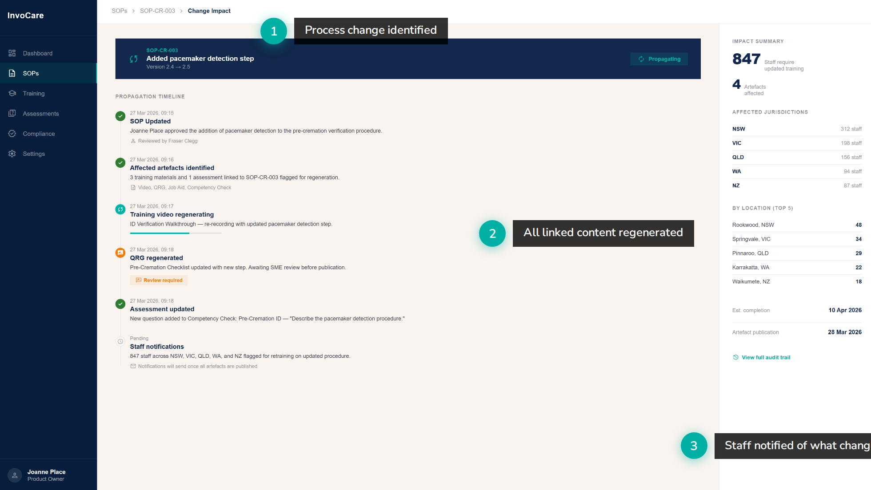
Notes:
Mockup: what happens when a process changes. Re-annotated to match the actual workflow Joanne described: 1. OPS team identifies a process change 2. All linked training content is regenerated 3. Affected staff are notified This is the core value proposition — small change, automatic cascade.

Slide 8
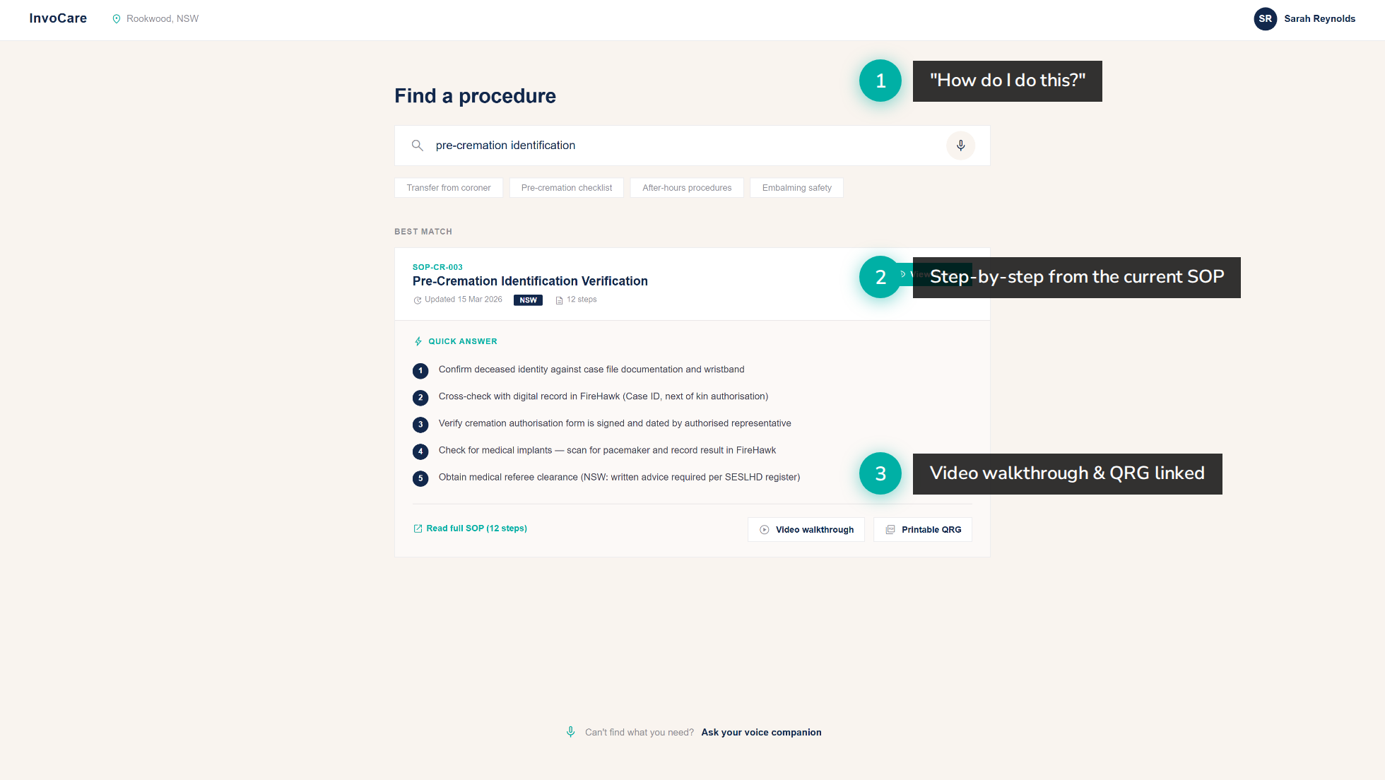
Notes:
Mockup: staff looking up a procedure. Re-annotated to match Joanne's description: 1. Staff asks "how do I do this?" — scan QR code or search 2. Gets the current SOP steps immediately 3. Video and QRG linked for deeper learning "It's really about the how to" — Joanne

Slide 9
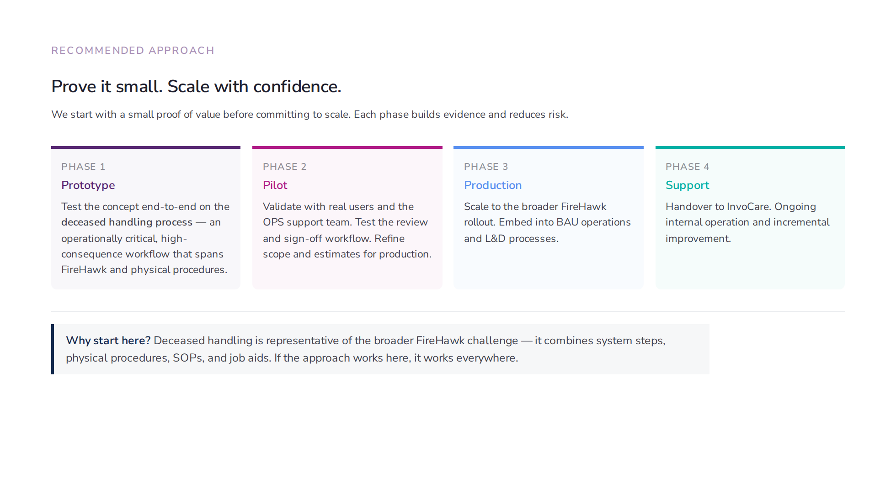
Notes:
UWA-style 4-phase cards. Prototype → Pilot → Production → Support. Short, non-technical, clearly about risk reduction. Matches what Joanne and the team agreed: start with a PoC, validate, then scale.

Slide 10
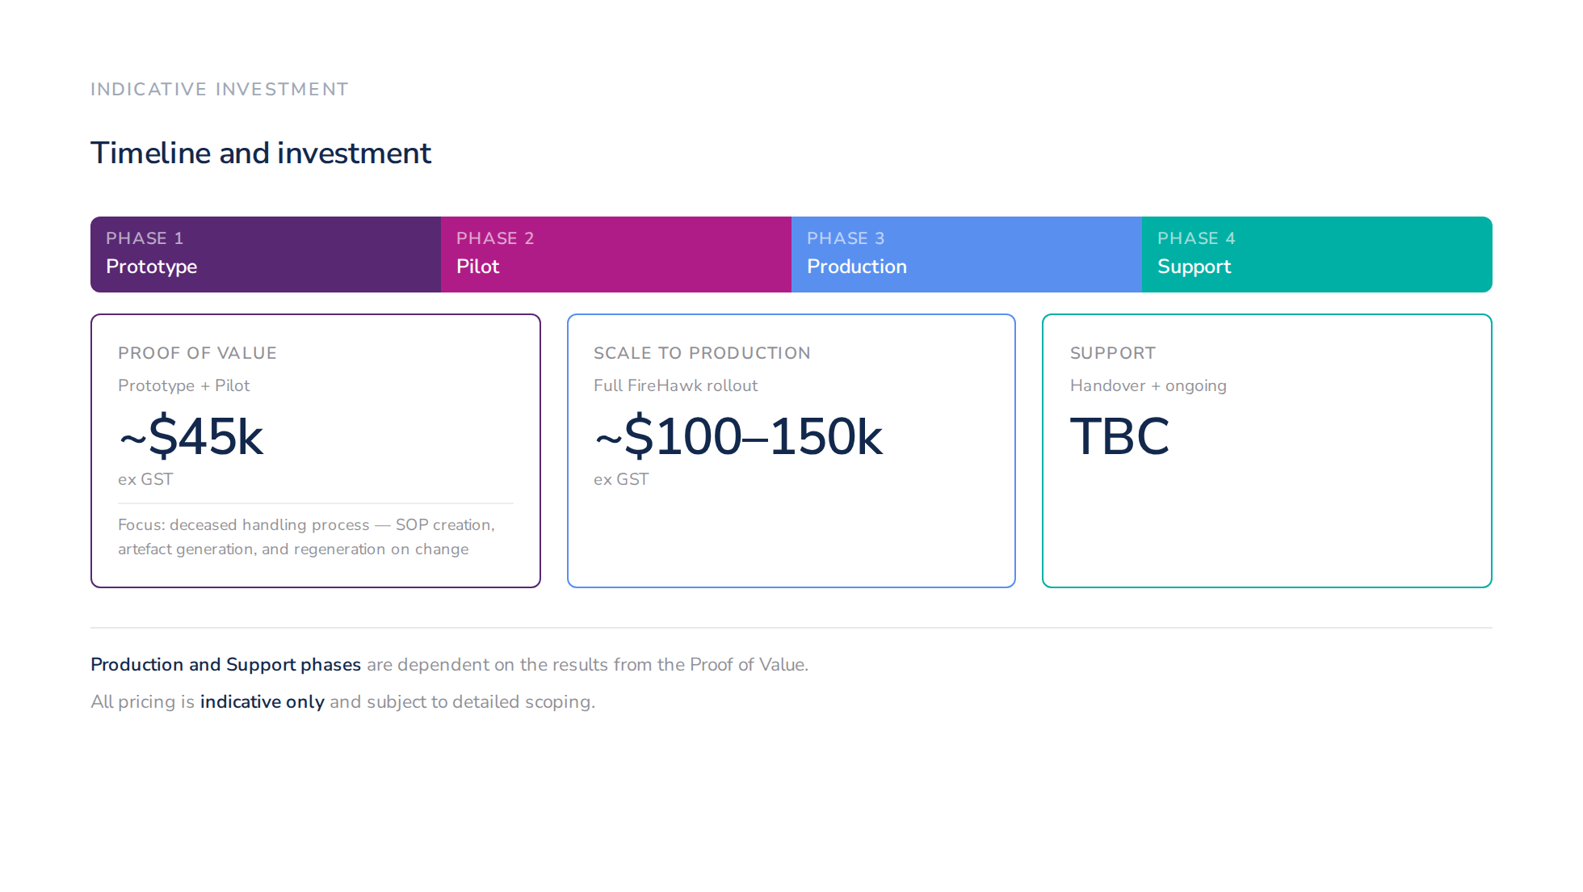
Notes:
Pricing slide. Clean and clear. - PoV bundles Prototype + Pilot at ~$45k - Production at ~$100-150k, contingent on PoV results - Support TBC - Caveats clearly stated: contingent on PoV, indicative only

Slide 11
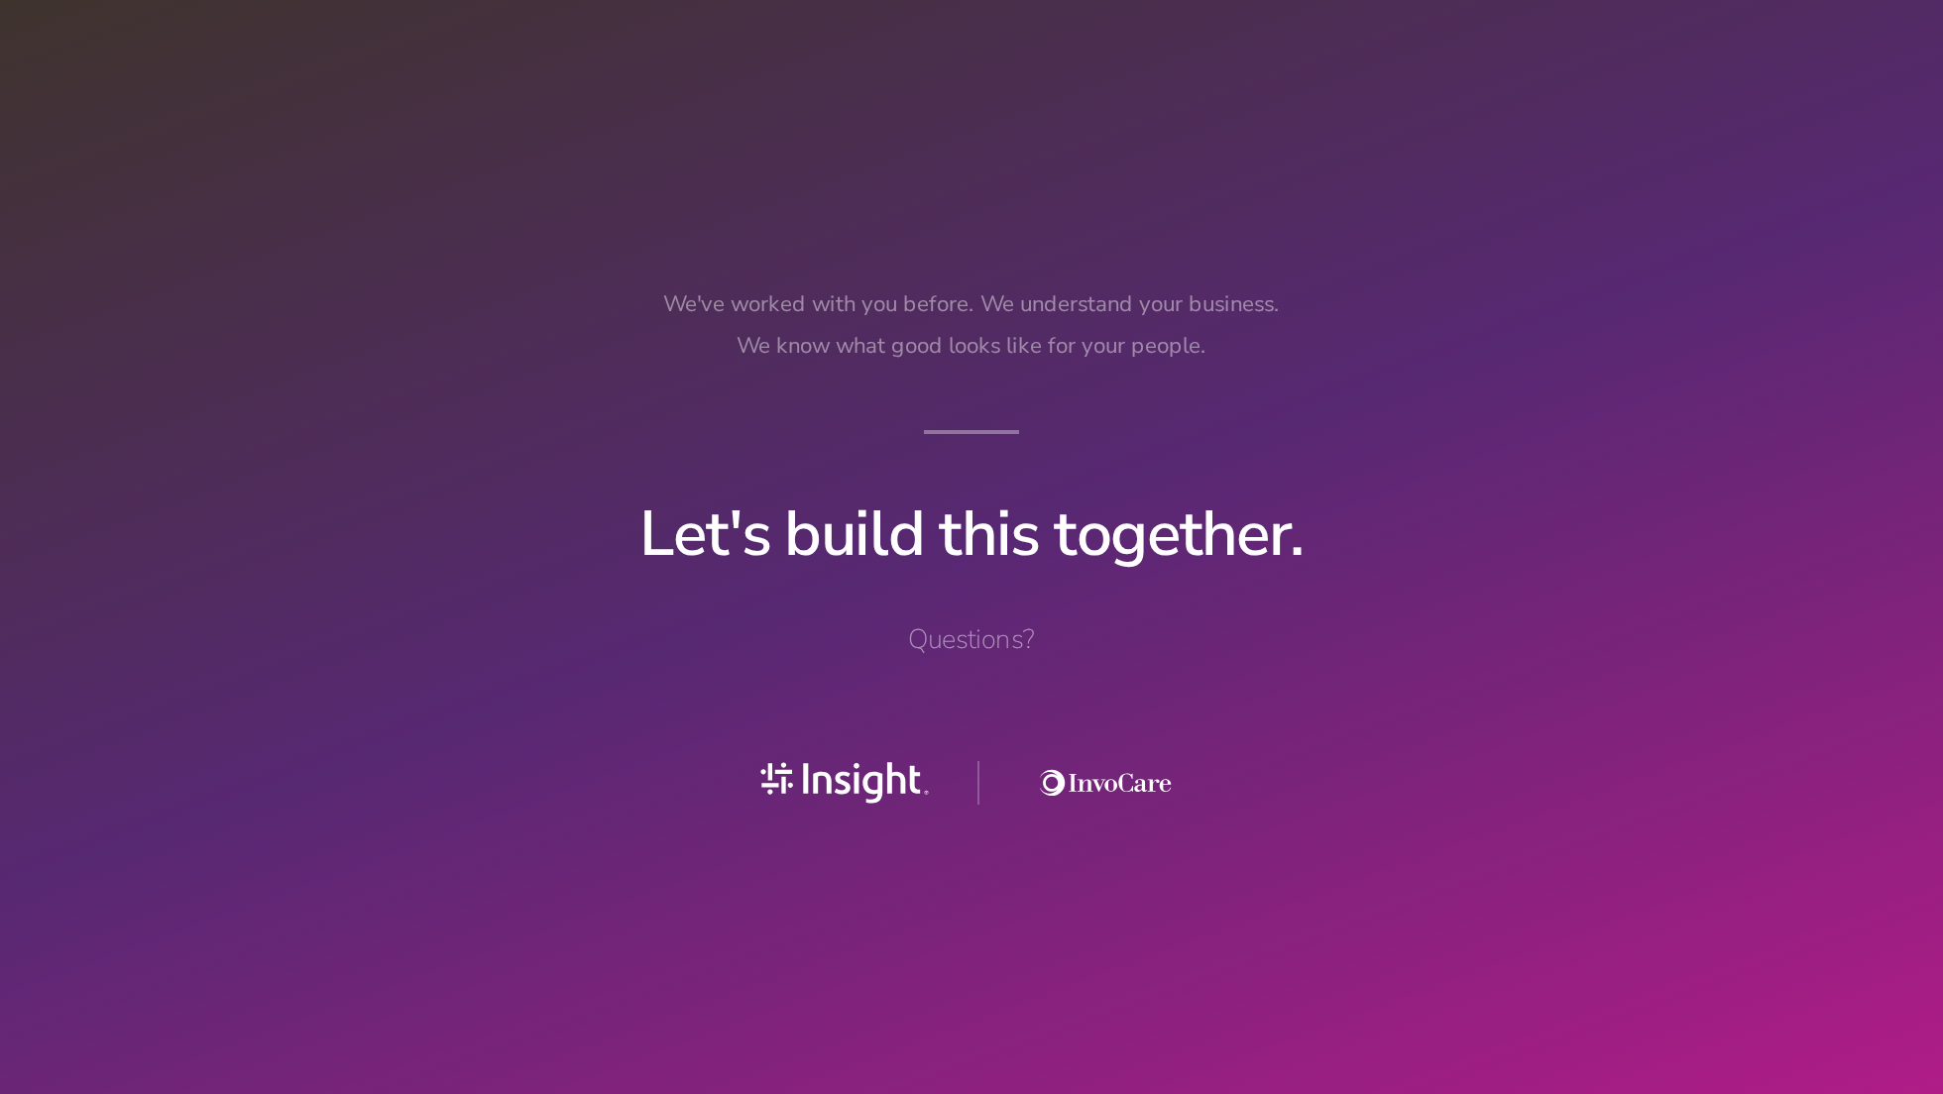
Notes:
Closing slide — bookends with the title. Partnership language: "Let's build this together."

