Slide 1
FPGA-BASED Rfc FOR ANOMALY DETECTION [IN DNP3 SCADA SYSTEMS IN SMART GRIDS]
GROUP - 03
HARISH .M – cb.sc.u4aie24115
JYOTHSNA .V – cb.sc.u4aie24117

Slide 2
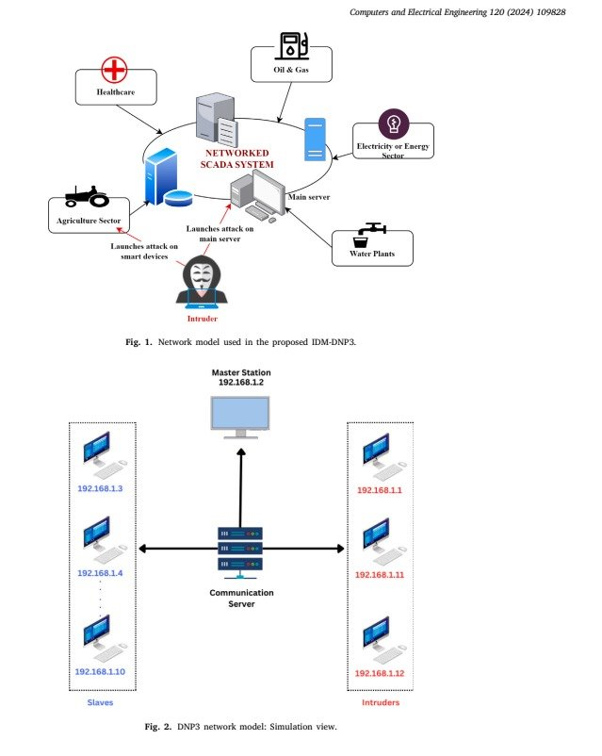
INTRODUCTION TO DNP3 IN SCADA
The DNP3, a widely adopted communication protocol in SCADA systems, facilitates real-time monitoring and control across critical infrastructure, like power grids, water systems, and energy management systems.
However, its inherent vulnerabilities to cyber threats, including unauthorized access and data manipulation, necessitates advanced security mechanisms.
This research aims to introduce an integrated approach combining Anomaly Detection for attack identification, with the FPGA to reduce latency, using DNP3 data flow in SCADA systems of smart grids.

Slide 3
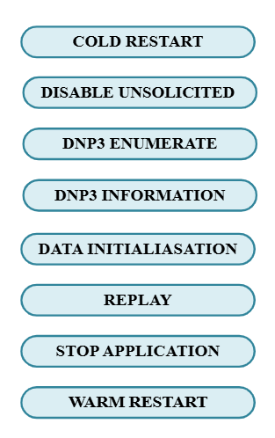
dataset overview
The DNP3 Parser dataset encompasses over 6,000 data flows, divided into 4,194 for training and 1,800 for testing, and features 102 attributes capturing traffic metadata, timing information, packet characteristics, and protocol behaviors.
The dataset consists of eight distinct attack types alongside a class representing normal, legitimate traffic. By simulating real-world challenges in intrusion detection, this balanced dataset highlights the pressing need to strengthen DNP3 against increasingly sophisticated and evolving cyber threats.

Slide 4

PROPOSED INTRUSION DETECTION SYSTEM - 1
Anomaly detection refers to the identification of unusual patterns, anomalous events, or data points that deviate from expected behavior. In the proposed framework, all attack types are classified as a single, anomalous class, while the other, non-attack data is labeled as normal class.
To simulate a real-world environment, the dataset used in this study is subjected to manual data augmentation, generating 1,398 normal traffic data points. Furthermore, varying levels of intrusion, approximately 1%, 3%, 5%, and 7% of anomalous data are introduced relative to the normal traffic, effectively mimicking realistic data flow patterns.

Slide 5
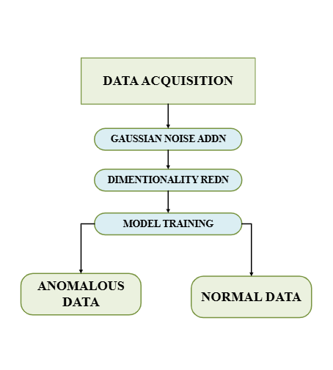
PROPOSED INTRUSION DETECTION SYSTEM -2
1) Gaussian Noise Injection: Gaussian noise is introduced into the dataset to simulate real-world perturbations and ensure that sensitive features are not overfitted by the model.
2) Dimensionality Reduction using Principal Component Analysis (PCA) is used for dimensionality reduction to project data into a lower-dimensional space and filter out less informative features while preserving the variance in the data.
3) Random Forest Classifier: Of all the Machine learning classifiers (like SVM, Decision trees, ANN, XGBoost, and Random forest) tried out for Anomaly detection for this dataset, Random Forest outperforms all others.

Slide 6
SOFTWARE RESULTS
The Random Forest Classifier (RFC) was implemented for anomaly detection in DNP3-based SCADA systems. The model was evaluated at different intrusion rates (1%, 3%, 5%, 7%), showing high accuracy and perfect recall across all cases.
Intrusion Rate | Accuracy | Precision | Recall | F1 - Score
1% | 98.59% | 20.00% | 100% | 33.33%
3% | 99.65% | 90.91% | 100% | 95.24%
5% | 98.98% | 86.36% | 100% | 92.68%
7% | 98.66% | 82.61% | 100% | 90.48%
The Random Forest Classifier achieved a peak accuracy of 99.65% (3% intrusion rate) and maintained a perfect 100% recall across all cases, ensuring no anomalies were missed.

Slide 7
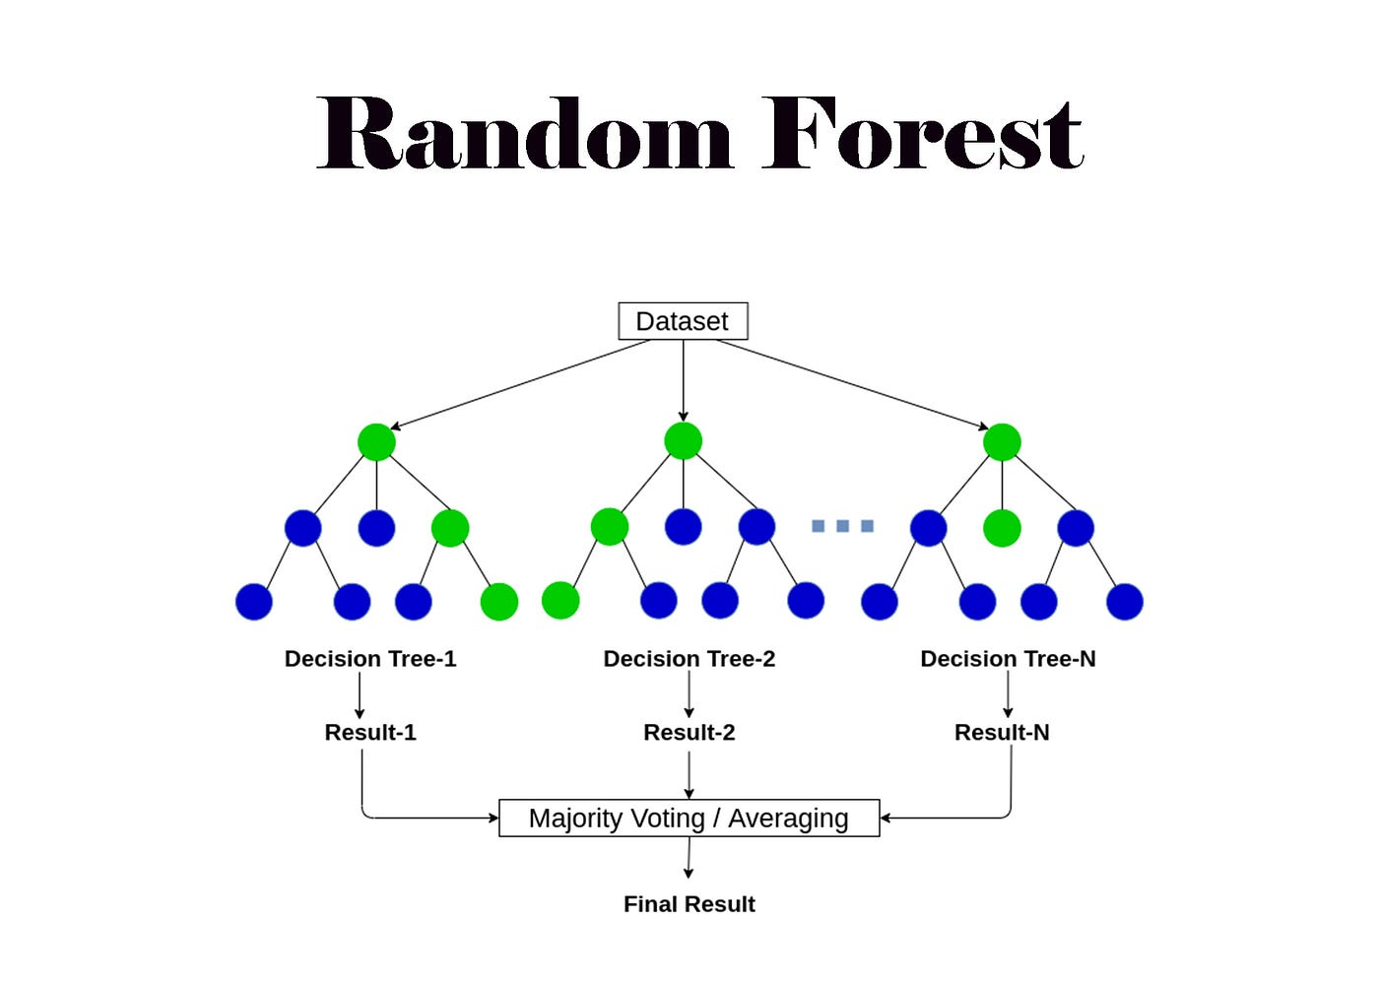
Random forest architecture
Random Forest (RF) is an ensemble learning algorithm that constructs multiple decision trees and combines their predictions to improve accuracy and reduce overfitting, which is widely used for classification and anomaly detection due to its robustness and efficiency.
This diversity is achieved through a technique called bagging (bootstrap aggregating). Bagging involves creating multiple random samples of the training data with replacement and training a separate decision tree on each sample.

Slide 8

Challenges of Software-based RFCs
1. Bottlenecks in CPU/GPU-based Implementations
Traditional implementations using Python’s Scikit-Learn rely on CPUs/GPUs, as dataset size and tree complexity increase, such execution suffers from memory bottlenecks and inefficient branching operations.
2. Latency Issues with Deep Decision Trees
Inference latency rises with deeper trees as each input navigates multiple branches. More memory accesses and evaluations slow decision-making on traditional hardware.
3. FPGA-Based Parallel Computation for Efficiency
FPGAs parallelize decision trees, reducing classification time. Custom design optimizes traversal and voting for real-time, low-power execution.

Slide 9
LITERATURE REVIEW
PAPER 1: AE-LSTM Based Anomaly Detection System for Communication Over DNP 3.0
ADVANTAGES:
High Accuracy & Efficiency – The AE-LSTM-based AI system detects DNP3 cyber threats with 99% accuracy, 98% TPR, and 1.6% FPR.
Enhanced EMS Security – The model strengthens power system resilience by detecting cyber threats in EMS and DNP3 vulnerabilities.
DISADVANTAGES:
Limited Generalization – Effective against known attacks but may struggle with zero-day threats and adversarial modifications.
High Complexity – Autoencoder-LSTM increases computational overhead, challenging real-time detection in large SCADA systems.
PAPER 2: An effective intrusion detection scheme for Distributed Network Protocol 3 (DNP3) applied in SCADA-enabled IoT applications
ADVANTAGES:
Multi-Class Classification – Classifies eight DNP3 attack types, improving threat differentiation and precision.
Optimized Features & Accuracy – Uses 99 features with XGBoost, Random Forest, and Decision Trees, achieving 99.56% accuracy in SCADA threat classification.
DISADVANTAGES:
Labeled Data Dependence – Limited effectiveness against novel cyber threats without prior training data.
Real-Time Constraints – Preprocessing and feature selection may introduce latency in SCADA monitoring.

Slide 10
NEED FOR FPGA IMPLEMENTATION
Feature | CPU | GPU | FPGA
Speed | 🚫 Slow | ⚠️ Faster | ✅ Real-time
Power Consumption | ⚠️ High | 🚫 Very High | ✅ Low
Parallel Processing | 🚫 Limited | ✅ High | ✅ Very High
Customizability | 🚫 Fixed | ⚠️ Limited | ✅ Fully Custom
Traditional CPU & GPU-based anomaly detection faces limitations in speed, power efficiency, and real-time performance.
FPGA offers real-time processing, low power consumption, and high parallelism, making it ideal for machine learning applications.
Our project leverages FPGA acceleration for Random Forest Classifier, ensuring efficient and scalable anomaly detection in real-world scenarios.

Slide 11
IMPLEMENTATION PLAN
PHASE 1: SOFTWARE IMPLEMENTATION AND RESULT ANALYSIS
PHASE 2: RANDOM FOREST CLASSIFIER ARCHITECTURE ANALYSIS
PHASE 3: RFC's IMPLEMENTATION ON FPGA
PHASE 4: MODEL FITTING AND FINE TUNING

Slide 12

Conclusion
Software Implementation & Model Evaluation: The Random Forest Classifier was successfully implemented and rigorously tested against multiple machine learning models, including SVM, XGBoost, Decision Tree, and ANN. The evaluation revealed that Random Forest consistently delivered the best performance in terms of accuracy, robustness, and generalization.
FPGA Implementation: Given the superior results, the next phase involves designing and implementing the Random Forest algorithm on FPGA. This transition aims to leverage FPGA’s parallel processing capabilities for improved efficiency, lower latency, and optimized hardware acceleration, making it suitable for real-time applications.

Slide 13

Thank you

