Slide 1

AI Course for Programmers
Thomas, Lai Hok Ming

Slide 2
Basic Information
Prerequisite
Familiar with any programming languages
Github
https://github.com/hmlaiac/NEW_AI
How to find me?
Personal Webpage: http://www.andiogame.com
Email: lxm8169@gmail.com

Slide 3

Learning Outcomes
Part A: Computer Vision and OpenCV
Object Detection
Object Tracking
Able to deal with most robotic problems

Slide 4
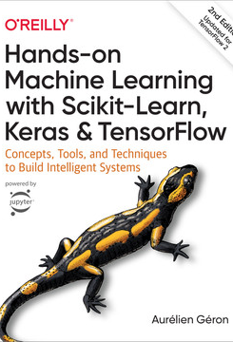
Learning Outcomes (Cont)
Part B. Deep Learning and Reinforcement Learning
Sklearn: Machine learning
Tensorflow: Deep learning
Reinforment Learning
Suggested Book：Hands-on Machine Learning with Sckit-Learn, Keras and Tensorflow

Slide 5
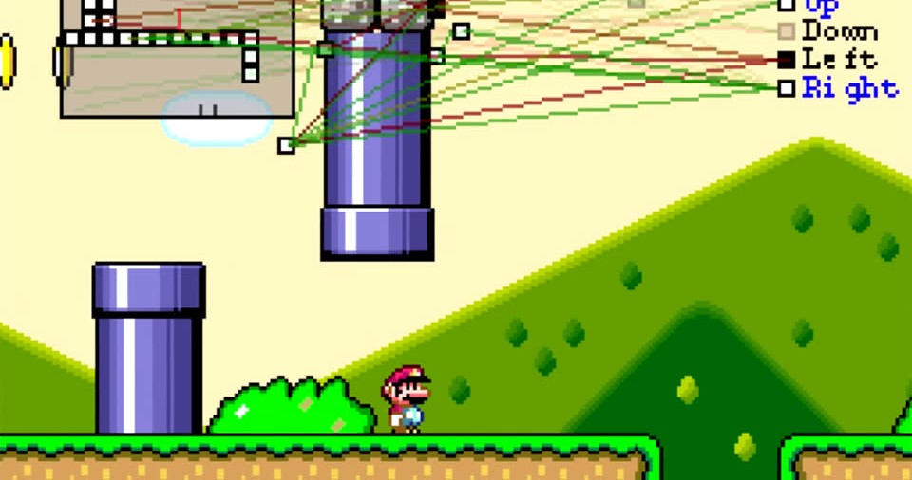
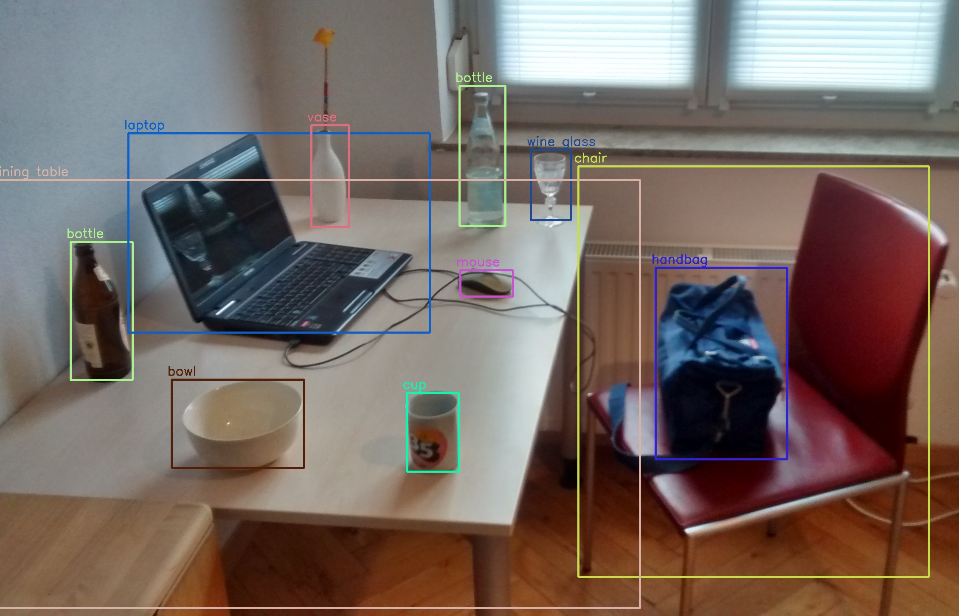
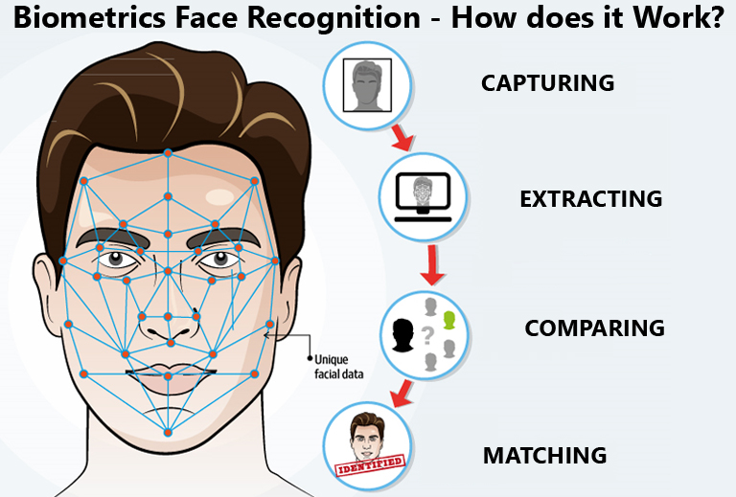
Projects
Face Recognition
Object Detection
Game Bot

Slide 6
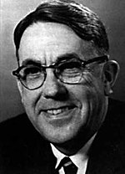
What is Artificial Intelligence?
[Machine Learning is the] field of study that gives computers the ability to learn without being explicitly programmed. —Arthur Samuel, 1959
讓電腦在不固定程序的情況下擁有學習能力

Slide 7

What is Artificial Intelligence?
A computer program is said to learn from experience E with respect to some task T and some performance measure P, if its performance on T, as measured by P, improves with experience E. —Tom Mitchell, 1997
從過往的經驗中進行學習，並進行評估，最後達致一定的表現

Slide 8
What is Artificial Intelligence?
The traditional computer programs are solid and fixed. AI gives computers abilities to learn data (Experiences) to perform human-like tasks.
個人理解：人工智能解決了一些以往程序無法完成的事情，從數據即過去的經驗中進行學習，以達致一些特定的目標

Slide 9
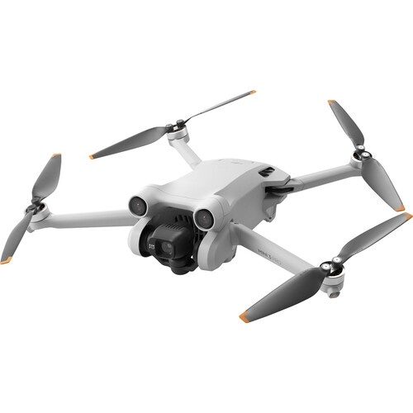
Example
Problems | Program | Machine Learning
How to handle unexpected accidents? | Imaginate all cases and convert them to programs | Run simulation and learn from experiences
How to handle vibration of Drone? | Physics and Equations, then convert then to programs | Study from sensing data and give a solution

Slide 10
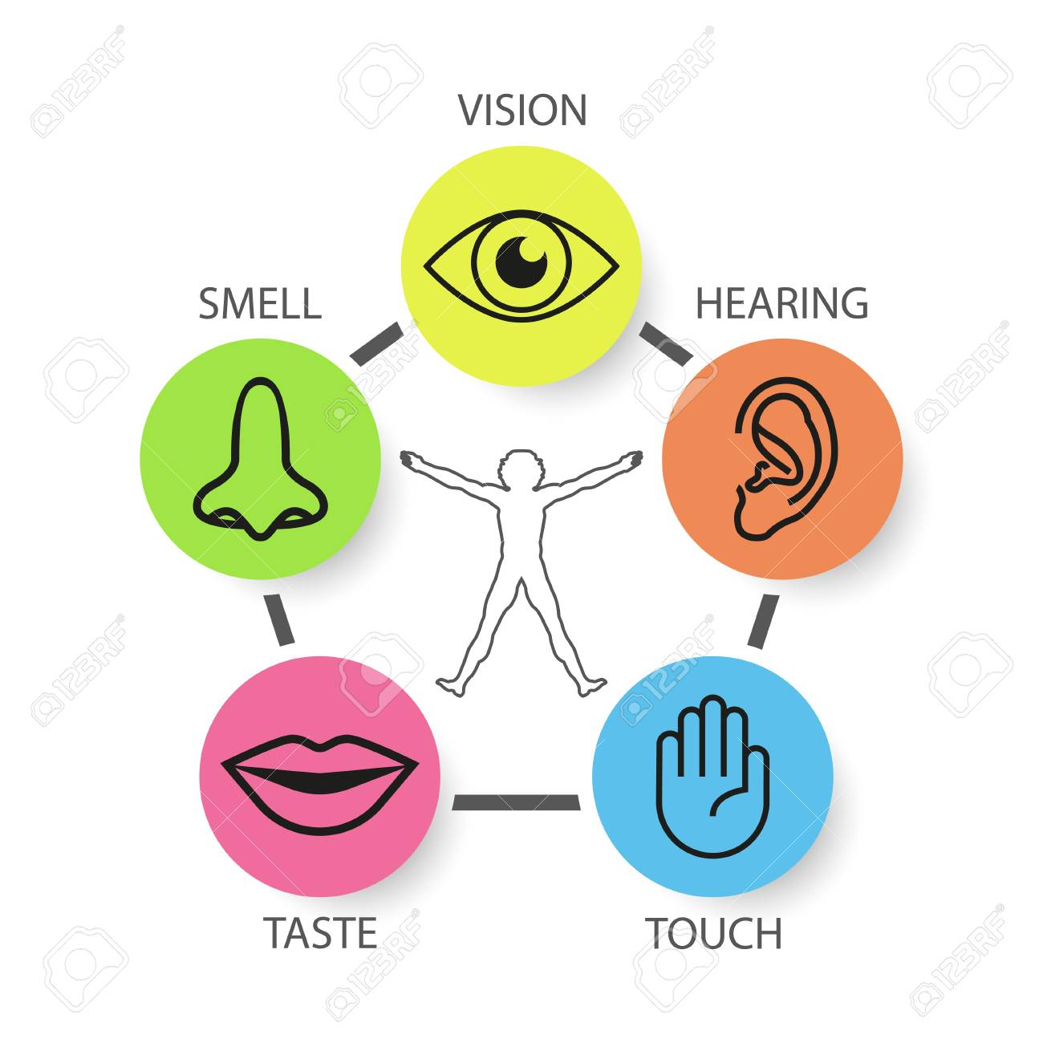
Human VS Computer
Vision (Computer Vision)
Hearing (Natural Voice Processing)
Touch (Robotics)
Taste (Chemical Detector)
Smell (Gas Detector)

