Slide 1
Sequences and Summations
Section 2.4

Slide 2
Section Summary
Sequences.
Examples: Geometric Progression, Arithmetic Progression
Recurrence Relations
Example: Fibonacci Sequence
Summations

Slide 3
Introduction
Sequences are ordered lists of elements.
1, 2, 3, 5, 8
1, 3, 9, 27, 81, …….
Sequences arise throughout mathematics, computer science, and in many other disciplines, ranging from botany to music.
We will introduce the terminology to represent sequences and sums of the terms in the sequences.

Slide 4
Sequences
Definition: A sequence is a function from a subset of the integers (usually either the set {0, 1, 2, 3, 4, …..} or {1, 2, 3, 4, ….} ) to a set S.
The notation a_{n} is used to denote the image of the integer n. We can think of a_{n} as the equivalent of f(n) where f is a function from {0,1,2,…..} to S. We call a_{n} a term of the sequence.

Slide 5
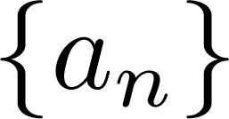
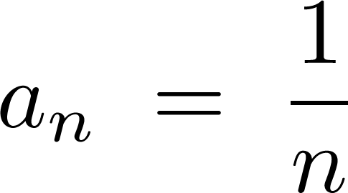

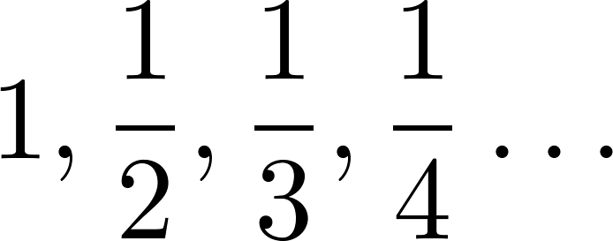
Sequences
Example: Consider the sequence where

Slide 6
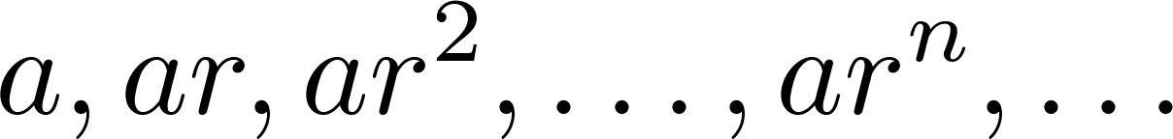
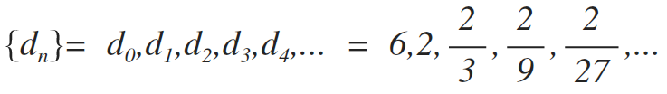
Geometric Progression
Definition: A geometric progression is a sequence of the form:
where the initial term a and the common ratio r are real numbers.
Examples:
Let a = 1 and r = −1. Then:
Let a = 2 and r = 5. Then:
Let a = 6 and r = 1/3. Then:

Slide 7
Arithmetic Progression
Definition: A arithmetic progression is a sequence of the form:
where the initial term a and the common difference d are real numbers.
Examples:
Let a = −1 and d = 4:
Let a = 7 and d = −3:
Let a = 1 and d = 2:

Slide 8
Strings
Definition: A string is a finite sequence of characters from a finite set (an alphabet).
Sequences of characters or bits are important in computer science.
The empty string is represented by λ.
The string abcde has length 5.

Slide 9
Recurrence Relations
Definition: A recurrence relation for the sequence {a_{n}} is an equation that expresses a_{n} in terms of one or more of the previous terms of the sequence, namely, a₀, a₁, …, a_{n-1}, for all integers n with n ≥ n₀, where n₀ is a nonnegative integer.
A sequence is called a solution of a recurrence relation if its terms satisfy the recurrence relation.
The initial conditions for a sequence specify the terms that precede the first term where the recurrence relation takes effect.

Slide 10
Questions about Recurrence Relations
Example 1: Let {a_{n}} be a sequence that satisfies the recurrence relation a_{n} = a_{n-1} + 3 for n = 1,2,3,4,…. and suppose that a₀ = 2. What are a₁ , a₂ and a₃?
[Here a₀ = 2 is the initial condition.]
Solution: We see from the recurrence relation that
a₁ = a₀ + 3 = 2 + 3 = 5
a₂ = 5 + 3 = 8
a₃ = 8 + 3 = 11

Slide 11
Questions about Recurrence Relations
Example 2: Let {a_{n}} be a sequence that satisfies the recurrence relation a_{n} = a_{n-1} – a_{n-2} for n = 2,3,4,…. and suppose that a₀ = 3 and a₁ = 5. What are a₂ and a₃?
[Here the initial conditions are a₀ = 3 and a₁ = 5. ]
Solution: We see from the recurrence relation that
a₂ = a₁ - a₀ = 5 – 3 = 2
a₃ = a₂ – a₁ = 2 – 5 = –3

Slide 12
Fibonacci Sequence
Definition: Define the Fibonacci sequence, f₀ ,f₁ ,f₂,…, by:
Initial Conditions: f₀ = 0, f₁ = 1
Recurrence Relation: f_{n} = f_{n-1} + f_{n-2}
Example: Find f₂ ,f₃ ,f₄ , f₅ and f₆ .
Answer:
f₂ = f₁ + f₀ = 1 + 0 = 1,
f₃ = f₂ + f₁ = 1 + 1 = 2,
f₄ = f₃ + f₂ = 2 + 1 = 3,
f₅ = f₄ + f₃ = 3 + 2 = 5,
f₆ = f₅ + f₄ = 5 + 3 = 8.

Slide 13
Solving Recurrence Relations
Finding a formula for the nth term of the sequence generated by a recurrence relation is called solving the recurrence relation.
Such a formula is called a closed formula.
Many methods for solving recurrence relations (Ch. 8)
Here we illustrate by example the method of iteration in which we need to guess the formula. The guess can be proved correct by the method of induction (Ch. 5).

Slide 14
Iterative Solution Example
Method 1: Working upward, forward substitution
Let {a_{n}} be a sequence that satisfies the recurrence relation a_{n} = a_{n-1} + 3 for n = 2,3,4,…. and suppose that a₁ = 2.
a₂ = 2 + 3
a₃ = (2 + 3) + 3 = 2 + 3 ∙ 2
a₄ = (2 + 2 ∙ 3) + 3 = 2 + 3 ∙ 3
.
.
.
a_{n} = a_{n-1} + 3 = (2 + 3 ∙ (n – 2)) + 3 = 2 + 3(n – 1)

Slide 15
Iterative Solution Example
Method 2: Working downward, backward substitution
Let {a_{n}} be a sequence that satisfies the recurrence relation a_{n} = a_{n-1} + 3 for n = 2,3,4,…. and suppose that a₁ = 2.
a_{n} = a_{n-1} + 3
= (a_{n-2} + 3) + 3 = a_{n-2} + 3 ∙ 2
= (a_{n-3} + 3 )+ 3 ∙ 2 = a_{n-3} + 3 ∙ 3
.
.
.
= a₂ + 3(n – 2) = (a₁ + 3) + 3(n – 2) = 2 + 3(n – 1)

Slide 16
Financial Application
Example: Suppose that a person deposits $10,000.00 in a savings account at a bank yielding 11% per year with interest compounded annually. How much will be in the account after 30 years?
Let P_{n} denote the amount in the account after 30 years. P_{n} satisfies the following recurrence relation:
P_{n} = P_{n-1} + 0.11P_{n-1} = (1.11) P_{n-1}
with the initial condition P₀ = 10,000
Continued on next slide →

Slide 17
Financial Application
P_{n} = P_{n-1} + 0.11P_{n-1} = (1.11) P_{n-1}
with the initial condition P₀ = 10,000
Solution: Forward Substitution
P₁ = (1.11)P₀
P₂ = (1.11)P₁ = (1.11)²P₀
P₃ = (1.11)P₂ = (1.11)³P₀
:
P_{n} = (1.11)P_{n-1} = (1.11)^{n}P₀ = (1.11)^{n} 10,000
P_{n} = (1.11)^{n} 10,000 (Can prove by induction, covered in Chapter 5)
P₃₀ = (1.11)³⁰ 10,000 = $228,992.97

Slide 18
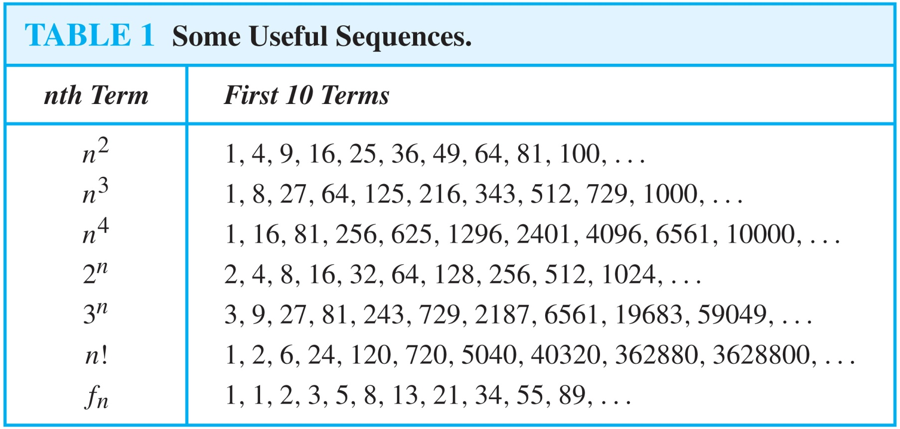
Useful Sequences
Example: Conjecture a formula for a_{n} if the first 10 terms of the sequence {a_{n}} are 1, 7, 25, 79, 241, 727, 2185, 6559, 19681, 59047
Solution: a_{n} = 3^{n} - 2

Slide 19
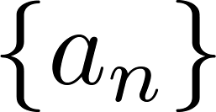
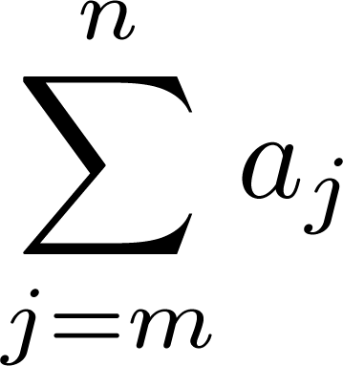
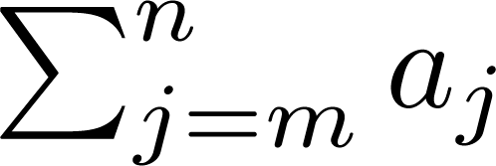
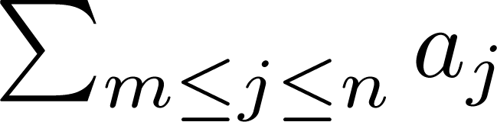
Summations
Sum of the terms
from the sequence
The notation:
represents
The variable j is called the index of summation. It runs through all the integers starting with its lower limit m and ending with its upper limit n.

Slide 20
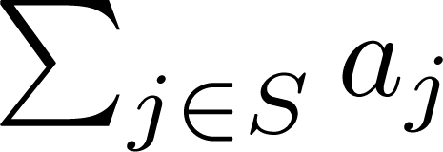
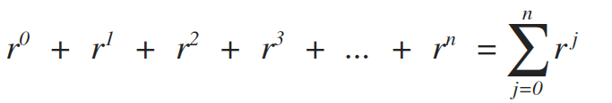
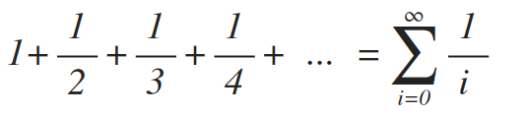
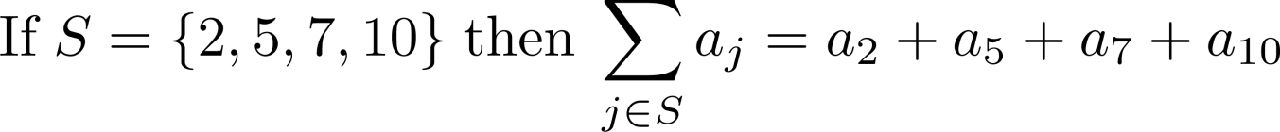
Summations
More generally for a set S:
Examples:

Slide 21
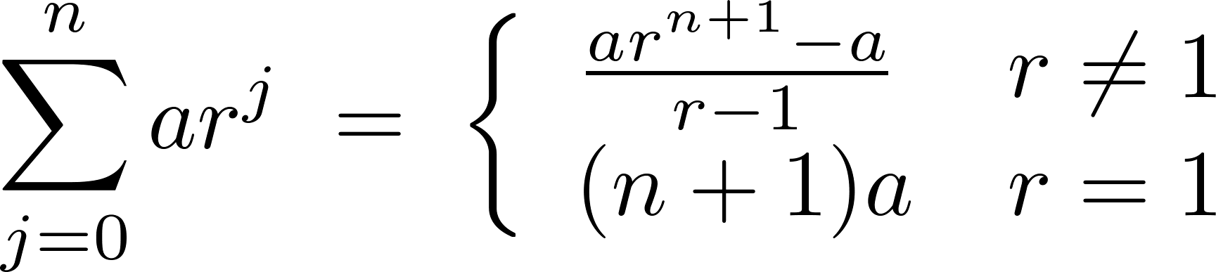
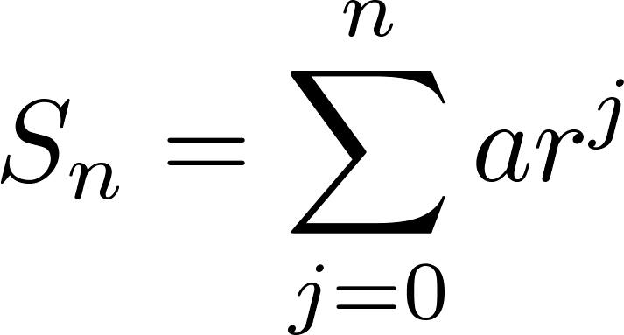
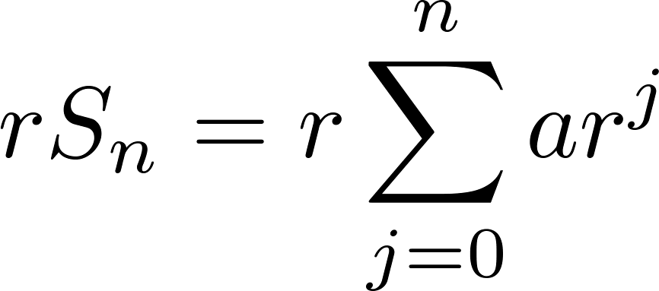
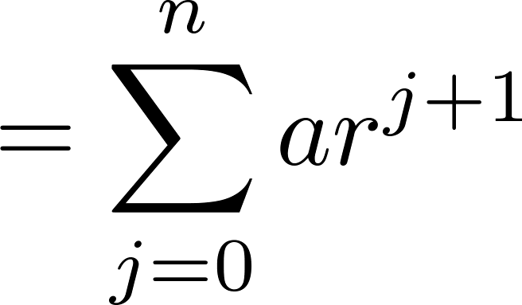
Geometric Series
Sums of terms of geometric progressions
Proof:
Let
To compute S_{n} , first multiply both sides of the equality by r and then manipulate the resulting sum as follows:
By the distributive property
Continued on next slide →

Slide 22
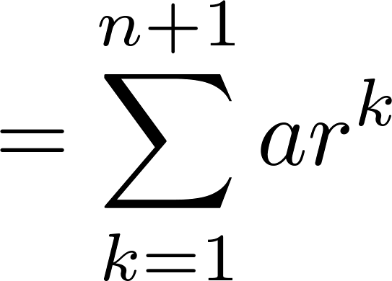
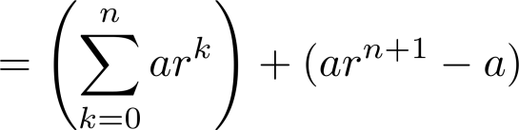
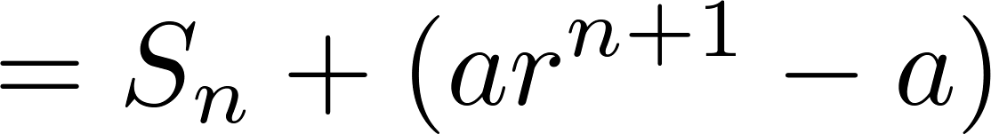
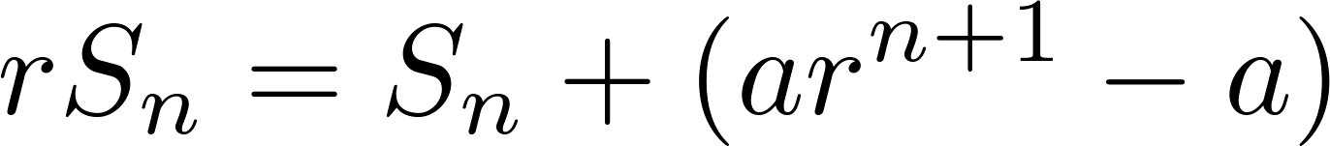
Geometric Series
From previous slide.
Shifting the index of summation with k = j + 1.
Removing k = n + 1 term and
adding k = 0 term.
Substituting S for summation formula
∴
Continued on next slide →

Slide 23


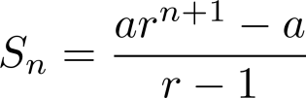
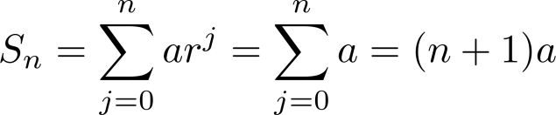
Geometric Series
∴
Solving for S_{n}
if r ≠1
if r = 1

Slide 24
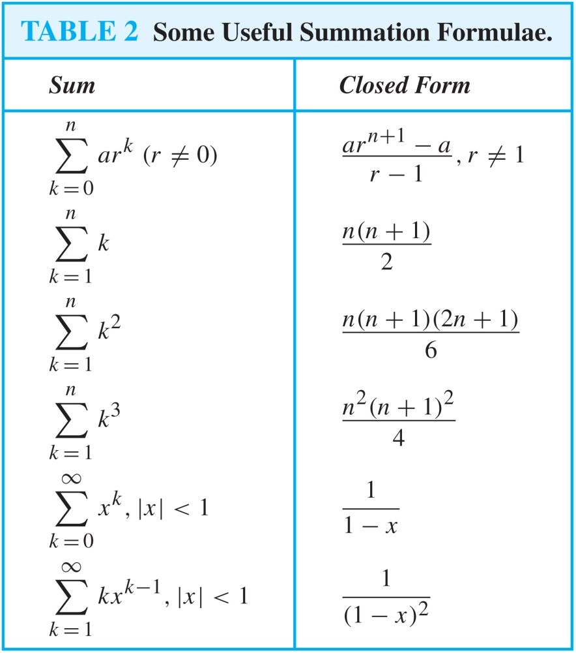
Some Useful Summation Formulae
Geometric Series: We just proved this.
Later we will prove some of these by induction.
Proof in text
(requires calculus)

