Slide 1
Mathematical Induction
Section 5.1

Slide 2
Section Summary
Mathematical Induction
Examples of Proof by Mathematical Induction
Mistaken Proofs by Mathematical Induction
Guidelines for Proofs by Mathematical Induction

Slide 3
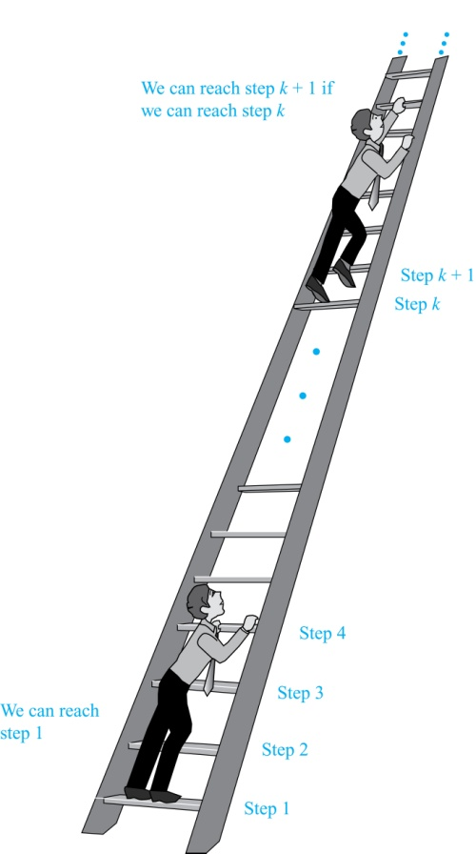
Climbing an Infinite Ladder
Suppose we have an infinite ladder:
We can reach the first rung of the ladder.
If we can reach a particular rung of the ladder, then we can reach the next rung.
From (1), we can reach the first rung. Then by applying (2), we can reach the second rung. Applying (2) again, the third rung. And so on. We can apply (2) any number of times to reach any particular rung, no matter how high up.
This example motivates proof by mathematical induction.

Slide 4
Principle of Mathematical Induction
Principle of Mathematical Induction: To prove that P(n) is true for all positive integers n, we complete these steps:
Basis Step: Show that P(1) is true.
Inductive Step: Show that P(k) → P(k + 1) is true for all positive integers k.
To complete the inductive step, assuming the inductive hypothesis that P(k) holds for an arbitrary integer k, show that must P(k + 1) be true.
Climbing an Infinite Ladder Example:
BASIS STEP: By (1), we can reach rung 1.
INDUCTIVE STEP: Assume the inductive hypothesis that we can reach rung k. Then by (2), we can reach rung k + 1.
Hence, P(k) → P(k + 1) is true for all positive integers k. We can reach every rung on the ladder.

Slide 5
Important Points About Using Mathematical Induction
Mathematical induction can be expressed as the rule of inference
where the domain is the set of positive integers.
In a proof by mathematical induction, we don’t assume that P(k) is true for all positive integers! We show that if we assume that P(k) is true, then P(k + 1) must also be true.
Proofs by mathematical induction do not always start at the integer 1. In such a case, the basis step begins at a starting point b where b is an integer. We will see examples of this soon.
(P(1) ∧ ∀k (P(k) → P(k + 1))) → ∀n P(n),

Slide 6
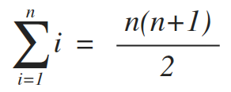
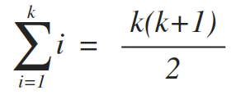
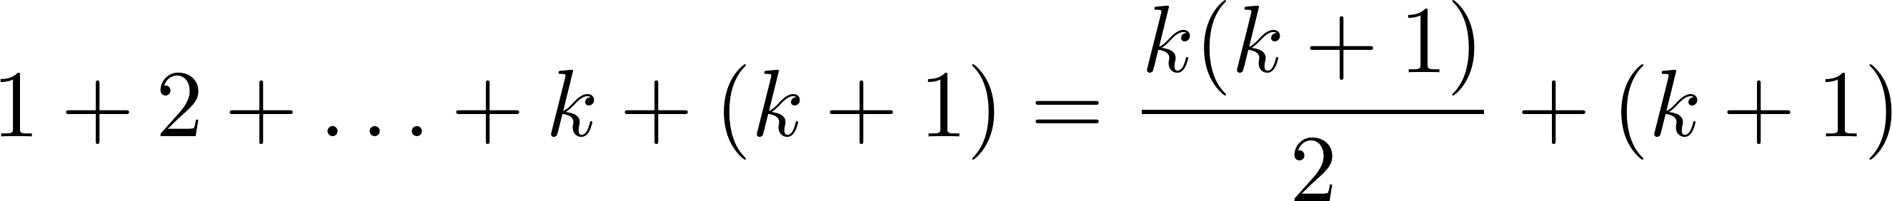
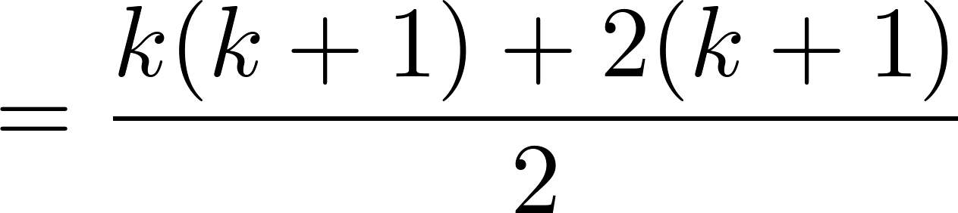
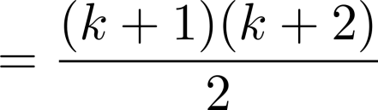
Proving a Summation Formula by Mathematical Induction
Note: Once we have this conjecture, mathematical induction can be used to prove it correct.
Example: Show that:
Solution:
BASIS STEP: P(1) is true since 1(1 + 1)/2 = 1.
INDUCTIVE STEP: Assume true for P(k).
The inductive hypothesis is
Under this assumption,

Slide 7
Conjecturing and Proving Correct a Summation Formula
Example: Conjecture and prove correct a formula for the sum of the first n positive odd integers. Then prove your conjecture.
Solution: We have:
1 = 1, 1 + 3 = 4,
1 + 3 + 5 = 9, 1 + 3 + 5 + 7 = 16,
1 + 3 + 5 + 7 + 9 = 25, 1 + 3 + 5 + 7 + 9 + 11 = 36
We can conjecture that the sum of the first n positive odd integers is n²,
1 + 3 + 5 + ∙∙∙+ (2n − 1) = n² .
continued →

Slide 8
Conjecturing and Proving Correct a Summation Formula
Conjecture: The sum of the first n positive odd integers is n²,
Proof (via mathematical induction):
BASIS STEP: P(1) is true since 1² = 1.
INDUCTIVE STEP: P(k) → P(k + 1) for every positive integer k.
Assume the inductive hypothesis holds and then show that P(k+1) holds.
So, assuming P(k), it follows that:
Hence, we have shown that P(k + 1) follows from P(k). Therefore the sum of the first n positive odd integers is n².
1 + 3 + 5 + ∙∙∙+ (2n − 1) =n² .
Inductive Hypothesis: 1 + 3 + 5 + ∙∙∙+ (2k − 1) =k²
1 + 3 + 5 + ∙∙∙+ (2k − 1) + (2k + 1) =[1 + 3 + 5 + ∙∙∙+ (2k − 1)] + (2k + 1)
= k² + (2k + 1) (by the inductive hypothesis)
= k² + 2k + 1
= (k + 1) ²

Slide 9
Proving Inequalities
Example: Use mathematical induction to prove that n < 2^{n} for all positive integers n.
Solution: Let P(n) be the proposition that n < 2^{n}.
BASIS STEP: P(1) is true since 1 < 2¹ = 2.
INDUCTIVE STEP: Assume P(k) holds, i.e., k < 2^{k}, for an arbitrary positive integer k.
Must show that P(k + 1) holds. Since by the inductive hypothesis, k < 2^{k}, it follows that:
k + 1 < 2^{k} + 1 ≤ 2^{k} + 2^{k} = 2 ∙ 2^{k} = 2^{k+1}
Therefore n < 2^{n} holds for all positive integers n.

Slide 10
Proving Inequalities
Example: Use mathematical induction to prove that 2^{n} < n!, for every integer n ≥ 4.
Solution: Let P(n) be the proposition that 2^{n} < n!.
BASIS STEP: P(4) is true since 2⁴ = 16 < 4! = 24.
INDUCTIVE STEP: Assume P(k) holds, i.e., 2^{k} < k! for an arbitrary integer k ≥ 4. To show that P(k + 1) holds:
2^{k+1} = 2∙2^{k}
< 2∙ k! (by the inductive hypothesis)
< (k + 1)k! (because 2 < k+1)
= (k + 1)!
Therefore, 2^{n} < n! holds, for every integer n ≥ 4.
Note that here the basis step is P(4), since P(0), P(1), P(2), and P(3) are all false.

Slide 11
Proving Divisibility Results
Example: Use mathematical induction to prove that n³ − n is divisible by 3, for every positive integer n.
Solution: Let P(n) be the proposition that n³ − n is divisible by 3.
BASIS STEP: P(1) is true since 1³ − 1 = 0, which is divisible by 3.
INDUCTIVE STEP: Assume P(k) holds, i.e., k³ − k is divisible by 3, for an arbitrary positive integer k. To show that P(k + 1) follows:
(k + 1)³ − (k + 1) = (k³ + 3k² + 3k + 1) − (k + 1)
= (k³ − k) + 3(k² + k)
By the inductive hypothesis, the first term (k³ − k) is divisible by 3 and the second term is divisible by 3 since it is an integer multiplied by 3. Thus, (k + 1)³ − (k + 1) is divisible by 3.
Therefore, n³ − n is divisible by 3, for every integer positive integer n.

Slide 12
Number of Subsets of a Finite Set
Example: Use mathematical induction to show that if S is a finite set with n elements, where n is a nonnegative integer, then S has 2^{n} subsets.
(Chapter 6 uses combinatorial methods to prove this result.)
Solution: Let P(n) be the proposition that a set with n elements has 2^{n} subsets.
BASIS STEP: P(0) is true, because the empty set has only itself as a subset and 2⁰ = 1.
INDUCTIVE STEP: Assume P(k) is true for an arbitrary nonnegative integer k.
continued →

Slide 13
Number of Subsets of a Finite Set
Let T be a set with k + 1 elements. Then T = S ∪ {a}, where a ∈ T and S = T − {a} (and hence |S| = k).
For each subset X of S, there are exactly two subsets of T, i.e., X and X ∪ {a}.
By the inductive hypothesis S has 2^{k} subsets. Since there are two subsets of T for each subset of S, the number of subsets of T is
2 ∙2^{k} = 2^{k+1} .
Inductive Hypothesis: Every set with k elements has 2^{k} subsets.
a
X
T
X
S
X ∪ {a}
T
a

Slide 14
An Incorrect “Proof” by Mathematical Induction
“Proof”: Let P(n) be the statement that every set of n lines in the plane, no two of which are parallel, meet in a common point. Here is a “proof” that P(n) is true for all positive integers n ≥ 2.
BASIS STEP: The statement P(2) is true because any two lines in the plane that are not parallel meet in a common point.
INDUCTIVE STEP: The inductive hypothesis is the statement that P(k) is true for the positive integer k ≥ 2, i.e., every set of k lines in the plane, no two of which are parallel, meet in a common point.
We must show that if P(k) holds, then P(k + 1) holds, i.e., if every set of k lines in the plane, no two of which are parallel, k ≥ 2, meet in a common point, then every set of k + 1 lines in the plane, no two of which are parallel, meet in a common point.
continued →

Slide 15
An Incorrect “Proof” by Mathematical Induction
Consider a set of k + 1 distinct lines in the plane, no two parallel. By the inductive hypothesis, the first k of these lines must meet in a common point p₁. By the inductive hypothesis, the last k of these lines meet in a common point p₂.
If p₁ and p₂ are different points, all lines containing both of them must be the same line since two points determine a line. This contradicts the assumption that the lines are distinct. Hence, p₁ = p₂ lies on all k + 1 distinct lines, and therefore P(k + 1) holds. Assuming that k ≥2, distinct lines meet in a common point, then every k + 1 lines meet in a common point.
There must be an error in this proof since the conclusion is absurd. But where is the error?
Answer: P(k)→ P(k + 1) only holds for k ≥3. It is not the case that P(2) implies P(3). The first two lines must meet in a common point p₁ and the second two must meet in a common point p₂. They do not have to be the same point since only the second line is common to both sets of lines.
Inductive Hypothesis: Every set of k lines in the plane, where k ≥ 2, no two of which are parallel, meet in a common point.

Slide 16
Guidelines: Mathematical Induction Proofs
Express the statement in the form “for all n ≥ b, P(n)” for a fixed integer b.
Write “BASIS STEP”
Show P(b) is true
Write “INDUCTIVE STEP”
State inductive hypothesis in the form “Assume P(k) is true for an arbitrary integer k ≥ b”
State what needs to be proven
Write out what P(k+1) is
continued →

Slide 17
Guidelines: Mathematical Induction Proofs
Assume P(k), and prove P(k+1)
Be sure proof is valid for all integers k ≥ b, including when k = b.
Identify when the INDUCTIVE STEP concludes, such as by saying “this completes the inductive step”
When finished, state the conclusion. “By mathematical induction, P(n) is true for all integers n ≥ b”

