Slide 1
Binomial Coefficients and Identities
Section 6.4

Slide 2
Section Summary
The Binomial Theorem
Pascal’s Identity and Triangle

Slide 3
Powers of Binomial Expressions
Definition: A binomial expression is the sum of two terms, such as x + y. (More generally, these terms can be products of constants and variables.)
We can use counting principles to find the coefficients in the expansion of (x + y)^{n} where n is a positive integer.
Example: Expand (x + y)³
x³ + 3x²y + 3xy² + y³
continued ➔

Slide 4




Powers of Binomial Expressions
(x +y)³ = (x+y)(x+y)(x+y)
= (xx +xy +yx +yy)(x+y)
= xxx + xxy + xyx + xyy + yxx + yxy + yyx +yyy
= x³ +3x²y + 3xy² + y³
How many ways are there to get the terms
x³ : Choose x three times = C(3,3) = 1
x²y : Choose x twice (and y once) = C(3,2) = 3
xy² : Choose x once (and y twice) = C(3,1) = 3
y³ : Choose x zero times = C(3,0) = 1

Slide 5


Binomial Theorem
Binomial Theorem: Let x and y be variables, and n a nonnegative integer. Then:
Proof: We use combinatorial reasoning. The terms in the expansion of (x + y)^{n} are of the form x^{n−j}y^{j} for j = 0,1,2,…,n. To form the term x^{n−j}y^{j}, it is necessary to choose n−j x’s from the n sums. Therefore, the coefficient of x^{n−j}y^{j} is , which equals .

Slide 6
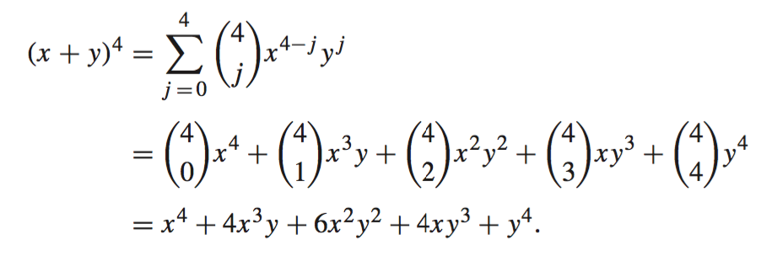
Using the Binomial Theorem
Example: What is the expansion of (x + y)⁴?
Solution: From the binomial theorem, we know that

Slide 7
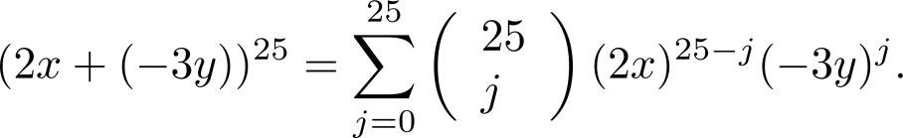
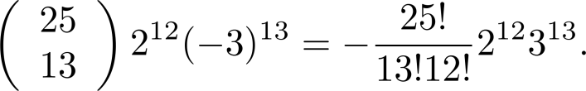
Using the Binomial Theorem
Example: What is the coefficient of x¹²y¹³ in the expansion of (2x − 3y)²⁵?
Solution: We view the expression as (2x +(−3y))²⁵. By the binomial theorem
The coefficient of x¹²y¹³ in the expansion is obtained when j = 13.

Slide 8
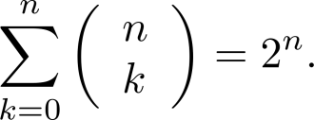
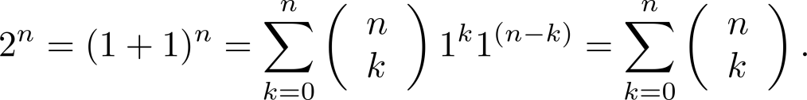
A Useful Identity
Corollary 1: With n ≥0,
Proof (using binomial theorem): With x = 1 and y = 1, from the binomial theorem we see that:

Slide 9




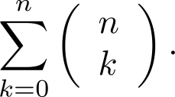
A Useful Identity
Corollary 1: With n ≥0,
Proof (combinatorial): Consider the subsets of a set with n elements. There are subsets with zero elements, with one element, with two elements, …, and with n elements. Therefore the total is
Since, we know that a set with n elements has 2^{n} subsets, we conclude:

Slide 10
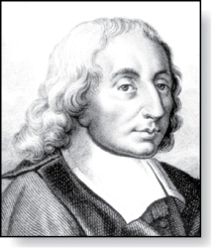
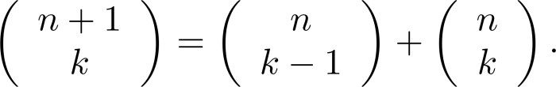



Pascal’s Identity
Blaise Pascal
(1623-1662)
Pascal’s Identity: If n and k are integers with n ≥ k ≥ 0, then
Proof (combinatorial): Let T be a set where |T| = n + 1, a ∊T, and S = T − {a}. There are subsets of T containing k elements. Each of these subsets either:
contains a with k − 1 other elements, or
contains k elements of S and not a.
There are
subsets of k elements that contain a, since there are subsets of k − 1 elements of S,
subsets of k elements of T that do not contain a, because there are subsets of k elements of S.
Hence,
See Exercise 19 for an algebraic proof.

Slide 11
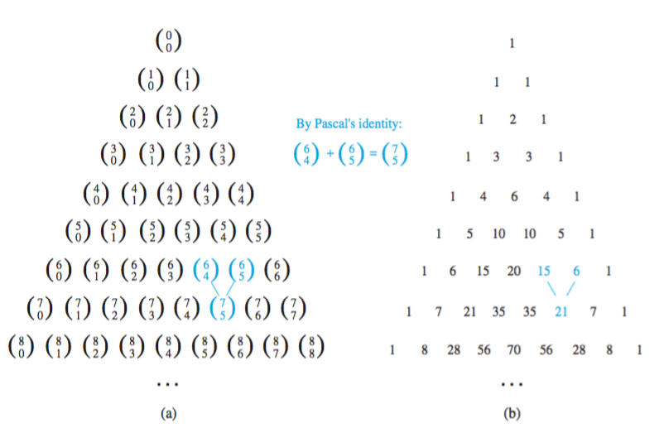
Pascal’s Triangle
The nth row in the triangle consists of the binomial coefficients ,
k = 0,1,….,n.
By Pascal’s identity, adding two adjacent bionomial coefficients results is the binomial coefficient in the next row between these two coefficients.

Slide 12
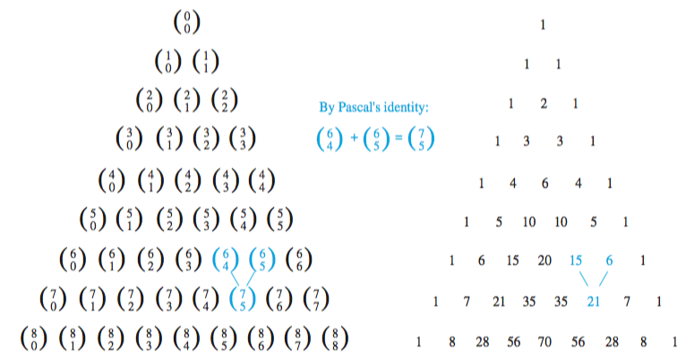
Pascal’s Triangle
(x+y)⁶ = 1x⁶ + 6x⁵y + 15x⁴y² + 20x³y³ + 15x²y⁴ + 6xy⁵ + 1y⁶

