Slide 1
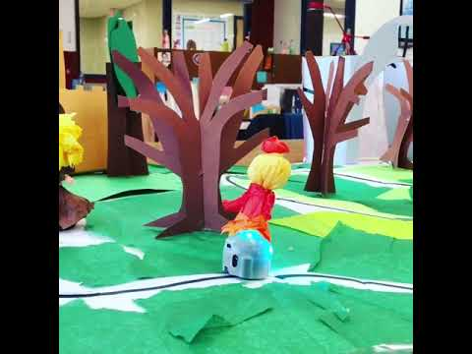
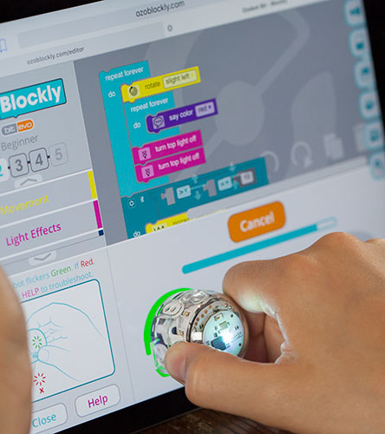

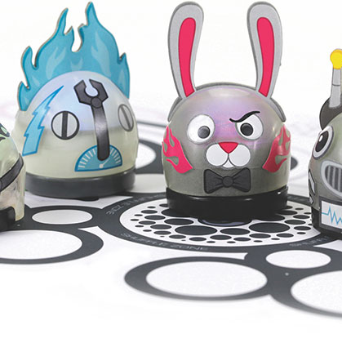
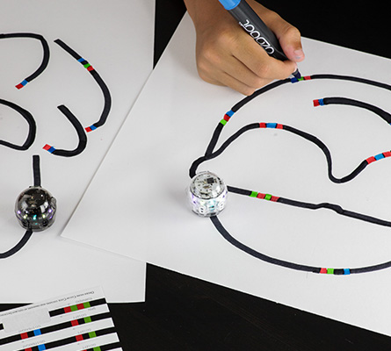
Bots Like to move it, move it
Dr. Sofia Visa Dr. Heather Guarnera 2025

Slide 2
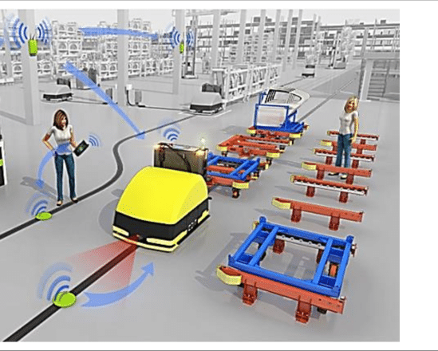
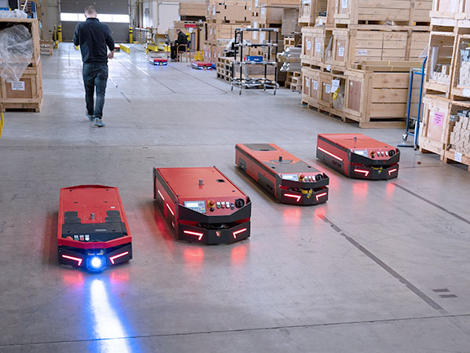
Automated Guided Vehicles (AGV)

Slide 3
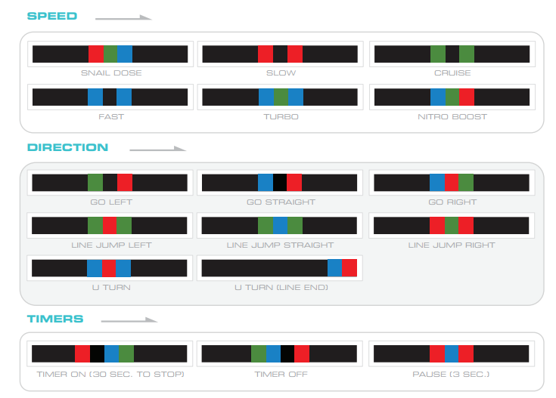
Color Codes

Slide 4
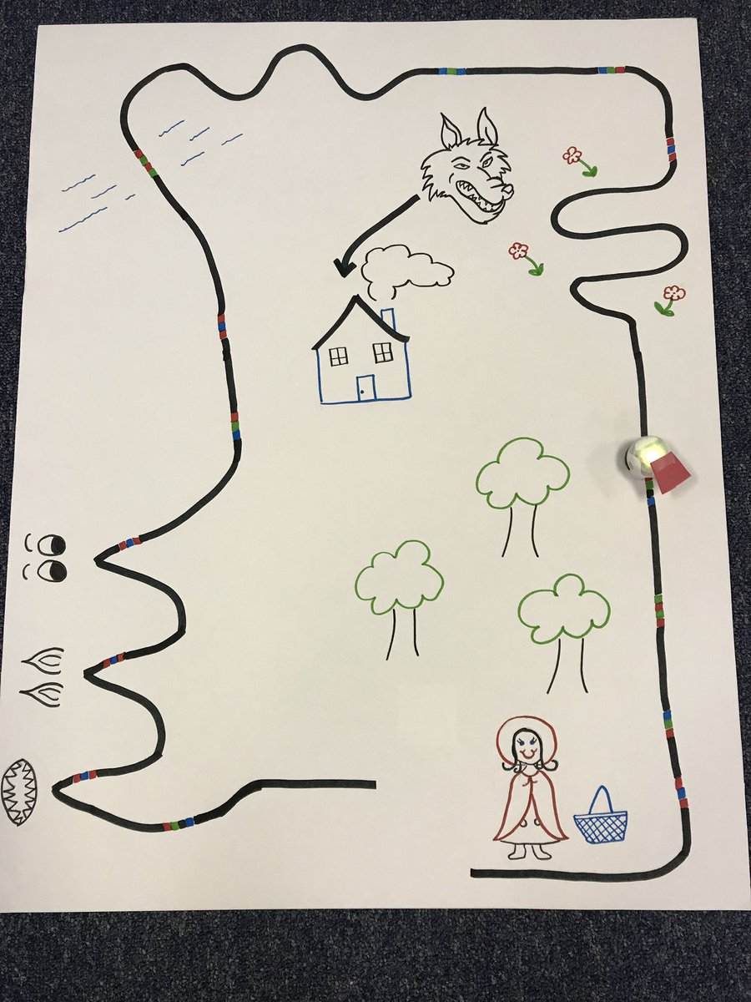
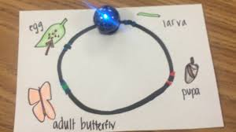
What kind of stories can I tell the ozobot?
Little Red Riding Hood
Life cycle

Slide 5
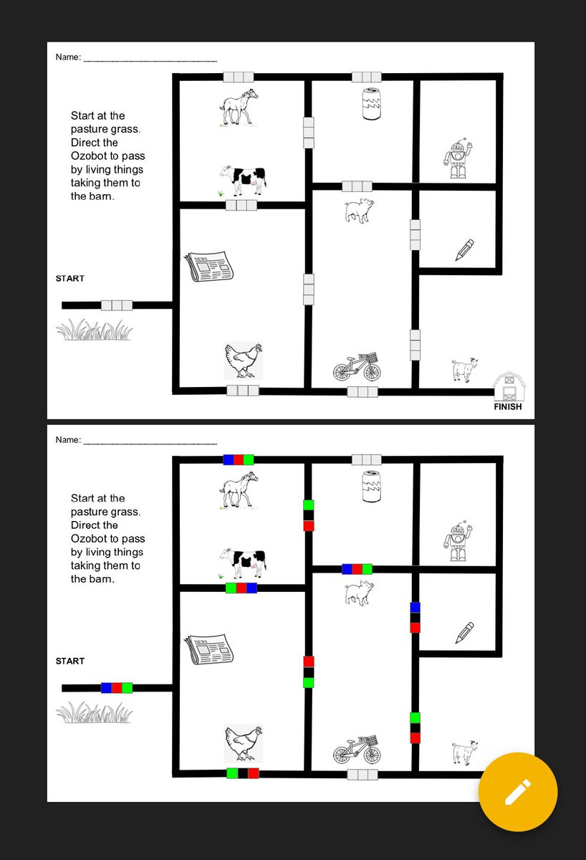
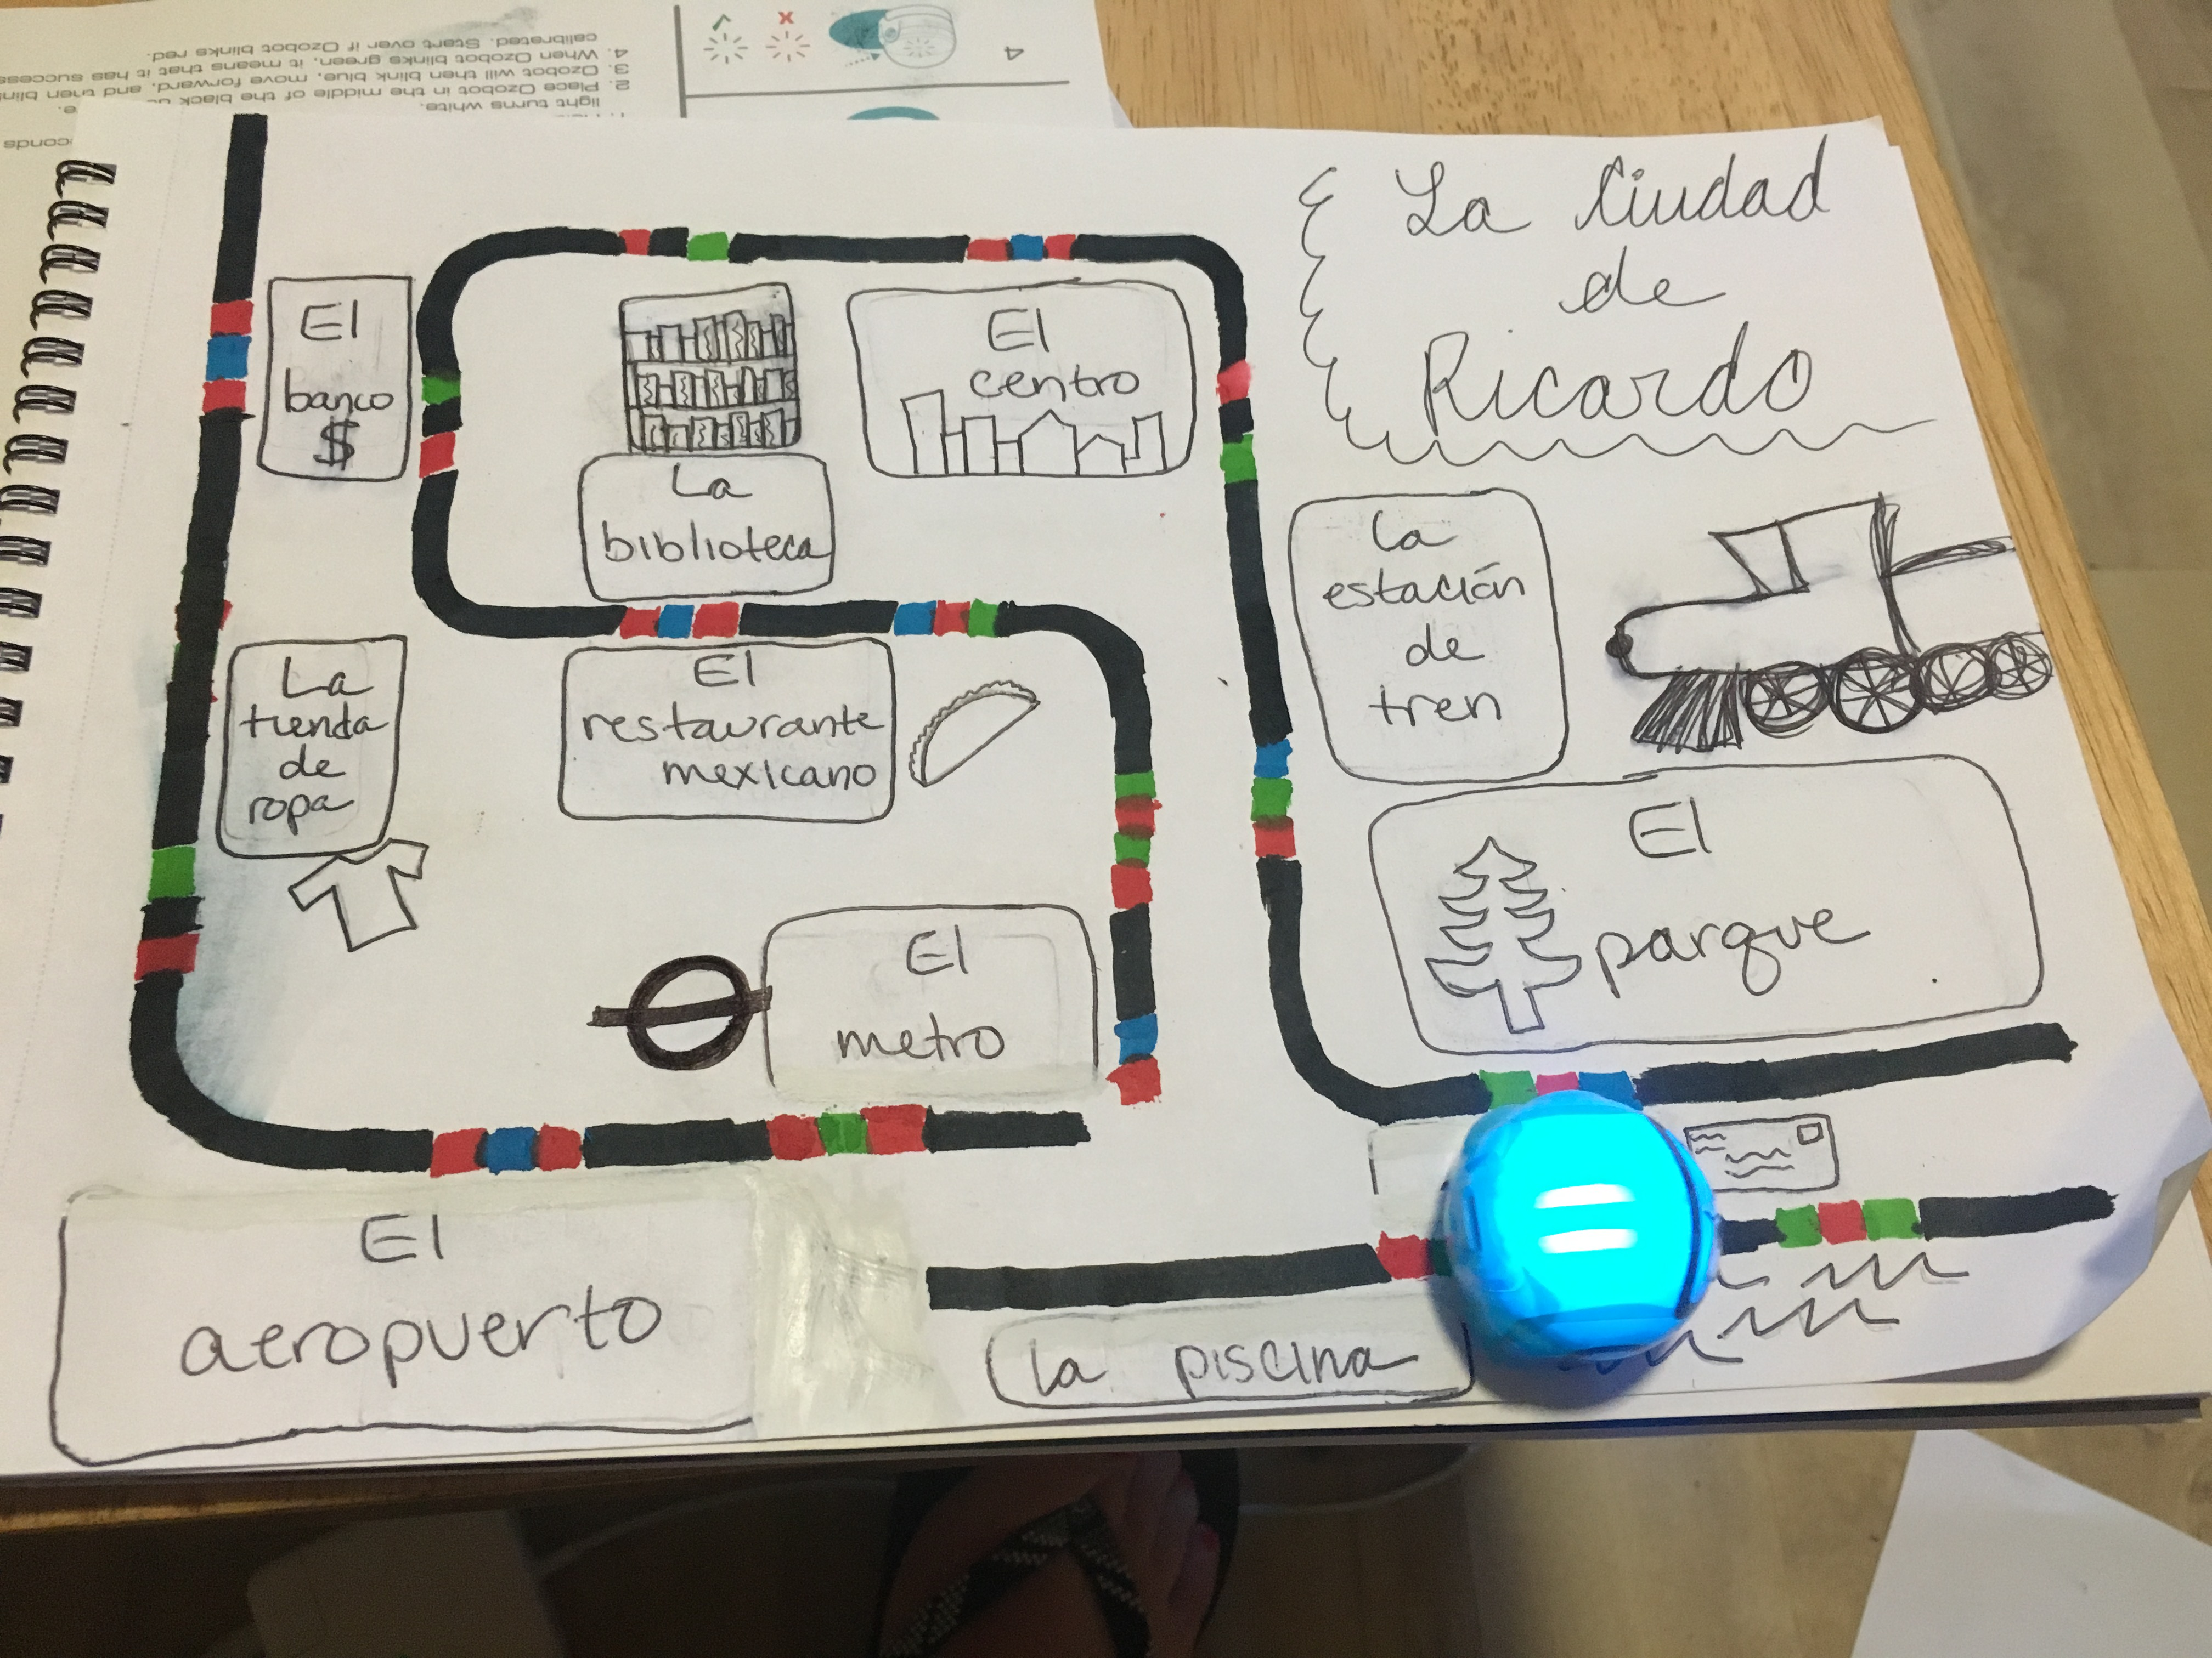
What kind of stories can I tell the ozobot?
Take all living things to the barn
El Ciudad de Ricardo

Slide 6
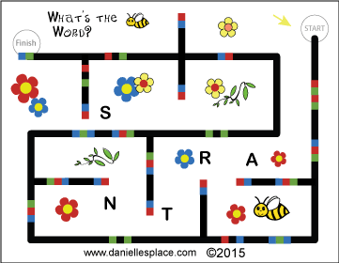
What kind of stories can I tell the ozobot?
Spell the Word
St. Patricks Day Game

Slide 7
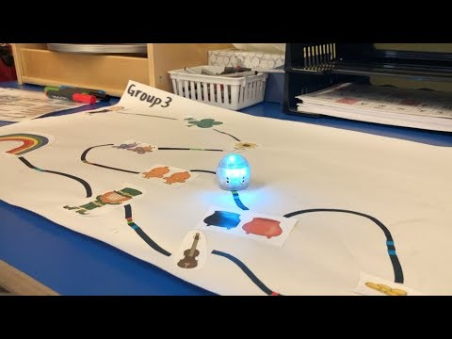
What kind of stories can I tell the ozobot?

Slide 8
Now it’s your turn! Build a story

