Slide 1
Operating System
COMPUTER LITERACY

Slide 2
Software
Types of software
Applications software
Systems software
Systems software include programs that enable the computer and its peripheral devices to function smoothly, such as
The operating system
System utilities (utility programs)
Notes:
Applications software: A program designed for a specific task or function. An “app”. PC examples include word processor, web browser, media player. Mobile examples include facebook app, Instagram app, calculator app. Can be uninstalled.
Systems software: Program designed to provide a platform to other software. The go-between for applications software and hardware. Can’t be uninstalled. PC examples include OS, BIOS, CLI.

Slide 3
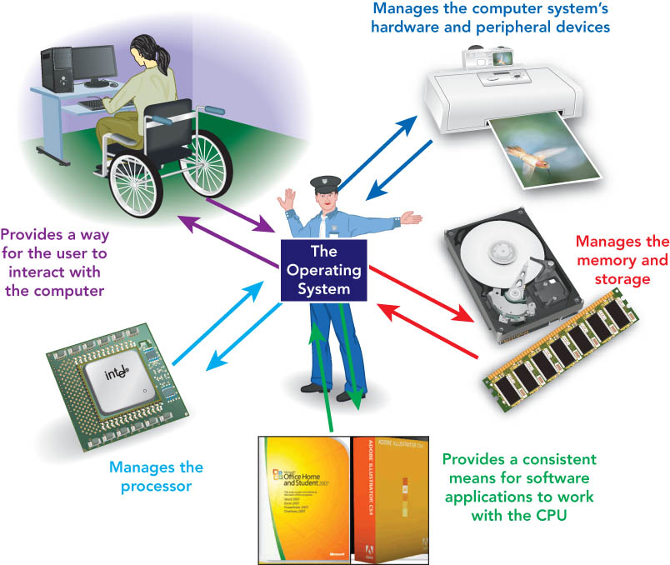
Operating System

Slide 4
Types of Operating Systems
Type | Application
Stand-alone OS: used by single users | laptop and desktop
Server OS: used in client/server network environments | typical business network, ecommerce application and large scale application.
Embedded OS: found on ROM chips in portable or dedicated devices | mobile devices, tablets, in-vehicle or any hand held devices
Notes:
Stand-alone: A complete operating program that works correctly on a desktop or laptop. Deals with just one computer a time.
Server: Runs on a server (dedicated machine). Deals with all the computers on the network.
Embedded: Resides on a ROM (read only memory) chip. Designed to be resource efficient at the cost of functionality.

Slide 5
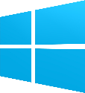


Popular Standalone Operating Systems
Platform is determined by combination of microprocessor chip & OS
Windows [Windows OS]
Dominates the marketplace
Least secure, prone to viruses
Intel or AMD chip
Mac [macOS]
Can run Windows software
More secure
Intel or IBM/Motorolla
Linux [Many distributions…]
Can be installed on PC or Mac machine
Most secure, fewer viruses
Notes:
Chart from 2017 StatCounter

Slide 6
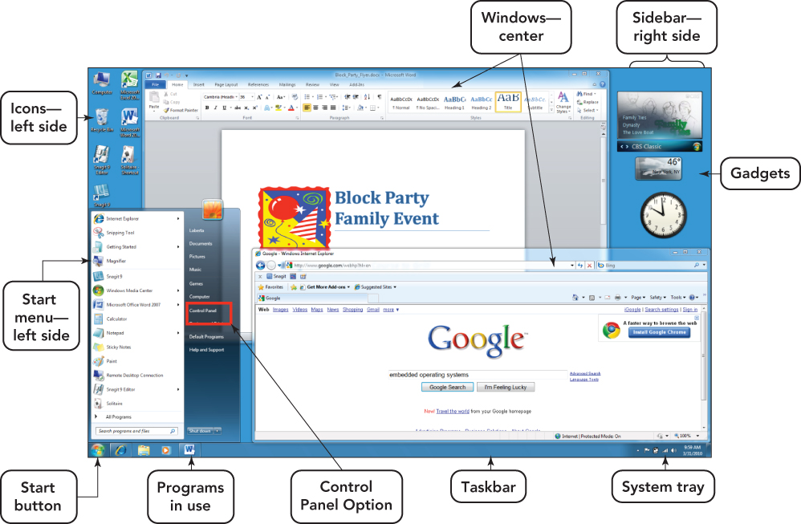
Windows Operating System

Slide 7
Booting the Computer
Booting: loads OS into RAM
Cold boot: Start computer by turning power on
Performs hardware checks
Loads main OS in RAM
Warm boot: Restart a computer that is already on
Shuts down all programs
Loads main OS in RAM
Notes:
The term “booting” is used because the computer seems to pull itself up by its own bootstraps
Cold:
Warm: No interruption to power. Skips some hardware checks (POST)

Slide 8
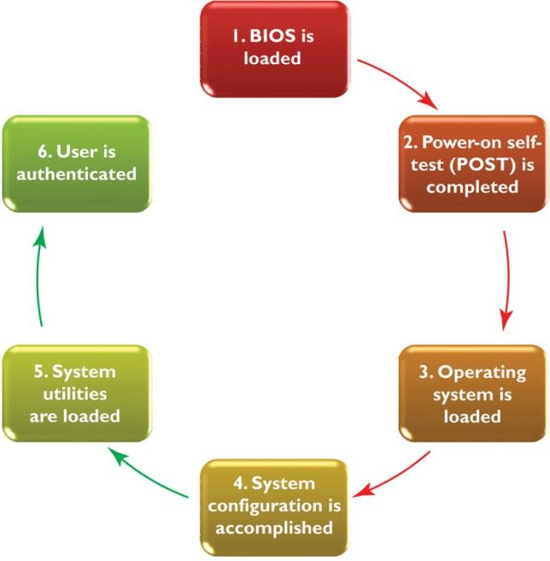
Booting Process
Notes:
BIOS: Hardware initialization
POST: Diagnostic tests
Load OS:
System configuration:
Load utilities:
Authenticate User: Type in your password

Slide 9
Step 1: BIOS and Setup Program
BIOS (Basic Input/output System) instructions with descriptions of the internal equipment
BIOS is encoded on ROM (read-only memory)
Manages exchange of data between OS and I/O devices
Setup program
Includes settings that control computer hardware
Making incorrect changes in BIOS will cause the system not to boot
Devices checked in following order
Hard disk > optical disk > flash drive
Notes:
CPU activates BIOS.
BIOS is on ROM (not erased when power turned off).
Tells the computer how to do very basic things (interact with some hardware, load the OS, etc).
Manages the exchange of data between the OS and all IO devices attached to the system.
Loads OS into RAM from its permanent location on the hard drive.
Order can be altered by setup program during startup

Slide 10
Step 2: Power-on Self-Test
Power-on Self-test
Confirms that computer and peripheral devices are working
FAIL -> A beep will sound with an error message
Notes:
A series of diagnostic tests done by BIOS. Includes RAM (read/write test, running sum of installed memory), keyboard (is there one?), processor (cache memory, CPU type and speed), etc.

Slide 11
Step 3: Load the Operating System
Load the Operating System
Looks for the operating system
Loads the kernel into memory—the central part of the operating system—and the operating system loads the system configuration information.

Slide 12
Steps 4 & 5: System Configuration and System Utilities
Configure the System
Checks the registry; Database that stores information about software and peripherals choices
Checks and installs the drivers: interfaces for I/O devices
Checks device conflicts and detects PNP (plug and play) devices
Load System Utilities: anti-virus, volume control etc.
Notes:
BIOS outputs a summary of sys config info (CPU, clock speed, size of memory)

Slide 13
Step 6: User Authentication
Uses a database of user name and password
Use identification patterns such as finger prints, iris or face recognition
Multiuser computer systems
each user has an account
Consists of user name, password, and storage space
Created by server/computer administrator
Loads user Profile: a record of a specific user’s preferences for the desktop theme, icons, and menu styles

