Slide 1
Mobile Devices
COMPUTER LITERACY
Notes:
Portable devices refers to mobile devices or tablets designed to move freely. They are handy, lightweight and can be carried around. In this lecture, we will be discussing about the different portable devices.

Slide 2
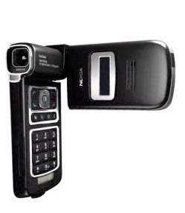
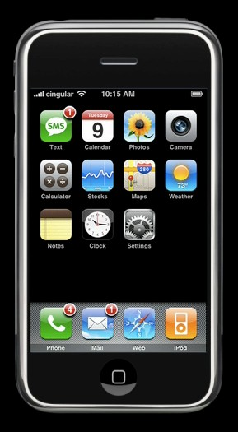
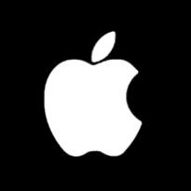

Multimedia Computer
Reinvented Phone
Notes:
The image here displays example of initially used mobile devices. Like Nokia phones and iPhone.

Slide 3


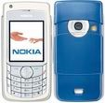


















Notes:
Some other examples are displayed here. You can see how the mobile devices have evolved through time.

Slide 4
Motorola
RIM
Samsung
Kyocera
Palm
Nokia
BenQ
Fujitsu
Mobile device manufacturers
Sanyo
Sharp
LG
SonyEricsson
Apple
Notes:
In this slide you can see the different mobile device manufacturers. The leading mobile device manufacturers across the globe are Apple, Samsung, Sony Ericsson, and Motorola.

Slide 5
Mobile Device Characteristics
Cell phones designed for one handed use
Limited processing power and battery life
Rich in sensors
Truly ubiquitous
Notes:
Why portable devices are so important? How are they growing?
One of the important aspect of this is it is designed for “one handed use”.
Each device is unique based upon processors and other technology built-in the device just like the laptops.
Some devices are rich in terms of technologies like built in sensors and some are basic devices for basic communications purpose.
Since these devices are light weight and small, they can be carried around.

Slide 6
Mobile Operating System
Embedded operating systems
Android OS
iOS
Windows OS
Blackberry OS
Symbian OS
Notes:
Mobile Operating system are operating system designed specifically for the portable devices. In this section we will discuss them and their types.
Operating system – the back bone of any computer or laptop. For portable devices, the operating system are designed as subset of the one’s used in computer and laptops. The operating system for portable devices are called as embedded operating system.
The different types of embedded operating system used widely are:-
iOS
Windows
Android
Blackberry
Symbian ( was used for Nokia devices previously)

Slide 7
Android
Released in 2007
Based on Linux kernel - Open source
Bought by Google
OS Names come in tasty flavors…
Cupcake, Donut, Éclair, Froyo, …., Nougat, Oreo
Update Ecosystem
Google releases an update to the OS
Manufacturers must write device drivers to support
Manufacturers, and carriers, can add custom software (if unwanted, this is called bloatware
Also supports Android Shield, Tablet, etc.
Notes:
Android Operating System are among the top most used operating system for the portable devices.
Many devices with this type of operating system are used across the globe.
Android operating system was initial founded in 2003 and later bought by google.

Slide 8
iOS
Released in 2007
Programmed in C, C++, Objective C, and Swift
Closed source
the foundation of the iPhone
Update Ecosystem
Apple releases an update to the OS
Apple is the manufacturer; OS created for those devices
Carriers can release software through the App Store
Also supports iPod touch, iPad, Apple Watch, and Apple TV
Notes:
iOS – an operating system designed for apple portable devices.
The iOS is widely used due to its simplicity and good user interface.
Even though it is used only for apple products but it dominates the mobile device market.

Slide 9
G - 1/2/3/4 G
G refers to the different generations of mobile technology
First generation (1G)
Second generation (2G)
Third generation (3G)
Fourth generation (4G)
Notes:
G refers to the different generations of mobile devices.
First generation (1G) cellphones were analog devices.
Second generation (2G) devices were digital, and
third generation (3G) allows for voice, data and advanced services.

Slide 10
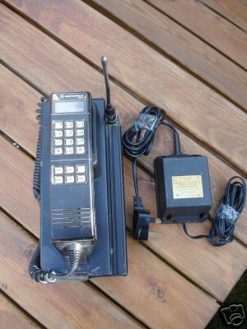
Early mobile phones
0G
1946-1980’s
Expensive
In cars/trucks
Voice only
Notes:
The early mobile phones used before the 80s were expensive and were only designed for voice calls.
They were mostly used in cars/trucks.

Slide 11
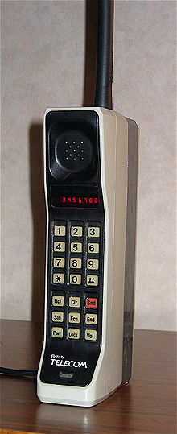
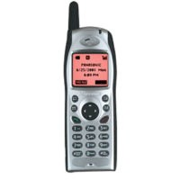
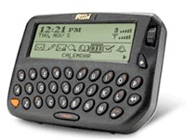
First generation cellular networks
1G
1980’s -2000’s
Radio signals are analog
Voice only
Bell Labs developed modern commercial cell technology
Centrally controlled base station
Each base station provides service to a small area known as a cell
Technologies
AMPS (Advanced Mobile Phone System)
FDMA (Frequency Division Multiple Access)
First Blackberry (850)
Notes:
The first generation mobile devices were the first to have radio signals.
The first device was blackberry with voice calls and limited data based communications.

Slide 12
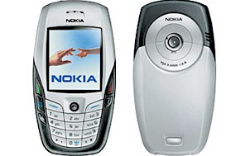
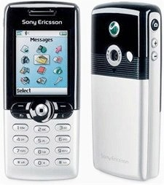
Second generation cellular networks
2G
1990’s-now
Radio signals are digital
Digital Voice
SMS (short message service)
Technologies
GSM (Global System for Mobile Communications) standard
TDMA (Time Division Multiple Access)
2.5G
An advancement for 2G
Introduction of packet switching
Notes:
The first generation mobile devices were the first to have radio signals.
The first device was blackberry with voice calls and limited data based communications.

Slide 13
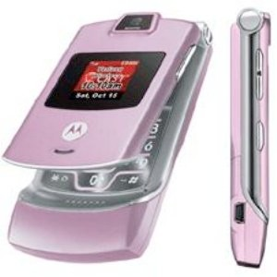
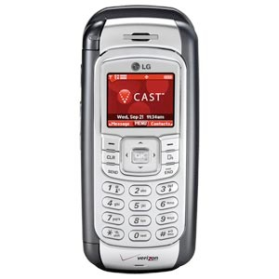
Third generation cellular networks
3G
2004-now
Radio signals are digital
Digital Voice
SMS (short message service)
Broadband data
Streaming video
Technologies
UMTS (Global System for Mobile Communications) standard
CDMA (Code Division Multiple Access)
Notes:
The first generation mobile devices were the first to have radio signals.
The first device was blackberry with voice calls and limited data based communications.

Slide 14
Fourth generation cellular networks
4G
2012 - now
All internet protocol
Can transmit data while traveling at 100Mb/s
Can transmit data while stationary at 1GB/s
Even faster data rates
Technologies
LTE (long term evolution) standard
More advanced multiplexing schemes
Notes:
The first generation mobile devices were the first to have radio signals.
The first device was blackberry with voice calls and limited data based communications.

Slide 15
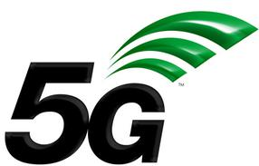
Fifth generation cellular networks
5G
2020 ??
2020 (expected): Coming to a cell tower near you…

