Slide 1
Computer Literacy HQ

Slide 2
Q1. Which of the following is not a part of the system unit?
Internal speaker
Mouse
Motherboard
Drive bays
Cooling fans

Slide 3
Q1. Which of the following is not a part of the system unit?
Internal speaker
Mouse
Motherboard
Drive bays
Cooling fans
Remember… system unit includes:
Motherboard
Power Supply
Cooling fans
Internal Speaker
Drive bays
Expansion slots

Slide 4
Q2. Which of the following is not a component on the motherboard?
CPU
RAM
Expansion cards
Keyboard
Interface cards

Slide 5
Q2. Which of the following is not a component on the motherboard?
CPU
RAM
Expansion cards
Keyboard
Interface cards
Remember… motherboard has:
CPU
RAM
Interface cards
[connectors to] IO devices and display devices
Expansion cards

Slide 6
Q3. How many bits make up a byte?
8 bits
16 bits
32 bits
4 bits
None of the above

Slide 7
Q3. How many bits make up a byte?
8 bits
16 bits
32 bits
4 bits
None of the above

Slide 8
Q4. The binary number 1010 is what decimal number?
11
32
15
7
8

Slide 9
Q4. The binary number 1010 is what decimal number?
11
32
15
7
8

Slide 10
Q5. Which of the following is not an example of mass storage?
RAM
Hard disk drive
Solid state drive
USB drive
Flash memory

Slide 11
Q5. Which of the following is not an example of mass storage?
RAM
Hard disk drive
Solid state drive
USB drive
Flash memory

Slide 12
Q6. What formula would you use in Microsoft Excel to determine the number of cells that contained a given word?
SUM
AVERAGE
TOTAL
COUNTIF
CORRELATION

Slide 13
Q6. What formula would you use in Microsoft Excel to determine the number of cells that contained a given word?
SUM
AVERAGE
TOTAL
COUNTIF
CORRELATION

Slide 14
Q7. What formula would you use in Microsoft Excel to add up all the total of all values within a specified range?
SUM
AVERAGE
TOTAL
COUNTIF
CORRELATION

Slide 15
Q7. What formula would you use in Microsoft Excel to add up all the total of all values within a specified range?
SUM
AVERAGE
TOTAL
COUNTIF
CORRELATION

Slide 16
Q8. Which operating system is currently the most popularly used server OS?
Windows
Mac
Linux
Chrome
Android

Slide 17
Q8. Which operating system is currently the most popularly used server OS?
Windows
Mac
Linux
Chrome
Android

Slide 18
Q9. Which operating system is currently the most popularly used embedded OS?
Windows
Mac
Linux
Chrome
Android

Slide 19
Q9. Which operating system is currently the most popularly used embedded OS?
Windows
Mac
Linux
Chrome
Android

Slide 20
Q10. Which operating system is currently the most popularly used standalone OS?
Windows
Mac
Linux
Chrome
Android

Slide 21
Q10. Which operating system is currently the most popularly used standalone OS?
Windows
Mac
Linux
Chrome
Android

Slide 22
Q11. The ALU is responsible for
Memory access
Hardware diagnostic tests
Logic/arithmetic operations
User authentication
None of the above

Slide 23
Q11. The ALU is responsible for
Memory access
Hardware diagnostic tests
Logic/arithmetic operations
User authentication
None of the above

Slide 24
Q12. What is the function of the operating system?
Provides a way for the user to interact with the computer
Manages the computer’s hardware and peripheral devices
Manages the memory and storage
Provides a consistent means for software applications to work with the CPU
All of the above

Slide 25
Q12. What is the function of the operating system?
Provides a way for the user to interact with the computer
Manages the computer’s hardware and peripheral devices
Manages the memory and storage
Provides a consistent means for software applications to work with the CPU
All of the above

Slide 26
Q13. What is Moore’s Law?
The observation that the number of pixels on a screen doubles every year.
The observation that the number of transistors in an integrated circuit doubles every two years.
The observation that the prices of computers doubles every two years.
The observation that the number of processors doubles every two years.
None of the above.

Slide 27
Q13. What is Moore’s Law?
The observation that the number of pixels on a screen doubles every year.
The observation that the number of transistors in an integrated circuit doubles every two years.
The observation that the prices of computers doubles every two years.
The observation that the number of processors doubles every two years.
None of the above.

Slide 28
Q14. A cell-phone runs on
A standalone operating system
A server operating system
An embedded operating system
All of the above
None of the above

Slide 29
Q14. A cell-phone runs on
A standalone operating system
A server operating system
An embedded operating system
All of the above
None of the above

Slide 30
Q15. _______________ describes a method where more than one processor can perform at the same time.
Sequential processing
Congruent processing
Multiple processing
Parallel processing
None of the above

Slide 31
Q15. _______________ describes a method where more than one processor can perform at the same time.
Sequential processing
Congruent processing
Multiple processing
Parallel processing
None of the above

Slide 32
Q16. Which statement is false?
Multi-core processing supports multiple threads of concurrent execution.
A single-core 2GHz processor is slower than a quad-core 2GHz processor for day-to-day tasks.
Multi-core processors will run every task or program in parallel.
Each core is a single CPU.
All of the above are true.

Slide 33
Q16. Which statement is false?
Multi-core processing supports multiple threads of concurrent execution
A single-core 2GHz processor is slower than a quad-core 2GHz processor for day-to-day tasks.
Multi-core processors will run every task or program in parallel.
Each core is a single CPU.
All of the above are true.

Slide 34
Q17. Which of the following is volatile storage?
Hard drive
Solid state drive
USB drive
CDs and DVDs
RAM

Slide 35
Q17. Which of the following is volatile storage?
Hard drive
Solid state drive
USB drive
CDs and DVDs
RAM

Slide 36
Q18. Suppose you create a new Word document. Before you save it, where does it reside on the computer?
Hard drive
RAM
Both on the hard drive and in RAM
None of the above

Slide 37
Q18. Suppose you create a new Word document. Before you save it, where does it reside on the computer?
Hard drive
RAM
Both on the hard drive and in RAM
None of the above

Slide 38
Q19. Suppose you save the word document (Version 1), but keep the file open and make changes to it later without saving it yet (Version 2). Where does each version reside on the computer?
Both versions are on the hard drive
Version 1 is on the hard drive; version 2 is in RAM
Version 2 is on the hard drive; version 1 is in RAM
Both versions are in RAM
None of the above

Slide 39
Q19. Suppose you save the word document (Version 1), but keep the file open and make changes to it later without saving it yet (Version 2). Where does each version reside on the computer?
Both versions are on the hard drive
Version 1 is on the hard drive; version 2 is in RAM
Version 2 is on the hard drive; version 1 is in RAM
Both versions are in RAM
None of the above

Slide 40
Q20. Inside the CPU, the control unit manages four basic operations which are part of the machine cycle. Arrange the steps of the machine cycle (processing cycle) in the order that they are performed.
Fetch, decode, execute, store
Fetch, execute, decode, store
Execute, decode, store, fetch
Decode, execute, store, fetch
Execute, fetch, decode, store

Slide 41
Q20. Inside the CPU, the control unit manages four basic operations which are part of the machine cycle. Arrange the steps of the machine cycle (processing cycle) in the order that they are performed.
Fetch, decode, execute, store
Fetch, execute, decode, store
Execute, decode, store, fetch
Decode, execute, store, fetch
Execute, fetch, decode, store

Slide 42
Bonus Questions: Bet your points!

Slide 43
Q1. Arrange the memory from fastest to slowest:
Hard disk
Cache
Registers
RAM

Slide 44
Q1. Arrange the memory from fastest to slowest:
Hard disk
Cache
Registers
RAM
1 (fastest): Registers
2: Cache
3: RAM
4 (slowest): Hard disk

Slide 45
Q2. What are the steps of the booting process, in order of start to finish?

Slide 46
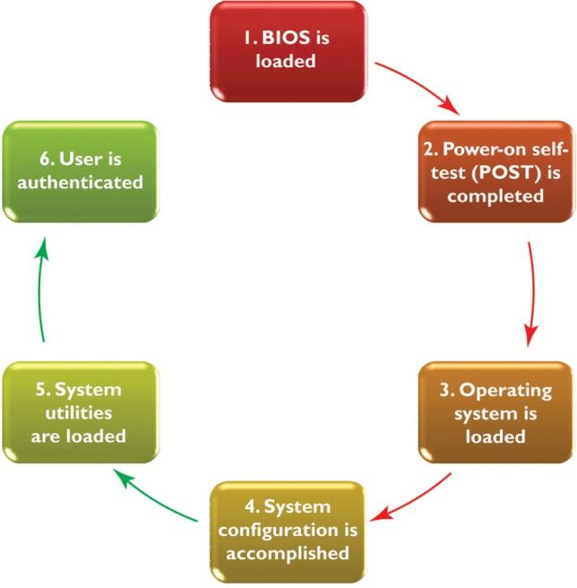
Q2. What are the steps of the booting process, in order of start to finish?

Slide 47
Good luck on your exam!!!

