Slide 1
Linear-time Sorting

Slide 2
Linear-time Sorting (integer sort)
Recall: Any comparison-based sorting algorithm runs in Ω(nlogn).
To achieve linear-time sorting:
Assume keys are integers in the range [0, N-1]
We can use other operations instead of comparisons
We can sort in linear time when N is small enough
Example on board: simple counting sort
Why/when would this be insufficient?
Notes:
Conjecture: keys of any integer range can be done in linear time
Best bound for any N: Han and Thorup (2002) O(n sqrt(loglogN) )
Best known parallel-sort for practical use is bitonic sort O(lg^2 n) time – due to Prof. Kenneth Batcher

Slide 3
Bucket Sort
S is a sequence of n (key, element) items with keys in the range [0, N − 1]
Use the keys as indices into an auxiliary array B of sequences (buckets)
Phase 1: Empty sequence S by moving each item (k, o) into its bucket B[k]
Phase 2: For i = 0, …, N − 1, move the items of bucket B[i] to the end of sequence S
Analysis:
Phase 1 takes O(n) time
Phase 2 takes O(n + N) time
Bucket-sort takes O(n + N) time.
When is this linear time?
Algorithm bucketSort(S, N)
Input sequence S of (key, element) items with keys in the range [0, N − 1] Output sequence S sorted by increasing keys
B ← array of N empty sequences
while ¬S.isEmpty()
(k, o) ← S.remove(S.first())
B[k].insertLast((k, o))
for i ← 0 to N − 1
while ¬B[i].isEmpty()
(k, o) ← B[i].remove(B[i].first())
S.insertLast((k, o))
Notes:
On-board example!

Slide 4
Example: key range [0, 9]
7, d
1, c
3, a
7, g
3, b
7, e
Phase 1
1, c
3, a
3, b
7, d
7, g
7, e
B
0
1
2
3
4
5
6
7
8
9
∅
∅
∅
∅
∅
∅
∅
Phase 2
1, c
3, a
3, b
7, d
7, g
7, e

Slide 5
Application: Create Histogram
Use bucket sort and keep track of number of items in each bucket
Example: histogram of student scores on an English exam
frequency
F D- D D+ C- C C+ B- B B+ A- A

Slide 6
Properties and Extensions
Properties
keys are used as indices into an array and cannot be arbitrary objects
no external comparator
stable sort
Extensions
Integer keys in the range [a, b]
Put item (k, o) into bucket B[k − a]
String keys from a set D of possible strings, where D has constant size (e.g., names of the 50 U.S. states)
Sort D and compute the rank r(k) of each string k of D in the sorted sequence
Put item (k, o) into bucket B[r(k)]

Slide 7
Lexicographic Order
A d-tuple is a sequence of d keys (k₁, k₂, …, k_{d}), where key k_{i} is said to be the i-th dimension of the tuple
Ex: the Cartesian coordinates of a point in space are a 3-tuple
The lexicographic order of two d-tuples is recursively defined as follows
(x₁, x₂, …, x_{d}) < (y₁, y₂, …, y_{d}) ⇔ (x₁ < y₁) ∨ ( x₁ = y₁ ∧ (x₂, …, x_{d}) < (y₂, …, y_{d}) )
that is, tuples are compared by the first dimension, then by the second, etc.

Slide 8
Lexicographic-Sort
Let stableSort(S, C) be a stable sorting algorithm that uses comparator C
C_{i} is the comparator that compares two tuples by their i-th dimension
Lexicographic-sort sorts a sequence of d-tuples in lexicographic order by executing d times algorithm stableSort, (one per dimension)
runs in O(dT(n)) time, where T(n) is the running time of stableSort
Algorithm lexicographicSort(S)
Input sequence S of d-tuples Output sequence S sorted in lexicographic order
for i ← d downto 1
stableSort(S, C_{i})
Example:
(7,4,6) (5,1,5) (2,4,6) (2,1,4) (3,2,4)
(2,1,4) (3,2,4) (5,1,5) (7,4,6) (2,4,6)
(2,1,4) (5,1,5) (3,2,4) (7,4,6) (2,4,6)
(2,1,4) (2,4,6) (3,2,4) (5,1,5) (7,4,6)

Slide 9
Radix Sort
A specialization of lexicographic-sort that uses bucket-sort as the stable sorting algorithm in each dimension
Radix-sort is applicable to tuples where the keys in each dimension are integers in the range [0, N − 1]
Radix-sort runs in time O(d(n + N))
Algorithm radixSort(S, N)
Input sequence S of d-tuples such that (0, …, 0) ≤ (x₁, …, x_{d}) and (x₁, …, x_{d}) ≤ (N − 1, …, N – 1) for each tuple (x₁, …, x_{d}) in S Output sequence S sorted in lexicographic order
for i ← d downto 1
bucketSort(S, N)

Slide 10
Radix Sort for Binary Numbers
Consider a sequence of n b-bit integers x = x_{b − 1} … x₁x₀
We represent each element as a b-tuple of integers in the range [0, 1] and apply radix-sort with N = 2
This application of the radix-sort algorithm runs in O(bn) time
For example, we can sort a sequence of 32-bit integers in linear time
Algorithm binaryRadixSort(S)
Input sequence S of b-bit integers Output sequence S sorted
replace each element x of S with the item (0, x)
for i ← 0 to b − 1
replace the key k of each item (k, x) of S with bit x_{i} of x
bucketSort(S, 2)

Slide 11
Example
Use radix sort to sort sequence of 4-bit integers
A
B
C
D
E
1001
B
E
A
C
D
0010
A
C
D
B
E
1001
A
D
B
C
E
1001
D
B
A
C
E
0001
0010
1110
1101
0001
0010
1101
1001
0001
0010
1001
0001
1101
0010
1101
1101
1110
0001
1110
1110
1110

Slide 12
Other
Describe an efficient method to sort a sequence of n elements if…
… the keys fall into the range of [n²- 5n, n² + 5n].
… the keys can be one of 26 possible characters.
… the keys are strings whose lengths vary from 1 to 30.
… the keys fall into the range [0, n³ – 1].
Notes:
In answering last one, show: FOR SMALL ENOUGH VALUES OF N…. N can be n^c

Slide 13
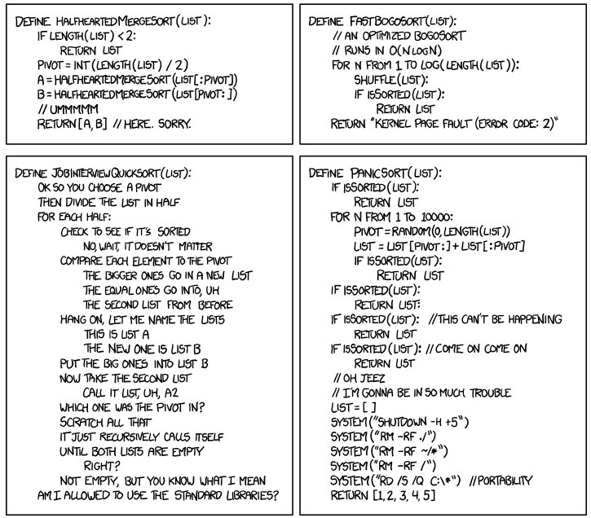
xkcd #1185 – ineffective sorts
Notes:
Summary of sorting algorithms so far

