Slide 1
Selection

Slide 2
Selection Problem
Given an integer k and n elements x₁, x₂, …, x_{n}, taken from a total order, find the k-th smallest element in this set.
Of course, we can sort the set in O(n log n) time and then index the k-th element.
Ex when k=3: 5, 10, 6, 3, 14, 12, 2 → 2, 3, 5, 6, 10, 12, 14
Can we solve the selection problem faster?

Slide 3
Quick-Select
A randomized selection algorithm based on the prune-and-search paradigm:
Prune: pick a random element x (called pivot) and partition S into
L elements less than x
E elements equal x
G elements greater than x
Search: depending on k, either answer is in E, or we need to recurse in either L or G
x
L
G
x
E
k > |L|+|E|
k’ = k - |L| - |E|
k < |L|
|L| < k < |L|+|E|
(done)

Slide 4
Partition
We partition an input sequence as in the quick-sort algorithm:
Remove, in turn, each element y from S and
Insert y into L, E or G, depending on the result of the comparison with the pivot x
Each insertion and removal is at the beginning or at the end of a sequence, and hence takes O(1) time
Thus, the partition step of quick-select takes O(n) time
Algorithm partition(S, p)
Input sequence S, position p of pivot
Output subsequences L, E, G of the elements of S less than, equal to, or greater than the pivot, resp.
L, E, G ← empty sequences
x ← S.remove(p)
while ¬S.isEmpty()
y ← S.remove(S.first())
if y < x
L.insertLast(y)
else if y = x
E.insertLast(y)
else { y > x }
G.insertLast(y)
return L, E, G

Slide 5
Quick-Select Visualization
An execution of quick-select can be visualized by a recursion path
each node represents a recursive call of quick-select, and stores k and the remaining sequence
k=5, S=(7 4 9 3 2 6 5 1 8)
k=2, S=(7 4 9 6 5 8)
k=2, S=(7 4 6 5)
k=1, S=(7 6 5)
5

Slide 6
Expected Running Time
Consider a recursive call of quick-select on a sequence of size s
Good call: the sizes of L and G are each less than 3s/4
Bad call: one of L and G has size greater than 3s/4
A call is good with probability 1/2
1/2 of the possible pivots cause good calls:
1 2 3 4 5 6 7 8 9 10 11 12 13 14 15
1 2 3 4 5 6 7 8 9 10 11 12 13 14 15
1 2 3 4 5 6 7
9 10 11 12 13 14 15
1
3 4 5 6 7 8 9 10 11 12 13 14 15
Good call
Bad call
1 2 3 4 5 6 7 8 9 10 11 12 13 14 15 16
Bad pivots
Good pivots
Bad pivots

Slide 7
Expected Running Time (2)
Probabilistic Fact #1: The expected number of coin tosses required in order to get one head is two.
Probabilistic Fact #2: Expectation is a linear function:
E(X + Y ) = E(X ) + E(Y )
E(cX ) = cE(X )
Let T(n) denote the expected running time of quick-select.
By Fact #2,
T(n) < T(3n/4) + bn*(expected # of calls before a good call)
By Fact #1,
T(n) < T(3n/4) + 2bn
That is, T(n) is a geometric series:
T(n) < 2bn + 2b(3/4)n + 2b(3/4)²n + 2b(3/4)³n + …
So T(n) is O(n).
We can solve the selection problem in O(n) expected time.

Slide 8
Deterministic Selection
We can do selection in O(n) worst-case time.
Main idea: recursively use the selection algorithm itself to find a good pivot for quick-select:
Divide S into n/5 sets of 5 each
Find a median in each set
Recursively find the median of the “baby” medians.
Use median of medians as a guaranteed good pivot
See Exercise C-4.24 for details of analysis.
Min size
for L
1
1
1
1
1
1
1
1
1
1
1
2
2
2
2
2
2
2
2
2
2
2
3
3
3
3
3
3
3
3
3
3
3
Min size
for G
4
4
4
4
4
4
4
4
4
4
4
5
5
5
5
5
5
5
5
5
5
5

Slide 9
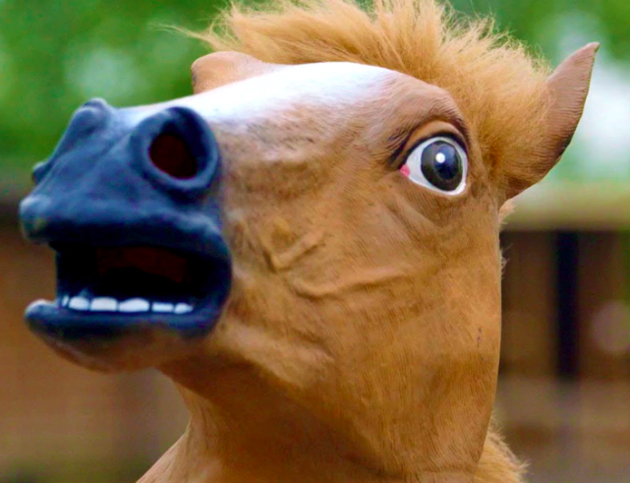
Other: Race Tracks
You have 25 horses and you want to pick the fastest 3 horses. At most 5 horses can race at the same time. You have no stopwatch, so you don’t know the actual speed of any horse in a race (you only know their relative speed - who came 1st, 2nd, 3rd, 4th, 5th in that race). Determine the minimum number of races that are required to find the top 3 fastest horses.

