Slide 1
Analysis of Algorithms
An algorithm is a step-by-step procedure for performing some task (ex: sorting a set of integers) in a finite amount of time.
We are concerned with the following properties:
  Correctness
  Efficiency (how fast it is, how many resources it needs)
Input
Output
Algorithm
Analysis of Algorithms
Notes:
.
.
.
.
.
.
.
.
.
.
.
..
Most algorithms transform input objects into output objects.

Slide 2
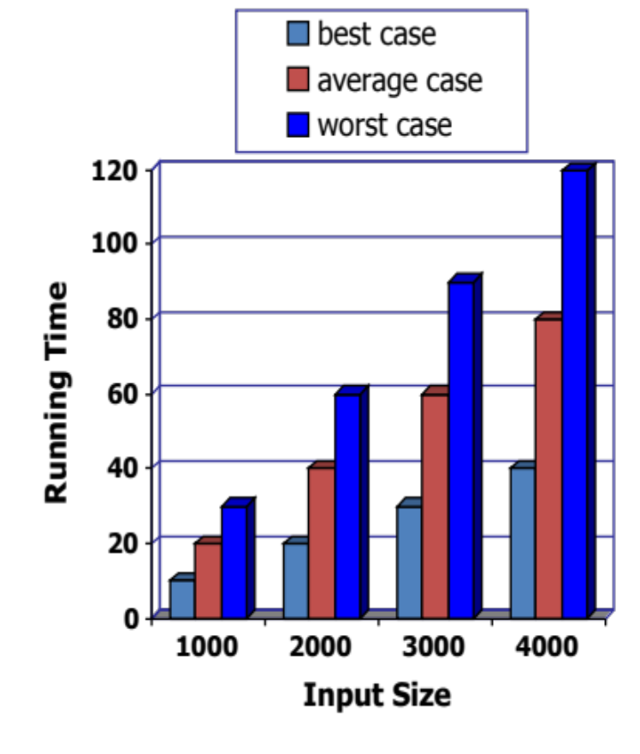
Running Time
The running time of an algorithm typically grows with the input size.
Average case time is often difficult to determine.
We focus on the worst case running time.
  Easier to analyze
  Crucial to applications such as games, finance, and robotics
Analysis of Algorithms
Notes:
.
- Avg run time requires us to define a probability distribution on the set of inputs (typically difficult; requires heavy math and probability)
- Making an algorithm with a good ‘worst case’ running time the standard of success ensures that the algorithm performs well on EVERY input.

Slide 3
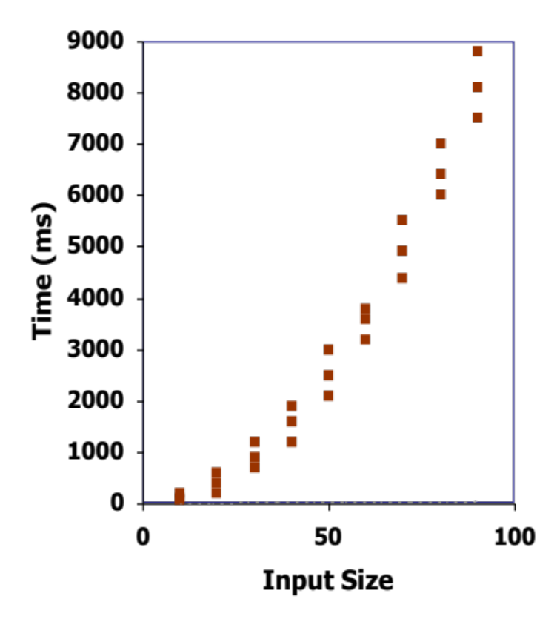
Experimental Studies
Write a program implementing the algorithm
Run the program with inputs of varying size and composition
  Use a method like std::clock() to get an accurate measure of the actual running time
Plot the results
Analysis of Algorithms
Notes:
.
Clock() is from ctime c++ standard library (measures CPU time).

Slide 4
Limitations of Experiments
Need to implement the algorithm
  may be difficult
Experiments done on a limited set of test inputs
  may not be indicative of running times on other inputs not included in the experiment
Difficult to compare
  same hardware and software environments must be used
Analysis of Algorithms

Slide 5
Theoretical Analysis
Uses pseudocode, a high-level description of the algorithm
  no implementation necessary
Takes into account all possible inputs
Characterizes running time by f(n), a function of the input size n
  allows us to evaluate the speed of an algorithm independent of hardware/software environment
Analysis of Algorithms

Slide 6
Pseudocode
Mixture of natural language and high-level programming constructs that describe the main ideas behind an algorithm implementation
Preferred notation for
describing algorithms
Hides program design issues
Algorithm arrayMax(A, n)
Input array A of n integers
Output maximum element of A
currentMax ← A[0]
for i ← 1 to n − 1 do
if A[i] > currentMax then
currentMax ← A[i]
return currentMax
Analysis of Algorithms
Notes:
.
High level description of an algorithm
More structured than English prose, but less detailed than a program

Slide 7
Pseudocode Details
Control flow
  if … then … [else …]
  while … do …
  repeat … until …
  for … do …
  Indentation replaces braces
Method declaration
  Algorithm method (arg [, arg…])
  Input …
  Output …
Method call
  var.method (arg [, arg…])
Return value
  return expression
Expressions
  Assignment (like = in C++)
  Equality testing (like == in C++)
  n² Superscripts and other mathematical formatting allowed
Analysis of Algorithms

Slide 8
The Random Access Machine (RAM) Model
Views a computer as:
  a CPU, with
  a potentially unbounded bank of memory cells, each of which can hold an arbitrary number or character
2
1
0
Memory cells are numbered and accessing any cell in memory takes unit time.
Random Access refers to ability of CPU to access arbitrary memory cell with one primitive operation
Analysis of Algorithms
Notes:
.
Not to be confused with “random access memory”.
Simplifies the idea of what a computer is and what it is capable of to make our analysis easier.

Slide 9
Primitive Operations
Basic computations performed by an algorithm
  Identifiable in pseudocode
  Largely independent from the programming language
  Exact definition not important (we’ll see why later)
Assumed to take a constant amount of time in the RAM model
Includes:
  evaluating an expression
  assigning a value to a variable
  indexing into an array
  calling a method
  returning from a method
Analysis of Algorithms

Slide 10
Counting Primitive Operations
By inspecting the pseudocode, we can determine the maximum number of primitive operations executed by an algorithm, as a function of the input size
Algorithm arrayMax(A, n)
currentMax ← A[0]
for i ← 1 to n − 1 do
if A[i] > currentMax then
currentMax ← A[i]
{ increment counter i }
return currentMax
# operations
2
2 + n
2(n - 1)
2(n - 1)
2(n - 1)
1
--------------
7n - 1
Analysis of Algorithms
Notes:
.
(2+n): 1 op is assignment; 1 op is the expression n -1; n ops is the check if I < n;

Slide 11
Estimating Running Time
Algorithm arrayMax executes 7n − 1 primitive operations in the worst case.
Define:
  a = time taken by the fastest primitive operation
  b = time taken by the slowest primitive operation
Let T(n) be worst-case time of arrayMax. Then
a(7n − 1) ≤ T(n) ≤ b(7n − 1)
Hence, the running time T(n) is bounded by two linear functions.
Analysis of Algorithms

Slide 12
Growth Rate of Running Time
Changing the hardware/software environment
  affects T(n) by a constant factor, but
  does not alter the growth rate of T(n)
The linear growth rate of the running time T(n) is an intrinsic property of algorithm arrayMax
Analysis of Algorithms
Notes:
.
Estimating running time this way lets us evaluate algorithms independently from the hardware and software.
Faster machines will execute faster, but it doesn’t alter the growth rate.

Slide 13
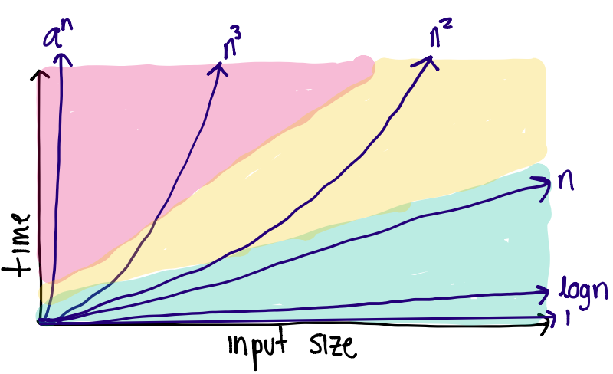
Growth Rates
Constant ≈ 1
Logarithmic ≈ logn
Linear ≈ n
Quadratic ≈ n²
Cubic ≈ n³
Polynomial ≈ n^{k} (for k ≥ 1)
Exponential ≈ a^{n} (a > 1)
Growth rate is not affected by
  constant factors or
  lower-order terms
  Ex: 10²n + 10⁵ is a linear function
  Ex: 10⁵n² + 10⁸n is a quadratic function
Analysis of Algorithms

Slide 14
Asymptotic Complexity
Worst case running time of an algorithm as a function of input size n for large n.
Expressed using only the highest-order term in the expression for the exact running time.
  Instead of exact running time, say O(n²)
Written using asymptotic notation (O, Ω, Θ, o, ω)
  Ex: f(n) = O(n²)
  Describes how f(n) grows in comparison to n²
The notations describe different rate-of-growth relations between the defining function and the defined set of functions
Analysis of Algorithms
Notes:
.
Describes behavior of function

Slide 15
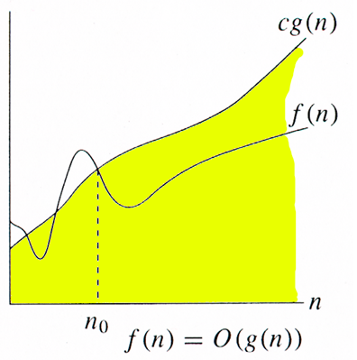
O-notation
For functions g(n), we define O(g(n)), big-O of g(n), as the set:
O(g(n)) = { f(n) :
∃ positive constants c and n₀,
such that ∀n ≥ n₀
we have 0 ≤ f(n) ≤ cg(n) }
Technically, f(n) ∈ O(g(n)).
Older usage, f(n) = O(g(n)).
Intuitively: Set of all functions whose rate of growth is the same as or lower than that of g(n).
g(n) is an asymptotic upper bound for f(n)
Analysis of Algorithms
Notes:
.
We can use this to rank functions according to their long-term growth rate

Slide 16
Examples
O(g(n)) = { f(n) : ∃ positive constants c and n₀,
such that ∀n ≥ n₀ , we have 0 ≤ f(n) ≤ cg(n) }
O(n)
  f(n) = 2n + 10
  f(n) = n + 1
  f(n) = 10000n
  f(n) = 10000n + 300
O(n²)
  f(n) = n² + 1
  f(n) = n² + n
  f(n) = 10000n² +10000n + 300
  f(n) = n^{1.99}
The function n² is not O(n)
  the inequality n² ≤ cn cannot be satisfied since c is constant
Analysis of Algorithms
Notes:
.
2n + 10 <= cn
Cn – 2n >= 10
N(c – 2) >= 10
N >= 10 / (c – 2)
Pick c = 3; n0 = 10;

Slide 17
Big-Oh Rules
Drop lower-order terms
  Ex: if f(n) is a polynomial of degree d, then f(n) is O(n^{d})
Drop constant factors, using the simplest expression of the class
  Say “3n + 5 is O(n)” instead of “3n + 5 is O(3n)”
Use the smallest possible class of functions
  Say “2n is O(n)” instead of “2n is O(n²)”
See Theorem 1.7 in your book
Analysis of Algorithms
Notes:
.
* (n^x) is O(a^n) for any fixed x>0 and a>1.
log(n^x) is O(logn) for any fixed x > 0
(log)^x(n) is O(n^y) for any fixed x > 0 and y > 0
DO EXAMPLES NOW:
7n – 2
30 + 10logn
100000n² + 12n³ + 42n – 40
8nlogn + n
n + 5n² + nlogn
13logn + 5loglogn
32

Slide 18
Asymptotic Algorithm Analysis
The asymptotic analysis of an algorithm determines the running time in big-Oh notation
To perform the asymptotic analysis
  Find the worst-case number of primitive operations executed as a function of the input size
  We express this function with big-Oh notation
Ex:
  arrayMax executes at most 7n − 1 primitive operations
  arrayMax “runs in O(n) time”
Since constant factors and lower-order terms are eventually dropped anyhow, we can disregard them when counting primitive operations
Analysis of Algorithms

Slide 19

Ex: Computing Prefix Averages
We further illustrate asymptotic analysis with two algorithms for prefix averages
The i-th prefix average of an array X is average of the first (i + 1) elements of X:
A[i] = (X[0] + X[1] + … + X[i])/(i+1)
Prefix average has applications in economic and statistics
Analysis of Algorithms
Notes:
.
Prefix averages are used often in economics and statistics
see an average of how some investment portfolio has done over last year/5years/10years.
Also used to as a “smoothing” function for a parameter that is quickly changing

Slide 20
Prefix Averages V1
O(n²) - Quadratic!
The following algorithm computes prefix averages by applying the definition
Algorithm prefixAverages1(X, n)
Input array X of n integers
Output array A of prefix averages of X
A ← new array of n integers
for i ← 0 to n − 1 do
s ← X[0]
for j ← 1 to i do
s ← s + X[j]
A[i] ← s / (i + 1)
return A
rough # operations
n
n
n
1 + 2 + … + (n-1)
1 + 2 + … + (n-1)
n
1
Analysis of Algorithms
Notes:
.
how many times do we compare j to i ?
first time... once
second time... j = 1 (once) and j = 2 (twice)
1 + 2 + 3 + 4 …. + n = n(n+1) / 2 -→ n^2

Slide 21
Prefix Averages V2
O(n) - Linear!
The following algorithm computes prefix averages by keeping a running sum
Algorithm prefixAverages2(X, n)
Input array X of n integers
Output array A of prefix averages of X
A ← new array of n integers
s ← 0
for i ← 0 to n − 1 do
s ← s + X[i]
A[i] ← s / (i + 1)
return A
rough # operations
n
1
n
n
n
1
Analysis of Algorithms
Notes:
Do other example functions to show growth rate of:
- constant
- for loop 1...5
- for loop 1...n {for loop 1...n {for loop 1...n}}
- for loop 1...n followed by for loop 1...n
- while n > 1, n=n/2

Slide 22

Ω-notation
For functions g(n), we define Ω(g(n)), big-Omega of g(n), as the set:
Ω(g(n)) = { f(n) :
∃ positive constants c and n₀,
such that ∀n ≥ n₀
we have 0 ≤ cg(n) ≤ f(n)}
Intuitively: Set of all functions whose rate of growth is the same as or higher than that of g(n).
g(n) is an asymptotic lower bound for f(n)
Analysis of Algorithms
Notes:
.
Example:
5n² is Ω(n²) [let c = 5; n0 = 1]
5n² is Ω(n) [let c = 1; n0 = 1]
n^3 is (n^3)
n^2.0001 is (n^2)
n is (logn)

Slide 23
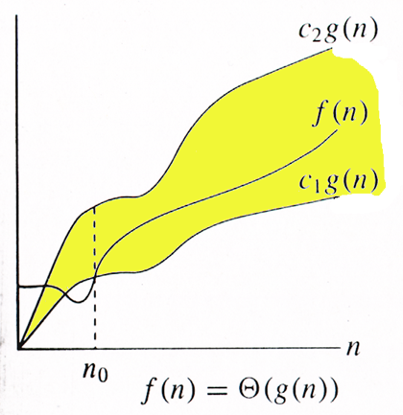
𝛩-notation
For functions g(n), we define 𝛩(g(n)), big-Theta of g(n), as the set:
𝛩(g(n)) = { f(n) :
∃ positive constants c₁, c₂, and n₀,
such that ∀n ≥ n₀
we have 0 ≤ c₁g(n) ≤ f(n) ≤ c₂g(n)}
Intuitively: Set of all functions that have the same rate of growth as g(n).
g(n) is an asymptotically tight bound for f(n)
Analysis of Algorithms
Notes:
.
Example:
30n^3 is (n^3)
10n - 3 is (n)

Slide 24
Relationship between O, Ω, 𝛩
Analysis of Algorithms

Slide 25
Relatives of O and Ω
Little-oh
f(n) is o(g(n)) if ∀c > 0, ∃n₀ ≥ 0 such that f(n) ≤ cg(n) for n ≥ n₀
Little-omega
f(n) is ω(g(n)) if ∀c > 0, ∃n₀ ≥ 0 such that cg(n) ≤ f(n) for n ≥ n₀
Analysis of Algorithms
Notes:
.
5n² is ω(n) [5n₀² ≥ c•n₀ → given c, the n₀ that satifies this is n₀ ≥ c/5 ≥ 0]

Slide 26

Intuition for Asymptotic Notation
Big-Oh
f(n) is O(g(n)) if f(n) is asymptotically less than or equal to g(n)
Big-Omega
f(n) is Ω(g(n)) if f(n) is asymptotically greater than or equal to g(n)
Big-Theta
f(n) is Θ(g(n)) if f(n) is asymptotically equal to g(n)
little-oh
f(n) is o(g(n)) if f(n) is asymptotically strictly less than g(n)
little-omega
f(n) is ω(g(n)) if f(n) is asymptotically strictly greater than g(n)
Analysis of Algorithms

Slide 27

Math you need to review
Summations (Sec. 1.3.1)
Logarithms and Exponents (Sec. 1.3.2)
Proof techniques (Sec. 1.3.3)
Basic probability (Sec. 1.3.4)
log_{b}a = c if a = b^{c}
properties of logarithms:
  log_{b}(xy) = log_{b}x + log_{b}y
  log_{b} (x/y) = log_{b}x - log_{b}y
  log_{b}xª = alog_{b}x
  log_{b}a = log_{x}a/log_{x}b
properties of exponentials:
  a^{(b+c)} = a^{b}a ^{c}
  a^{bc} = (a^{b})^{c}
  a^{b} /a^{c} = a^{(b-c)}
  b = a ^{log}_{a}^{b}
  b^{c} = a ^{c*log}_{a}^{b}
Analysis of Algorithms

