Slide 1
Applications of Propositional Logic
Section 1.2

Slide 2
Applications of Propositional Logic: Summary
Translating English to Propositional Logic
System Specifications
Boolean Searching
Logic Puzzles
Logic Circuits

Slide 3
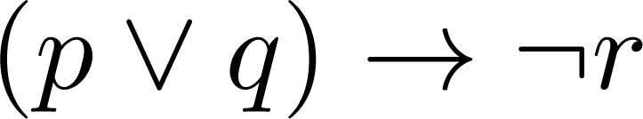
Translating English Sentences
Steps to convert an English sentence to a statement in propositional logic
Identify atomic propositions and represent using propositional variables.
Determine appropriate logical connectives
“If I go to Harry’s or to the country, I will not go shopping.”
p: I go to Harry’s
q: I go to the country.
r: I will go shopping.
If p or q then not r.

Slide 4
Example
Problem: Translate the following sentence into propositional logic:
“You can access the Internet from campus only if you are a computer science major or you are not a freshman.”
One Solution: Let a, c, and f represent respectively “You can access the internet from campus,” “You are a computer science major,” and “You are a freshman.”
a→ (c ∨ ¬ f )

Slide 5
System Specifications
System and Software engineers take requirements in English and express them in a precise specification language based on logic.
Example: Express in propositional logic:
“The automated reply cannot be sent when the file system is full”
Solution: One possible solution: Let p denote “The automated reply can be sent” and q denote “The file system is full.”
q→ ¬ p

Slide 6
Consistent System Specifications
Definition: A list of propositions is consistent if it is possible to assign truth values to the proposition variables so that each proposition is true.
Exercise: Are these specifications consistent?
“The diagnostic message is stored in the buffer or it is retransmitted.”
“The diagnostic message is not stored in the buffer.”
“If the diagnostic message is stored in the buffer, then it is retransmitted.”
Solution: Let p denote “The diagnostic message is stored in the buffer.” Let q denote “The diagnostic message is retransmitted” The specification can be written as: p ∨ q, p→ q, ¬p. When p is false and q is true all three statements are true. So the specification is consistent.
What if “The diagnostic message is not retransmitted” is added.
Solution: Now we are adding ¬q and there is no satisfying assignment. So the specification is not consistent.

Slide 7
Consistent System Specifications
“The diagnostic message is stored in the buffer or it is retransmitted.”
“The diagnostic message is not stored in the buffer.”
“If the diagnostic message is stored in the buffer, then it is retransmitted.”
What if “The diagnostic message is not retransmitted” is added.
p | q | p ∨ q | ¬p | p→ q | ¬q
F | F | F | T | T | T
F | T | T | T | T | F
T | F | T | F | F | T
T | T | T | F | T | F

Slide 8
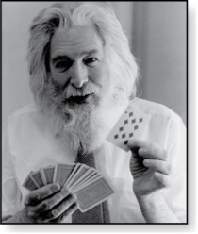
Logic Puzzles
Raymond Smullyan
(Born 1919)
An island has two kinds of inhabitants, knights, who always tell the truth, and knaves, who always lie.
You go to the island and meet A and B.
A says “B is a knight.”
B says “The two of us are of opposite types.”
Example: What are the types of A and B?

Slide 9
Logic Puzzles
Raymond Smullyan
(Born 1919)
An island has two kinds of inhabitants, knights, who always tell the truth, and knaves, who always lie.
You go to the island and meet A and B.
A says “B is a knight.”
B says “The two of us are of opposite types.”
Example: What are the types of A and B?
Solution: Let p and q be the statements that A is a knight and B is a knight, respectively. So, then ¬p represents the proposition that A is a knave and ¬q that B is a knave.
If A is a knight, then p is true. Since knights tell the truth, q must also be true. Then (p ∧ ¬ q)∨ (¬ p ∧ q) would have to be true, but it is not. So, A is not a knight and therefore ¬p must be true.
If A is a knave, then B must not be a knight since knaves always lie. So, then both ¬p and ¬q hold since both are knaves.

Slide 10
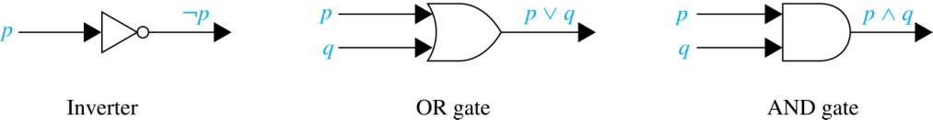
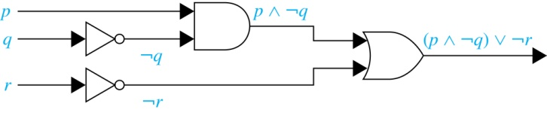
Logic Circuits (Studied in depth in Chapter 12)
Electronic circuits; each input/output signal can be viewed as a 0 or 1.
0 represents False
1 represents True
Complicated circuits are constructed from three basic circuits called gates.
The inverter (NOT gate)takes an input bit and produces the negation of that bit.
The OR gate takes two input bits and produces the value equivalent to the disjunction of the two bits.
The AND gate takes two input bits and produces the value equivalent to the conjunction of the two bits.
More complicated digital circuits can be constructed by combining these basic circuits to produce the desired output given the input signals by building a circuit for each piece of the output expression and then combining them. For example:

