Slide 1
Proof Methods and Strategy
Section 1.8

Slide 2
Section Summary
Proof by Cases
Existence Proofs
Constructive
Nonconstructive
Disproof by Counterexample
Nonexistence Proofs
Uniqueness Proofs
Proof Strategies
Proving Universally Quantified Assertions
Open Problems

Slide 3
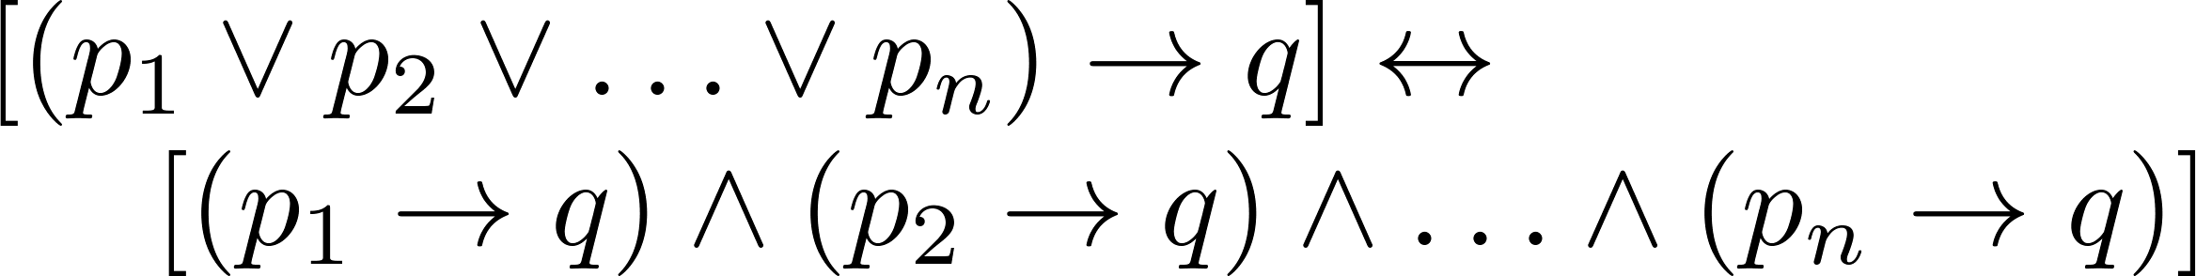

Proof by Cases
To prove a conditional statement of the form:
Use the tautology
Each of the implications is a case.

Slide 4
Proof by Cases
Example: Let a @ b = max{a, b} = a if a ≥ b, otherwise a @ b = max{a, b} = b.
Show that for all real numbers a, b, c
(a @ b) @ c = a @ (b @ c)
(This means the operation @ is associative.)
Proof: Let a, b, and c be arbitrary real numbers.
Then one of the following 6 cases must hold.
a ≥ b ≥ c
a ≥ c ≥ b
b ≥ a ≥c
b ≥ c ≥a
c ≥ a ≥ b
c ≥ b ≥ a
Continued on next slide →

Slide 5
Proof by Cases
Case 1: a ≥ b ≥ c
(a @ b) = a, a @ c = a, b @ c = b
Hence (a @ b) @ c = a = a @ (b @ c)
Therefore the equality holds for the first case.
A complete proof requires that the equality be shown to hold for all 6 cases. But the proofs of the remaining cases are similar. Try them.

Slide 6
Without Loss of Generality
Example: Show that if x and y are integers and both x∙y and x+y are even, then both x and y are even.
Proof: Use a proof by contraposition. Suppose x and y are not both even. Then, one or both are odd. Without loss of generality, assume that x is odd. Then x = 2m + 1 for some integer k.
Case 1: y is even. Then y = 2n for some integer n, so x + y = (2m + 1) + 2n = 2(m + n) + 1 is odd.
Case 2: y is odd. Then y = 2n + 1 for some integer n, so x ∙ y = (2m + 1) (2n + 1) = 2(2m ∙ n +m + n) + 1 is odd.
We only cover the case where x is odd because the case where y is odd is similar. The use phrase without loss of generality (WLOG) indicates this.

Slide 7
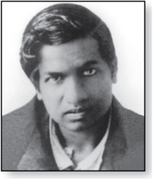
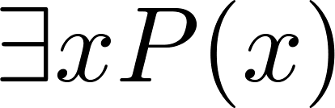
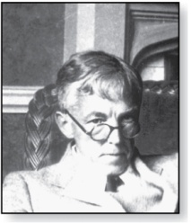
Existence Proofs
Srinivasa Ramanujan
(1887-1920)
Proof of theorems of the form .
Constructive existence proof:
Find an explicit value of c, for which P(c) is true.
Then is true by Existential Generalization (EG).
Example: Show that there is a positive integer that can be written as the sum of cubes of positive integers in two different ways:
Proof: 1729 is such a number since
1729 = 10³ + 9³ = 12³ + 1³
Godfrey Harold Hardy
(1877-1947)

Slide 8
Nonconstructive Existence Proofs
In a nonconstructive existence proof, we assume no c exists which makes P(c) true and derive a contradiction.
Example: Show that there exist irrational numbers x and y such that x^{y} is rational.
Proof: We know that √2 is irrational. Consider the number √2 ^{√2} . If it is rational, we have two irrational numbers x and y with x^{y} rational, namely x = √2 and y = √2. But if √2 ^{√2} is irrational, then we can let x = √2 ^{√2} and y = √2 so that aaaaa x^{y} = (√2 ^{√2} )^{√2} = √2 ^{(√2 √2)} = √2 ² = 2.

Slide 9
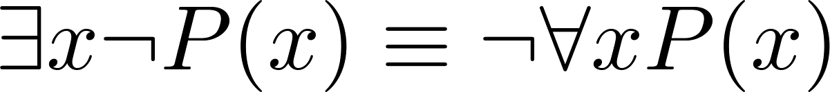
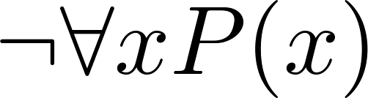
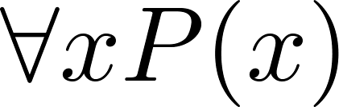
Counterexamples
Recall .
To establish that is true (or is false) find a c such that ¬P(c) is true or P(c) is false.
In this case c is called a counterexample to the assertion .
Example: “Every positive integer is the sum of the squares of 3 integers.” The integer 7 is a counterexample. So the claim is false.

Slide 10
Uniqueness Proofs
Some theorems assert the existence of a unique element with a particular property, ∃!x P(x). The two parts of a uniqueness proof are
Existence: We show that an element x with the property exists.
Uniqueness: We show that if y≠x, then y does not have the property.
Example: Show that if a and b are real numbers and a ≠0, then there is a unique real number r such that ar + b = 0.
Solution:
Existence: The real number r = −b/a is a solution of ar + b = 0 because a(−b/a) + b = −b + b =0.
Uniqueness: Suppose that s is a real number such that as + b = 0. Then ar + b = as + b, where r = −b/a. Subtracting b from both sides and dividing by a shows that r = s.

Slide 11
Proof Strategies for proving p → q
Choose a method.
First try a direct method of proof.
If this does not work, try an indirect method (e.g., try to prove the contrapositive).
For whichever method you are trying, choose a strategy.
First try forward reasoning. Start with the axioms and known theorems and construct a sequence of steps that end in the conclusion. Start with p and prove q, or start with ¬q and prove ¬p.
If this doesn’t work, try backward reasoning. When trying to prove q, find a statement p that we can prove with the property p → q.

Slide 12
Backward Reasoning
Example: Suppose that two people play a game taking turns removing, 1, 2, or 3 stones at a time from a pile that begins with 15 stones. The person who removes the last stone wins the game. Show that the first player can win the game no matter what the second player does.
Proof: Let n be the last step of the game.
Step n: Player₁ can win if the pile contains 1,2, or 3 stones.
Step n-1: Player₂ will have to leave such a pile if the pile that he/she is faced with has 4 stones.
Step n-2: Player₁ can leave 4 stones when there are 5,6, or 7 stones left at the beginning of his/her turn.
Step n-3: Player₂ must leave such a pile, if there are 8 stones .
Step n-4: Player₁ has to have a pile with 9,10, or 11 stones to ensure that there are 8 left.
Step n-5: Player₂ needs to be faced with 12 stones to be forced to leave 9,10, or 11.
Step n-6: Player₁ can leave 12 stones by removing 3 stones.
Now reasoning forward, the first player can ensure a win by removing 3 stones and leaving 12.

Slide 13

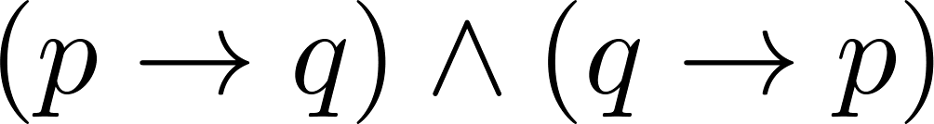
Universally Quantified Assertions
To prove theorems of the form ,assume x is an arbitrary member of the domain and show that P(x) must be true. Using UG it follows that .
Example: An integer x is even if and only if x² is even.
Solution: The quantified assertion is
∀x [x is even ↔ x² is even]
We assume x is arbitrary.
Recall that is equivalent to
So, we have two cases to consider. These are considered in turn.
Continued on next slide →

Slide 14
Universally Quantified Assertions
Case 1. We show that if x is even then x² is even using a direct proof (the only if part or necessity).
If x is even then x = 2k for some integer k.
Hence x² = 4k² = 2(2k² ) which is even since it is an integer divisible by 2.
This completes the proof of case 1.
Case 2 on next slide →

Slide 15
Universally Quantified Assertions
Case 2. We show that if x² is even then x must be even (the if part or sufficiency). We use a proof by contraposition.
Assume x is not even and then show that x² is not even.
If x is not even then it must be odd. So, x = 2k + 1 for some integer k. Then x² = (2k + 1)²
= 4k² + 4k + 1
= 2(2k² + 2k) + 1, which is odd and hence not even. This completes the proof of case 2.
Since x was arbitrary, the result follows by UG.
Therefore we have shown that x is even if and only if x² is even.

Slide 16
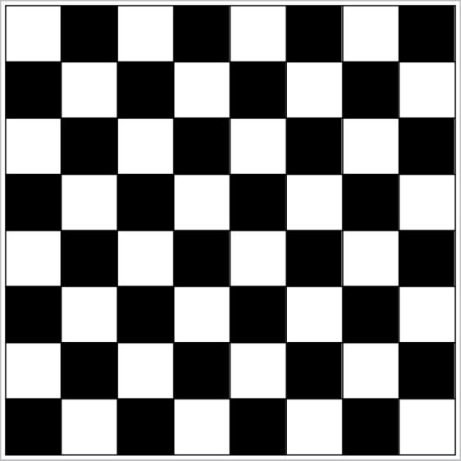
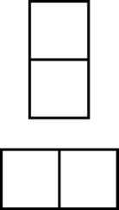
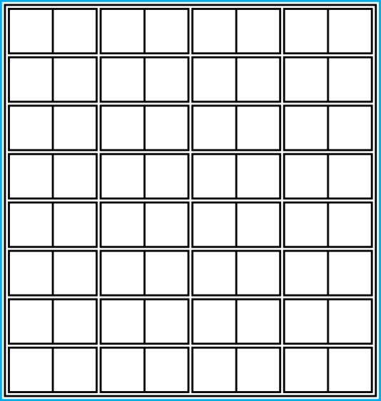
Proof and Disproof: Tilings
Example 1: Can we tile the standard checkerboard using dominos?
Solution: Yes! One example provides a constructive existence proof.
Two Dominoes
The Standard Checkerboard
One Possible Solution

Slide 17
Tilings
Example 2: Can we tile a checkerboard obtained by removing one of the four corner squares of a standard checkerboard?
Solution:
Our checkerboard has 64 − 1 = 63 squares.
Since each domino has two squares, a board with a tiling must have an even number of squares.
The number 63 is not even.
We have a contradiction.

Slide 18

Tilings
Example 3: Can we tile a board obtained by removing both the upper left and the lower right squares of a standard checkerboard?
Nonstandard Checkerboard
Dominoes
Continued on next slide →

Slide 19
Tilings
Solution:
There are 62 squares in this board.
To tile it we need 31 dominos.
Key fact: Each domino covers one black and one white square.
Therefore the tiling covers 31 black squares and 31 white squares.
Our board has either 30 black squares and 32 white squares or 32 black squares and 30 white squares.
Contradiction!

Slide 20
The Role of Open Problems
Unsolved problems have motivated much work in mathematics. Fermat’s Last Theorem was conjectured more than 300 years ago. It has only recently been finally solved.
Fermat’s Last Theorem: The equation x^{n} + y^{n} = z^{n}
has no solutions in integers x, y, and z, with xyz≠0 whenever n is an integer with n > 2.
A proof was found by Andrew Wiles in the 1990s.

Slide 21
An Open Problem
The 3x + 1 Conjecture: Let T be the transformation that sends an even integer x to x/2 and an odd integer x to 3x + 1. For all positive integers x, when we repeatedly apply the transformation T, we will eventually reach the integer 1.
For example, starting with x = 13:
T(13) = 3∙13 + 1 = 40, T(40) = 40/2 = 20, T(20) = 20/2 = 10,
T(10) = 10/2 = 5, T(5) = 3∙5 + 1 = 16,T(16) = 16/2 = 8,
T(8) = 8/2 = 4, T(4) = 4/2 = 2, T(2) = 2/2 = 1
The conjecture has been verified using computers up to 5.6 ∙ 10¹³ .

Slide 22
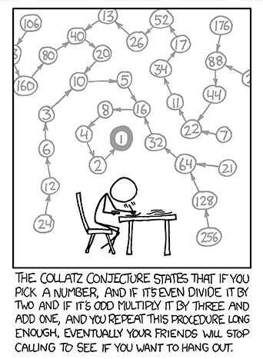
http://xkcd.com/710/

Slide 23
Additional Proof Methods
Later we will see many other proof methods:
Mathematical induction, which is a useful method for proving statements of the form ∀n P(n), where the domain consists of all positive integers.
Structural induction, which can be used to prove such results about recursively defined sets.
Cantor diagonalization is used to prove results about the size of infinite sets.
Combinatorial proofs use counting arguments.

