Slide 1
The Pigeonhole Principle
Section 6.2

Slide 2
Section Summary
The Pigeonhole Principle
The Generalized Pigeonhole Principle

Slide 3
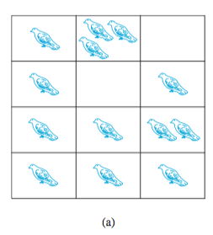
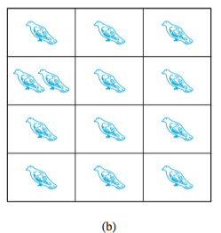
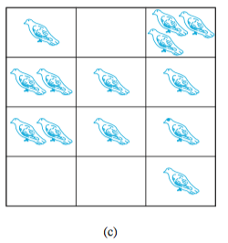
Where the pigeons come in…
If a flock of 13 pigeons roosts in a set of 12 pigeonholes, one of the pigeonholes must have more than 1 pigeon.
There are more pigeons than pigeonholes.

Slide 4
The Pigeonhole Principle
Pigeonhole Principle: If k is a positive integer and k + 1 objects are placed into k boxes, then at least one box contains two or more objects.
Proof: We use a proof by contraposition. Suppose none of the k boxes has more than one object. Then the total number of objects would be at most k. This contradicts the statement that we have k + 1 objects.

Slide 5
The Pigeonhole Principle
Corollary 1: A function f from a set with k + 1 elements to a set with k elements is not one-to-one.
Proof: Use the pigeonhole principle.
Create a box for each element y in the codomain of f .
Put in the box for y all of the elements x from the domain such that f(x) = y.
Because there are k + 1 elements and only k boxes, at least one box has two or more elements.
Hence, f can’t be one-to-one.

Slide 6
The Pigeonhole Principle
Example: Among any group of 367 people, there must be at least two with the same birthday, because there are only 366 possible birthdays.
Example: In a group of 27 English words, there must be at least two that begin with the same letter, because there are 26 letters in the English alphabet.

Slide 7
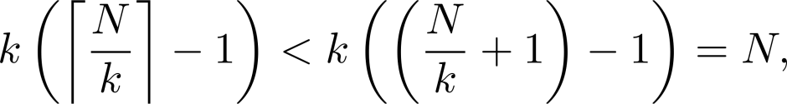
The Generalized Pigeonhole Principle
The Generalized Pigeonhole Principle: If N objects are placed into k boxes, then there is at least one box containing at least ⌈N/k⌉ objects.
Proof: We use a proof by contraposition. Suppose that none of the boxes contains more than ⌈N/k⌉ − 1 objects. Then the total number of objects is at most
where the inequality ⌈N/k⌉ < (N/k) + 1 has been used. This is a contradiction because there are a total of N objects

Slide 8
The Generalized Pigeonhole Principle
Example: Among 100 people there are at least ⌈100/12⌉ = 9 who were born in the same month.
Example: Among 26 students and five possible grades (A,B,C,D,F), there are at least ⌈26/5⌉ = 6 students who will get the same grade.

Slide 9
The Generalized Pigeonhole Principle
Example: a) How many cards must be selected from a standard deck of 52 cards to guarantee that at least three cards of the same suit are chosen?
b) How many must be selected to guarantee that at least three hearts are selected?
Solution: (a) We assume four boxes; one for each suit. Using the generalized pigeonhole principle, at least one box contains at least ⌈N/4⌉ cards. At least three cards of one suit are selected if ⌈N/4⌉ ≥3. The smallest integer N such that ⌈N/4⌉ ≥3 is
N = 2 ∙ 4 + 1 = 9 cards.

Slide 10
The Generalized Pigeonhole Principle
Example: a) How many cards must be selected from a standard deck of 52 cards to guarantee that at least three cards of the same suit are chosen?
b) How many must be selected to guarantee that at least three hearts are selected?
Solution: (b) A deck contains 13 hearts and 39 cards which are not hearts. In the worst case, we select all clubs, diamonds, and spades first – 39 cards in all. The next three cards will be all hearts, so we may need to select 42 cards to get three hearts. (Note that the generalized pigeonhole principle is not used here.)

