Slide 1
An Introduction to Discrete Probability
Section 7.1

Slide 2
Section Summary
Finite Probability
Probabilities of Complements and Unions of Events
Probabilistic Reasoning

Slide 3

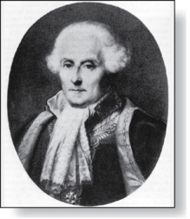
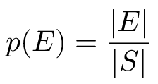
Probability of an Event
Pierre-Simon Laplace
(1749-1827)
An experiment is a procedure that yields one of a given set of possible outcomes.
The sample space of the experiment is the set of possible outcomes.
An event is a subset of the sample space.
Laplace’s Definition: If S is a finite sample space of equally likely outcomes, and E is an event (a subset of S), then the probability of E is
For every event E, 0 ≤ p(E) ≤ 1.

Slide 4
Applying Laplace’s Definition
Example: An urn contains four blue balls and five red balls. What is the probability that a ball chosen from the urn is blue?
Solution: 4/9 (9 possible outcomes, and 4 of these produce a blue ball)
Example: What is the probability that when two dice are rolled, the sum of the numbers on the two dice is 7?
Solution: 6/36 = 1/6 (by the product rule there are 6² = 36 possible outcomes, and 6 of these outcomes have a sum of 7)

Slide 5
Applying Laplace’s Definition
Example: In a lottery, a player wins a large prize when they pick four digits that match, in correct order, four digits selected by a random mechanical process. What is the probability that a player wins the prize?
Solution: 1/10,000 = 0.0001
There is only 1 way to pick the correct digits
By the product rule there are 10⁴= 10,000 ways to pick four digits.

Slide 6
Applying Laplace’s Definition
Example: (continued) A smaller prize is won if only 3 digits are matched. What is the probability that a player wins the small prize?
Solution: 36/10,000 = 9/2500 = 0.0036
If exactly 3 digits are matched, one of the four digits must be incorrect and the other 3 digits must be correct. For the digit that is incorrect, there are 9 possible choices. Hence, by the sum rule, there a total of 36 possible ways to choose four digits that match exactly 3 of the winning four digits.
By the product rule there are 10⁴= 10,000 ways to pick four digits.

Slide 7
Applying Laplace’s Definition
08
27
34
04
19
10
Example: There are many lotteries that award prizes to people who correctly choose a set of six numbers out of the first n positive integers, where n is usually between 30 and 60. What is the probability that a person picks the correct six numbers out of 40?
Solution: 1/ 3,838,380 ≈ 0.00000026
The number of ways to choose six numbers out of 40 is
C(40,6) = 40!/(34!6!) = 3,838,380.
Can you work out the probability of winning the lottery with the biggest prize where you live?

Slide 8
Applying Laplace’s Definition
Example: What is the probability that the numbers 11, 4, 17, 39, and 23 are drawn in that order from a bin with 50 balls labeled with the numbers 1,2, …, 50 if
The ball selected is not returned to the bin.
The ball selected is returned to the bin before the next ball is selected.
Solution: Use the product rule in each case.
a) Sampling without replacement: The probability is 1/254,251,200 since there are 50 ∙49 ∙48∙ 47 ∙46 = 254,251,200 ways to choose the five balls.
b) Sampling with replacement: The probability is 1/50⁵ = 1/312,500,000 since 50⁵ = 312,500,000.

Slide 9


The Probability of Complements and Unions of Events
Theorem 1: Let E be an event in sample space S. The probability of the event = S − E, the complementary event of E, is given by
Proof: Using the fact that | | = |S| − |E|,

Slide 10
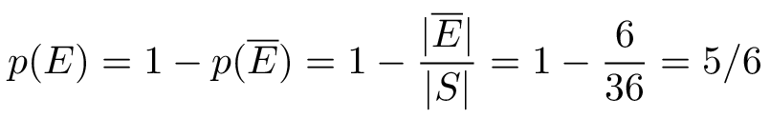
The Probability of Complements and Unions of Events
Example: Throw two dice. What’s the probability that the two scores are different?
Solution:
E = the event that two scores are different
= the event that two scores are the same
|S| = 36 ways for two dice to land

Slide 11
The Probability of Complements and Unions of Events
Example: A sequence of 10 bits is chosen randomly. What is the probability that at least one of these bits is 0?
Solution: Let E be the event that at least one of the 10 bits is 0. Then is the event that all of the bits are 1s. The size of the sample space S is 2¹⁰. Hence,

Slide 12
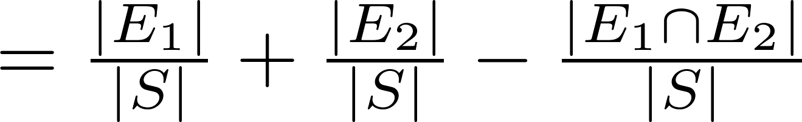
The Probability of Complements and Unions of Events
Theorem 2: Let E₁ and E₂ be events in the sample space S. Then
Proof: Given the inclusion-exclusion formula
|A ∪ B| = |A| + | B| − |A ∩ B|, it follows that

Slide 13
The Probability of Complements and Unions of Events
Example: What is the probability that a randomly selected positive integer between 1 and 100 is divisible by either 2 or 5?
Solution:
Let E₁ be the event that the integer is divisible by 2
Let E₂ be the event that it is divisible 5
Then, E₁ ∪ E₂ is the event that the integer is divisible by 2 or 5
And, E₁ ∩ E₂ is the event that it is divisible by 2 and 5.
p(E₁ ∪ E₂) = p(E₁) + p(E₂) – p(E₁ ∩ E₂)
= 50/100 + 20/100 − 10/100 = 3/5.

Slide 14
Monty Hall Puzzle
1
2
3
Example: You are asked to select one of three doors to open. Behind one of the doors is a car; behind the others, goats. If you select the door with a car, you win the car. After you select a door, the game show host opens one of the other doors (which he knows is not the winning door). The prize is not behind the door and he gives you the opportunity to switch your selection. Should you switch?
Solution: You should switch. The probability that your initial pick is correct is 1/3. This is the same whether or not you switch doors. But since the game show host always opens a door that does not have the prize, if you switch the probability of winning will be 2/3, because you win if your initial pick was not the correct door and the probability your initial pick was wrong is 2/3.
(This is a notoriously confusing problem that has been the subject of much discussion. Do a web search to see why!)

Slide 15
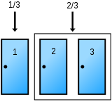
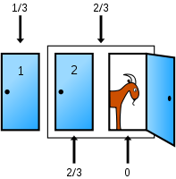
Monty Hall Puzzle
After the host pick a door with a goat:
The odds for the two sets don’t change, but the odds move to 0 for the open door and ⅔ for the closed door.
Before the host picks:
Car has ⅓ chance of being behind the player’s pick and a ⅔ chance of being behind one of the other two doors.

