Slide 1
Personal Computing
COMPUTER LITERACY

Slide 2
What’s inside a computer?

Slide 3
Hardware
System unit
Storage devices
Input device
Output devices
Communication devices

Slide 4
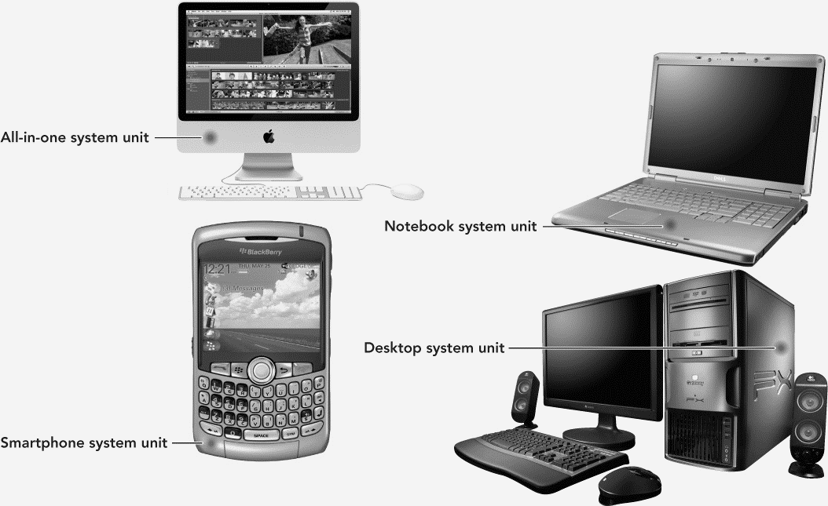
System unit

Slide 5
Parts of the System Unit
Motherboard
Power Supply
Cooling fans
Internal Speaker
Drive bays
Expansion slots
Notes:
- Motherboard: computer’s main circuit board. It’s a thin plate that holds the CPU, memory, and many other important features. It connects directly or indirectly to every part of the computer.
- Power supply: converts AC to low-voltage regulated DC power for the internal components of a computer.
- Cooling fan: prevents overheating when processors, graphics cards, RAM, and other components get hot. Not required for mobile phones or tables b/c it has a different architecture that’s more power efficient and doesn’t generate as much heat.
- Internal speaker: Separate from the speaker you use to listen to music, etc. It creates basic monotonic beeps, which can be used to troubleshoot problems (this was especially helpful before GUIs).
Drive-bay: a standard-sized area for adding hardware to a computer (hard-drive, CD-drive, etc)
Expansion slots: allow you to add various types of expansion cards, sometimes called PCI (peripheral component interconnect) cards (video card, sound card, network card, etc.)

Slide 6
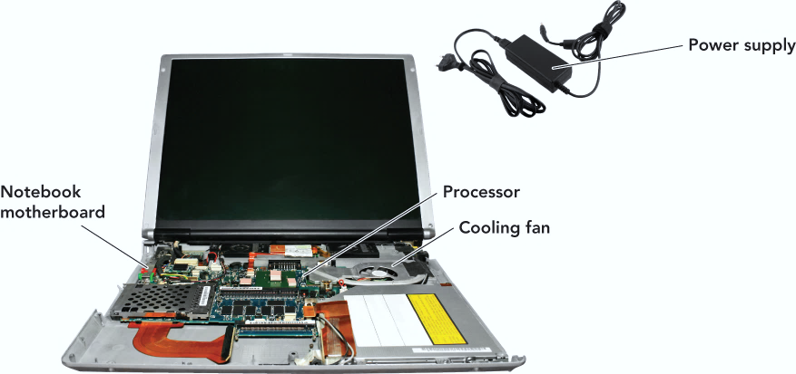
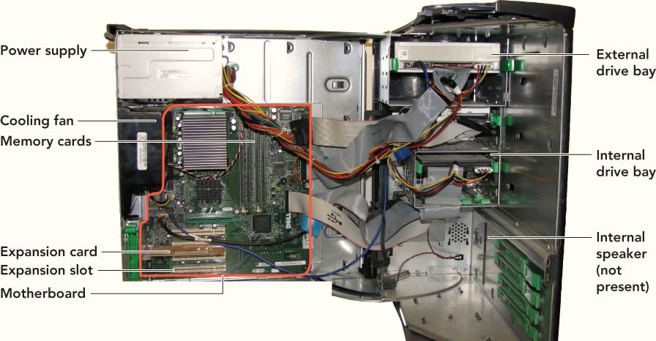
Inside the System Unit
Desktop system unit
Laptop system unit

Slide 7
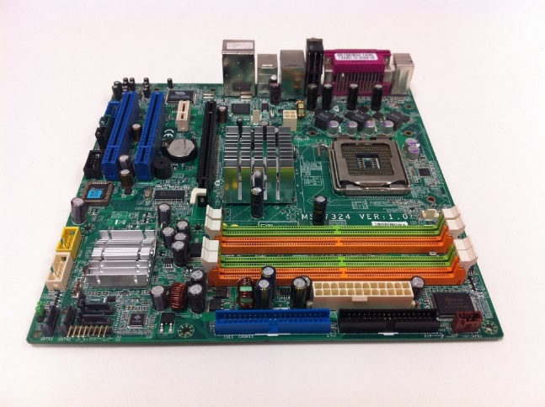
MOTHERBOARD
Printed circuit board that contains the electrical circuitry for the computer.
The majority of parts found on the motherboard are integrated circuits – miniaturized billion of transistors.
Components
CPU
RAM
Interface cards
IO devices and display devices
Expansion cards
CPU - A large square chip covered by a heat sink = A heat dissipating component
Notes:
Image credit: https://pixabay.com/p-707774/?no_redirect
Integrated circuits are a set of electronic circuits on a small flat piece of semiconductor material, usually sillicon. This is how Sillicon Valley got its name as it is the area where most of these chips are created, though it has also progressed to being a strong software manufacturing area as well.
Transistor: devices that control the flow of electricity. They can both switch or amplify electronic signals.
CPU (aka Central Processing Unit, processor): carries out the instructions of a computer program by performing basic arithmetic, logical, control, and IO operations specified by some instructions. This is the brain of the computer and its job is to carry out commands.
RAM (aka Random Access Memory): Short-term memory. Whenever your computer performs calculations, it temporarily stores the data in RAM until it is needed. This short-term memory disappears when the computer is turned off. The more RAM you have, the more things your computer can do at the same time.
Network Interface cards (aka NIC): Supports ethernet (wired) and WiFi (wireless) connections.
Expansion slots: allow you to add various types of expansion cards, sometimes called PCI (peripheral component interconnect) cards (video card, sound card, network card, etc.)

Slide 8
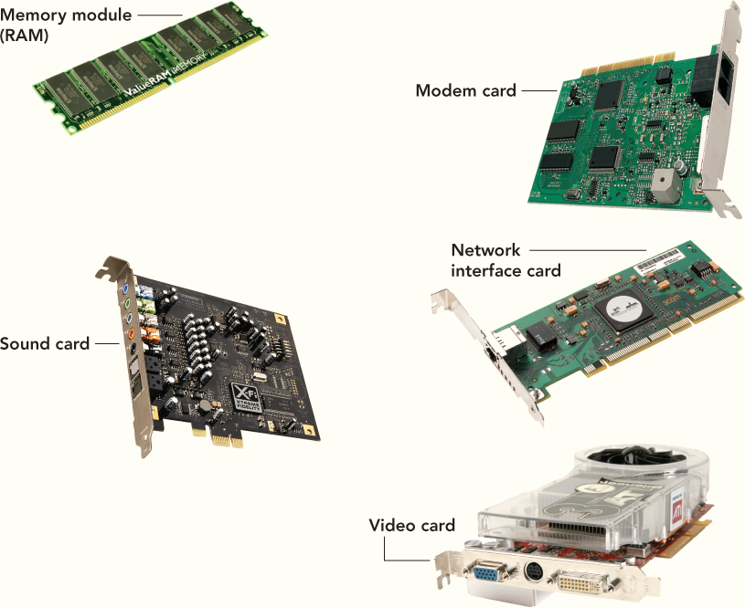
What’s on the Motherboard?
CPU
RAM
Network Interface
IO devices and display devices
Modem card
Video Card
Expansion cards

Slide 9
What’s important when buying a computer?
How important is the Processor speed?
How much RAM does a computer need?
Which type of drive is best?

Slide 10
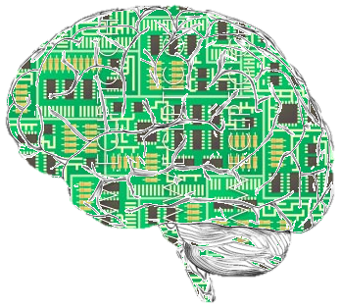
CPU: Central processing unit
The brain of the computer
Leading CPU manufacturers are Intel and AMD
32-bit or 64-bit processor
Number of bits a computer can handle at a time
What is CPU clock speed (GHz)?
The higher the processor’s speed, the faster the computer
Notes:
Image credit: https://zh.wikipedia.org/wiki/User:David290/Artificial_intelligence
CPU (aka Central Processing Unit, processor): carries out the instructions of a computer program by performing basic arithmetic, logical, control, and IO operations specified by some instructions. This is the brain of the computer and its job is to carry out commands.
Clock Speed (labeled in GHz or Gigahertz) tells you how much data it can process (per second).

Slide 11
CPU: Microprocessor
Instruction – A single operation performed by the CPU
Example of operations
Retrieve a character from the computer’s memory
Find the largest number
Instruction set – list of CPU instruction used by the program
Notes:
A microprocessor is essentially a processor that happens to be on a chip (or a small number of chips), as opposed to one made from a larger number of individual components.
Example of instruction set:
Add
Compare
Input from device
Jump to an address
Jump toaddress if something is true
Load information from RAM
Output information to device
Store information to RAM

Slide 12
Inside the CPU – Control Unit
Control Unit manages four basic operations
FETCH: Retrieve instructions from computer’s memory
DECODE: Determine what the program is telling the computer to do
EXECUTE: Perform the requested instructions
STORE: Store the results
The four-step process is called machine cycle or processing cycle
Registers
operations require the control unit to store data temporary

Slide 13
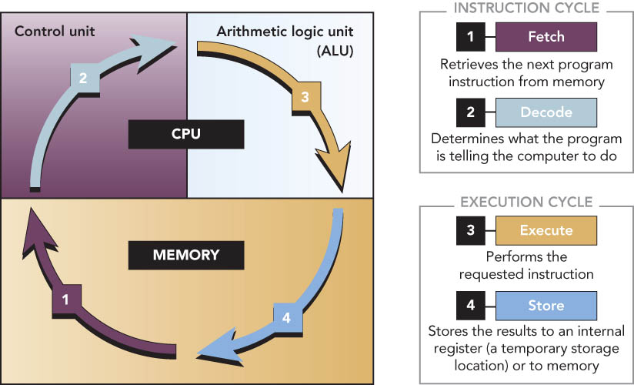
Processing Cycle

Slide 14
Inside the CPU – ALU
Arithmetic Logic Unit (ALU)
Performs arithmetic and logical operations
Involve adding, subtracting, multiplying, dividing
Logical operations involve comparisons between two or more data items.
Notes:
Minecraft ALU
10,000 Domino ALU

Slide 15
Parallel Processing
Method where more than one processor performs at the same time—faster processing
What does core mean?
Each core is a single CPU
A single-core 2GHz processor is slower than a four-core 2GHz processor
Advantages of multicore
Processing time improved
Supports multiple threads of concurrent execution
Types of multicore technology
Dual core: two processor CPU
Quad core: four processor CPU

Slide 16
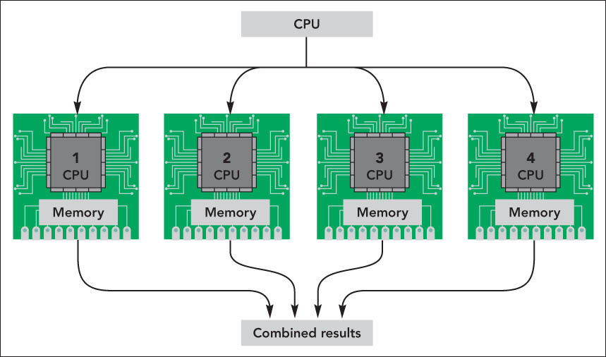
Parallel Processing – Continued

Slide 17
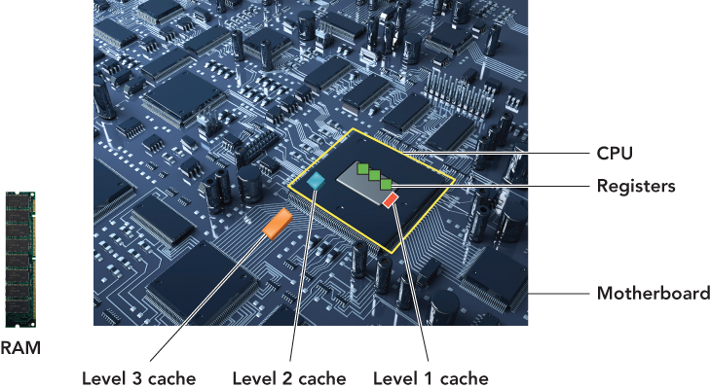
Memory on the motherboard
Notes:
A cache is a smaller, faster memory, closer to the processor core, which stores copies of data from frequently used main memory locations.
Registers hold a very small amount of memory, but they are very fast. L1 is the next fastest, but it has a bit more memory. At each level, the amount of memory increases but it takes longer to copy over.

Slide 18
Cache
Small unit of ultrafast memory built into or near the CPU
Store frequently or recently access program instructions or data
Three levels of cache on a system:
Level 1 (L1) cache (primary cache)
Level 2 (L2) cache (secondary cache)
Level 3 (L3) cache

Slide 19
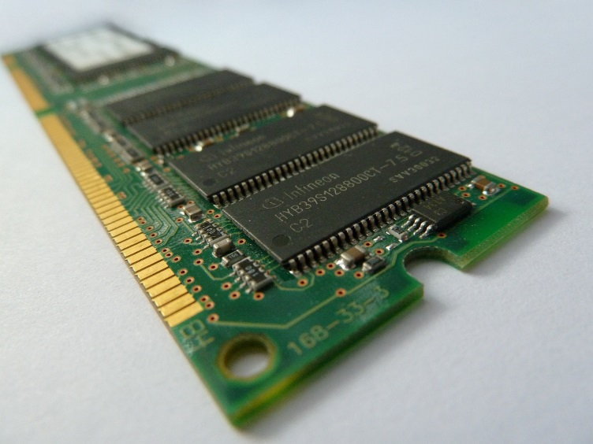
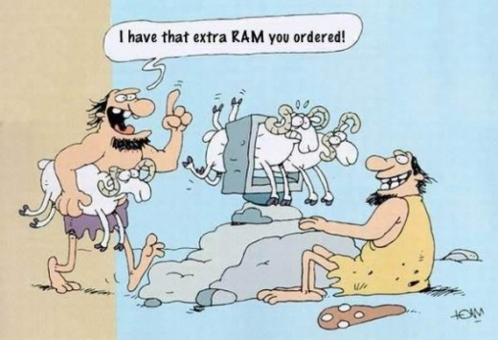
RAM (random access memory)
RAM is temporary storage
Volatile
Data stored in RAM is lost when computer is turned off
Notes:
Image credit: https://commons.wikimedia.org/wiki/File:Ram_chip.jpg

Slide 20
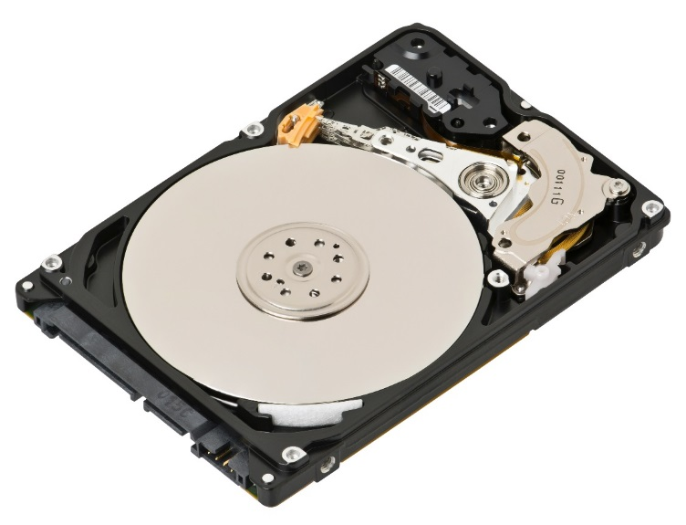
Hard drive vs. Solid State Drive
Storage device where all files, images and other different files are stored
Non-volatile
Acts like file cabinet
Solid state drive:
No moving parts
Faster, more expensive
Hard drive (above):
Contains moving parts
Slower, but cheaper
Notes:
Image credit: https://commons.wikimedia.org/wiki/File:Laptop-hard-drive-exposed.jpg

