Slide 1
Storage device
Computer literacy

Slide 2
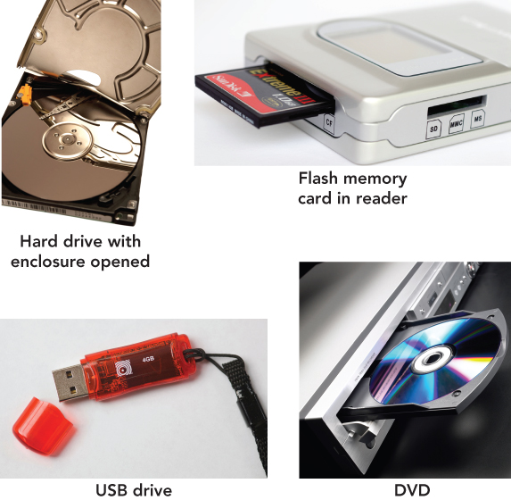
Mass storage
Process of saving software and data
Also called mass storage, auxiliary storage,
or secondary storage
Is nonvolatile
Examples
Solid state devices
Hard disks
Floppy disks (legacy)
Flash memory
USB drives
Optical drives: CDs and DVDs, Blue rays

Slide 3
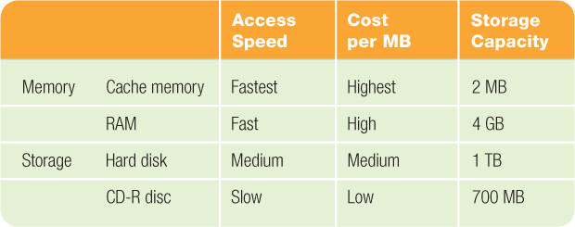
RAM vs. Mass Storage
Mass Storage devices retain data even if power is turned off
Data stored in memory (RAM) will be lost
Storage devices are less expensive than memory

Slide 4
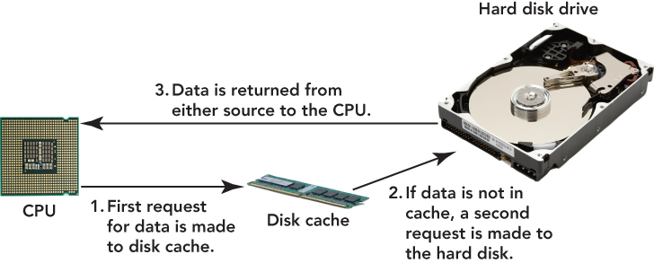
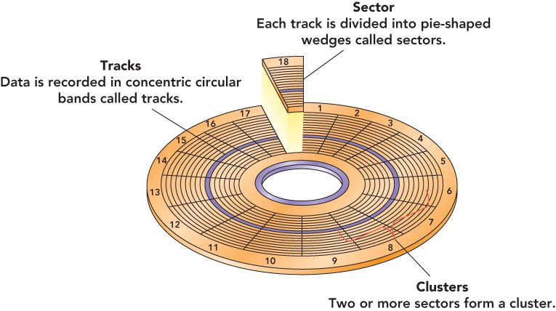
Hard DISK drive

Slide 5
SOLID STATE DRIVE
Uses a type of memory called “flash memory”
Flash memory uses a grid of electrical cells to quickly send and receive data.
These grids are separated into sections called “pages”
Pages are clumped together to form “blocks.”

Slide 6
Comparing Solid State Drives to Traditional Hard Drives
Spin-up Time:
SSDs have no spin up time; the drive has no moving parts.
Data Access Time and Latency:
by skipping the mechanical spin and seek routine they can access data almost instantly wherever it is on the disk
Noise:
SSDs are silent; no moving parts means no noise.
Reliability
Power Consumption:
SSD drives consume 30-60% less energy than traditional HDDs.
Cost:
SSD are not cheap.

Slide 7
Other Storage Devices
Express Card
Notebook accessory—size of a credit card
Can be used as a modem, as extra memory, or as a network adapter
Flash memory cards
Solid-state storage device
Used with MP3 players, smartphones, digital cameras
Flash memory reader
Slot or compartment allows access to files stored on the card

Slide 8
Cloud Storage
A service provided by a company to store your data
Data is stored on the internet (in the “cloud”), not locally
Usually requires software installation
Examples:
Drop Box
Google Drive
Apple iCloud
Amazon Drive
Microsoft OneDrive

