Slide 1
Application Software
COMPUTER LITERACY

Slide 2
Tools for Productivity
Productivity
Word processing, Spreadsheet, Presentation
Database
Personal information management
Media and Graphic
Desktop publishing
Image animation creation and editing
Audio/Video editing
Internet Based
Email
Web browsers
Video conferencing
Home and Educational
Personal finance
Tax preparation
Games

Slide 3
Productivity Programs
Shared Office Interface
Features interfaces similar to Microsoft’s Windows operating systems
Application window
Application workspace
Document
Title bar
Window control buttons: minimize, restore down/maximize, close
Window border
Status bar
Scroll bars and scroll arrows
Ribbon
Tab and contextual tab
Group
Quick Access Toolbar

Slide 4
Microsoft Word
Automatic text wrapping
Find and Replace utility
Ability to cut, copy and paste text, images, highlight, and screen captures
Within document
Between documents and programs
Editing and formatting tools insert headers, footers, page breaks, page numbers, dates; page layout; versions
Embed pictures, graphics, charts, tables, footnotes, endnotes, & more
Add tables, columns, tabs, bulleted or numbered lists
Theme feature provides pre-created color schemes and font selections
Live Preview option
Portrait or landscape orientation print options
Reviewing options: spell checker; grammar and style checking
Provides collaboration capability
Mail merge capability: create multiple personalized letters with addresses

Slide 5
Microsoft Excel
Leading spreadsheet program for business and personal use
Stores and manipulates numbers
Modeling/what-if analysis—prediction of things that might happen
Each file is a workbook holding worksheets with columns, rows & cells
Spreadsheet entries and features
Labels; Formulas; Functions; Charts ;
Interface with Microsoft Office

Slide 6
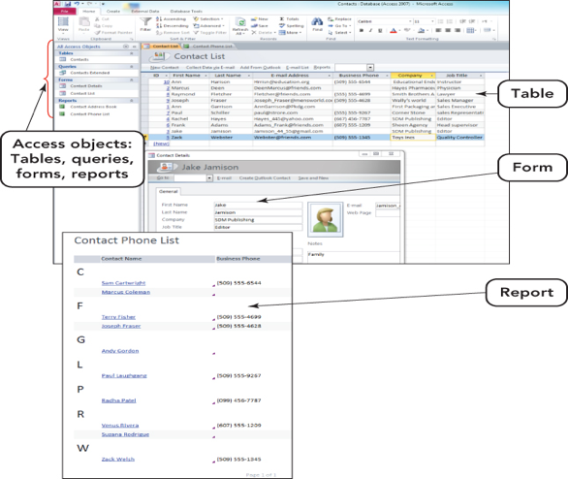
Microsoft Access
Database management system
Designed to
Store related data in tables
Create relationships
Generate forms, queries, & reports
Features include
Table; Data set; Form
Filter; Query
Report

Slide 7
Microsoft PowerPoint
Popular program used to create and deliver presentations
PowerPoint screen features
Slide/Outline pane; Notes pane; View buttons; Slide pane
Features include
Professionally designed templates
Slide transitions
Placeholder and image animation options
Animation painter
Ability to insert video
Convert presentation into a WMV video file

Slide 8
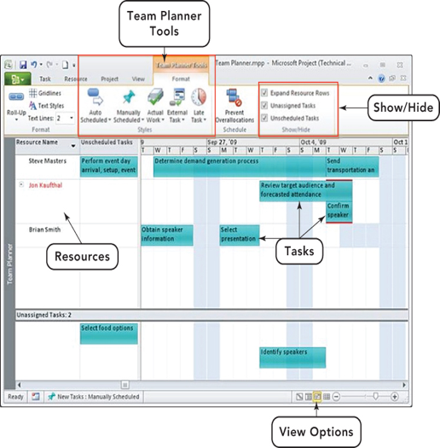
Microsoft Project
Management of one or more projects that can vary in complexity
Features include
Visually enhanced timeline emphasizes due dates and deadlines
Team-planning capability
Portfolio manager monitors allocation of scarce resources and current project costs

Slide 9
Microsoft Outlook
Personal information management system
Features include
E-mail
Conversation grouping
Ignoring conversations
Think before you send feature
Calendar with alarms
Appointment scheduling
Phone book
Net meeting
Spam filtering

Slide 10
Emerging Word Tools
Processing handwritten words
Diversity in handwriting makes it difficult
Processing words with speech
Speech recognition software
Intelligent word processing software
Word processors that are able to anticipate the writer’s needs

Slide 11
Media and Graphics Software
Media
Refers to the technology used in presenting information including: Pictures, sound, video, and text
Multimedia programs
Enable users to incorporate more than one type of technology
Professional desktop publishing; Multimedia authoring; Paint, drawing, and animation; Image editing; 3D rendering, such as CAD (Computer Aided Design); Audio editing; Video editing
Compression and decompression
Codecs—algorithms that reduce file size and allow faster Internet transfer speeds
Lossless compression—does not delete information needed to reproduce the image without flaws
Lossy compression—removes some information, but the loss is typically not noticeable
Audio Video Interleave (AVI)—Microsoft-created specification for packaging audio and video data into a file

Slide 12
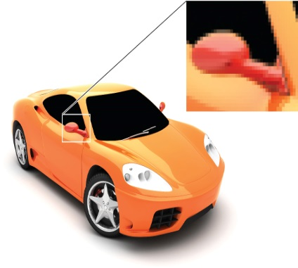
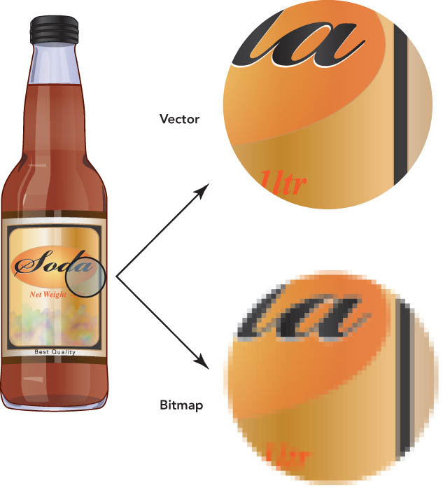
Media Programs
Desktop publishing programs
Used to create newsletters,
product catalogs,
advertising brochures
Paint programs
Create bitmapped images (raster graphics)
made up of pixels
Paint program file formats
GIF; JPEG; PNG; BMP; TIFF; PNG
Drawing programs
Create vector graphics
edited and resized without distortion

Slide 13
Modern Desktop Publishing
Desktop publishing
Producing drawings, photographs, and other graphics to accompany the text
Designing a basic format for the publication
Typesetting text
Arranging text and graphics on pages
Typesetting and printing pages
Binding pages into a finished publication
The production process can be accomplished with sophisticated tools that are affordable and easy to use.
A desktop publishing system generally includes:
One or more Macs or PCs
A scanner and/or digital camera
Transforms photographs and hand-drawn images into computer-readable documents
A high-resolution printer
Software (see next slide)

Slide 14
Paperless Publishing
Paperless publishing and the Web
A common prediction is that desktop publishing—and paper publishing in general—will be replaced by paperless electronic media.
Electronic books and digital paper
The electronic book, or ebook, is a handheld device that can contain anything from today’s top news stories to lengthy novels.
Digital paper, or e-paper, is a flexible, portable, paper-like material that can dynamically display black-and-white text and images on its surface.

