Slide 1
Privacy and Security
Computer Literacy

Slide 2
Privacy in Cyberspace
Privacy: an individual’s ability to restrict or eliminate the collection, use, and sale of confidential personal information
Definition and concern depends upon individual
Westin survey for Equifax found 3 categories of people
Fundamentalist: highly concerned
Pragmatist: moderately concerned
Unconcerned: low level of concern
The problem is collection of information without consent
Anonymity: the ability to communicate without disclosing one’s identity
More difficult with the use of computers and the Internet
Notes:
Source: Westin, A., and Harris Louis & Associates. Harris-Equifax Consumer Privacy Survey. Tech. rep., 1991. Conducted for Equifax Inc. 1,255 adults of the U.S. public.

Slide 3
Technologies that jeopardize anonymity
Cookies
Global unique identifiers
Ubiquitous computing
Radio frequency identification

Slide 4
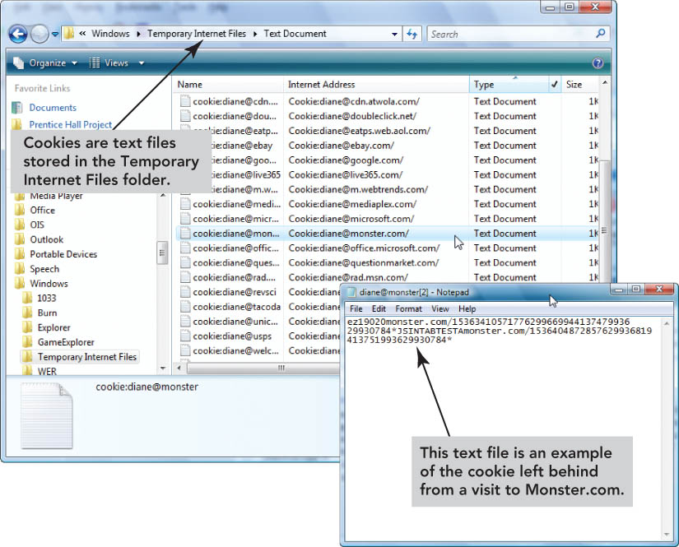
Cookies
Small text files written to your hard disk by web sites visited
Intent: store data about you and your preferences so it doesn’t have to keep asking
Examples include:
Name, address, password, credit card
Items in a shopping cart
Track your browsing habits
Gather personal information without your consent
Can be disabled
Banner ads
targeted display ads based on cookies

Slide 5
Global unique identifier (GUID)
Identification number produced by software or a piece of hardware
Web servers read the GUID
Users are not always aware of the GUID
If used, companies typically allow users to opt out
Civil liberties groups and public concern have decreased the use of GUIDs

Slide 6
Ubiquitous computing
The concept that computing appears anytime everywhere (everyware)
Interacting with multiple networked devices
Smart things allow for ubiquitous data collection and tracking
Examples:
Active badge transmits infrared signals to create an electronic trail
Location data in cell phones
Health data in wearable devices
Search history and always-on-microphone on home assistants

Slide 7
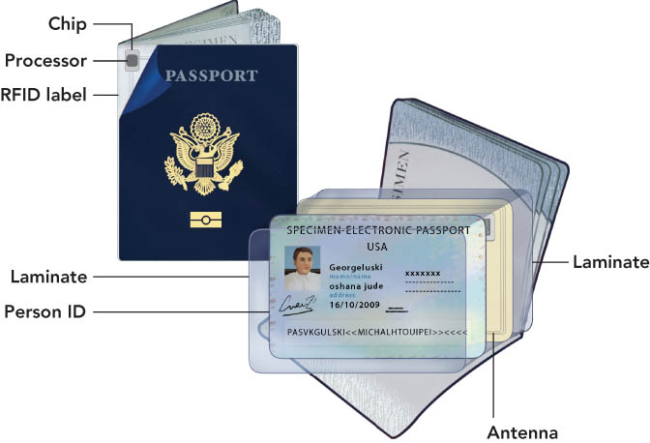
Radio frequency identification (RFID)
Automatically identify and track objects using radio waves
Used for tracking and inventory control in stores
Embedded in passports
Recognizes microchips in pets
Research on embedding chips in humans

Slide 8
Protecting privacy at home
Create logins and passwords for each person using the computer
Do not save account numbers or passwords written down
Use strong passwords
Do use:
Difficult to guess passwords
At least 16 characters or more
Uppercase, lowercase, numbers, and special characters
Do not use:
Recognizable word or phrase
Name of anything/anyone close to you
Recognizable strings of numbers (SSN, birthdates, etc.)

Slide 9
Protecting privacy at work
Employee monitoring
Majority of large U.S. employers observe employee phone calls, e-mails, Web browsing habits, and computer files
Refrain from making personal calls on a work phone
Avoid using company e-mail for personal purposes
Assume you are monitored
Be aware of shoulder surfing

Slide 10
Are social networking sites spying on you?

Slide 11
Monitored activity
Things we do
Information we provide
Address, school, location, preferences
Images
Video
Day-to-day activity
Holidays
Network and connections
Any payments
Device information
What happens to collected data if your account is deleted?

Slide 12
How does social media use this information?
Marketing
Studies and experiments
Personal information sold to advertisers
Other actors
Hotels
Standardized testing companies
Insurance companies
Landlords
Universities
Potential employers
Police

Slide 13
Security

Slide 14
Computer security risk
An event or action that could cause damage to a computer system or its data
Wireless LAN security options include:
WEP (Wired Equivalent Privacy)
First security standard
Easily hacked
WPA (Wi-Fi Protected Access)
Interim standard to address major WEP flaws
Only use this if WPA2 is not available
WPA2
Current standard
Most secure wireless standard available
Vacation hacking: tricking travelers into using phony WiFi hot spots known as evil twins

Slide 15
Computer security threats
Social engineering
Malware
Corporate espionage
Pod slurping
Backdoors
Information warfare
Attacks on safety-critical systems
Cyberterrorism

Slide 16
Protecting your computer
Firewalls
Antivirus
Antispyware
Use secure passwords
Limit physical access to devices
Biometric authentication
Only connect to trusted/secure WiFi
Be conscious of social engineering

