Slide 1
Virtual Reality
COMPUTER LITERACY

Slide 2
What is Virtual Reality (VR) ?
Virtual Reality: an artificial environment created with computer hardware and software and presented to the user in such a way that it appears and feels like a real environment.
Why VR?

Slide 3
Types of VR
Collaborative
Non-Immersive
Fully immersive
Mixed Reality (Augmented Reality)

Slide 4
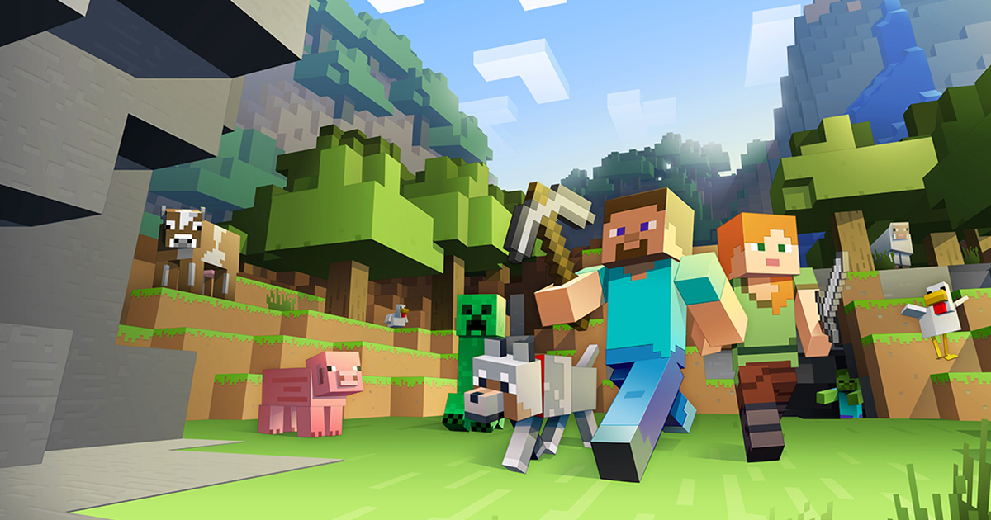
Collaborative
The idea of sharing an experience in a virtual world with other people, often in real time
Example: Second Life, Minecraft

Slide 5
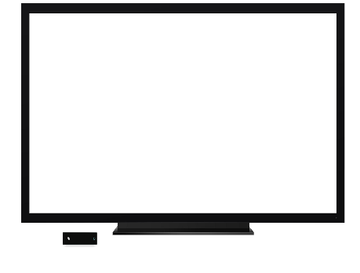

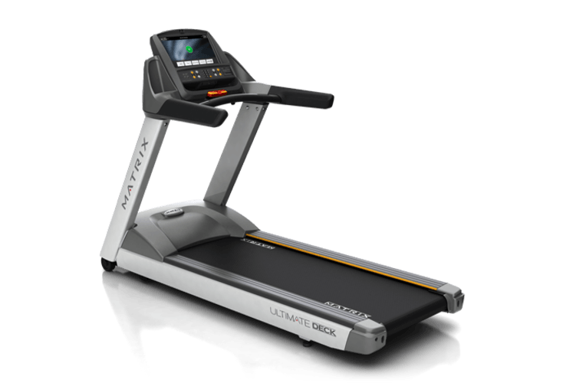
Non-Immersive
A variation of visualizing complete computer generated worlds
Links remote sensors in the real world with the senses of a human operator.
Example: realistic flight simulator on home desktop with wide-screen, headphones, and realistic joystick
Notes:
A highly realistic flight simulator on a home PC might qualify as non-immersive virtual reality, especially if it uses a very wide screen, with headphones or surround sound, and a realistic joystick and other controls. Not everyone wants or needs to be fully immersed in an alternative reality. An architect might build a detailed 3D model of a new building to show to clients that can be explored on a desktop computer by moving a mouse. Most people would classify that as a kind of virtual reality, even if it doesn't fully immerse you. In the same way, computer archaeologists often create engaging 3D reconstructions of long-lost settlements that you can move around and explore. They don't take you back hundreds or thousands of years or create the sounds, smells, and tastes of prehistory, but they give a much richer experience than a few pastel drawings or even an animated movie

Slide 6
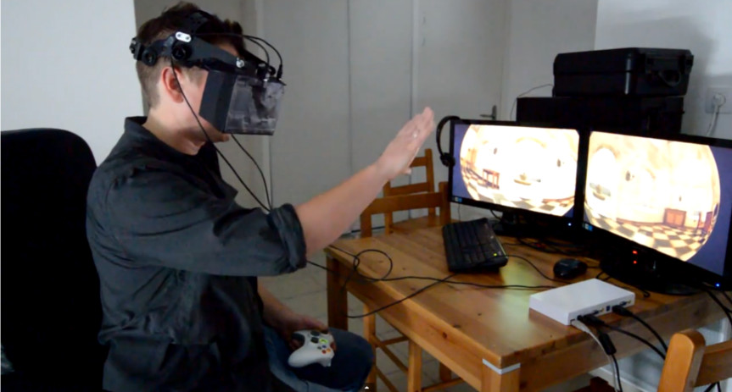
Fully immersive
Equipped with a Head Mounted Display (HMD)
Completely immerse the user's personal viewpoint inside the virtual 3D world.
The user has no visual contact with the physical word.

Slide 7
Mixed Reality (Augmented Reality)
The seamless merging of real space and virtual space.
Integrate the computer-generated virtual objects into the physical world which become, in a sense, an equal part of our natural environment
Example: Pokemon GO

Slide 8
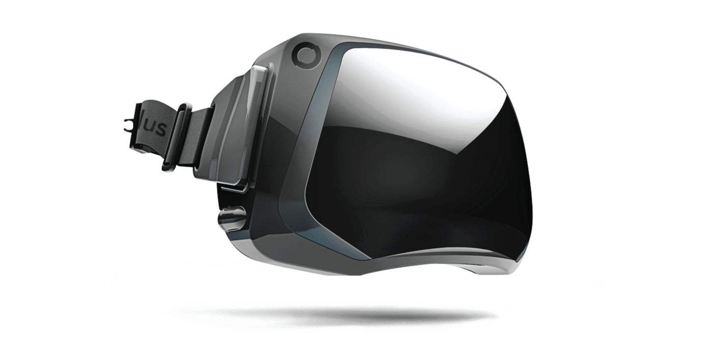
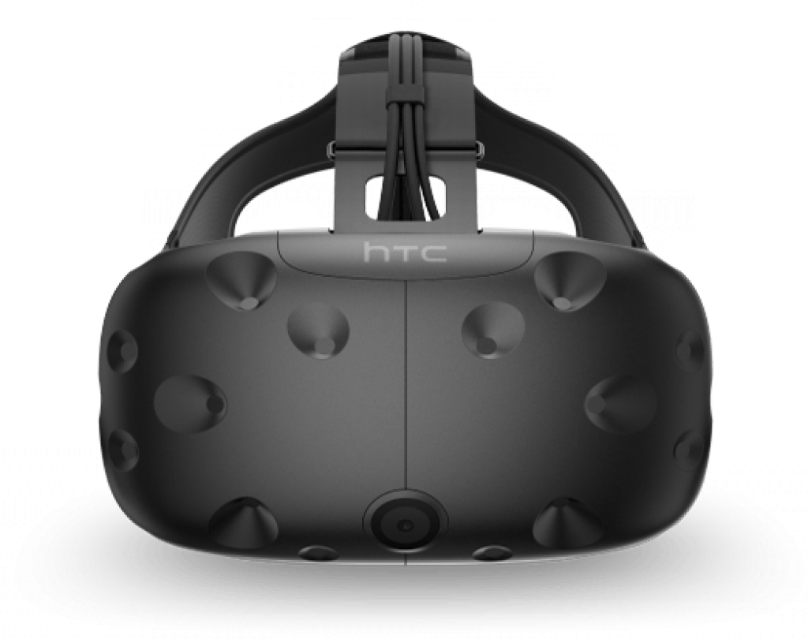
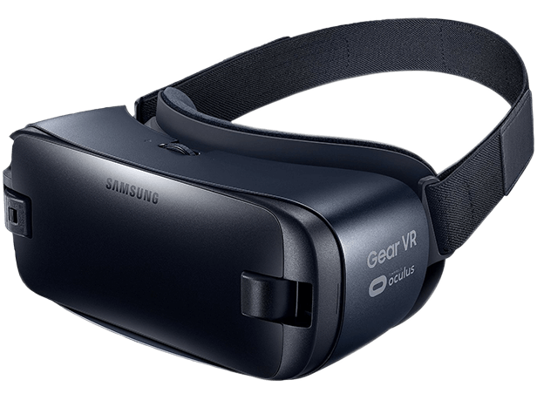
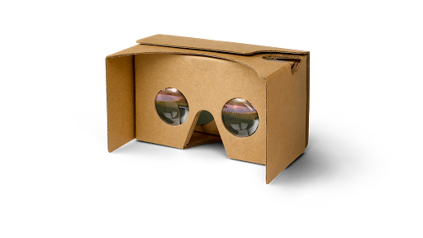
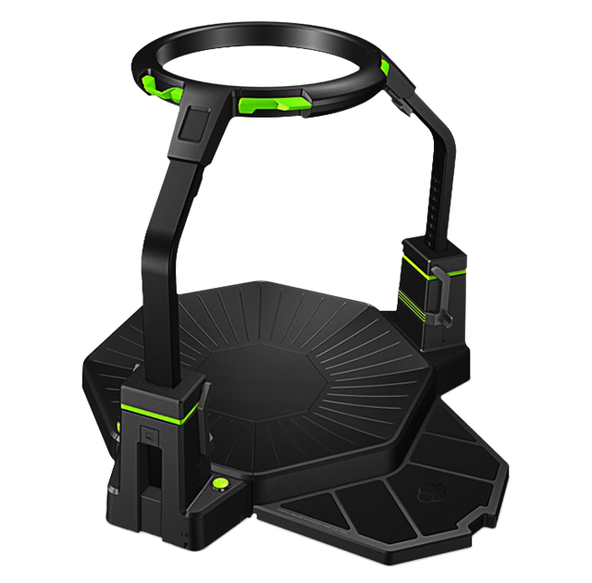
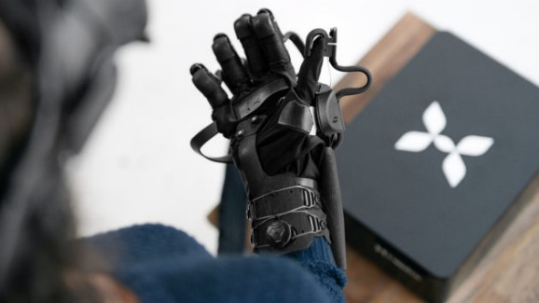
Types of Virtual Reality Devices
Oculus Rift
HTC Vive
Samsung Gear VR
Google Cardboard
Treadmills
Haptic Gloves

Slide 9
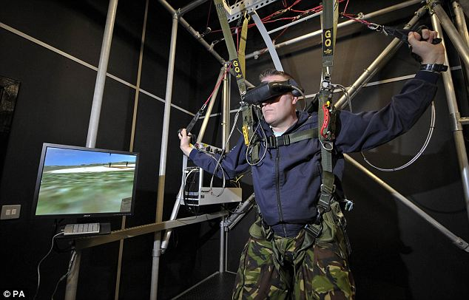
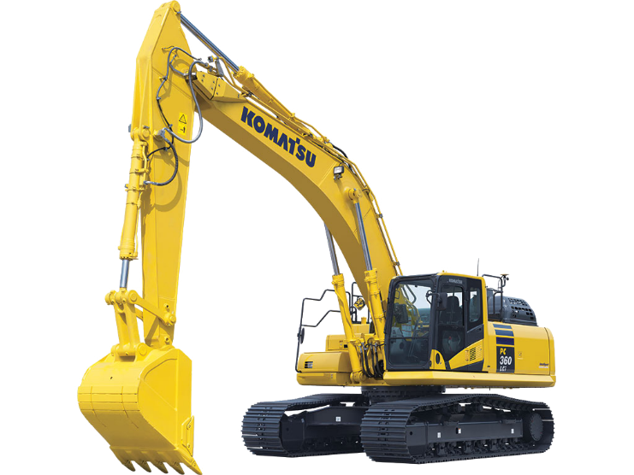
Applications
Training simulations for dangerous situations
Battlefield
Surgery
Flying
Construction machines
Entertainment
Video games
Movies
Immersive education

