Slide 1
Autonomous Vehicle
COMPUTER LITERACY

Slide 2
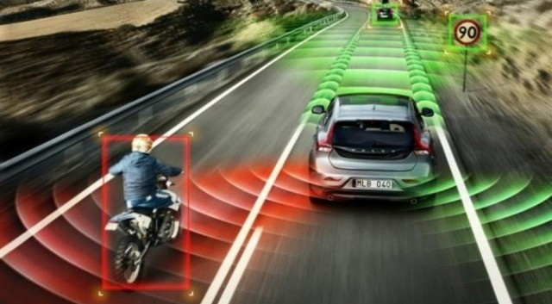
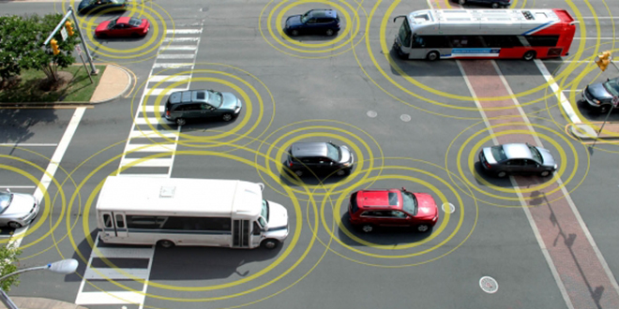
What is an autonomous vehicle?
Autonomous vehicle: a vehicle capable of sensing its environment and navigate without human input

Slide 3
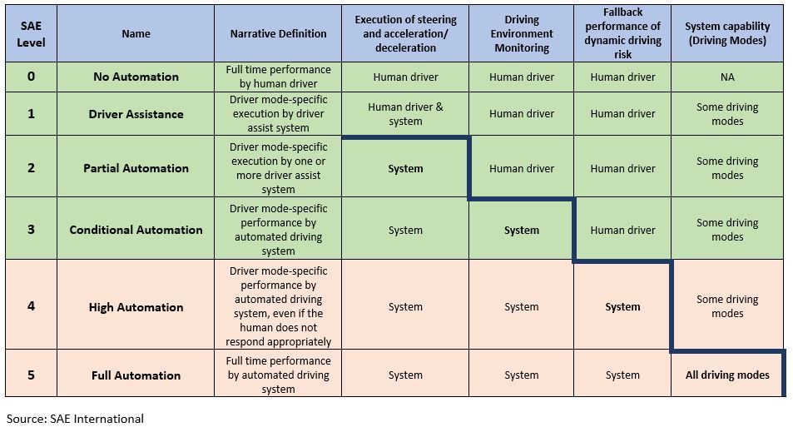
Levels of autonomy
Established by the Society of Automotive Engineers

Slide 4
Dangers of autonomous driving
Trolley problem as an ethical dilemma
Driver override systems: when the car actively ignores driver’s commands
Weaponized vehicles
Life threatening situations could arise from
Computer malfunction
Imperfect GPS causes wrong-turn
Lanes distorted by weather
Driver attention decreases

Slide 5
Future and possible impact of autonomous driving
Less traffic collisions
Less traffic congestion
Higher speed limits
Less expensive car insurance
Parking lots moved further away
Commute time becomes free time
Smarter infrastructure (road signs, traffic lights, lanes…)
Mobility as a service
Liability and other legislation
Decrease in jobs (public transportation, truck drivers, diners, toll-booths)

Slide 6
Other automotive technologies

Slide 7
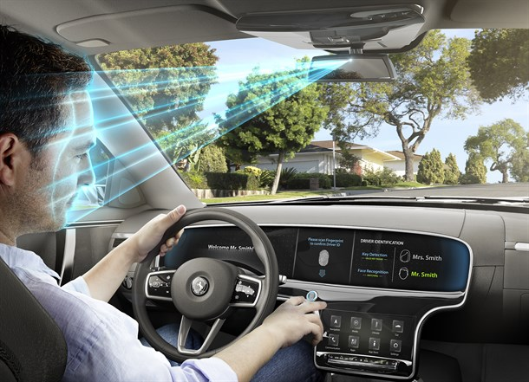
Biometric Vehicle Access
Recognition systems include
Fingerprint
Facial
Voice
Iris

Slide 8
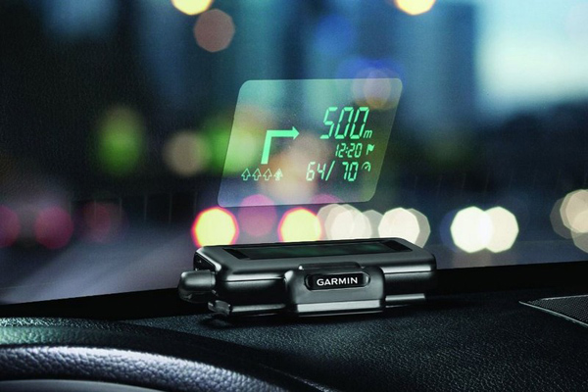
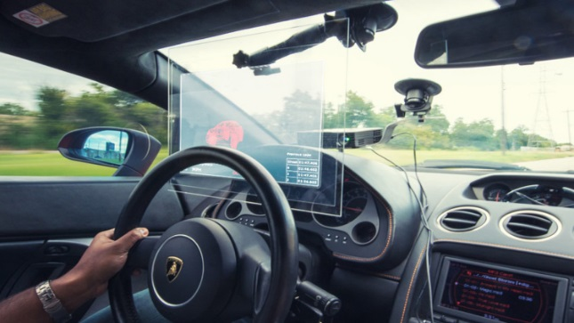
Active Window Displays
Head up displays
Designed by the military for accessing quick glance information while driving.

Slide 9
Remote Vehicle Shutdown
Can be used by truck drivers, taxi cabs, other companies if a unit is under suspicion
Example: TrackNStop
http://www.tracknstop.com/
Can also be used by bad actors
https://www.youtube.com/watch?v=MK0SrxBC1xs

