Slide 1
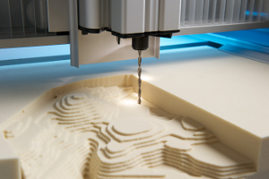
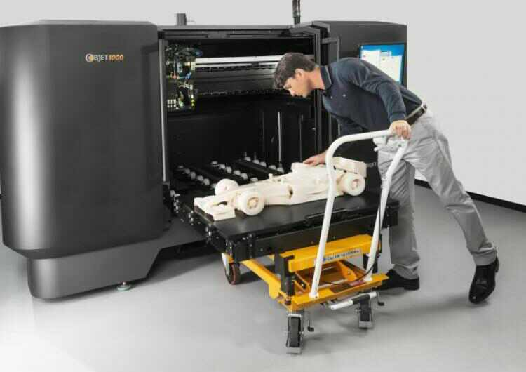
3D Printing
COMPUTER LITERACY

Slide 2
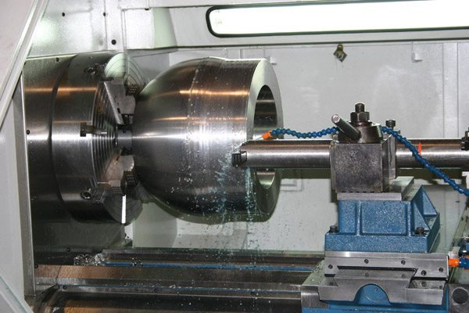
How it differs from traditional manufacturing
Traditional methods involve subtractive methods or moulding/casting processes
Can result in waste
For example, CNC Machining
Remove layer by layer
3D Printing is additive manufacturing
Production is carried out layer by layer in an additive process
3D Printer
Physical object
3D digital model

Slide 3
A Brief History
1980s
First patent for rapid prototyping technology
1990s
Manufacturing split into two sections
Late 2000s
Attempt to reach a wider audience
First system under $10,000
RepRap: a self replicating system
High end section is very expensive and geared for high value and complex parts.
Concept modeler section keeps improving concepts of prototyping.
First system under $5,000

Slide 4
How does 3D Printing Affect the world?
Medical procedures
Advances in research
Product prototyping
Historic Preservation
Architectural Engineering / Construction
Advanced Manufacturing
Food Industries
Automotive
Accessories

Slide 5
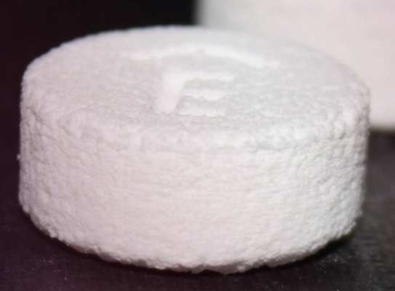
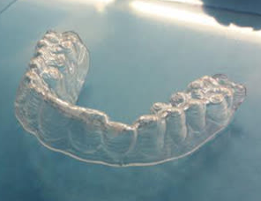
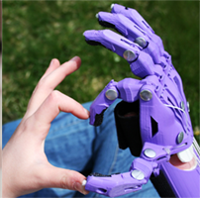
Medical Procedures
Custom hearing aids, braces, splints
Drugs: Spritam is the first FDA approved 3D printed drug
Body parts, including ears, hips and even organs, in exact proportions to fit the patient.
2012: Surgeons successfully implanted an entire titanium jaw, made with 3D printing, in an elderly woman.
2014: Surgeons replaced the entire top of a woman’s skull with a customized print implant
Low cost prosthetics
https://www.youtube.com/watch?v=WoZ2BgPVtA0

Slide 6
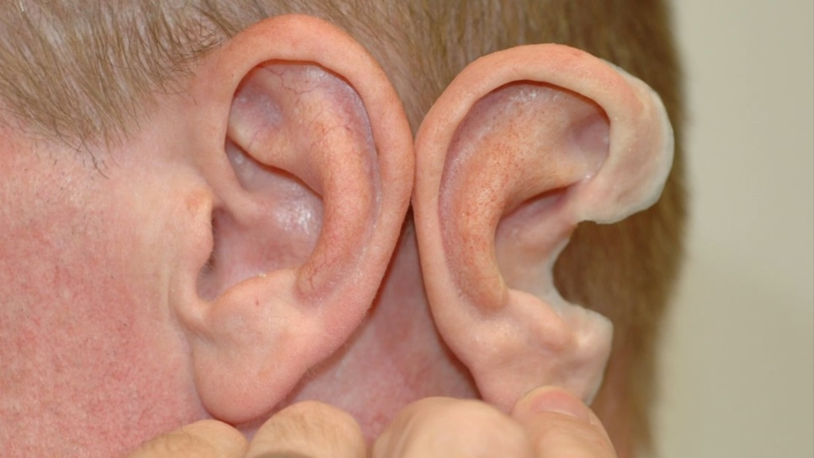
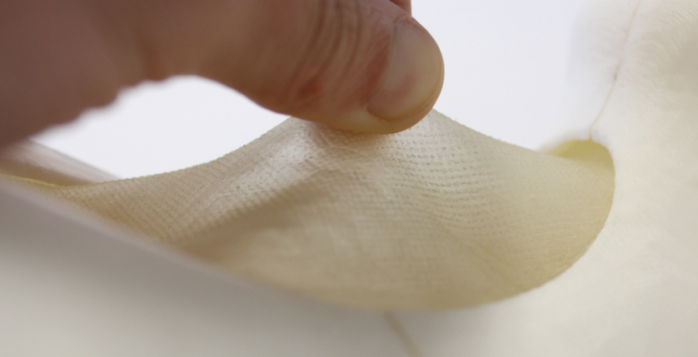
Other Biomaterials
Blood vessels: https://www.youtube.com/watch?v=9VHFlwJQIkE
Bones
Heart Valve
Ears
Skin
Synthetic organs

Slide 7
Advanced Manufacturing
Airbus would like to make a 3D printer that is large enough to make planes from the ground up – a hangar-size printer as large as 80m x 80m.
Made In Space is a US company experimenting with zero-gravity 3D printing.
Print objects as needed in space
Save valuable weight at launch
NASA has been looking at 3D printing for some time now, and considering the technology for long missions.
Astronauts could create their own equipment during the trip.

Slide 8
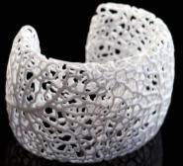
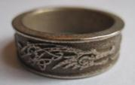
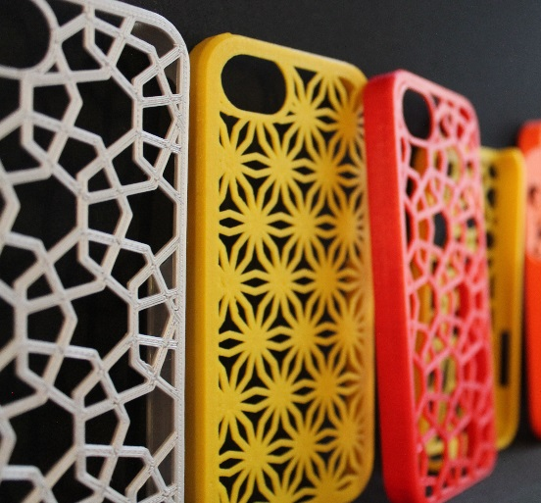
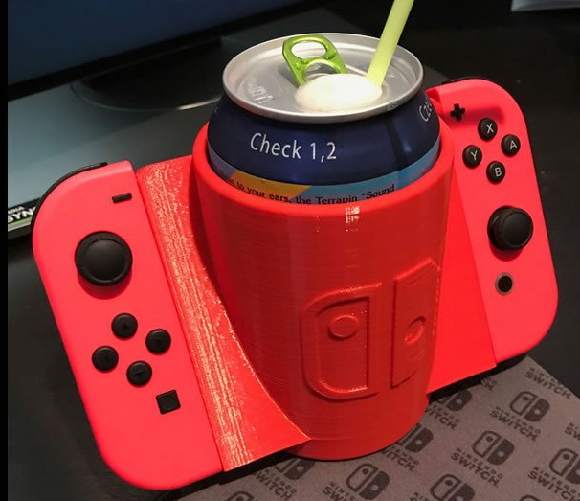
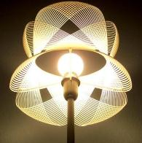
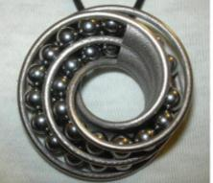
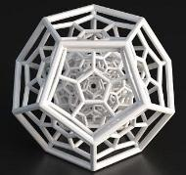
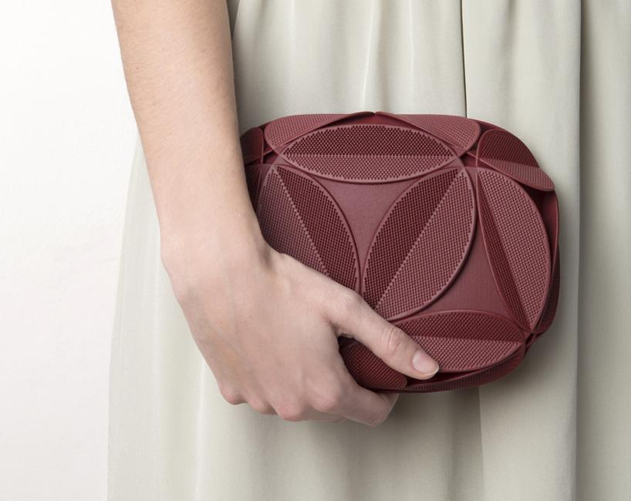
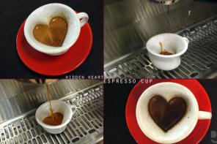
Accessories

Slide 9
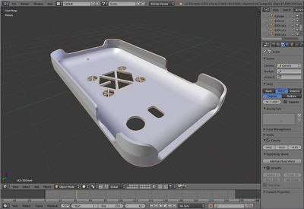
How it works
Start with a 3D digital model
3D CAD
Blender
TinkerCAD
3D Scanner
Model is sliced into layers
3D printer processes material and layers it, binding layers based on the type of material and process used
Functional plastics
Metals
Ceramics
Sand
Bio materials
Food

Slide 10
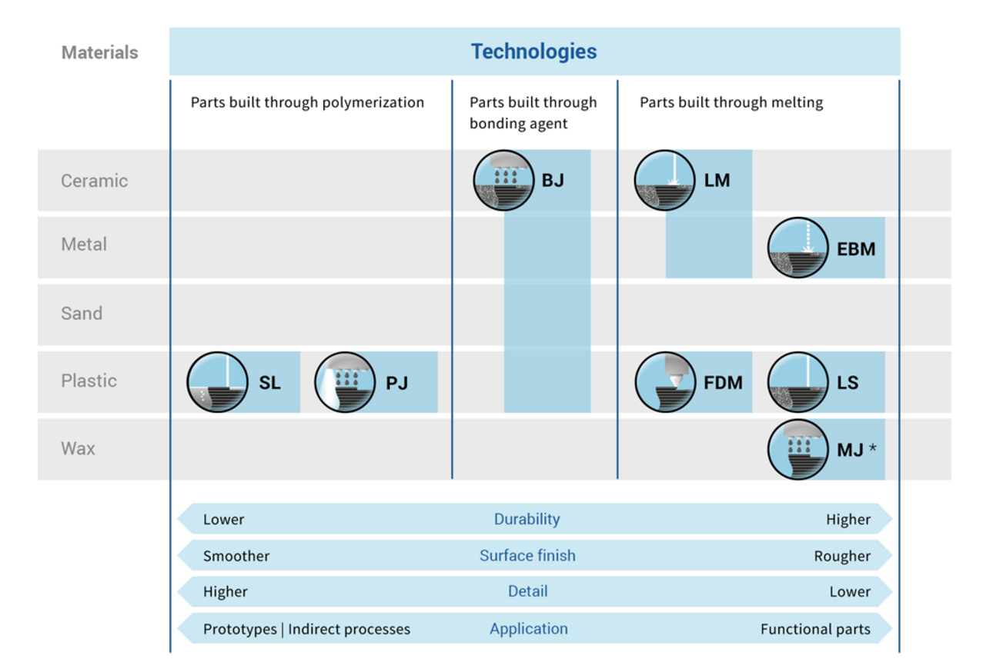
3D Printing Technologies
Fused Deposition Modeling (FDM)
Stereo lithography (SL)
Selective Laser Sintering (LS)
Selective Laser Melting (LM)
Binder Jetting (BJ)
Material Jetting / Wax Casting (MJ)
Electron Beam Melting (EBM)
Laminated Object Manufacturing (LOM)

Slide 11
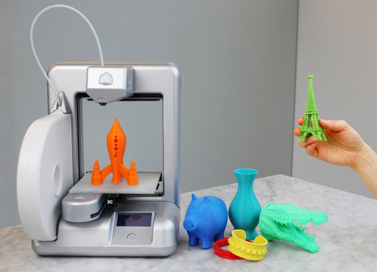
Fused Deposition Modeling (FDM)
Most common 3D printing method used in desktop 3D printing
A plastic filament is melted and extruded through a nozzle
Parts are built by laying down layer-by-layer
https://youtu.be/cyXHHEfOAaA

Slide 12
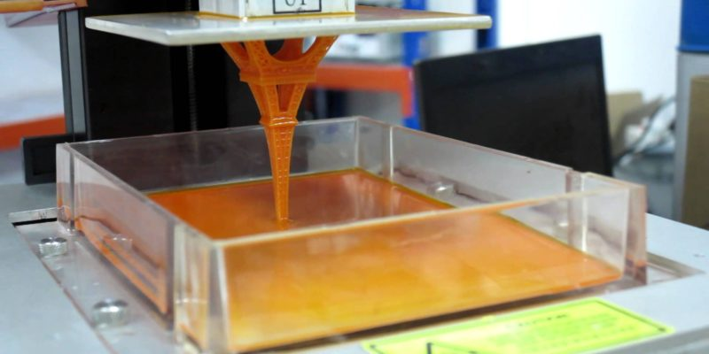
Stereolithography (SLA)
A UV laser is curing a liquid photopolymer in a vat
The part is built by lowering the build platform into the vat
https://youtu.be/yW4EbCWaJHE

Slide 13
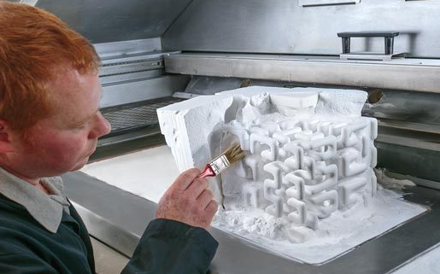
Selective Laser Sintering (SL)
A thin layer of plastic powder is selectively melted by a laser
Parts are built up layer by layer in the powder bed.
High durability, rough finish, less detailed
https://youtu.be/wdRswasftfI

Slide 14
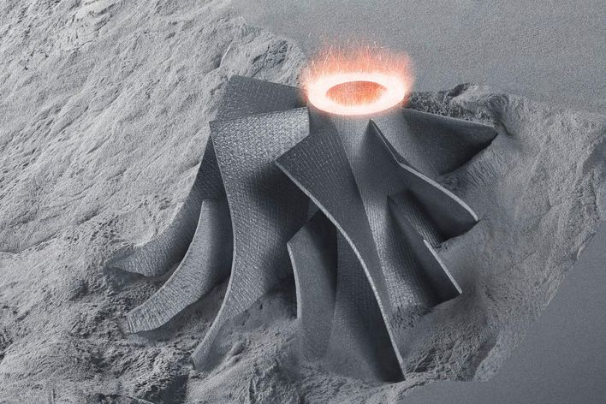
Selective Laser Melting (LM)
A thin layer of metal powder is selectively melted by a laser
Parts are built up layer by layer in the powder bed.
https://www.youtube.com/watch?v=te9OaSZ0kf8

Slide 15
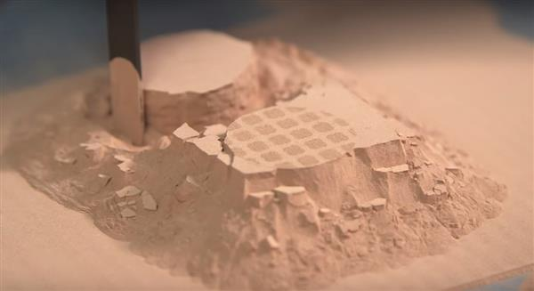
Binder Jetting
Injket print heads apply a liquid bonding agent onto thin layers of powder
Part is build up layer by layer by gluing the particles together
https://www.youtube.com/watch?v=eX8sv9gXpqc

Slide 16
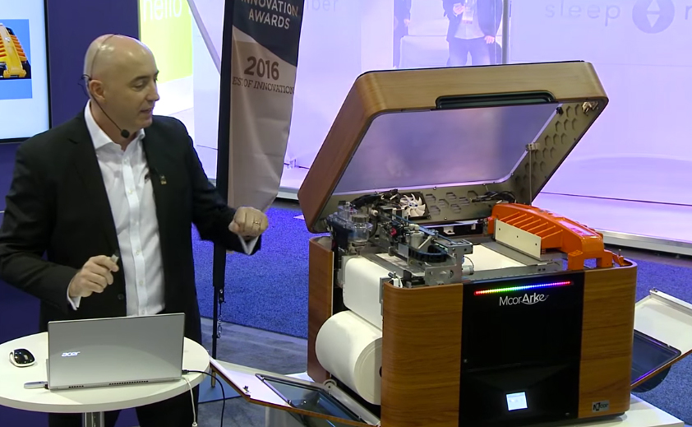
Laminated Object Manufacturing (LOM)
A standard 2D inkjet printer is used for each paper layer.
Layers are pressed together via a heat plate.
https://www.youtube.com/watch?v=Nkj6yrqfnSs

