Slide 1
Graphs
1843
ORD
SFO
802
337
1743
LAX
1233
DFW

Slide 2
Outline / Reading
Graphs (6.1)
Definition
Applications
Terminology
Properties
ADT
Data structures for graphs (6.2)
Edge list structure
Adjacency list structure
Adjacency matrix structure

Slide 3
Graph
A graph is a pair (V, E), where
V is a set of nodes, called vertices
E is a collection of pairs of vertices, called edges
Vertices and edges are positions and store elements
Example:
A vertex represents an airport and stores the three-letter airport code
An edge represents a flight route between two airports and stores the mileage of the route
849
PVD
1843
ORD
142
SFO
802
LGA
337
1743
1387
HNL
2555
1099
LAX
1233
DFW
1120
MIA

Slide 4
Edge Types
Directed edge
ordered pair of vertices (u,v)
first vertex u is the origin
second vertex v is the destination
e.g., a flight
Undirected edge
unordered pair of vertices (u,v)
e.g., a flight route
Directed graph
all the edges are directed
e.g., flight network
Undirected graph
all the edges are undirected
e.g., route network
ORD
flight
AA 1206
PVD
ORD
849
miles
PVD

Slide 5
Applications
Electronic circuits
Printed circuit board
Integrated circuit
Transportation networks
Highway network
Flight network
Computer networks
Local area network
Internet
Web
Databases
Entity-relationship diagram
Notes:
Routing traffic (cell phone towers, internet traffic, car traffic)
Finding influential nodes (social network, terrorist network)
Spread (of disease, of disinformation)

Slide 6
Terminology
End vertices (or endpoints) of an edge
U and V are the endpoints of a
Edges incident on a vertex
a, d, and b are incident on V
Adjacent vertices
U and V are adjacent
Degree of a vertex
X has degree 5
Parallel edges
h and i are parallel edges
Self-loop
j is a self-loop
V
a
b
h
j
U
d
X
Z
c
e
i
W
g
f
Y

Slide 7
Terminology (cont.)
Path
sequence of alternating vertices and edges
begins with a vertex
ends with a vertex
each edge is preceded and followed by its endpoints
Simple path
path such that all its vertices and edges are distinct
Examples
P₁=(V,b,X,h,Z) is a simple path
P₂=(U,c,W,e,X,g,Y,f,W,d,V) is a path that is not simple
V
a
b
P₁
d
U
X
Z
P₂
h
c
e
W
g
f
Y

Slide 8
Terminology (cont.)
Cycle
circular sequence of alternating vertices and edges
each edge is preceded and followed by its endpoints
Simple cycle
cycle such that all its vertices and edges are distinct
Examples
C₁=(V,b,X,g,Y,f,W,c,U,a,↵) is a simple cycle
C₂=(U,c,W,e,X,g,Y,f,W,d,V,a,↵) is a cycle that is not simple
V
a
b
d
U
X
Z
C₂
h
e
C₁
c
W
g
f
Y

Slide 9
Properties
Notation
n number of vertices
m number of edges
deg(v) degree of vertex v
Property 1. Σ_{v} deg(v) = 2m
Proof: each edge is counted twice
Property 2. In an undirected graph with no self-loops and no multiple edges
m ≤ n (n − 1)/2
Proof: each vertex has degree at most (n − 1)
What is the bound for a directed graph?
Ex: n = 4; m = 6; deg(v) = 3

Slide 10
Main Methods of the Graph ADT
Vertices and edges
are positions
store elements
Accessor methods
aVertex()
incidentEdges(v)
endVertices(e)
isDirected(e)
origin(e)
destination(e)
opposite(v, e)
areAdjacent(v, w)
Update methods
insertVertex(o)
insertEdge(v, w, o)
insertDirectedEdge(v, w, o)
removeVertex(v)
removeEdge(e)
Generic methods
numVertices()
numEdges()
vertices()
edges()

Slide 11
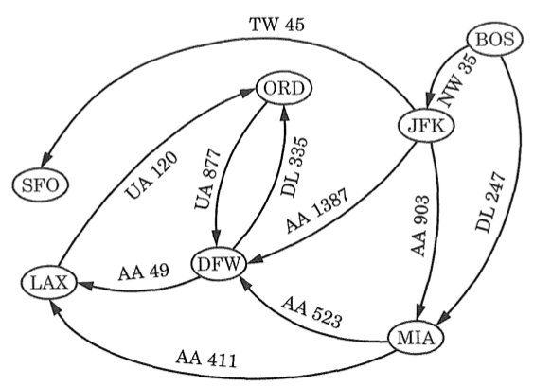
Data Structures
Structures to represent a graph:
Edge List
Adjacency List
Adjacency Matrix

Slide 12
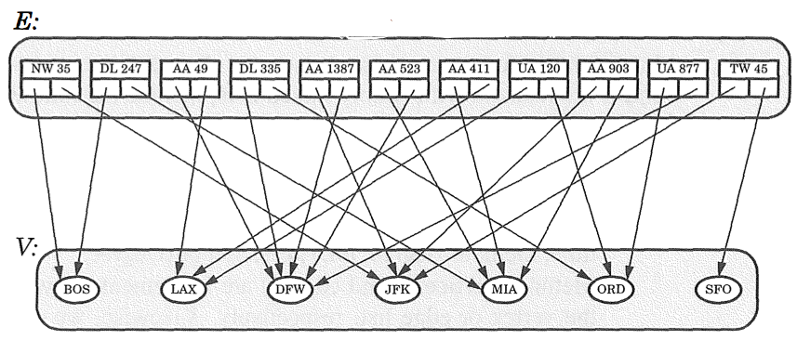
Edge List Structure
A container of edge objects, where each edge object references the origin and destination vertex object

Slide 13
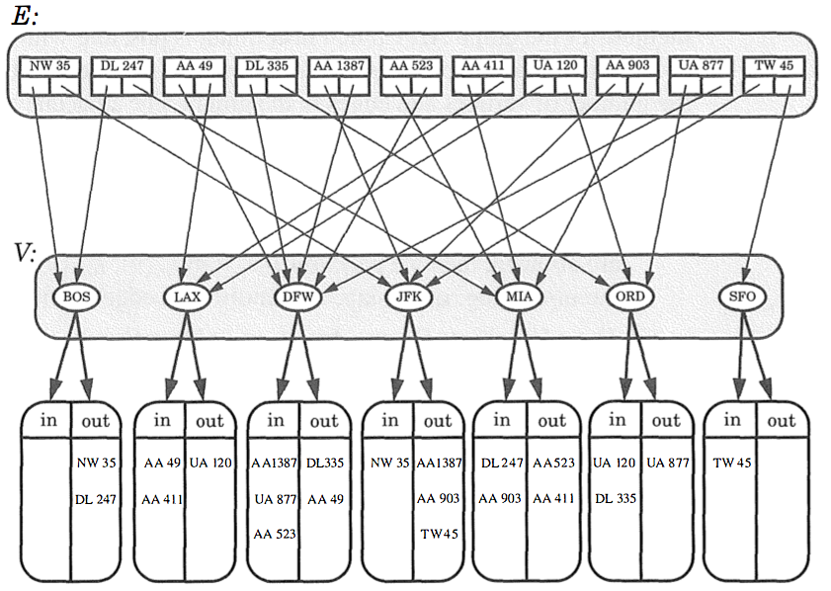
Adjacency List Structure
An edge list structure, where additionally each vertex object v references an incidence container which stores references to the edges incident on v.

Slide 14
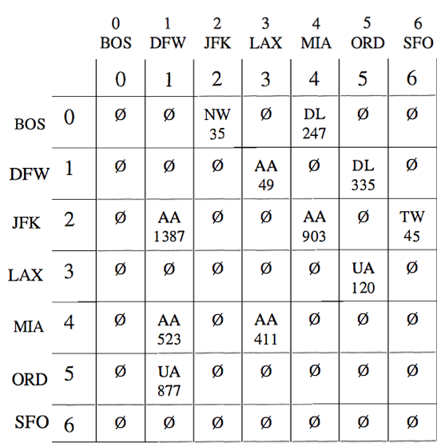
Adjacency Matrix Structure
A 2D array of all vertex pairs, where cell A[u,v] stores edge e incident on vertices u,v if such an edge exists.

Slide 15
Asymptotic Performance
n vertices, m edges no parallel edges no self-loops Bounds are “big-Oh” | Edge List | Adjacency List | Adjacency Matrix
Space | n + m | n + m | n²
incidentEdges(v) | m | deg(v) | n
areAdjacent (v, w) | m | min(deg(v), deg(w)) | 1
insertVertex(o) | 1 | 1 | n²
insertEdge(v, w, o) | 1 | 1 | 1
removeVertex(v) | m | deg(v) | n²
removeEdge(e) | 1 | 1 | 1

