Slide 1
Dependency Update Latency in the Maven Software Ecosystem
Authors: Baltasar Berretta, Gus Thomas, Heather Guarnera

Slide 2



Context
Regular dependency updates protect dependent software components
Upstream bugs
Security vulnerabilities
Poor Code Quality

Slide 3
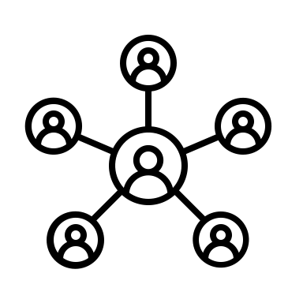
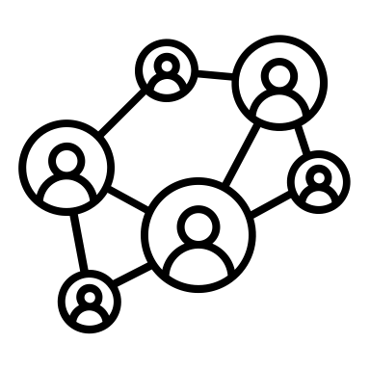

How do we measure dependency updates?
Adoption Lifespan
Adoption Reach
The time span during which a release is being newly adopted
The extent of adoption across the ecosystem
Adoption Lifespan
Original
Release
Version
Adopted

Slide 4
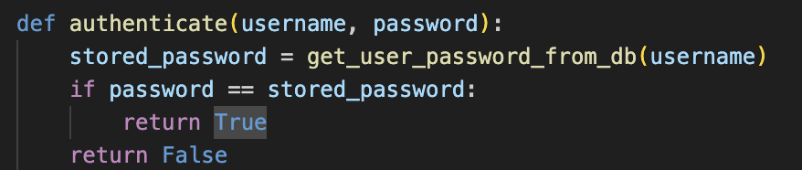
How do we examine correlations between adoption patterns?
Semantic Change
The extent of modifications affecting the meaning or behavior of the code
Version 1.0.1

Slide 5
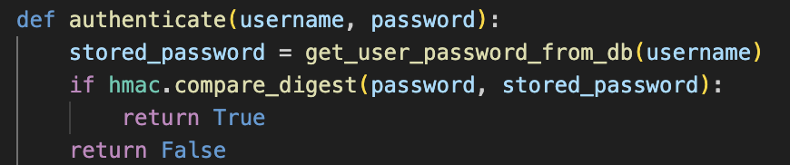

How do we examine correlations between adoption patterns?
Semantic Change
Adoption Patterns
The extent of modifications affecting the meaning or behavior of the code
We have fulfilled the criteria to state research question 1
Version 1.0.2

Slide 6
Research Question 1
How does
Semantic Change
size correlate with
Adoption Patterns
?
Correlations between
Magnitude of semantic change size (major, minor, patch), and
Number of dependents and adoption lifespan

Slide 7
How do we examine correlations between adoption patterns?
Semantic Change
Maintenance Rate
The extent of modifications affecting the meaning or behavior of the code
The relative maintenance rate of upstream packages
Version 1.0.2

Slide 8
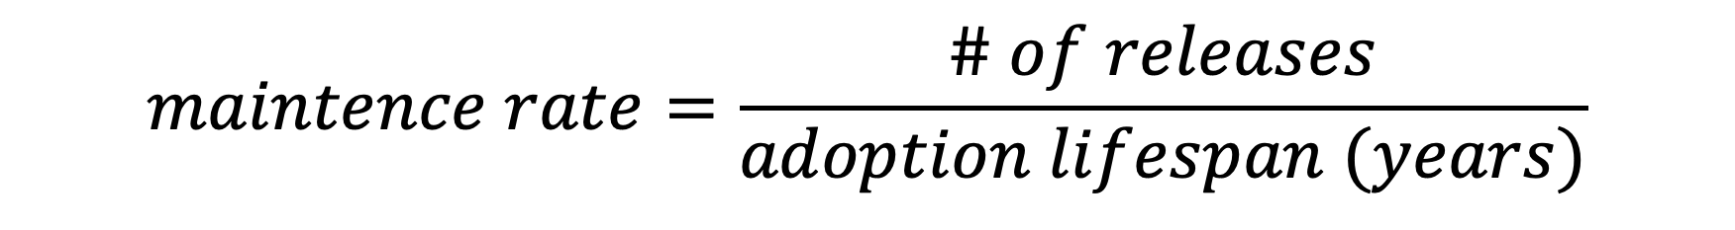
How do we examine correlations between adoption patterns?
Maintenance Rate
Custom metric that quantifies the number of updates
relative to a release’s adoption lifespan
$$maintence rate=\frac{\# of releases}{adoption lifespan (years)}$$

Slide 9
Research Question 2
How does
Maintenance Activity
correlate with
Adoption Patterns
?
Correlations between
Frequency of maintenance activity (high, medium, low) and
Number of dependents and adoption lifespan

Slide 10
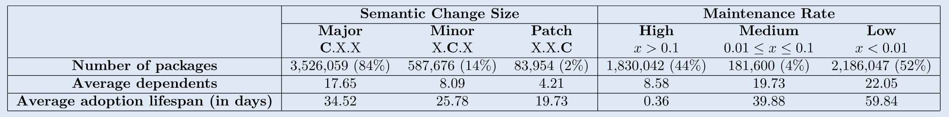
Insights

Slide 11
Insights
Major changes are most common (84%)
Have highest # of average dependents (17)
And longest average adoption lifespan (34 days)

Slide 12
Insights
Minor Changes are less common (14%)
Have fewer average dependents (8)
With a shorter average adoption lifespan (25 days)

Slide 13
Insights
Patch Changes are rarest (2%)
Have the least amount of dependents (4%)
And the shortest adoption lifespan (19 days)

Slide 14
Insights
More than one update every 10 days
44% of packages are high maintenance
Average 8.58 dependents and 0.36-day adoption lifespan.

Slide 15
Insights
One update every 10 to 100 days.
4% of packages are medium maintenance.
Average 19 dependents and 40-day adoption lifespan.

Slide 16
Insights
Fewer than one update every 100 days
52% of packages are low maintenance
Average 22 dependents and 60-day adoption lifespan

Slide 17
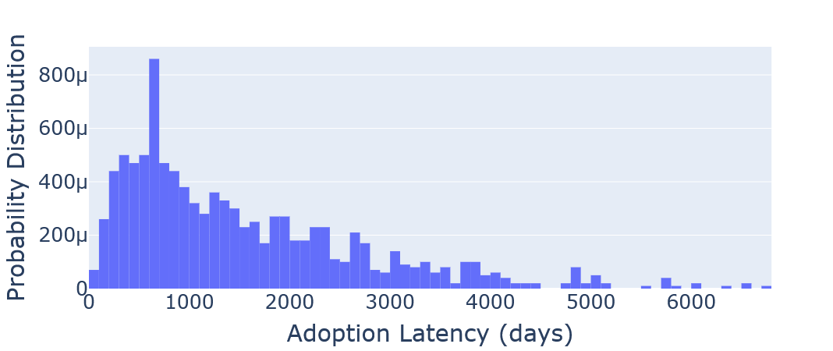
Maven Trends
Figure 1: Probability distribution of adoption lifespan across a sample of Maven packages (N=1,000)
Adoption Latencies
Time between first and last adoption of a package

Slide 18
Maven Trends
Figure 1: Probability distribution of adoption lifespan across a sample of Maven packages (N=1,000)
Modal adoption latency ~ 2 years

Slide 19
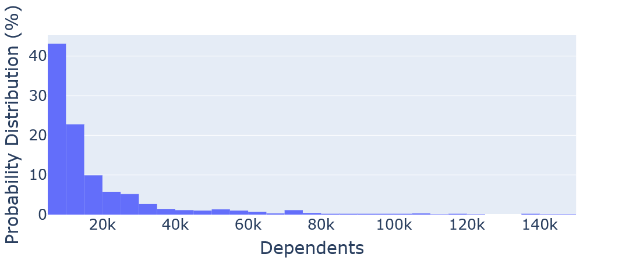
Maven Trends
Figure 2: Probability distribution of number of dependents across a sample of Maven packages (N=1,000)
Number of dependents is exponentially distributed
Number of Dependents
Total number of releases that are dependent on a project

Slide 20
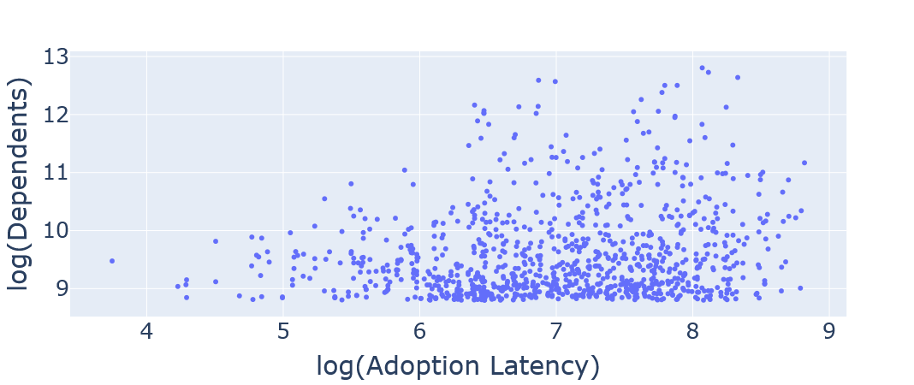
Maven Trends
Figure 4: Logarithm of dependent number as a function of the logarithm of adoption lifespan
Adoption latency is loosely correlated with number of dependents
Dependent-Latency Correlation
Number of dependents as a function of adoption latency

Slide 21
Threats to Validity
Dataset sampling: due to infrastructure & query-time constraints for “Maven trends” we only analyzed the 1,000 packages with the highest number of dependents
Semantic versioning compliance the change caused by a release may not be represented according to the versioning convention (i.e. some “patches” may change APIs causing longer adoption times)

Slide 22
Conclusion & Future Work
Maintainers of highly-depended packages should expect longer adoption periods for their major releases
Consumers of highly maintained components should integrate automated dependency update tools
Minor and patches are adopted at the same rate
Tendencies to adopt minor changes?
Larger semantic version changes correlate to longer adoption lifespans
Measuring semantic change size by adoption latency

Slide 23
References
D. Jaime, J. E. Haddad, and P. Poizat, “Goblin: A framework for enriching and querying the Maven Central Dependency Graph,” in Proceedings of the 21st International Conference on Mining Software Repositories, ser. MSR ’24. Association for Computing Machinery, 2024, pp. 37–41. [Online]. Available: https://dl.acm.org/doi/10.1145/3643991.3644879
A. Tsakpinis, “Analyzing maintenance activities of software libraries,” in Proceedings of the 27th International Conference on Evaluation and Assessment in Software Engineering, ser. EASE ’23. New York, NY, USA: Association for Computing Machinery, 2023, p. 313–318. [Online]. Available: https://doi.org/10.1145/3593434.3593474
H. He, R. He, H. Gu, and M. Zhou, “A large-scale empirical study on Java library migrations: prevalence, trends, and rationales,” in Proceedings of the 29th ACM Joint Meeting on European Software Engineering Conference and Symposium on the Foundations of Software Engineering, ser. ESEC/FSE 2021. New York, NY, USA: Association for Computing Machinery, 2021, pp. 478–490. :
https://doi.org/10.1145/3468264.3468571

