Slide 1
Financial Data Forecasting
Can We Predict the Stock Market?
Hu Mengnan, Johnson
3035027447
Notes:
Good morning, everyone. I am Johnson. Today I will introduce to you my project, Financial Data Forecasting, Can We Predict the Stock Market?
Financial forecasting has been gaining long-term interests in the field of finance and many other research areas, like computer science and statistics.
The enormous historical data provided by historical stock prices, suggest a great potential in data mining.

Slide 2
SUMMARY
Introduction
Methods
Progress
Conclusion
Notes:
The presentation will go as follows. I will first give an introduction of my project, then go through the methods that will be used. The current progress and conclusion will be given at the end of the presentation.

Slide 3

1
INTRODUCTION
Eugene Fama
2013 Nobel Prize Winner
Efficient Market Hypothesis
Notes:
Predicting market can be hard. The Efficient Market Hypothesis, put forth by Nobel winning economist Eugen Fama, asserts that the predictability relies heavily on the market efficiency. So the purpose of the project is to create a stock prediction model for emerging markets, like China, and predict the direction of future, and compare the result to the efficient market like US.

Slide 4
1
1.1
Prediction Methods
Fundamental Analysis
Concentrate on the company
Technical Analysis
Study the price pattern
Notes:
There are mainly two methods for predicting the stock prices, fundamental analysis and technical analysis. The fundamental analysis cares more about the company itself rather than the actual stock, and the technical analysis studies the past patterns of the stock and makes predictions based on them. In this project, I will focus on the technical analysis due to the limitation of time.

Slide 5
1
1.1
Prediction Methods
Assumptions of Technical Analysis
Market action discounts everything
Price moves in trends
History repeats itself
Notes:
There are mainly two methods for predicting the stock prices, fundamental analysis and technical analysis. The fundamental analysis cares more about the company itself rather than the actual stock, and the technical analysis studies the past patterns of the stock and makes predictions based on them. In this project, I will focus on the technical analysis due to the limitation of time.

Slide 6
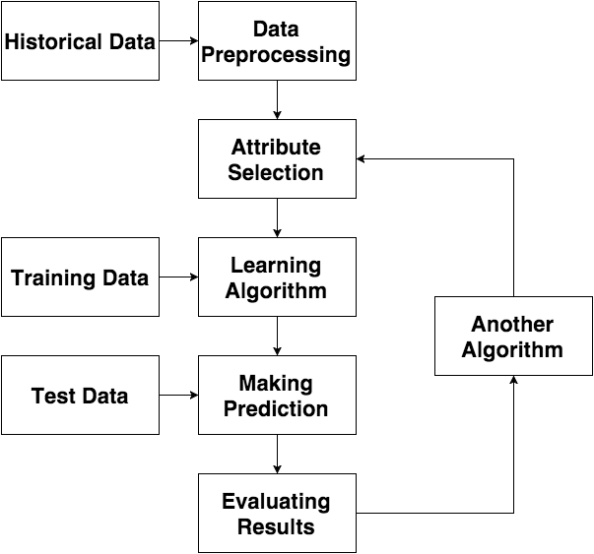
1.2
Project Flow
Notes:
This diagram shows the whole flow of the project,

Slide 7
1.3
Language Chosen
Python
Advantages
simple and clear syntax
open-source and popular
Drawbacks
not as fast as C++/Java
Notes:
This diagram shows the whole flow of the project,

Slide 8
2
METHODOLOGY
Technical Indicators
Machine Learning Techniques
Notes:
The main idea is to use technical indicators to generate features and implement machine learning techniques to train models.

Slide 9
2.1
Technical Indicators
Feature Name | Description
TSF | Time Series Forecast
STDDEV | Standard Deviation
ADOSC | Chaikin A/D Oscillator
ADX | Average Directional Movement Index
MACD | Moving Average Convergence/Divergence
MFI | Money Flow Index
MOM | Momentum
RSI | Relative Strength Index
TRIX | 1-day Rate-Of-Change (ROC) of a Triple Smooth EMA
ATR | Average True Range
Notes:
Indicators help identify momentum, trends, volatility and various other aspects in a security to aid in the technical analysis of trends, and provide an extremely useful source of additional information

Slide 10
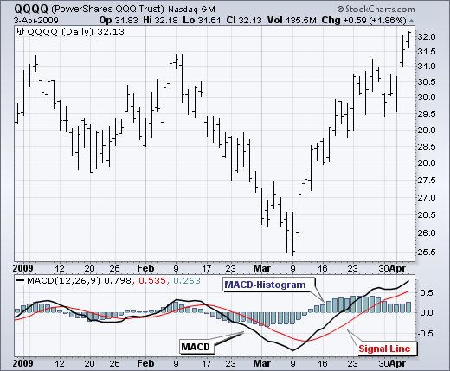
2.1
Technical Indicators
$$MACD=26 day EMA −12 day EMA$$
Notes:
The moving average convergence divergence(MACD) is comprised of two exponential moving averages. It compares short-term momentum and longer term momentum to help identify the current direction of momentum.

Slide 11
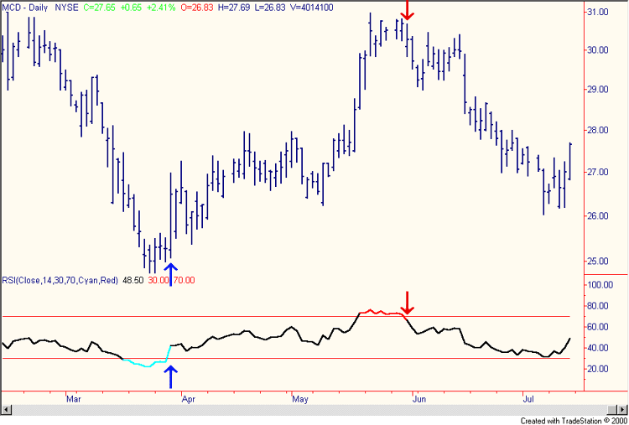
2.1
Technical Indicators
$$RSI=\frac{100}{1+RS} RS=\frac{Average Gain}{Average Loss}$$

Slide 12
2.2
ML Techniques
Support Vector Machine
k-Nearest Neighbor
Random Forest
Linear Discriminant Analysis
Quadratic Discriminant Analysis

Slide 13
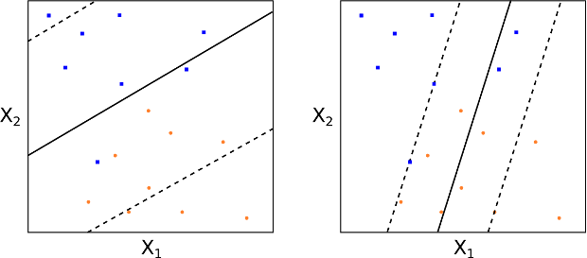
2.2
ML Techniques
SVM: Soft Margin Classification
Notes:
support vector machines (SVMs, also support vector networks^{[1]}) are supervised learning models with associated learning algorithms that analyze data and recognize patterns,

Slide 14
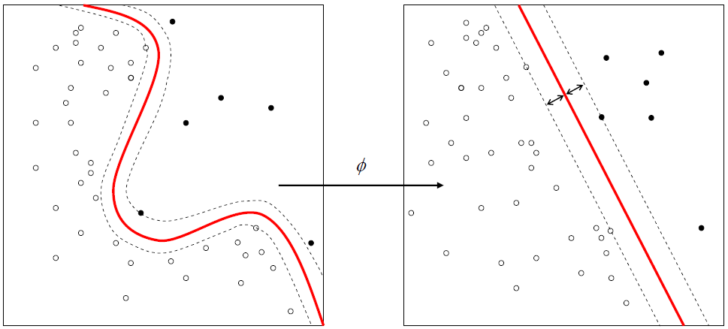
2.2
ML Techniques
SVM: Kernel Function
Notes:
perform a non-linear classification using what is called the kernel trick

Slide 15
3
Progress
Task | Data Accessing | Data Analyzing | Feature Generation | Model Selection | Results Evaluation
Progress | Completed | Completed | Completed | Completed | In Progress
Completed Date | 9th Oct 2015 | 20th Oct 2015 | 8th Nov 2015 | 15nd Nov 2015 | 30th Nov 2015

Slide 16
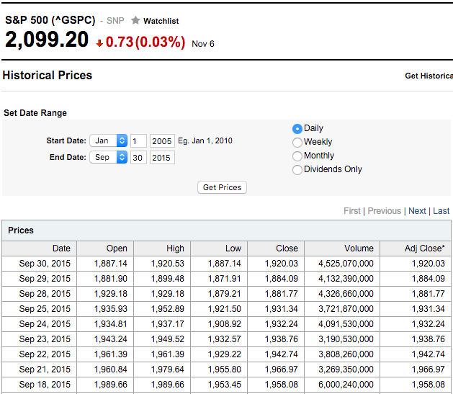
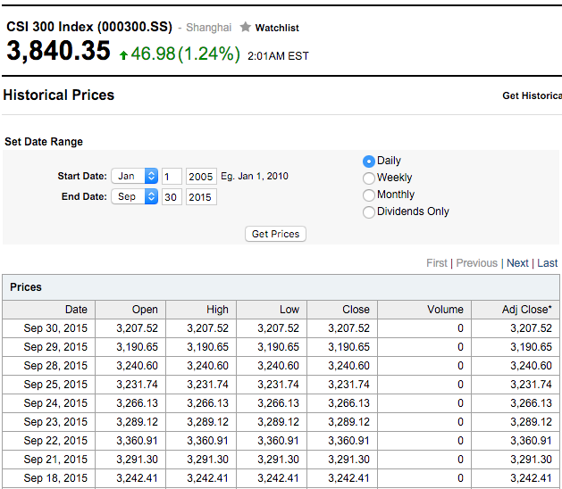
3.1
Data Accessing
(Source from Yahoo Finance)
Notes:
This is a screenshot of Yahoo Finance website showing a subset of S&P500 and CSI300 historical prices, and that is where the data came from.

Slide 17
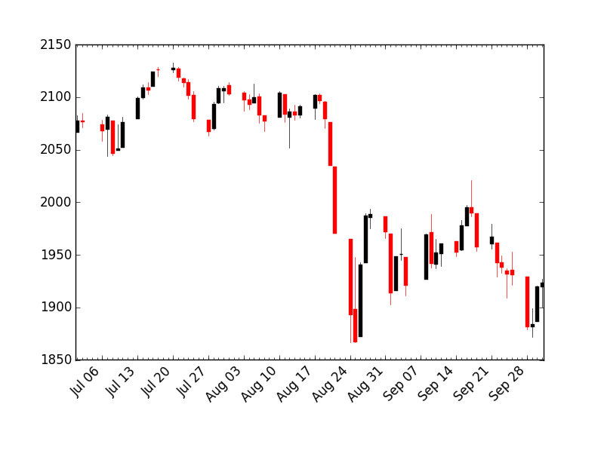
3.1
Data Accessing
Candlestick Plot of S&P 500 from 01/07/2015 to
01/10/2015
Notes:
Candlestick Plot of S&P 500 from 01/07/2015 to
01/10/2015

Slide 18
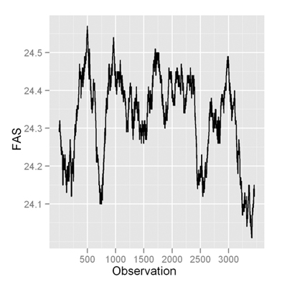
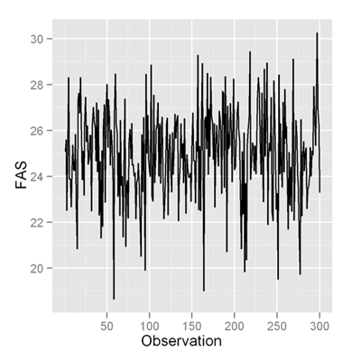
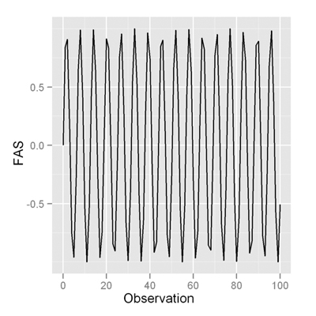
3.2
Data Analyzing
Hurst Exponent
H<0.5 - The time series is mean reverting
H=0.5 - The time series is a Geometric Brownian Motion
H>0.5 - The time series is trending
Notes:
In an anti-persistent time series (also known as a mean-reverting series) an increase will most likely be followed by a decrease or vice-versa. In a Brownian time series (also known as a random walk or a drunkard’s walk) there is no correlation between the observations and a future observation. In a persistent time series an increase in values will most likely be followed by an increase in the short term and a decrease in values will most likely be followed by another decrease in the short term.

Slide 19
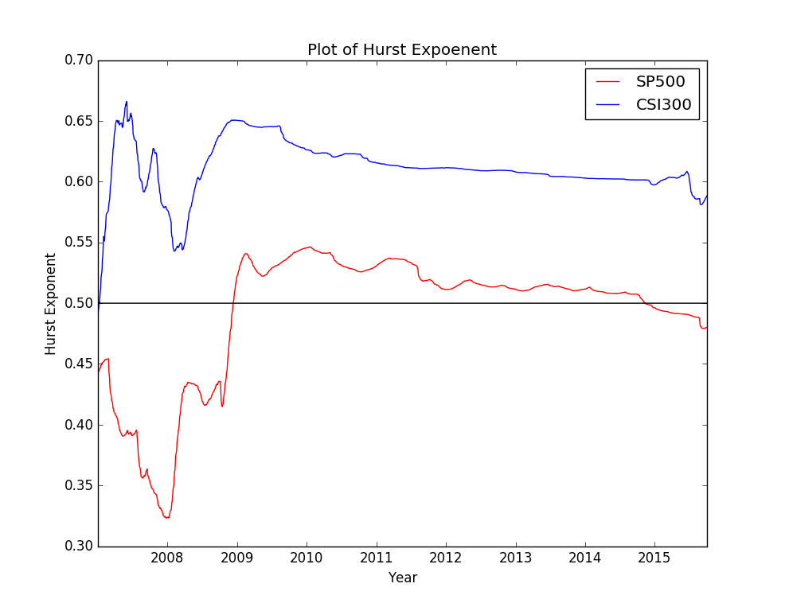
3.2
Data Analyzing

Slide 20
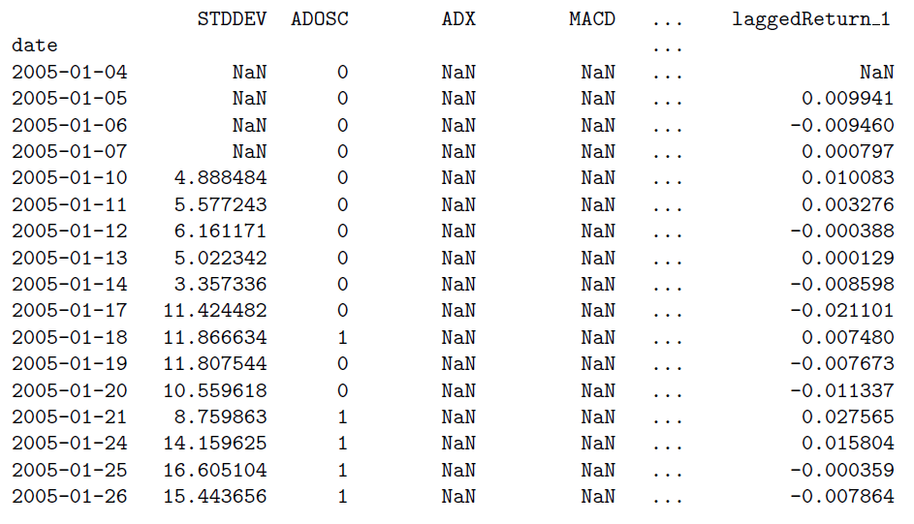
3.2
Feature Generation
10 indicators and 9 lagged returns
Notes:
simplification of models to make them easier to interpret
shorter training times,
enhanced generalization by reducing overfitting

Slide 21
3.2
Feature Generation
Why Feature Selection?
Easy to interpret
Shorter training times
Reducing overfitting
Notes:
simplification of models to make them easier to interpret
shorter training times,
enhanced generalization by reducing overfitting

Slide 22
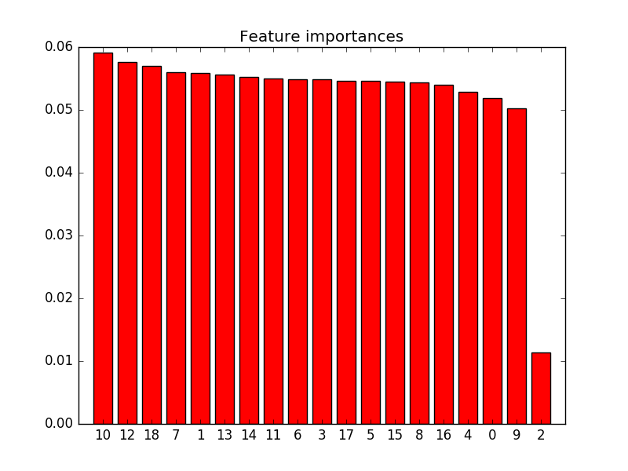
3.2
Feature Generation
Less important: ADOSC

Slide 23
3.3
Model Selection
Target
Price Movement Next Day
Evaluation Criteria
Area Under the Curve (AUC)
Evaluation Period
From 2014/01/01 to 2015/09/29
Notes:
percentage of misclassified events counted

Slide 24
3.3
Model Selection
Models | CSI300 | S&P500
RF | 0.53864168618266 | 0.50341685649202
KNN | 0.50819672131147 | 0.47835990888382
SVM | 0.54332552693208 | 0.52847380410022
LDA | 0.55269320843091 | 0.52391799544419
QDA | 0.53864168618266 | 0.53758542141230
Initial Result

Slide 25
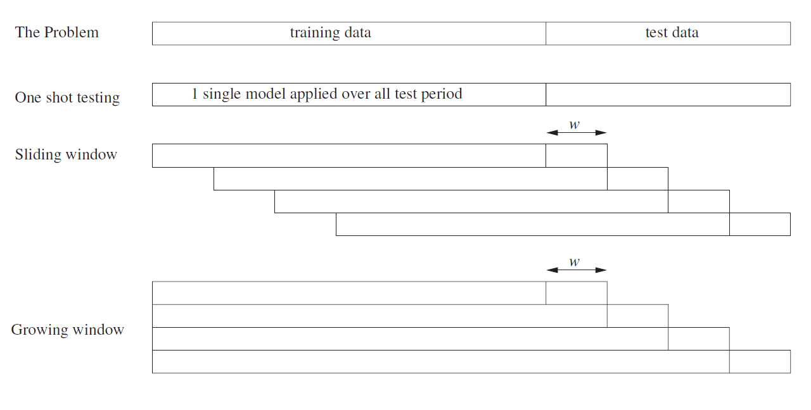
3.3
Model Selection
Time Series Cross Validation Method

Slide 26
3.3
Model Selection
CV of RF on CSI300 | CV of LDA on CSI300
Accuracy on fold 2: 0.545454545455 Accuracy on fold 3: 0.614718614719 Accuracy on fold 4: 0.554112554113 Accuracy on fold 5: 0.614718614719 Accuracy on fold 6: 0.497835497835 Accuracy on fold 7: 0.480519480519 Accuracy on fold 8: 0.554112554113 Accuracy on fold 9: 0.554112554113 | Accuracy on fold 2: 0.575757575758 Accuracy on fold 3: 0.588744588745 Accuracy on fold 4: 0.554112554113 Accuracy on fold 5: 0.640692640693 Accuracy on fold 6: 0.497835497835 Accuracy on fold 7: 0.463203463203 Accuracy on fold 8: 0.52380952381 Accuracy on fold 9: 0.441558441558

Slide 27
3.4
Results Evaluation
Models | CSI300 | S&P500
RF | 0.55194805194805 | 0.504687499999
KNN | 0.52922077922077 | 0.500520833333
SVM | 0.53733766233766 | 0.508333333333
LDA | 0.53571428571428 | 0.500000000000
QDA | 0.53140692640692 | 0.503645833333
Final Result

Slide 28
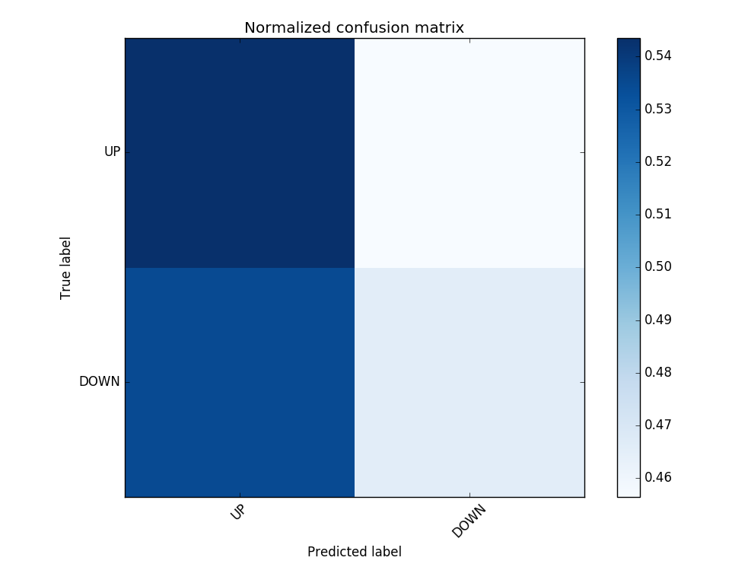
3.4
Results Evaluation
Confusion Matrix of Prediction

Slide 29
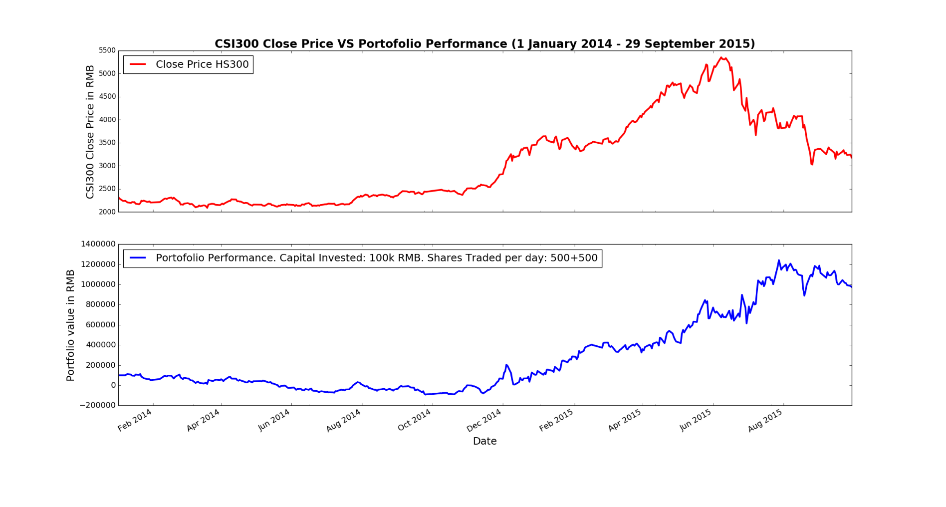
3.4
Results Evaluation

Slide 30
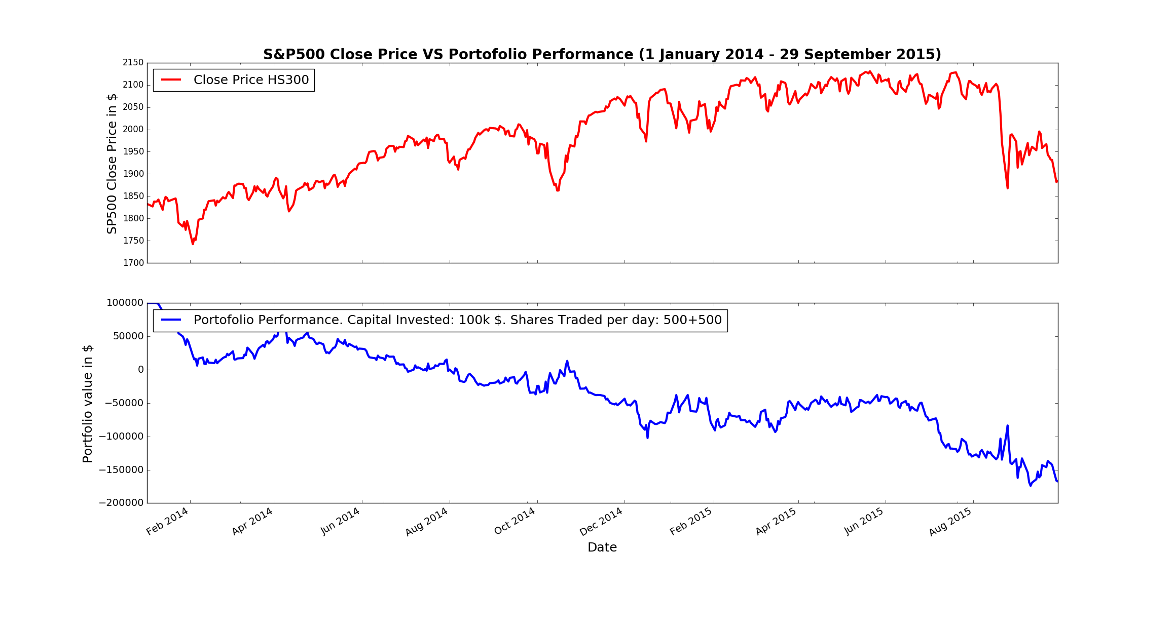
3.4
Results Evaluation

Slide 31
3
CONCLUSION
US stock markets more efficient than Chinese markets
Expected different predicting accuracy
Difficulties and Limitations

Slide 32
Thank You

