Slide 1
Assignment 4 Road Slope From Probe Data
Arun | A20360689
Himanshu | A20365395
Shivani | A20353384
Suraj | A20341126

Slide 2
Aim:
To derive road slope for the links given in the link data file.
Input is the set of map matched points from HW3.
We calculate the slope of links based on the information available in map matched probe points and verify our results against given slope data in link file.
We have retained the structures we had, for storing probe and link data with following changes.
Added a list of probe object type called ProbePoints to link structure
This stores the probe data that were matched to the particular link
Added a state called slope to probe structure
This stores the calculated slope for each probe point.

Slide 3
Understanding the Problem
Raw Probe point
Map matched Probe point

M2
Link Edge
M1
C
Link Node
H2-H1
M
H1
H2
B
D
d
P
E
M1, M2: Map Matched Probe Points
H1, H2: Altitudes of M1 and M2
d: Haversine Distance between M1 and M2
: Required slope angle. Can be calculated by using atan function.
A

Slide 4
Steps Followed
Parse map matched probe data
Find Haversine distance between adjacent probe points
Find altitude difference between adjacent probe points
Using atan(), calculate the slope between adjacent probe points
Consolidate the given slope data available in the link file
Compare the calculated and given slope values
Print and store the results
Convert the slope units from radians to degrees
Calculate mean and cumulative slope for each link

Slide 5
Code Overview
Main Function:
Read and parse the map matched probe data file and link data file, line by line.
Save these data to objects of dedicated structures (link and probe classes), so that data access is easy and efficient.
Now build two lists, one has the link objects and the other has probe data objects
Iterate over the list with probe data and calculate slope of the line joining current probe point and its adjacent (previous) probe point.
Mark the slopes of those points as X for which there is no previous probe point available in the same link.
For other probe points, calculate the slope, by using the information known about the adjacent probe point.

Slide 6
Code Overview
Slope Calculation:
First, we find the Haversine distance between the current probe point and the previous probe point.
Haversine distance provides great-circle distances between two points on a sphere, given their latitudes and longitudes.
aVal = math.sin(dlat/2)**2 + math.cos(lat1) * math.cos(lat2) * math.sin(dlong/2)**2
Distance in km = 6367 * (2 * math.asin(math.sqrt(aVal)))
Then we calculate the difference between the altitudes of current and previous probe points.
We can see that a right-angled triangle can be drawn here with the distance between the adjacent probe points as base, difference in altitude as height and the line joining adjacent probe points tilted by an angle  , as the hypotenuse.
Since we have already calculated the distance and altitude difference, slope (or the ) calculation can be done easily by using the atan function.
Slope () = atan (opposite side/adjacent side)
Hence, Slope () = atan (H2-H1/d)
M2

H2-H1
M1
d

Slide 7
Code Overview
Slope Comparison:
After we get slope at every probe point with the previous probe point, we add the probe data objects to an array in the structure of its matched link.
Then we do one more pass on the new updated link data and consolidate the slope values (find mean slope and cumulative slope) in the matched probe point array.
Mean slope is the average and cumulative slope is the sum of slopes in the probe point array.
We also find the mean of the given slope values (in slopeInfo field) for each link.
At last, we compare the consolidated slopes from the given data and calculated data for each link. We print and save the results.

Slide 8
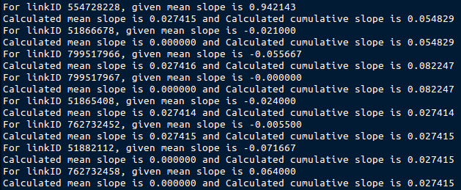
Result:
As we can see, we get some matching slope values when we compare the given and the calculated data.
Our observation from this assignment was that, if we get enough probe points for a link, then we are able to calculate the slope of the link to an acceptable precision.

Slide 9
Questions?!

Slide 10
Thank You!

