Slide 1

Predicting Term Deposit Subscriptions Using Decision Trees and Naïve Bayes By-Harsh Monga Course: Data 101 I performed all programming, analysis, and visualization, and prepared this report independently.

Slide 2
Abstract
This project applies classification techniques to the Bank Marketing dataset from the UCI Machine Learning Repository. The goal was to predict whether a client would subscribe to a term deposit using their demographic and interaction data. I used decision trees (rpart) and Naïve Bayes classifiers to model the dataset. Before modeling, I conducted exploratory analysis to understand the class distribution and feature relationships. The decision tree achieved 90.3% accuracy while Naïve Bayes achieved 87.7%. The tree model better handled feature interactions and imbalances. This analysis highlights the importance of model selection in marketing decision-making.

Slide 3
Introduction
Problem: Predict whether a customer will subscribe to a term deposit
Why it matters: Helps businesses target customers more effectively
Dataset: Bank Marketing dataset (45,211 rows, 17 features)
Target Variable: y (yes/no)
Class imbalance: ~88% “no” vs ~12% “yes”

Slide 4
Materials and Methods
Tools Used: R, rpart, e1071, caret, ggplot2, readr, rpart.plot, dplyr
Data Split: 70% training / 30% testing
Preprocessing:
Converted target to factor
No missing values
Models Applied:
Decision Tree via rpart()
Naïve Bayes via naiveBayes()

Slide 5
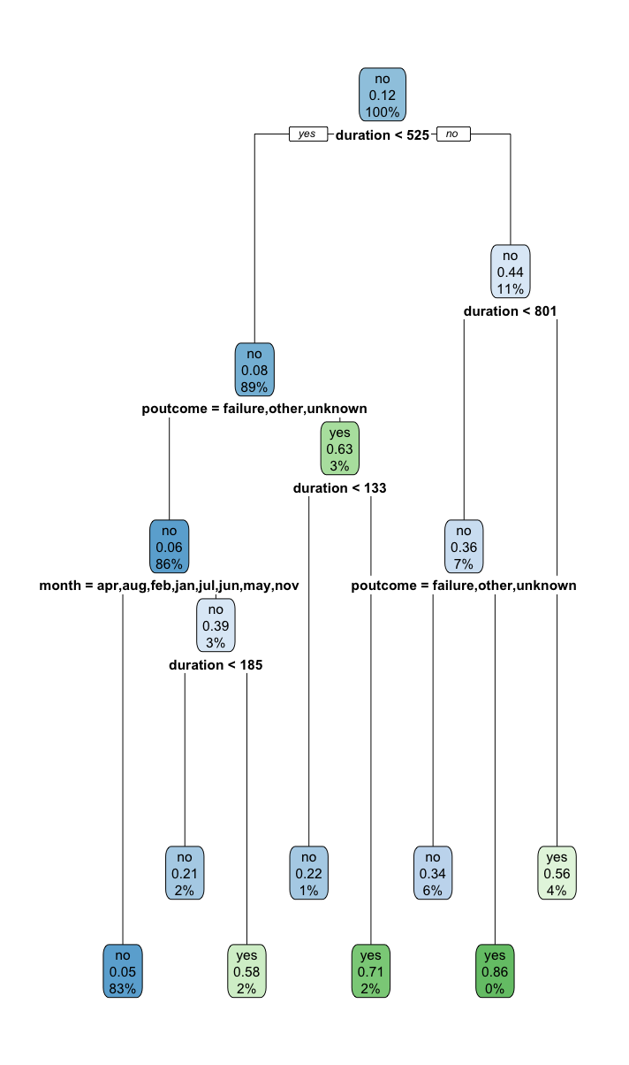
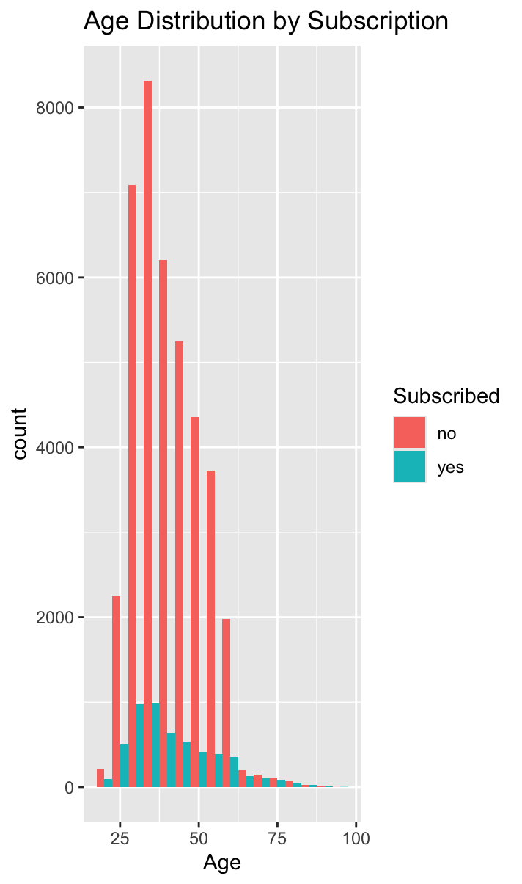
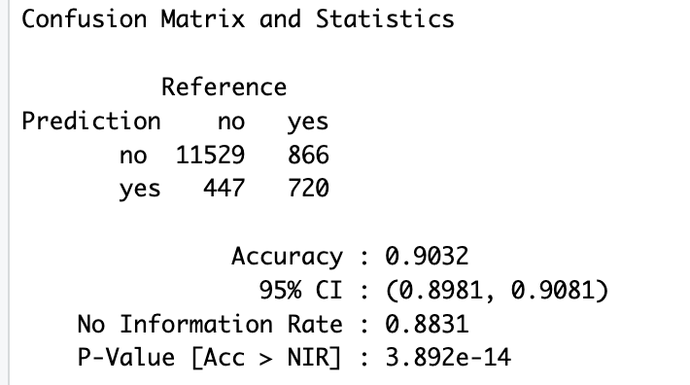
Results (Part 1: Decision Tree)
Accuracy: 90.3%
Sensitivity: 96.3%
Specificity: 45.4%
Observation: High sensitivity but lower specificity → good at predicting "no", less at "yes”
The decision tree shows that call duration and prior campaign outcome (poutcome) are key predictors. Clients with shorter calls and no successful past interaction (poutcome = failure, other, unknown) were far less likely to subscribe.

Slide 6
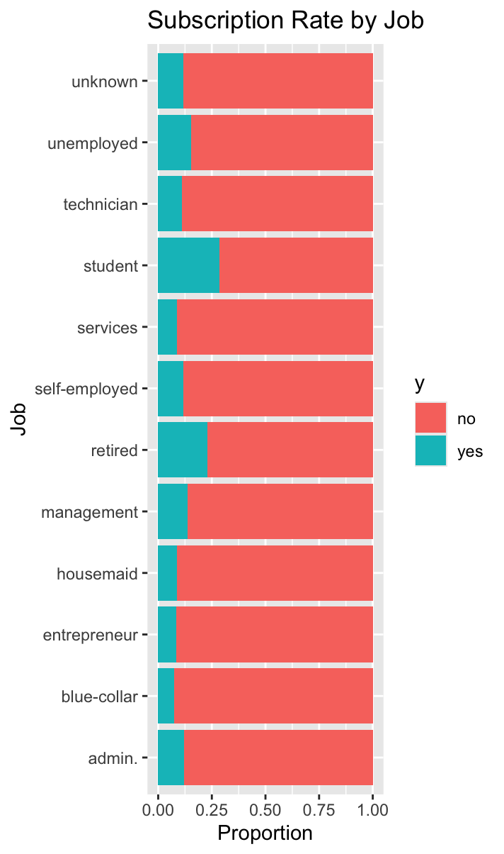
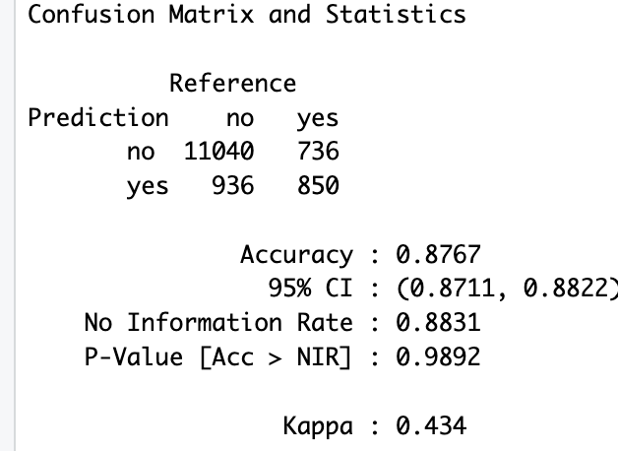
Results (Part 2: Naïve Bayes)
• Observation: Naïve Bayes achieved slightly lower overall accuracy than the decision tree.
• Accuracy: 87.7%, Sensitivity: 92.2%, Specificity: 53.6%
• Compared to the decision tree, this model performed better at identifying “yes” cases but worse at predicting “no.”
• This tradeoff is expected because Naïve Bayes assumes feature independence, which may not hold true in this dataset.
| Model | Accuracy | Sensitivity | Specificity |
|---------------|----------|-------------|-------------|
| Decision Tree | 90.3% | 96.3% | 45.4% |
| Naïve Bayes | 87.7% | 92.2% | 53.6% |

Slide 7
Acknowledgments
UCI Machine Learning Repository for providing the Bank Marketing dataset used in this project.
• R and its packages (`rpart`, `caret`, `e1071`, `ggplot2`, and others) made the analysis and visualization process efficient and reproducible.
• I used ChatGPT to assist with R code libraries and confusion matrix, project organization, and presentation formatting.
• All analysis, coding, and reporting were completed independently.

Slide 8
Literature Cited
• Dua, D., & Graff, C. (2019). *UCI Machine Learning Repository: Bank Marketing Dataset*. University of California, Irvine.
https://archive.ics.uci.edu/ml/datasets/Bank+Marketing
• Therneau, T., & Atkinson, B. (2019). *rpart: Recursive Partitioning and Regression Trees* [R package].
https://cran.r-project.org/web/packages/rpart/
• Meyer, D., Dimitriadou, E., Hornik, K., Weingessel, A., & Leisch, F. (2023). *e1071: Misc Functions of the Department of Statistics* [R package].
https://cran.r-project.org/web/packages/e1071/
• Bates College. (2014). *How to Write a Paper in Scientific Journal Style and Format*.
https://www.bates.edu/biology/files/2010/06/How-to-Write-Guide-v10-2014.pdf

Slide 9
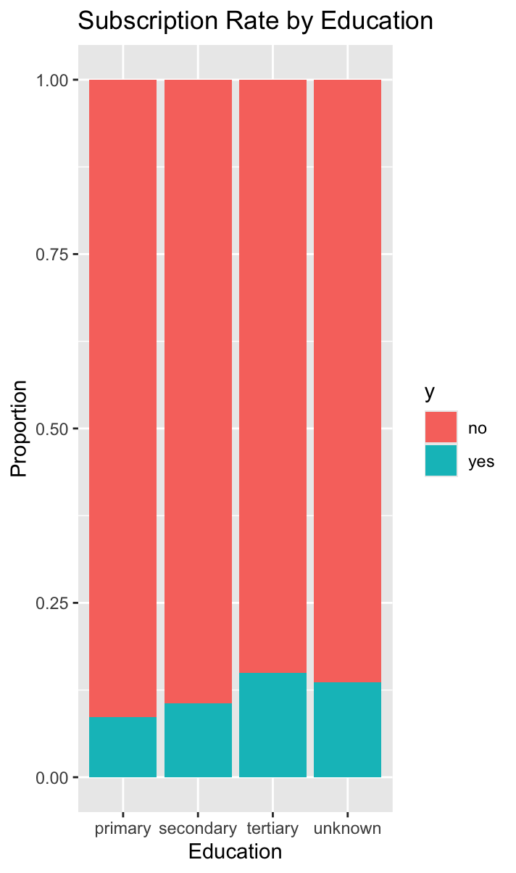
Extra Info
Code and Output on Google Docs: https://docs.google.com/document/d/1AtpCRoCoJZS_bCUiurpDEV3SKp6i4E5scR7JoD3ZBQo/edit?usp=sharing
• Dataset Source: https://archive.ics.uci.edu/ml/datasets/Bank+Marketing

