Slide 1
Product Survey- Customer response Data Analysis
Submitted by: Hemanth Movva

Slide 2
Index
1. Dataset Preparation
2. Analyze the Datasets
3. Conclusion from Analysis
4. Recommended Next Steps
5. Additional Data for Future Analysis
6.Part-2

Slide 3
1. Dataset Preparation
Imported the JSON (Responses (1) (1).json) into Excel and encountered the Following issue.
The JSON input is NOT valid according to RFC 4627 (JSON specification). (Adding an Object on the top the file will solve the issue)
Exported the Excel-Data into Table and converted to CSV.
Now we have both the datasets in CSV Formats.
Exported the data-sets into Data-frames and also imported into table using “Import Table Data” wizard in Toad.
The missing and null values are identified for the given data-sets to proceed with the analysis.
Converted date from epoch to Standard format.

Slide 4
Missing and Null Values
User Info Data Set : Missing data / Null value findings
Based on the summary above, each column has 4788 rows of data, and 2 columns containing missing data:
"USER_ROLE": 1858 missing data.
"PRODUCT_ADDONS": 1858 responses doesn't have any addons.
Survey Response Data Set : Missing data findings
Based on the summary above, each column has 4788 rows of data, and 2 columns containing missing data:
"COUNTRY_CODE": 794 missing data.
"REGION": 1573 missing data.

Slide 5
2. Analyze the Datasets
Data sets are analyzed using the following steps listed
Statistical summary Analysis.
Binning of data based on continuous numerical Variables (Survey Score).
Assigning Categorical Variables to various product tier groups.
Filtering the data by conditions in SQL and Pandas.
Grouping and aggregation of data-sets using SQL and Python.
Exploratory data-analysis using python libraries.
Determining the Interdependency between the Product-tier and Survey Score.

Slide 6
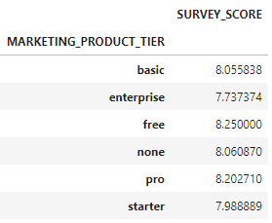
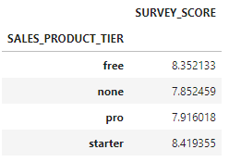
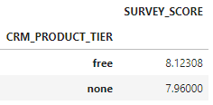
3. Conclusion from Analysis
Survey Score average by Product-tiers
Observations:
Marketing Product Tier - “FREE” and “PRO” products has better score averages when compared to others.
Sales Product Tier - “STARTER” and “FREE” products has better score averages when compared to others.
CRM Product Tier- “FREE” offering has good score average from all the available responses.
Notes:
None Values are included in the analysis for the reason that the survey responses are not individually recorded for these product offerings.

Slide 7
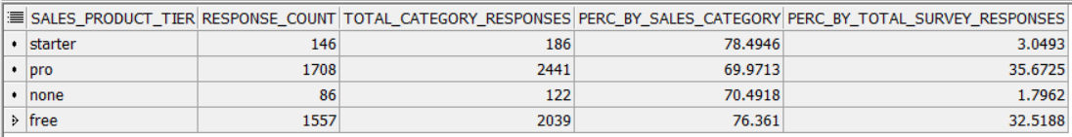
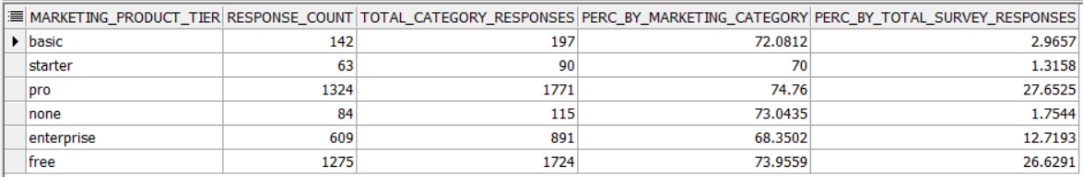
3. Conclusion from Analysis
Product Ratings by High Survey score (8-10)

Slide 8
3. Conclusion from Analysis
Product Ratings with High Survey score (8-10)
Product Subscription having good approval from users
“SALES-PRODUCT-TIER-STARTER” – 78.49%
“SALES-PRODUCT-TIER-FREE” – 76.36%
“MARKETING-PRODUCT-TIER-PRO” – 74.76%
“MARKETING-PRODUCT-TIER-FREE” – 73.95
Popular Product Subscriptions by Product Type having score (8-10)
“CRM-PRODUCT-TIER-FREE” – 71.51 %
“SALES-PRODUCT-TIER-PRO” – 35.67%
“MARKETING-PRODUCT-TIER-PRO” – 27.65%

Slide 9
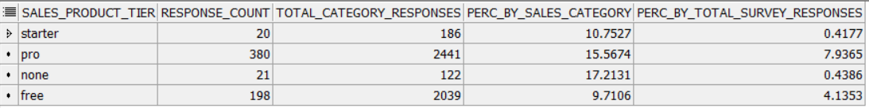
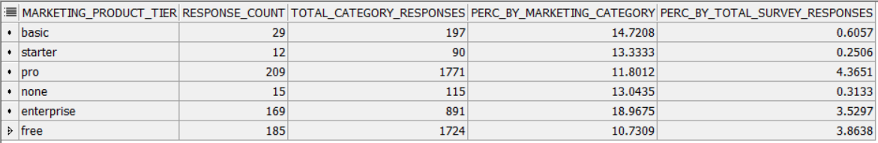
3. Conclusion from Analysis
Survey Responses by Product having Score average less than 6

Slide 10
3. Conclusion from Analysis
Product Ratings with Low Survey score (less than 6)
Product Subscription having low approval from users
“MARKETING-PRODUCT-TIER-ENTERPRISE” – 18.96%
“SALES-PRODUCT-TIER-PRO” – 15.56%
“MARKETING-PRODUCT-TIER-BASIC” – 14.72%
Product Subscriptions having highest low level approval percentages
“CRM-PRODUCT-TIER-FREE” – 12.61%
“SALES-PRODUCT-TIER-PRO” – 7.93%
“MARKETING-PRODUCT-TIER-PRO” – 4.36%

Slide 11
3. Conclusion from Analysis
Other Observations
483 Customers responded with low level average score of less than 6.0
619 Users responded with low level average score of less than 6.0
2355 customers responded with average score greater than 8.0
2674 users responded with average score greater than 8.0
1683 Customers responded with average score as 10.0
Country Code “TH” has lowest average score of 4.0
20 Countries have highest average score of 10.0
Sales-Product-Tier-Pro and Sales-Product-Tier-Free has statistically significant correlation with Survey Score.
Marketing-Product-Tier Enterprise has statistically significant correlation with Survey Score.
Marketing-Product-Tier Pro has statistically less significant correlation with Survey Score.
No linear relationship exists between the Product Tier subscriptions and Survey score.

Slide 12
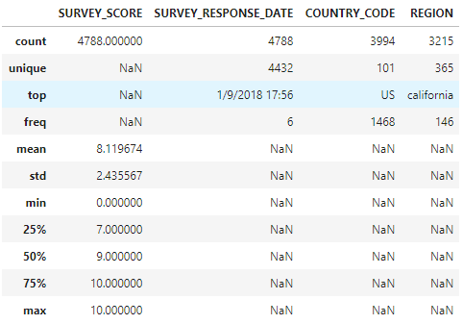
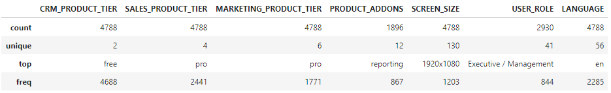
3. Conclusion from Analysis
Statistical Summary Analysis of two Data-sets
→ Survey Reponses Summary
User Info Summary→

Slide 13
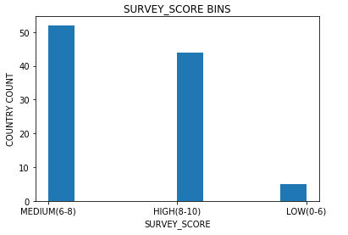
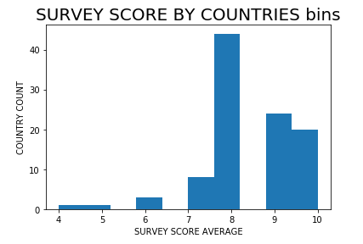

3. Conclusion from Analysis
Binning Score averages into three groups and respective country counts:
52 Countries reported Medium Survey score average
44 Countries reported High Survey score average
5 Countries reported Low Survey score average

Slide 14
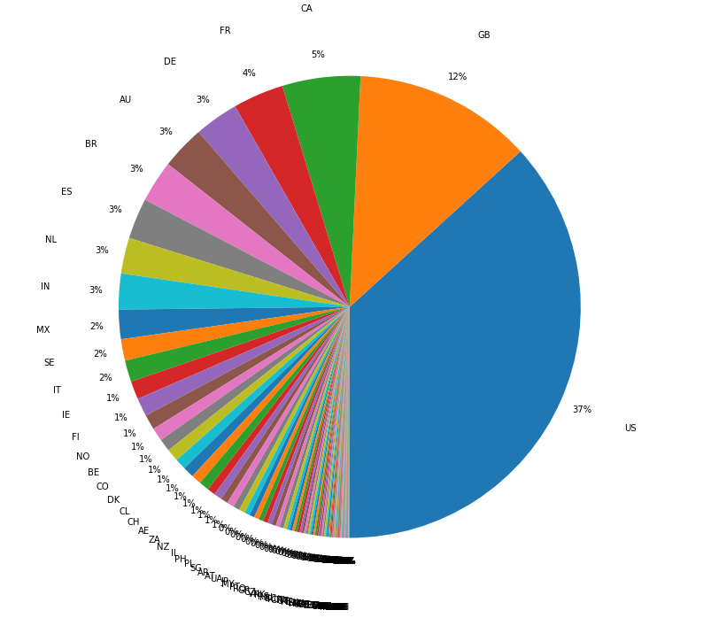
3. Conclusion from Analysis
Percentage of responses by Country
A Pie chart representing the country percentages by total responses. The Rows having no Country codes are excluded from the analysis.

Slide 15
4. Recommended Next Steps
Next Steps:
Conclusions/results can be reviewed with Product teams and Leadership.
Data can be further analyzed based on specific questions from stakeholders.
Customers responded with Low ratings:
Contacting the customers who responded with low ratings.
Most important aspect is to contact the paid subscribers on priority to get detailed feedback that can help improve the product featuring.
Countries having low survey responses:
6 countries having low survey averages has to taken into account for any localizations/extensions.

Slide 16
5. Additional Data for Future Analysis
Additional Data:
Country codes has to be captured and should be a mandatory column for survey response.
Survey responses can be obtained by product and individual scores can be captured by product tier.
User role has to be captured in English and the user data-set language is not standardized for reporting needs.
User responses for recommendations/text can be captured for descriptive analysis.
Information like trans-continental regions can be captured for world wide analysis of user responses by the respective region.

