Slide 1
<Angle><Brackets>

Slide 2

URLs

Slide 3
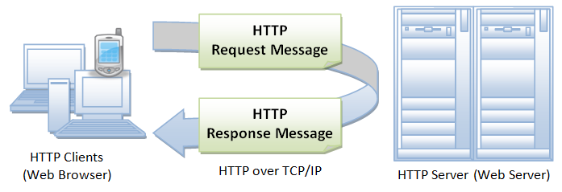
HTTP

Slide 4
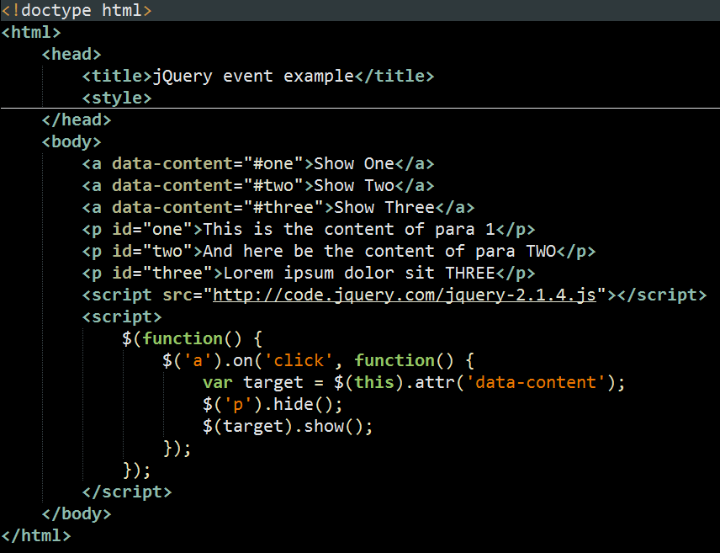
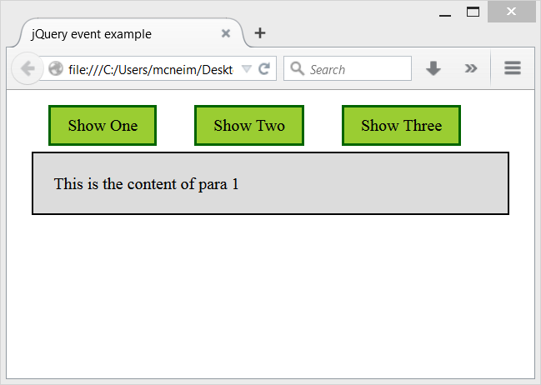
HTML Document

Slide 5
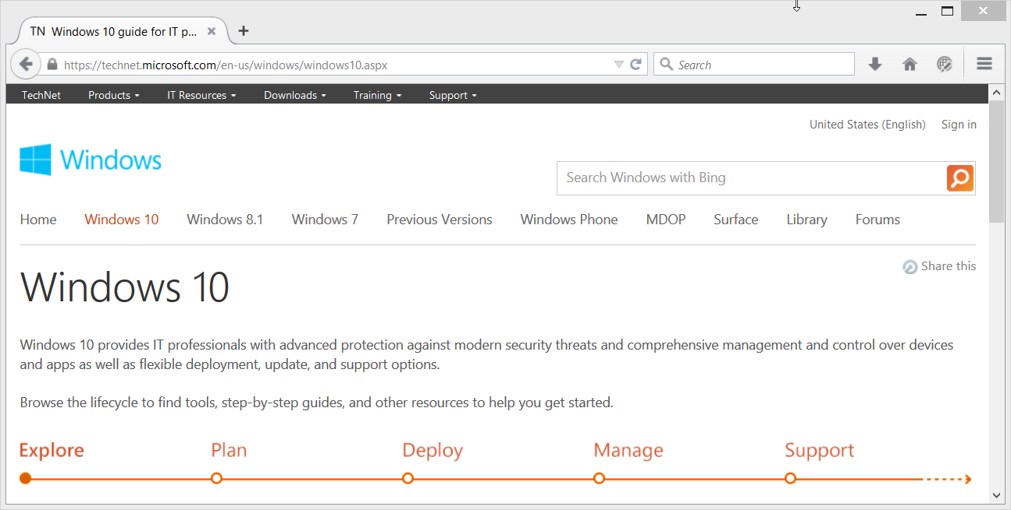
The Web is delivered as HTML

Slide 6
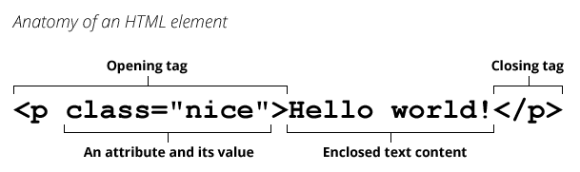
HTML Element

Slide 7
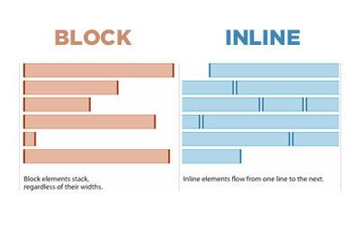
Block vs Inline elements

Slide 8
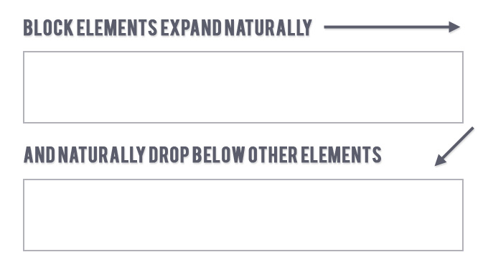
Block elements

Slide 9
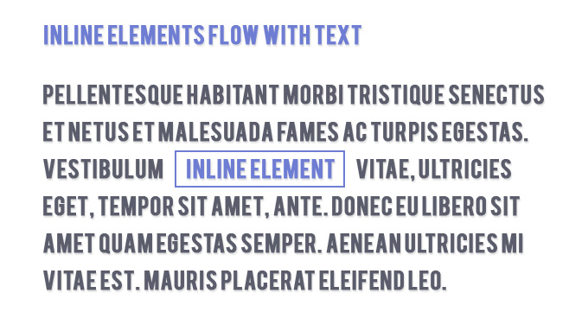
Inline Elements

Slide 10
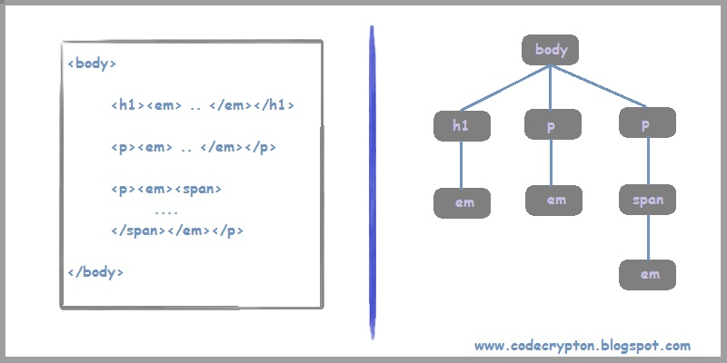
Element nesting – parents, children, ancestors, descendants

Slide 11
DOCTYPE declarations you don’t need to know
<!DOCTYPE HTML PUBLIC "-//W3C//DTD HTML 4.01//EN" "http://www.w3.org/TR/html4/strict.dtd">
<!DOCTYPE HTML PUBLIC "-//W3C//DTD HTML 4.01 Transitional//EN" "http://www.w3.org/TR/html4/loose.dtd">
<!DOCTYPE HTML PUBLIC "-//W3C//DTD HTML 4.01 Frameset//EN" "http://www.w3.org/TR/html4/frameset.dtd">
<?xml version="1.0" encoding="UTF-8"?>
<!DOCTYPE html
PUBLIC "-//W3C//DTD XHTML 1.0 Transitional//EN"
"http://www.w3.org/TR/xhtml1/DTD/xhtml1-transitional.dtd">

Slide 12

The only DOCTYPE declaration you need to know

Slide 13
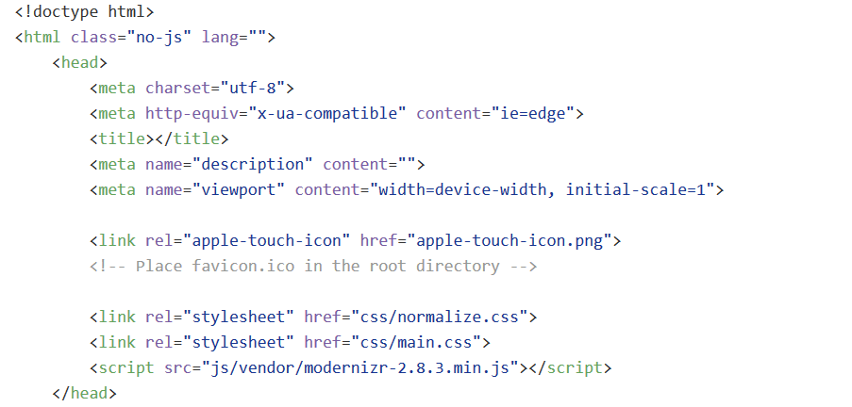
HTML <head>

Slide 14


Slide 15
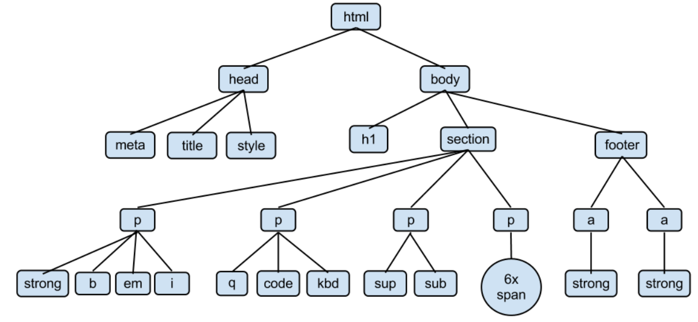
HTML <body>

Slide 16

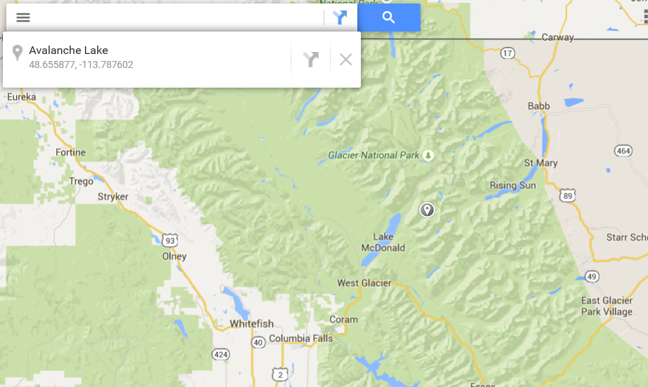
HTML links: relative vs absolute

Slide 17
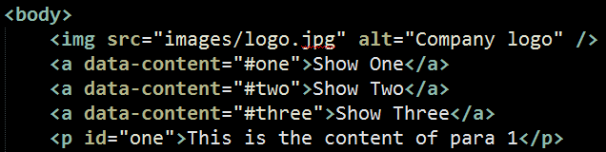

HTML <img> element

Slide 18
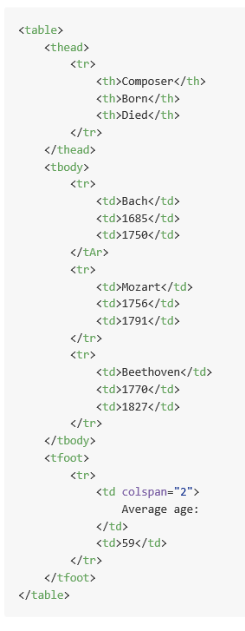
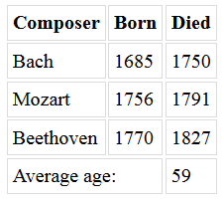
HTML <table> element

Slide 19
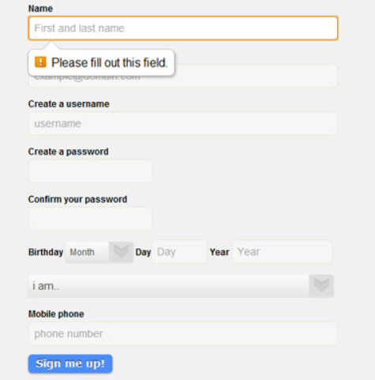
HTML <form> element

Slide 20

Yes! You *CAN* use <table> elements for layout!

Slide 21


