Slide 1
<Angle><Brackets>

Slide 2

URLs

Slide 3
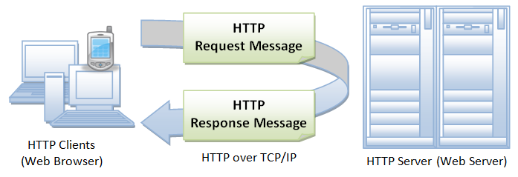
HTTP

Slide 4
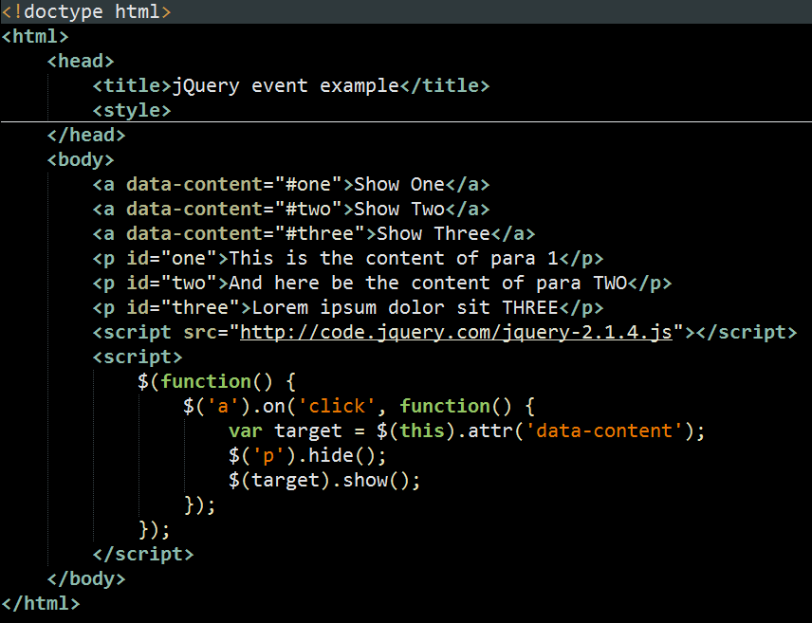
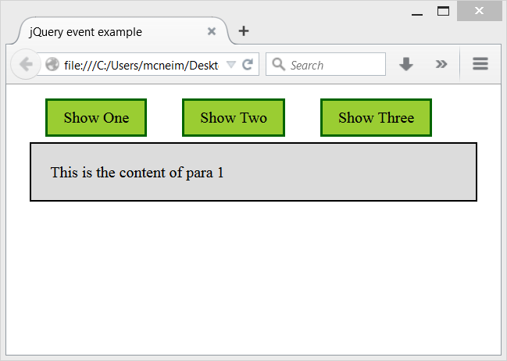
HTML Document

Slide 5
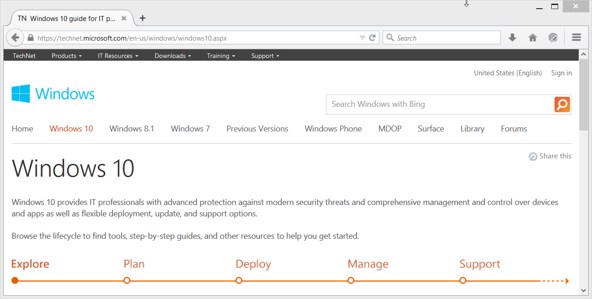
The Web is delivered as HTML

Slide 6
